Slide 1
SNF
File created on: 8/23/2021 10:18:54 PM

Slide 2
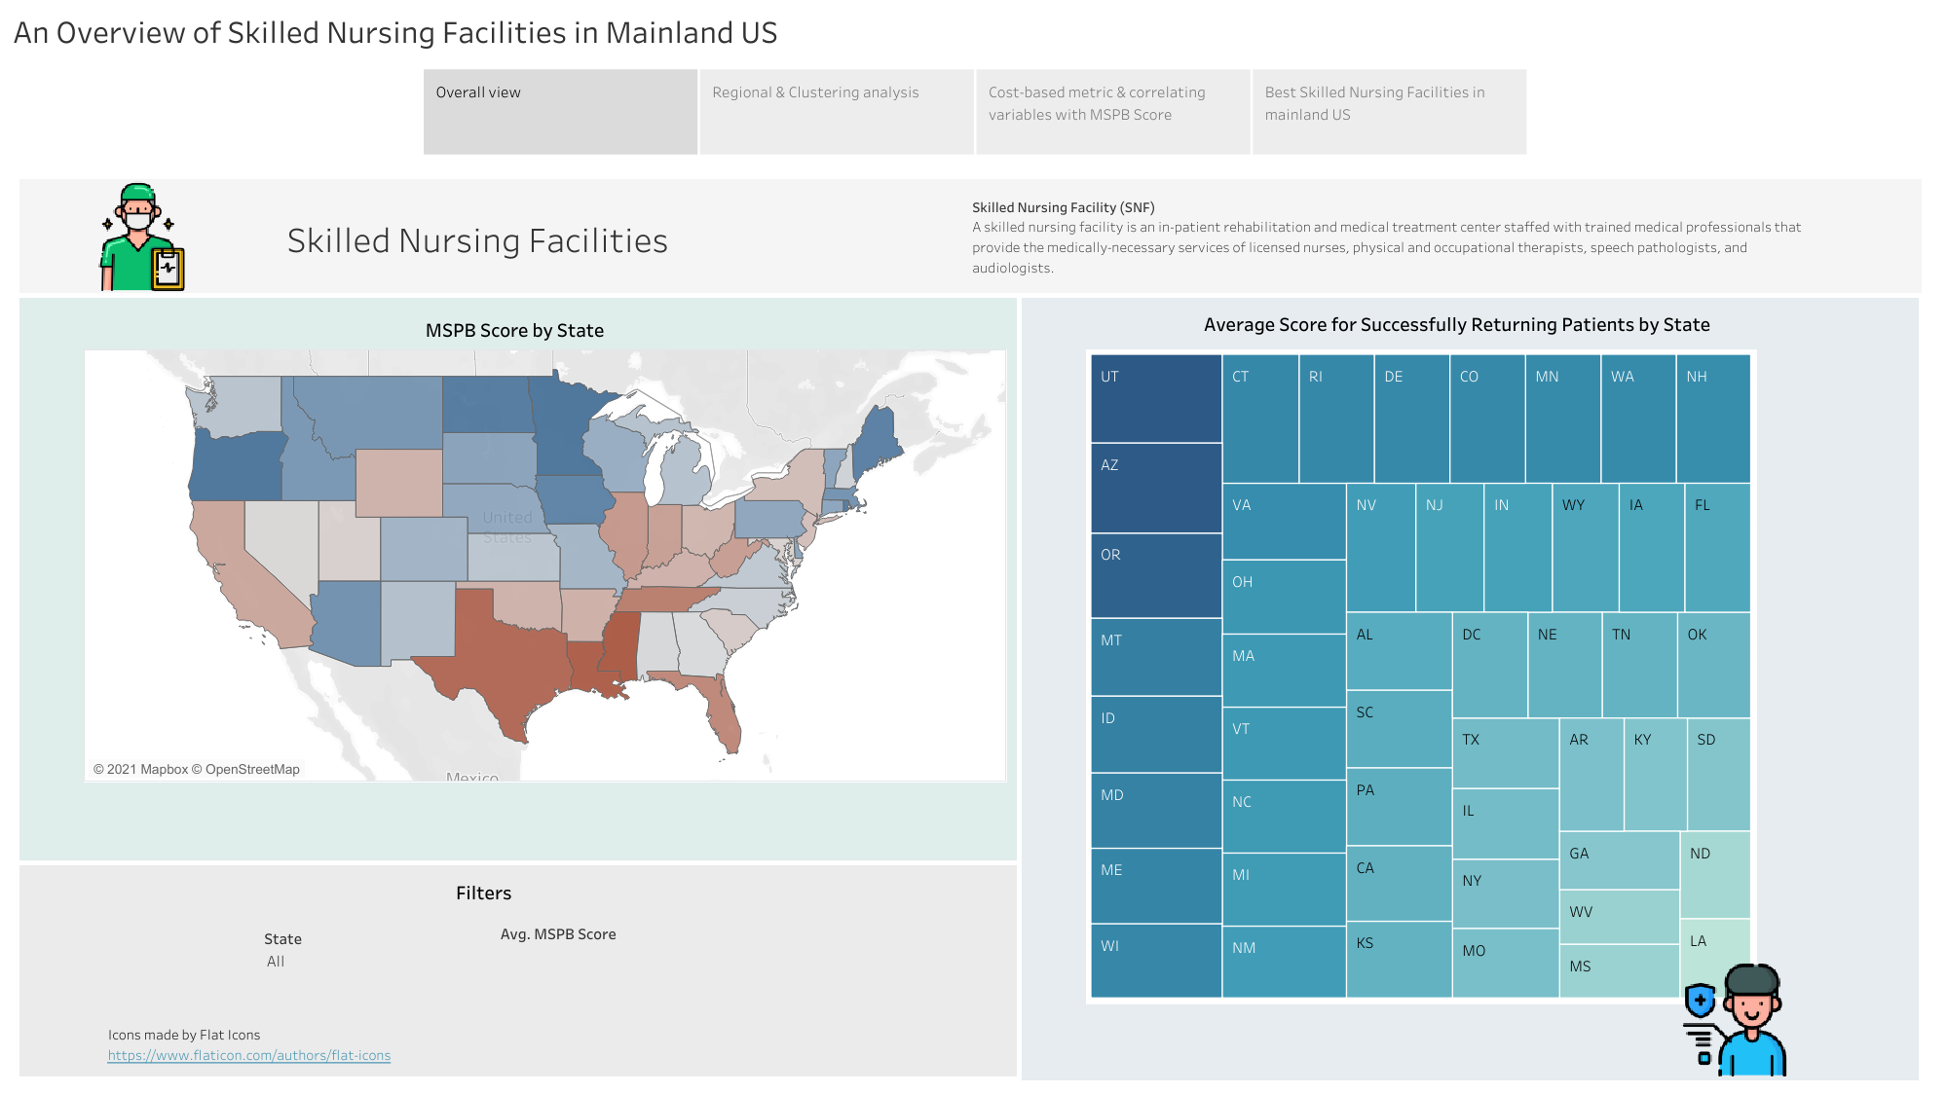

Slide 3
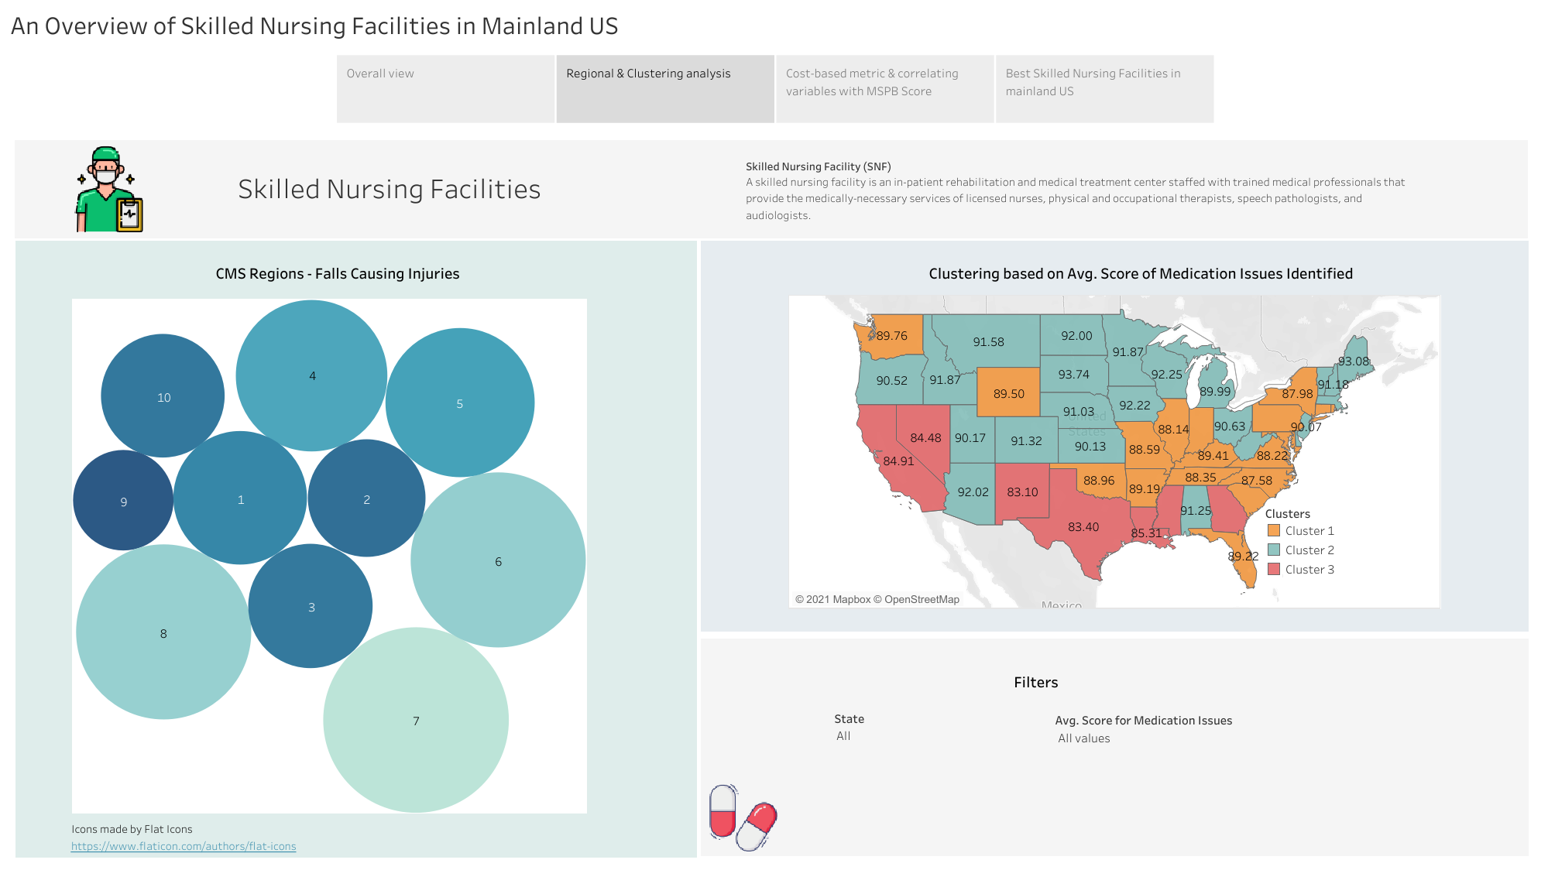

Slide 4
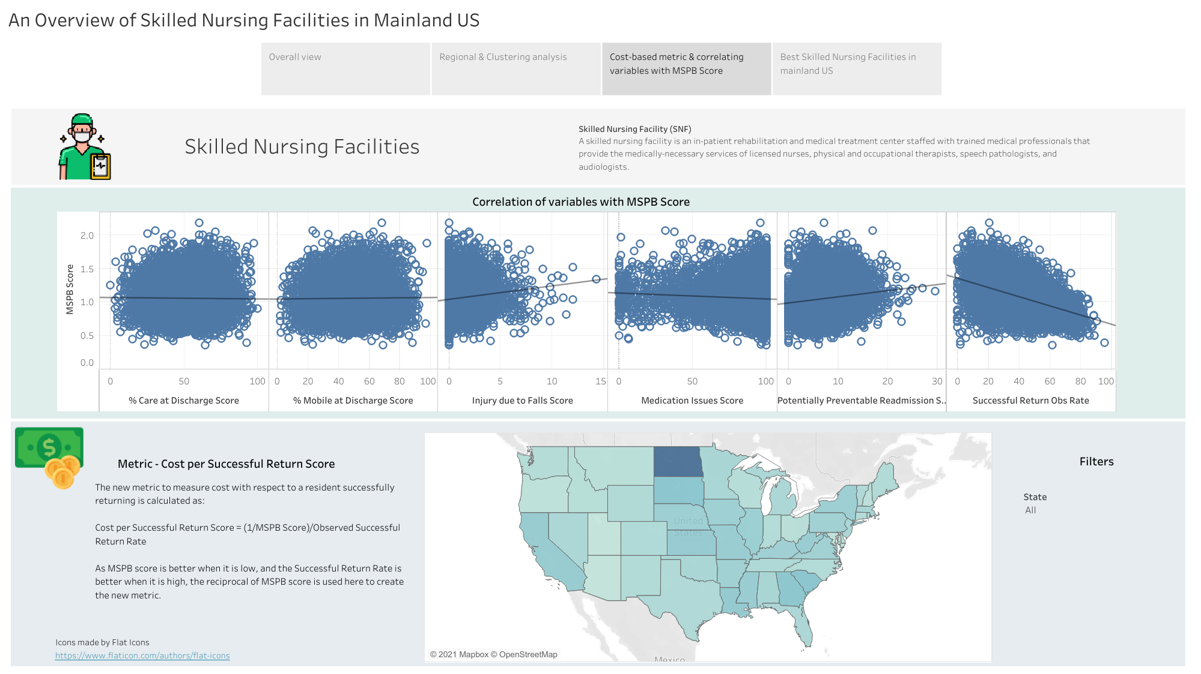

Slide 5
