Slide 1
Factors Affecting Parent and Student Satisfaction of New York City Public High Schools
Kara and Sara Johnson
CS 5963 – Introduction to Data Science
Final Project
Notes:
Education is an important piece of our society and is integral for the development and success of many citizens of the US. However, the quality of education and school environmental factors are key for productive learning and overall student success rate. This data science project was to identify factors affecting parent and student satisfaction of New York City public high schools.

Slide 2

New York City Schools Data
NYC Dept. of Education 2015-16 School Survey
436 High Schools
% Satisfaction with 'Collaborative Teachers’
% Satisfaction with 'School Leadership’
% Satisfaction with 'Rigorous Instruction'
% Satisfaction with 'Family-Community Ties’
% Satisfaction with 'Supportive Environment’
% Satisfaction with 'Trust’
% Overall Parent Satisfaction
% Overall Student Satisfaction
Notes:
The New York City Department of Education releases the annual results of their NYC School Survey, which is distributed at 436 high schools. This survey collects responses from parents and students pertaining to ^^^LIST OF VARIABLES^^^.

Slide 3
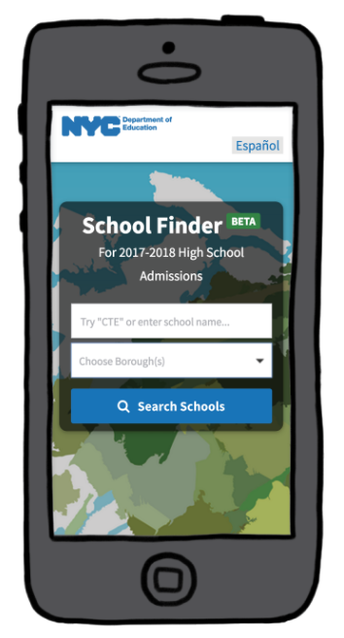
New York City Schools Data
NYC “High Schools At a Glance” Dataset
Tool mostly used by parents for choosing schools
based on a number of factors:
Borough
Number of Programs
Neighborhood
Graduation Rate
Attendance Rate
% Students who feel safe
AP Courses
CTE Programs
Notes:
Additionally, New York City has made the “High Schools At a Glance” dataset, which provides data mostly for a tool used by parents for choosing schools based on a number of factors, such as ^^LIST OF VARIABLES^^. These variables give insight on key statistics on these schools.

Slide 4
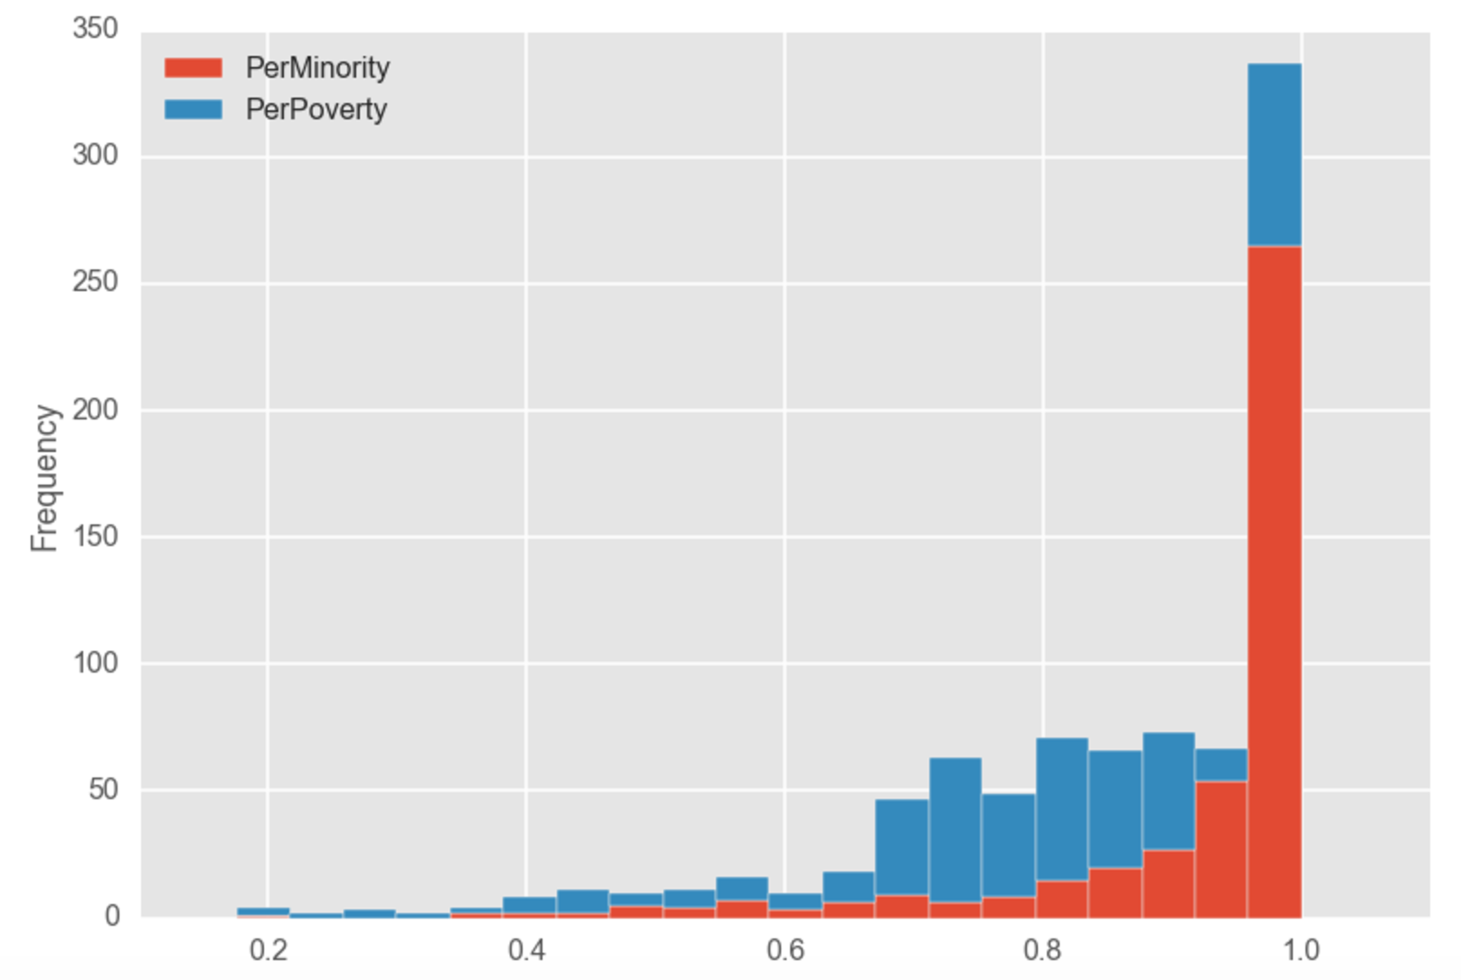
Demographics and Socioeconomics
Notes:
Additionally, we integrated demographic and socioeconomic information, including the percent of minority students (in orange) and the percent of students considered to be in poverty based on their parents income (in blue). The distribution of these variables show that the high schools in New York City are highly diverse and a high percentage of their students are in poverty.

Slide 5
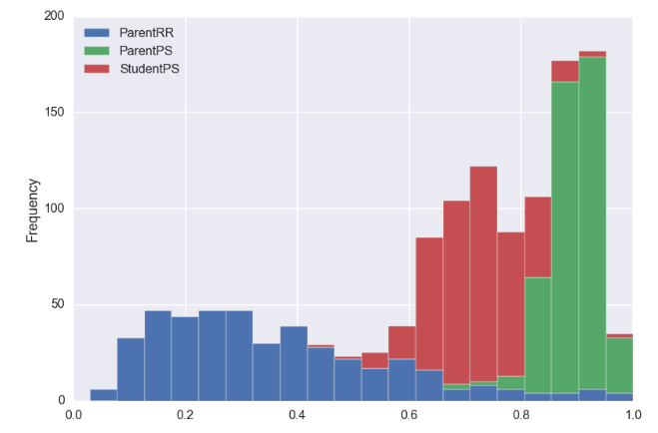
Overall Satisfaction with School
Notes:
We also explored the distributions of the parent response rate (in blue), parent percent satisfaction (in green), and student percent satisfaction (in red). This shows that there is a relatively broad distribution in student satisfaction between 40-90% while the parent satisfaction is a tight curve between 80-100%.
When we considered both the high minority and high poverty rates combined with this disparity in student and parent satisfaction, we decided to ask some questions about the relationships between environmental and educational factors and

Slide 6
Objective 1: Identify factors important to students versus parents
Multilinear Regression
STUDENTS
PARENTS
Trust
Collaborative Teachers
Supportive Environment
Trust
School Leadership
Family-Community Ties
R² = 0.976
R² = 0.763

Slide 7
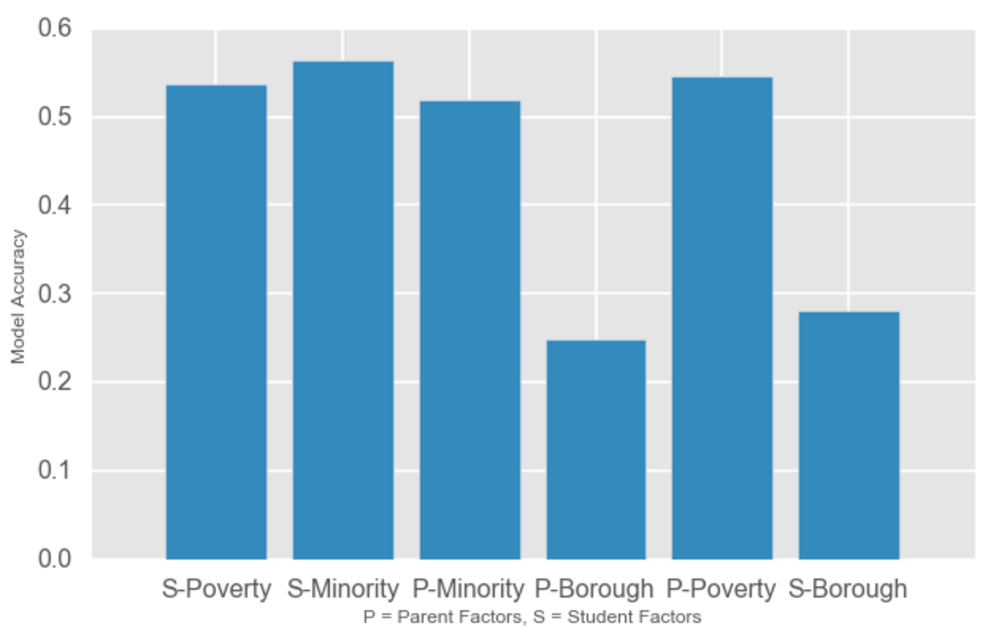
Objective 2: Do factors important to students or parents best predict minority, poverty, or borough?
Classification
(K-NN)

Slide 8
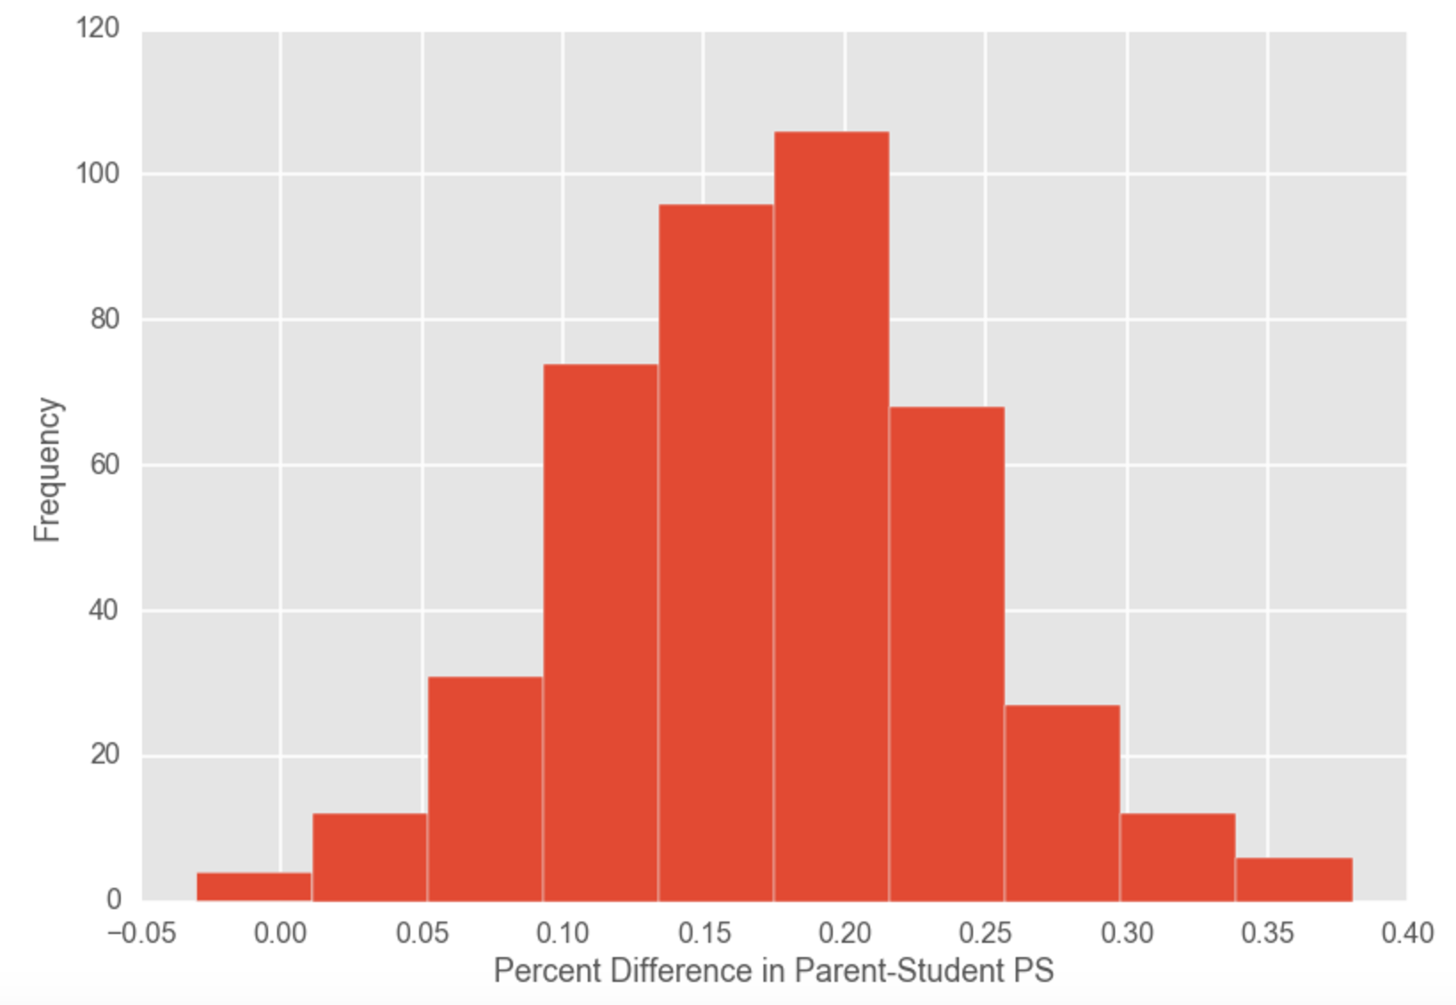
Objective 3: What factors best predict differences in student and parent satisfaction?
Classification
(K-NN)
“Small
Difference”
“Large Difference”

Slide 9
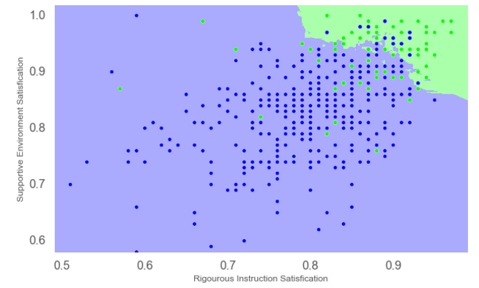
Objective 3: What factors best predict differences in student and parent satisfaction?
Rigorous Instruction
Student Safety
Confusion Matrix | Correct | Incorrect
Small Difference | 41 | 40
Large Difference | 15 | 340

