Slide 1
Factors Affecting Parent and Student Satisfaction of New York City Public High Schools
Kara and Sara Johnson
CS 5963 – Introduction to Data Science
Final Project

Slide 2

New York City Schools Data
NYC Dept. of Education 2015-16 School Survey
436 High Schools
Collects responses from parents and students
pertaining to the following variables:
% Satisfaction with 'Collaborative Teachers’
% Satisfaction with 'School Leadership’
% Satisfaction with 'Rigorous Instruction'
% Satisfaction with 'Family-Community Ties’
% Satisfaction with 'Supportive Environment’
% Satisfaction with 'Trust’
% Overall Parent Satisfaction
% Overall Student Satisfaction

Slide 3
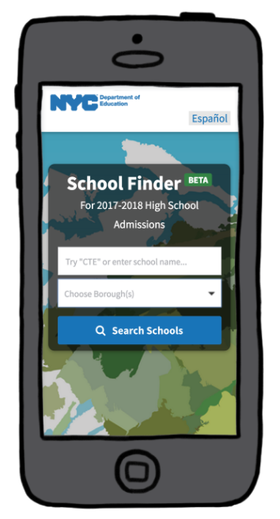
New York City Schools Data
NYC “High Schools At a Glance” Dataset
Tool mostly used by parents for choosing schools
based on a number of factors:
Borough
Number of Programs
Neighborhood
Graduation Rate
Attendance Rate
% Students who feel safe
AP Courses
CTE Programs

Slide 4
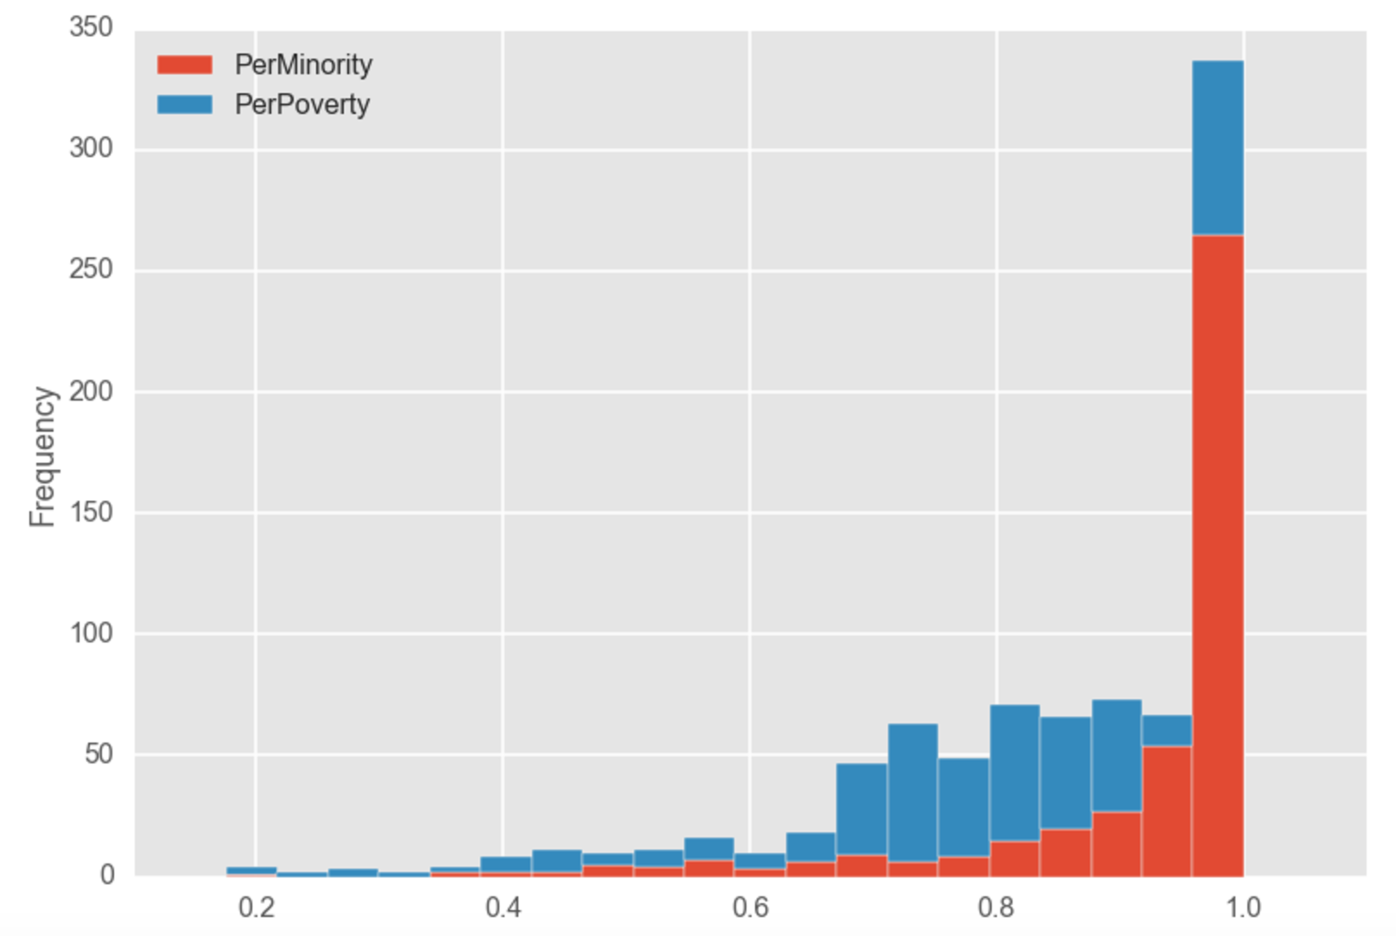
Demographics and Socioeconomics

Slide 5
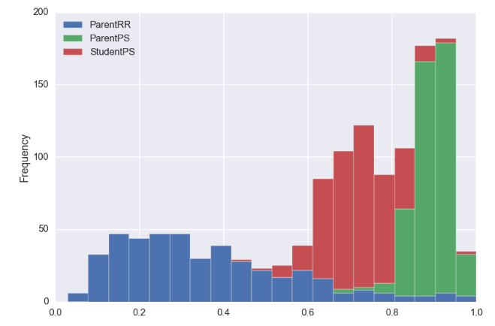
Overall Satisfaction with School

Slide 6
Objective 1: Identify factors important to students versus parents
Multilinear Regression
STUDENTS
PARENTS
Trust
Collaborative Teachers
Supportive Environment
Trust
School Leadership
Family-Community Ties
R² = 0.976
R² = 0.763

Slide 7
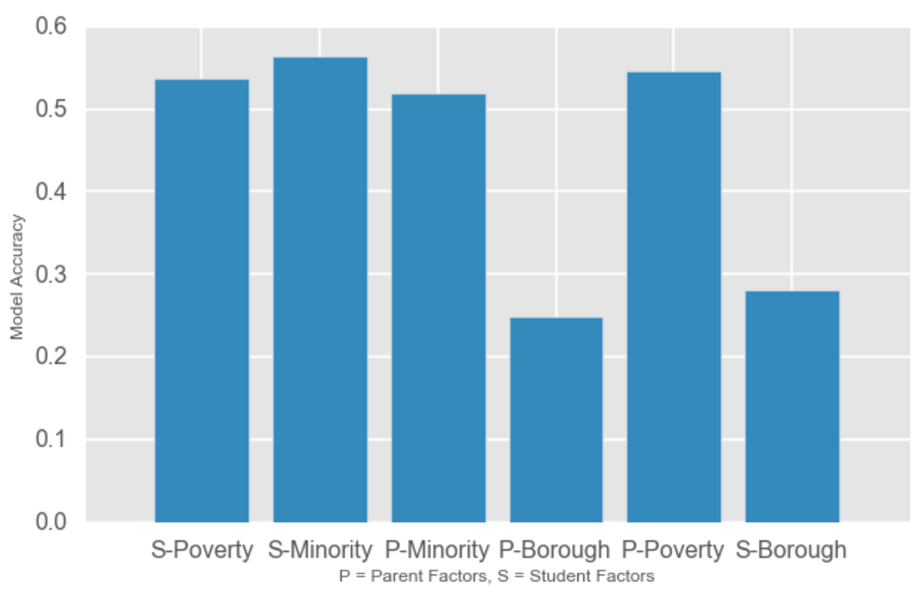
Objective 2: Do factors important to students or parents best predict minority, poverty, or borough?
Classification
(K-NN)

Slide 8
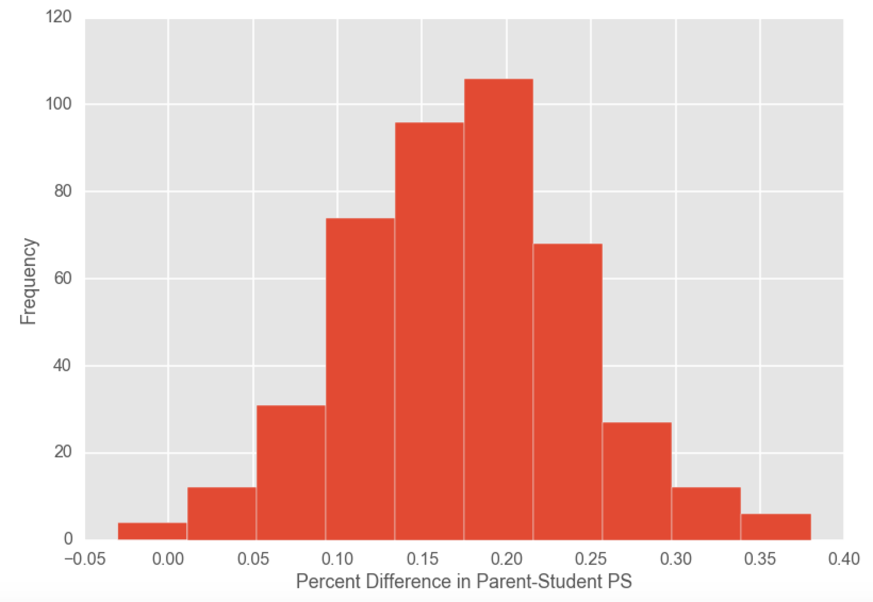
Objective 3: What factors best predict differences in student and parent satisfaction?
Classification
(K-NN)
“Small
Difference”
“Large Difference”

Slide 9
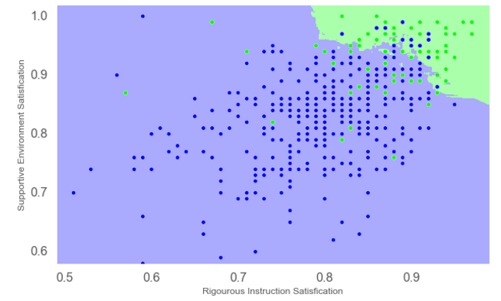
Objective 3: What factors best predict differences in student and parent satisfaction?
Rigorous Instruction
Student Safety
Confusion Matrix | Correct | Incorrect
Small Difference | 41 | 40
Large Difference | 15 | 340

