Slide 1

Shri Vishnu engineering college for women::Bhimavaram (Autonomous)
On Security of an Identity- based Dynamic Data Auditing Protocol
IV B.Tech II Sem Project power point presentation
In
Computer Science and Engineering
By
MARLAPUDI SOWMYA(18B01A0575)
SARAKANAM TEJA SRI(18B01A0584)
MOPIDEVI HARITHA ( 18B01A05A2)
PENMATSA SAI NAGA SIRI SOWMYA ( 18B01A05B1)
SARIPELLA VAISHNAVI DEVI(18B01A05B9)
Under the guidance of
Mr. M . NARASIMHA RAJU
Assistant Professor
REVIEW NO: 03
Date: 12-04-2022
Department of Computer Science and Engineering Slide No: 1

Slide 2
Problem Statement
Cloud Storage has been a solution for the rapidly growing data. We investigate how to achieve data sharing with sensitive information hiding in remote data integrity auditing, and propose a new concept called identity-based shared data integrity auditing with sensitive information hiding for secure cloud storage. In such a scheme, the sensitive information can be protected and the other information can be published. It makes the file stored in the cloud able to be shared and used by others on the condition that the sensitive information is protected, while the remote data integrity auditing is still able to be efficiently executed.
Department of Computer Science and Engineering Slide No:2

Slide 3
Objectives
To design a well - defined secured cloud storage.
To facilitate identity-based data outsourcing.
To facilitate comprehensive data auditing.
Department of Computer Science and Engineering Slide No:3

Slide 4
Existing System
Existing solutions are designed based on the public key infrastructure (PKI).
Disadvantages :
The users will lose physical control of their files after outsourced to a cloud storage server maintained by some cloud service provider (CSP). Thus, the file-owners may worry about whether their files have been maintained safe.
Most schemes lack a controlled way of delegatable outsourcing.
Department of Computer Science and Engineering Slide No:4

Slide 5
Proposed System
Our scheme has the following distinguishing features.
Identity-based outsourcing. A user and his/her authorized proxies can securely outsource files to a remote cloud server which is not fully trustable, while any unauthorized ones cannot outsource files on behalf of the user. The cloud clients, including the file-owners, proxies and auditors, are recognized with their identities, which avoids the usage of complicated cryptographic certificates. This delegate mechanism allows our scheme to be efficiently deployed in a multi-user setting.
Comprehensive auditing. Our IBDO scheme achieves a strong auditing mechanism. The integrity of outsourced files can be efficiently verified by an auditor, even if the files might be outsourced by different clients. Also, the information about the origin, type and consistence of outsourced files can be publicly audited.
Department of Computer Science and Engineering Slide No:5

Slide 6
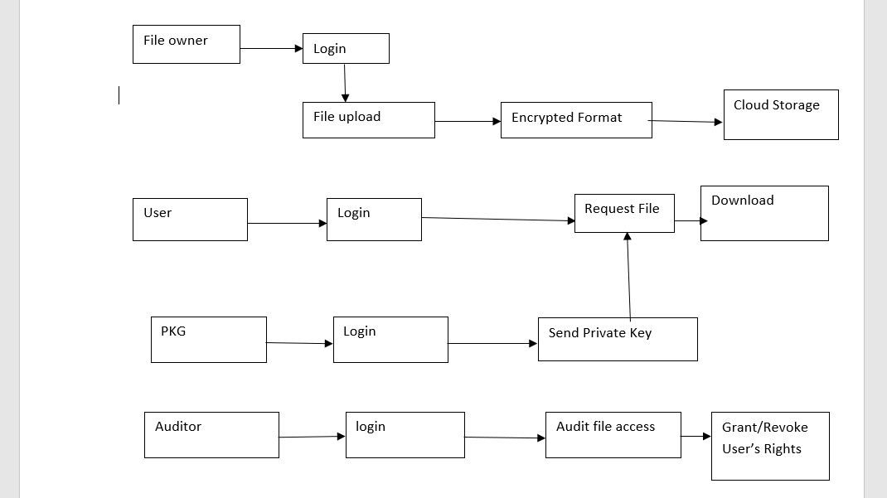
SYSTEM DESIGN
Department of Computer Science and Engineering Slide No: 6

Slide 7
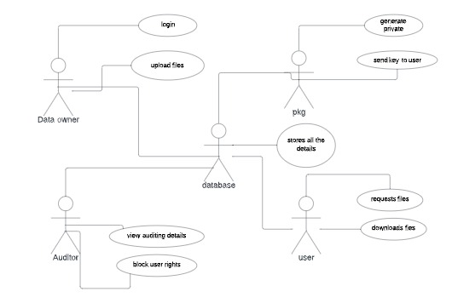
SYSTEM DESIGN
Department of Computer Science and Engineering Slide No: 7

Slide 8
FUNCTIONALITIES
Upload File
View Files
View Audit Results
View Users
Grant Permissions
Send Access key
Validate Access key
Download File
View Cloud Files
Department of Computer Science and Engineering Slide No: 8

Slide 9
TECHNICAL SKILLS
cloud computing
. Databases
. Servers
. Networking
. Software
Mysql
. open source database
Java
Department of Computer Science and Engineering Slide No: 9

Slide 10
Design Comparisons & Improvements
In the existing systems users will lose physical control of their files after outsourced to a cloud storage server maintained by some cloud service provider (CSP).
We observe critical issues not well addressed in existing proposals. most schemes lack a controlled way of delegatable outsourcing.
Features that are planned to implement:
. Identity-based outsourcing
. Comprehensive auditing
Department of Computer Science and Engineering Slide No: 10

Slide 11
Design Comparisons & Improvements
Identity-based outsourcing:
. A user and his/her authorized proxies can securely outsource files to a remote cloud server which is not fully trustable, while any unauthorized ones cannot outsource files on behalf of the user.
. The cloud clients, including the file-owners, proxies and auditors, are recognized with their identities, which avoids the usage of complicated cryptographic certificates.
. This delegate mechanism allows our scheme to be efficiently deployed in a multi-user setting.
Comprehensive auditing:
. Our IBDO scheme achieves a strong auditing mechanism and the integrity of outsourced files can be efficiently verified by an auditor, even if the files might be outsourced by different clients.
. The information about the origin, type and consistence of outsourced files can be publicly audited.
. The auditor can run the auditing protocol to provide convincing judicial witnesses without requiring disputing parties to be corporative.
Department of Computer Science and Engineering Slide No: 11

Slide 12
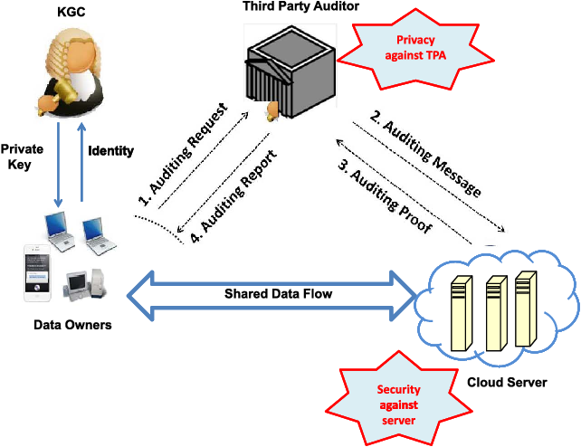
Design Comparisons & Improvements
Data Flow Diagram:
Department of Computer Science and Engineering Slide No: 12

Slide 13
Implementation
The system model involves four kinds of different entities: the cloud, the user, the Private Key Generator (PKG).
Cloud: The cloud provides enormous data storage space to the user. Through the cloud storage service, users can upload their data to the cloud and share their data with others.
User: The user is a member of an organization, which has a large number of files to be stored in the cloud.
PKG: The PKG is trusted by other entities. It is responsible for generating system public parameters and the private key for the user according to his identity ID.
Department of Computer Science and Engineering Slide No: 13

Slide 14
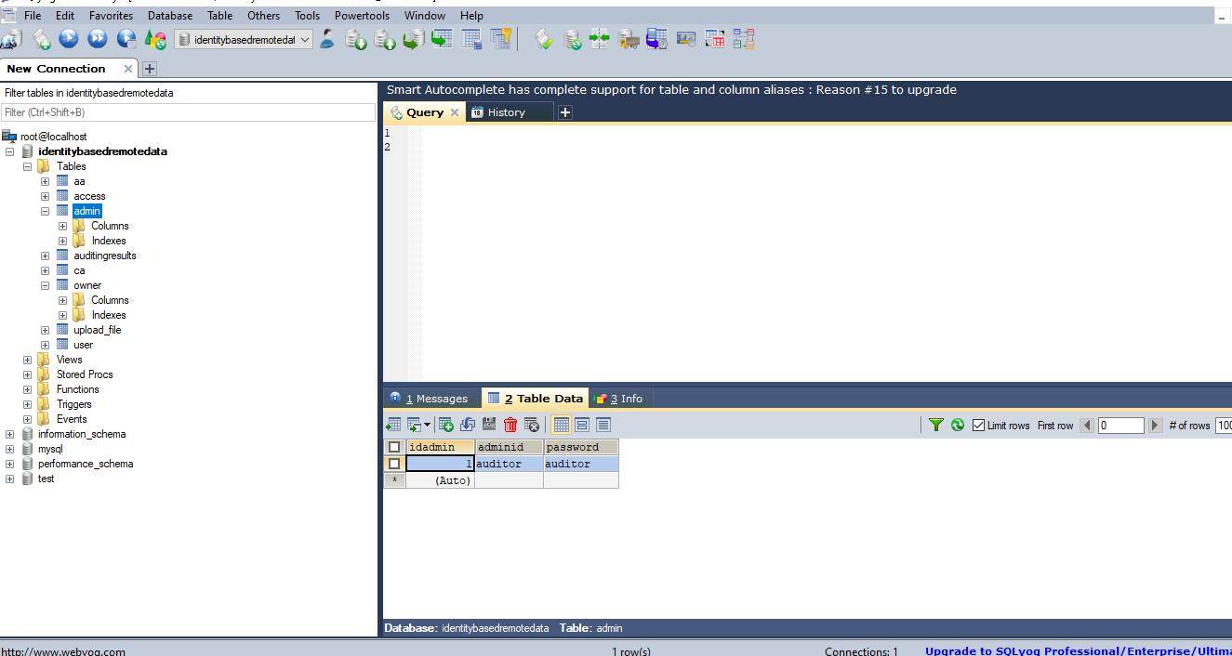
DATABASE
Department of Computer Science and Engineering Slide No: 14

Slide 15
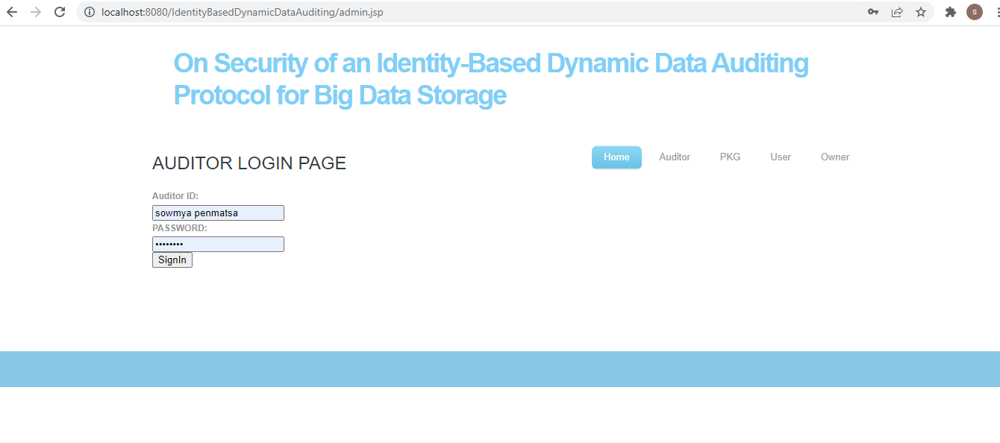
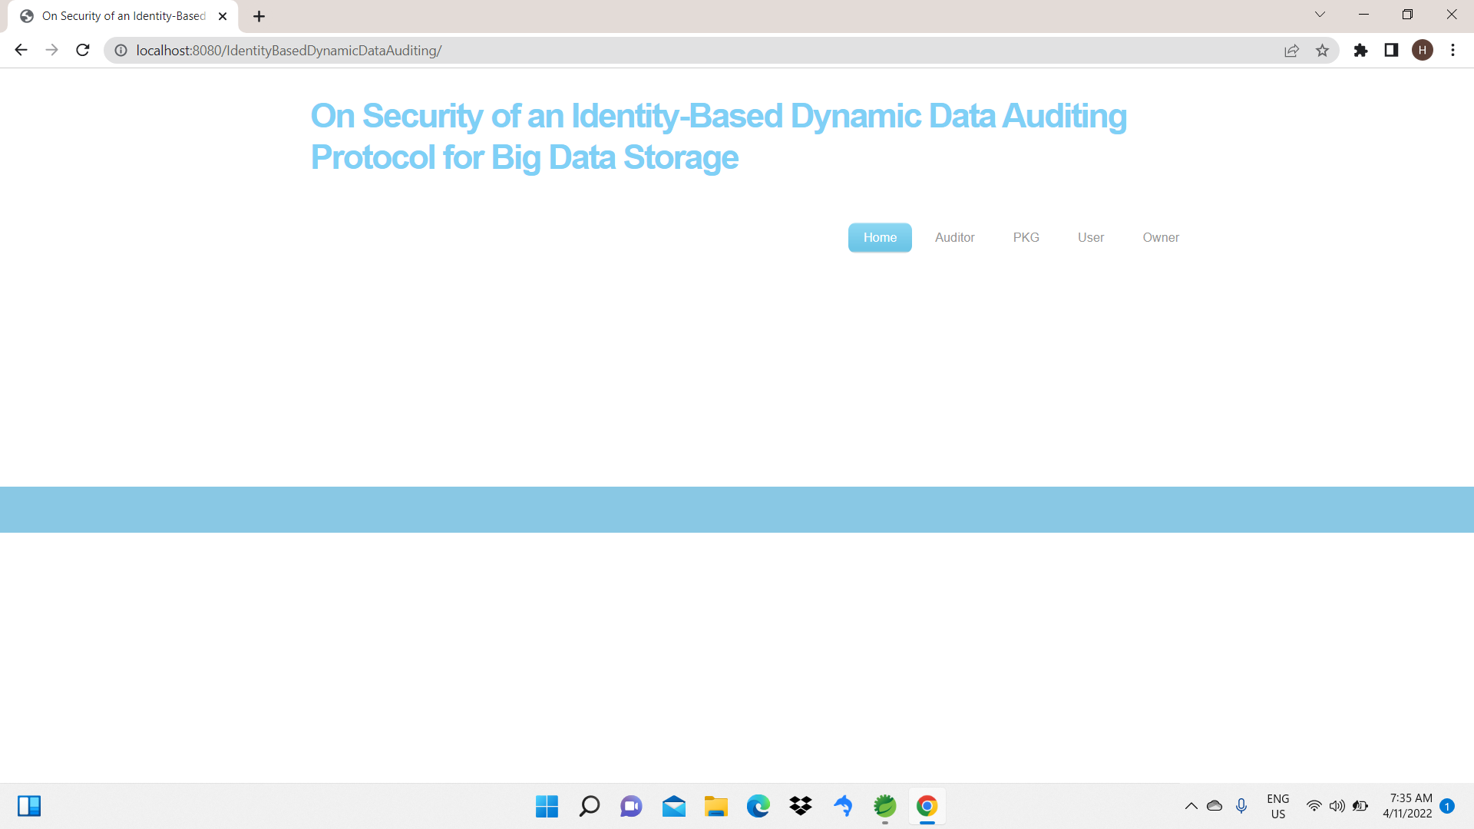
RESULTS
Department of Computer Science and Engineering Slide No: 15

Slide 16
RESULTS
Department of Computer Science and Engineering Slide No: 16

Slide 17
Attainment of Objectives
S.NO | Test Case |  | Checked Output | Status
1 | Register into the system |  | Registered successfully by entering the Data Owner or Data User details | Yes
2 | Login |  | Data Owner or Data user can login successfully by entering usernameand password | Yes
3 | Data owner canupload afile |  | While uploading file enter the keywords and category then file will upload successfully | Yes
4 | Data owner view details of file |  | Data owner can successfully view details of the file after successfully uploaded file into the cloud | Yes
5 | Encrypt the file |  | Uploaded a file into the cloud in encrypted form and also indexed | Yes
6 | Issue Rights |  | Pkg issue rights to User | Yes
7 | Send Keys |  | PKG send private key to User | Yes
Department of Computer Science and Engineering Slide No: 17

Slide 18
Attainment of Objectives
9 | Admin View Cloud Files | Admin can view the File in the cloud | Yes
10 | View Auditing Results | Admin Can view the Auditing Results | Yes
12 | Download | Download a file | Yes
13 | Logout page | Data owner or Data user can successfully logout | Yes
Department of Computer Science and Engineering Slide No: 18

Slide 19
THANK YOU
Department of Computer Science and Engineering Slide No: 19

