Slide 1
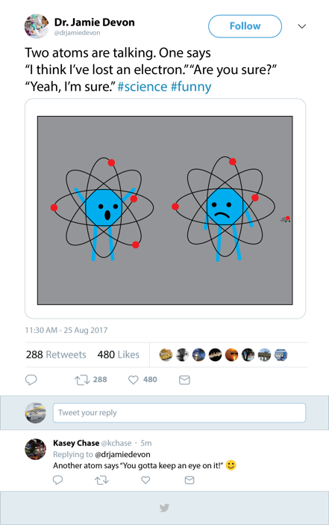
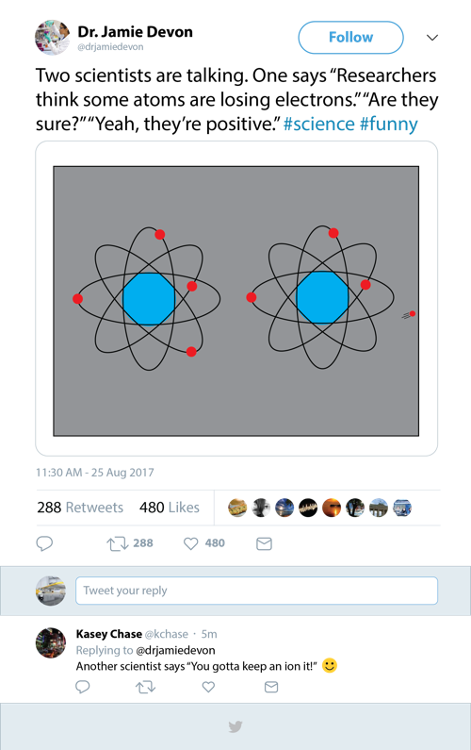
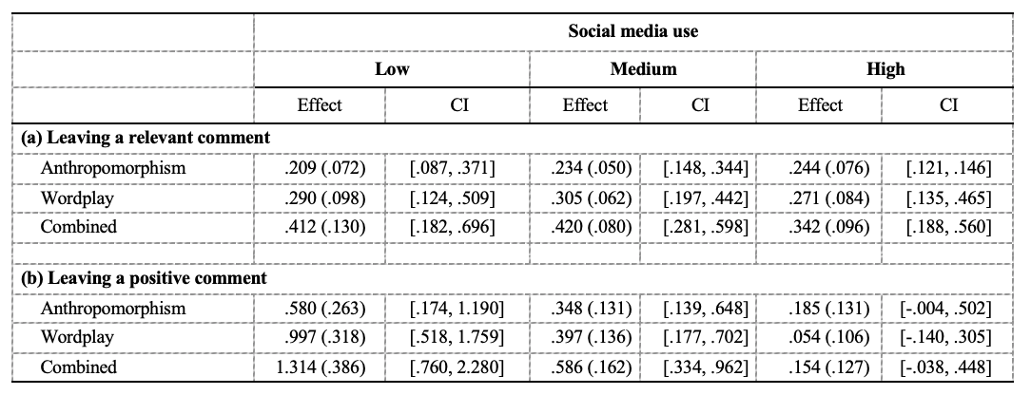
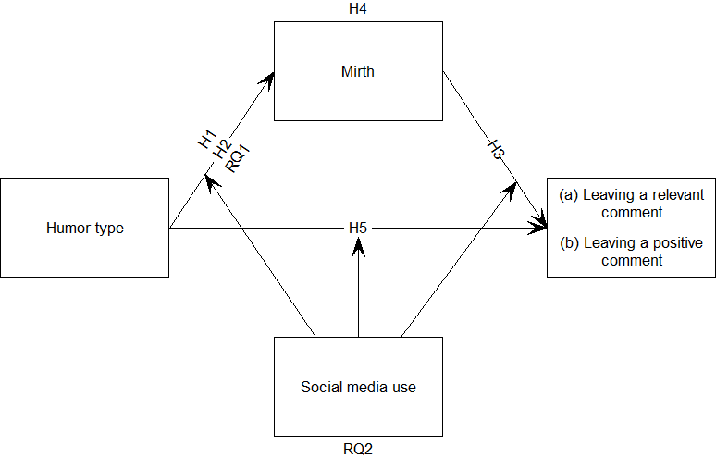
Preparing your poster for printing:
Go to File > Save As. Under Save as type (Windows) or Format (OS X), select PDF.
Open the PDF in Adobe Photoshop. Go to File > Save As. Under Format, select JPEG or TIFF. Choose a location and file name for your file and click Save. Click OK on the default save settings.
DO NOT SAVE TO A JPEG OR TIFF FROM POWERPOINT!
“That’s Some Positive Energy”: How Social Media Users Respond to #Funny Science Content
Liane O’Neill¹, Meaghan McKasy², Leona Yi-Fan Su³ , Michael A. Cacciatore⁴ , Sara K. Yeo¹ , Sijia Qian⁵
¹ University of Utah, ² Utah Valley University, ³ University of Illinois at Urbana-Champaign, ⁴ University of Georgia, ⁵ University of California, Davis
INTRODUCTION
Scientists are adopting social media to communicate with publics (Pew, 2015a; You, 2014). This is thought to reduce knowledge and attitude gaps (Brossard & Scheufele, 2013; Leshner, 2015). Humor is found in science communication on and offline and may influence behavioral intentions (Anderson & Becker, 2018; Brewer & McKnight, 2015; Heathers, 2019).
This study investigates the effects of science humor shared on Twitter on audience commenting behavior. Cognitive theories of humor suggest that when people derive mirth from humor, they allocate cognitive resources to elaborate on the content (Eisend, 2011; Slater & Rouner, 2002). Here, we compare the effects of wordplay and anthropomorphism (both delivered in a single dose), combined wordplay and anthropomorphism (a double dose), and no humor.
We test for an indirect path between humorous tweets and leaving relevant and positive comments that is mediated by experienced mirth. We also test a direct path between humor types and leaving relevant and positive comments. Finally, individuals with more exposure to social media may have a more sophisticated understanding of normative social media “funniness” and the impacts of engaging with content, sp we explore whether social media use moderates the described mediated model at the three paths described.
METHODS
The 4 (humor types) x 2 (social media metrics) experimental design exposed participants to a science joke commonly found online. The joke was in a tweet by a fictional scientist that contained either (1) anthropomorphism (2) wordplay (3) combined humor or (4) no humor. After viewing the stimuli, respondents could add a comment to the Twitter conversation and provided a text box.
The final sample size was 1,524.
Coders coded comments left for whether they were relevant (𝛂 = .84; n = 445). Relevant comments were coded for positive tone (𝛂 = .67; n = 243).
Data were analyzed using analysis of covariance and PROCESS Model 59. The Johnson-Neyman technique probed the conditional indirect effect.
RESULTS (CONT.)
Mirth mediated the relationship between the humor conditions and leaving a relevant comment across all levels of social media use.
Mirth mediated the relationship between the humor conditions and leaving a positive comment, except at the highest levels of social media use.
All humor types directly predicted leaving relevant comments, while only the wordplay and combination conditions predicted positive comments.
Social media use moderated the path between the humor conditions and experienced mirth in both the relevant and positive models for those in the wordplay and combination humor conditions, but not for those assigned to the anthropomorphism condition
CONCLUSIONS
Social media science humor can influence the likelihood of relevant and positive comments. We find different types and doses of humor may have varying influences on mirth and commenting behaviors. Our results also suggest people may access cues (i.e. #funny) to make decisions about whether and how to engage with funny science content, even without devoting the attention and/or processing necessary to experience mirth. Finally, humor is effective at engaging audiences, regardless of low social media experience. This suggests that humor creates a low point of entry for interest and engagement, even among users who may have less exposure to internet culture.
Anthropomorphism
Condition
Wordplay
Condition
RESULTS
Assignment to the humor conditions predicted higher levels of mirth.
Combined humor predicted higher levels of mirth than just the anthropomorphism or wordplay conditions.
There were significant differences in experienced mirth between all conditions except anthropomorphism and wordplay
Mirth predicted the likelihood of leaving relevant and positive comments.
REFERENCES
List your references here. Tiny font is okay!

