Slide 1
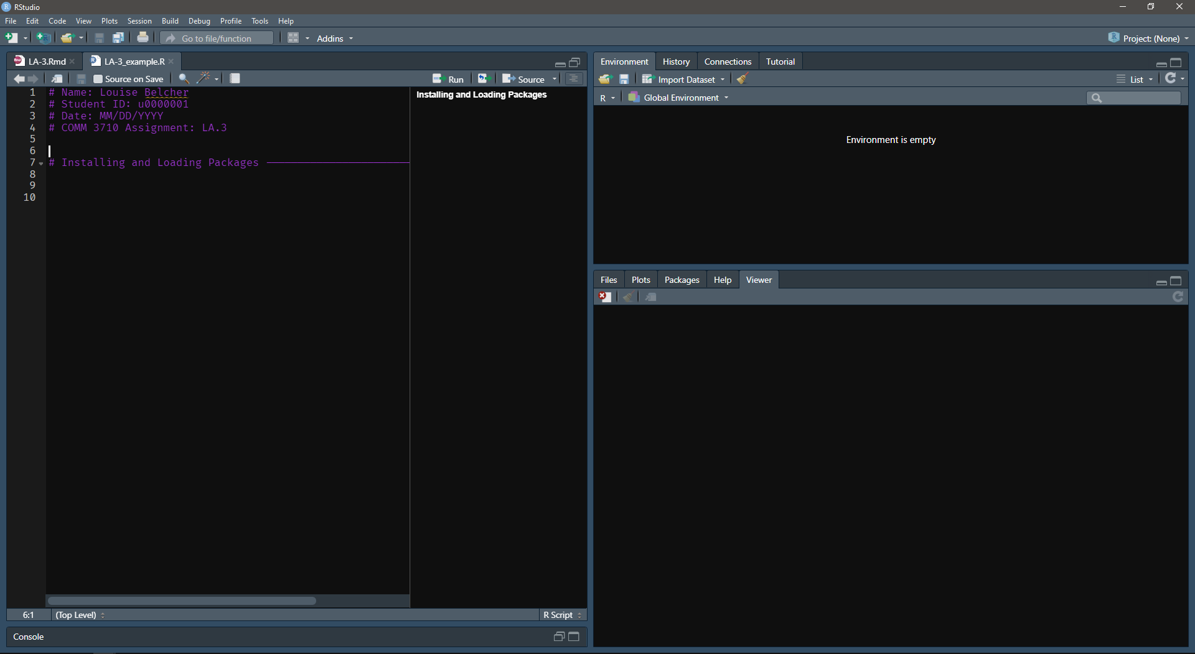
Add section of foldable code

Slide 2
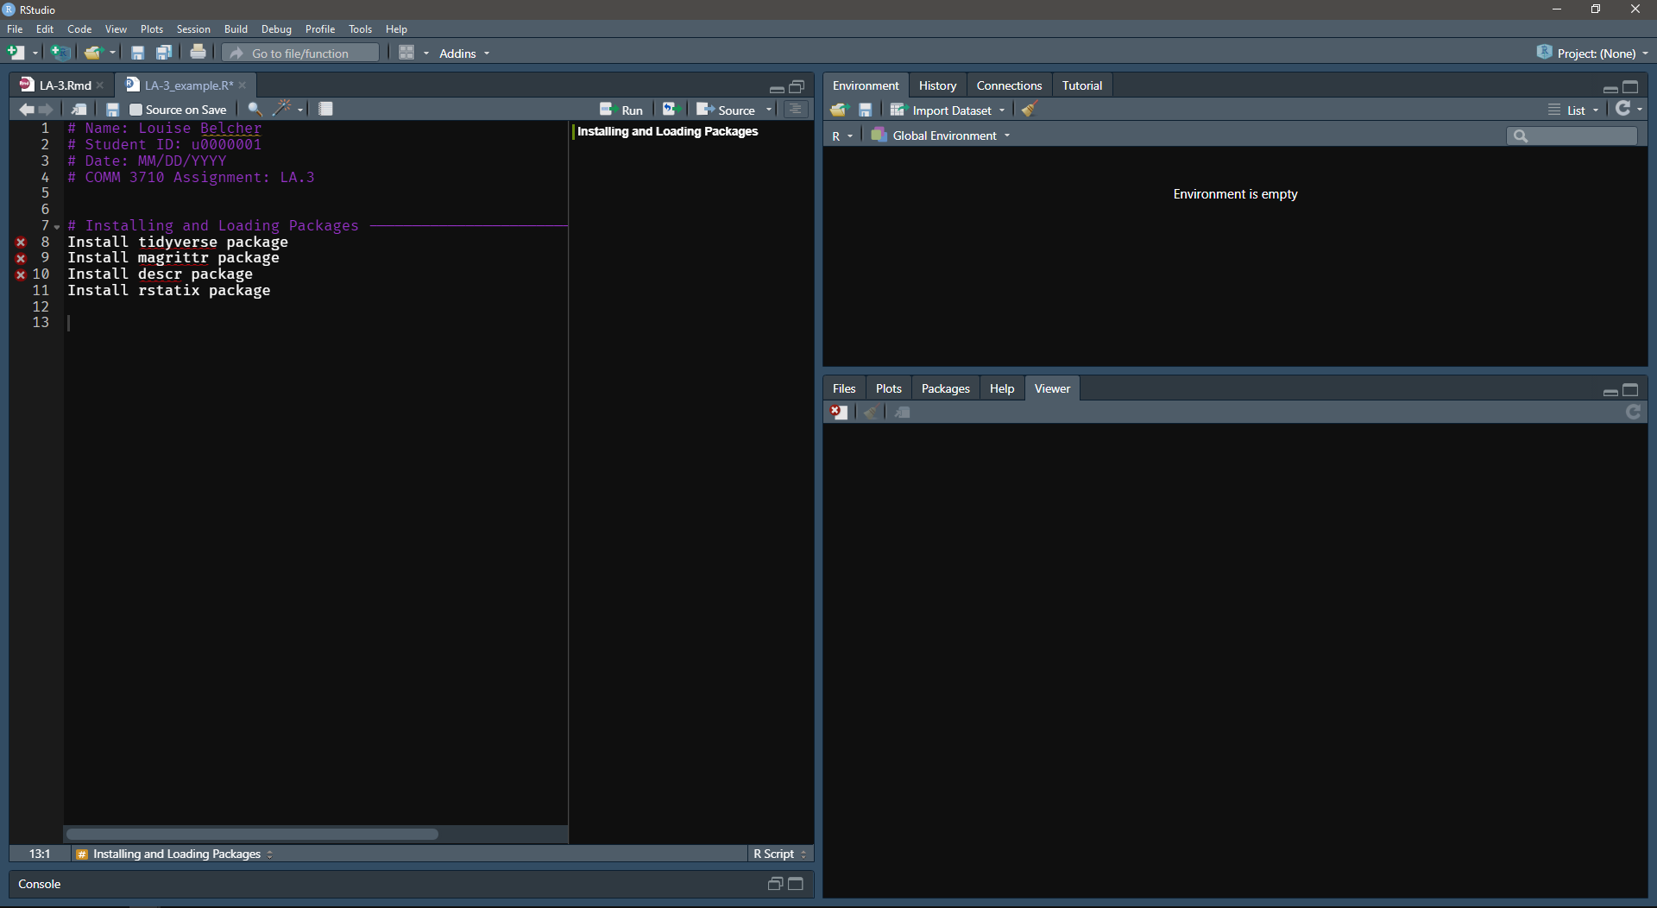
Write pseudocode
(one line per command)

Slide 3
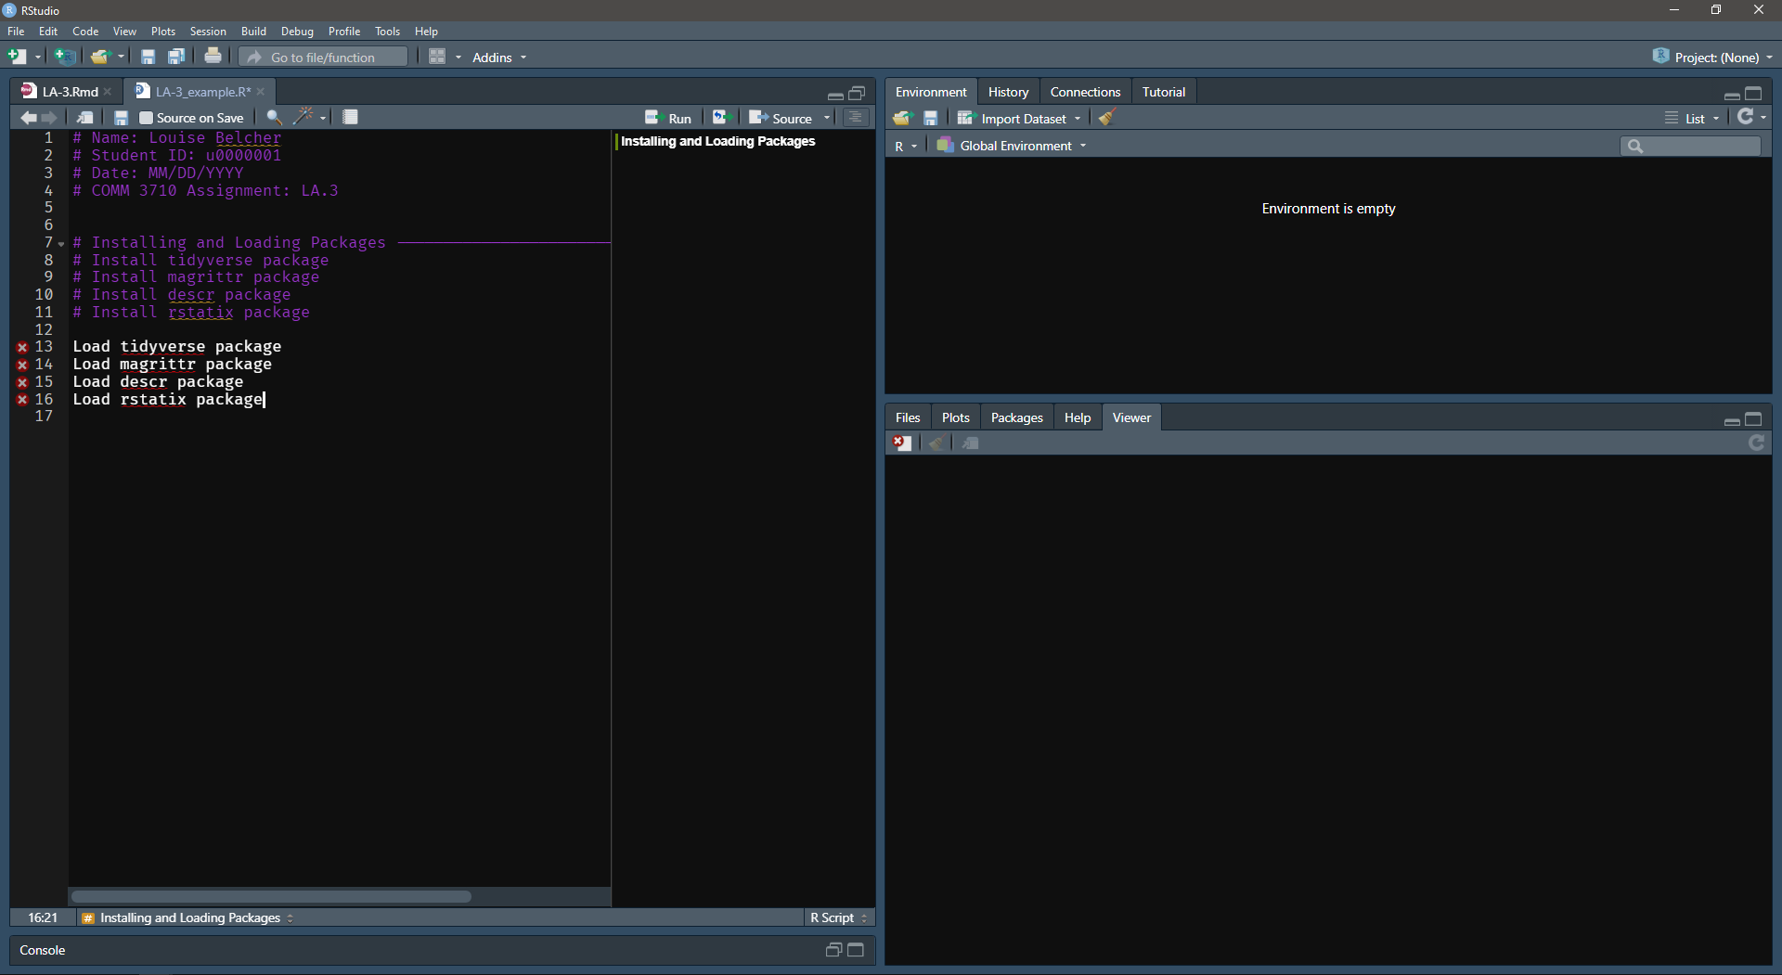
Comment out pseudocode
(so that R does not run it)
Pseudocode to load packages

Slide 4
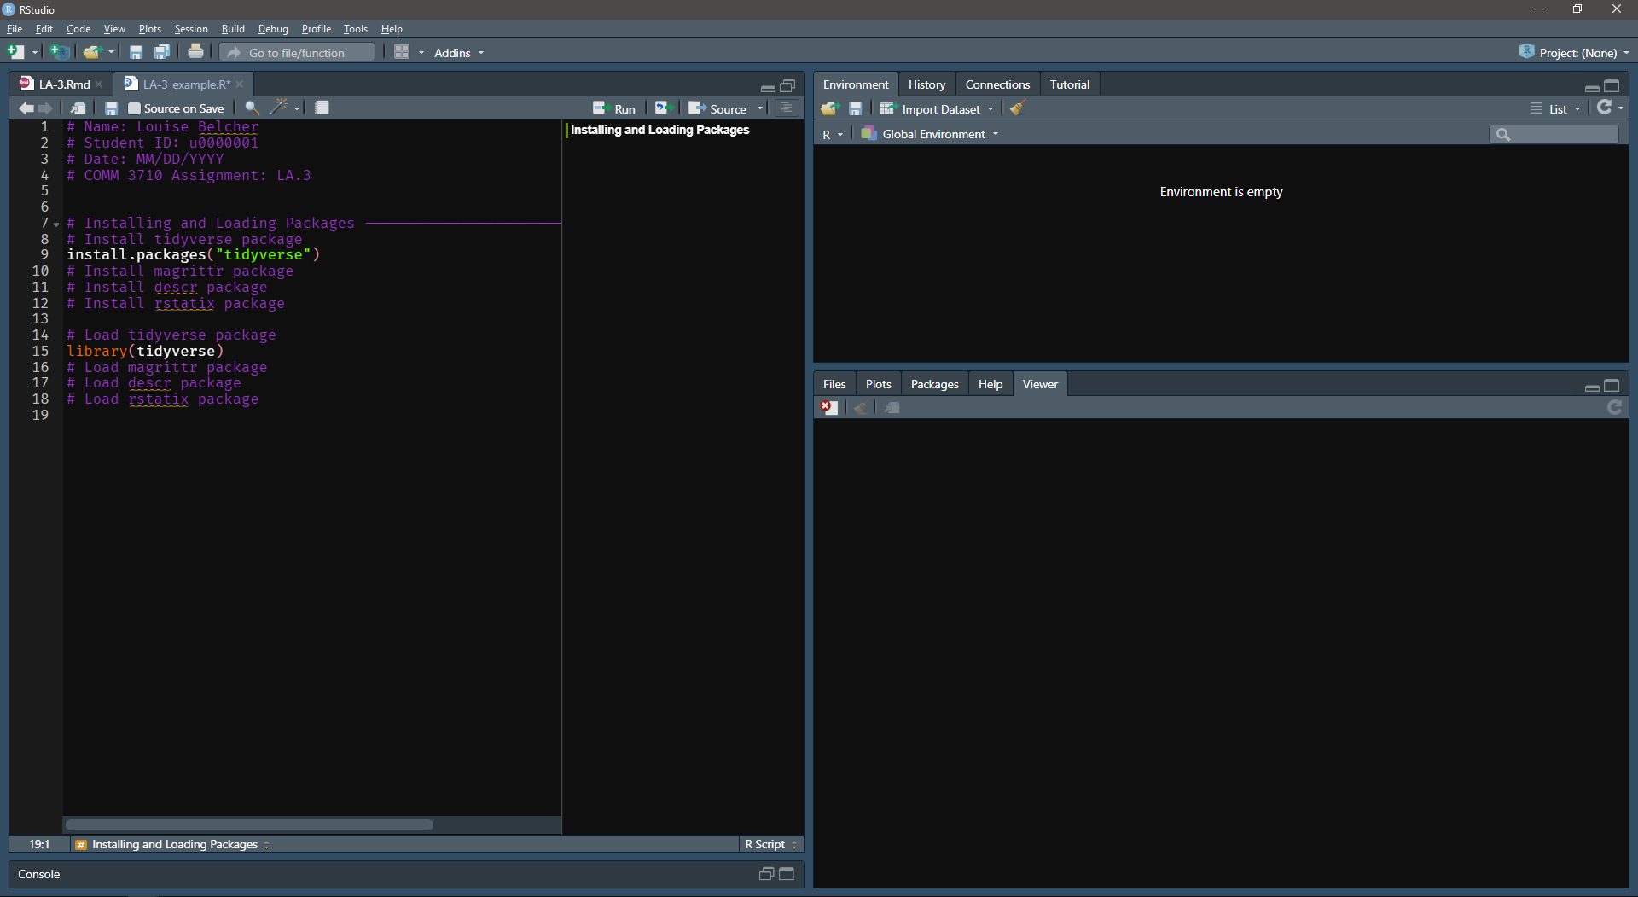
Write commands under
each line of pseudocode

