Slide 1
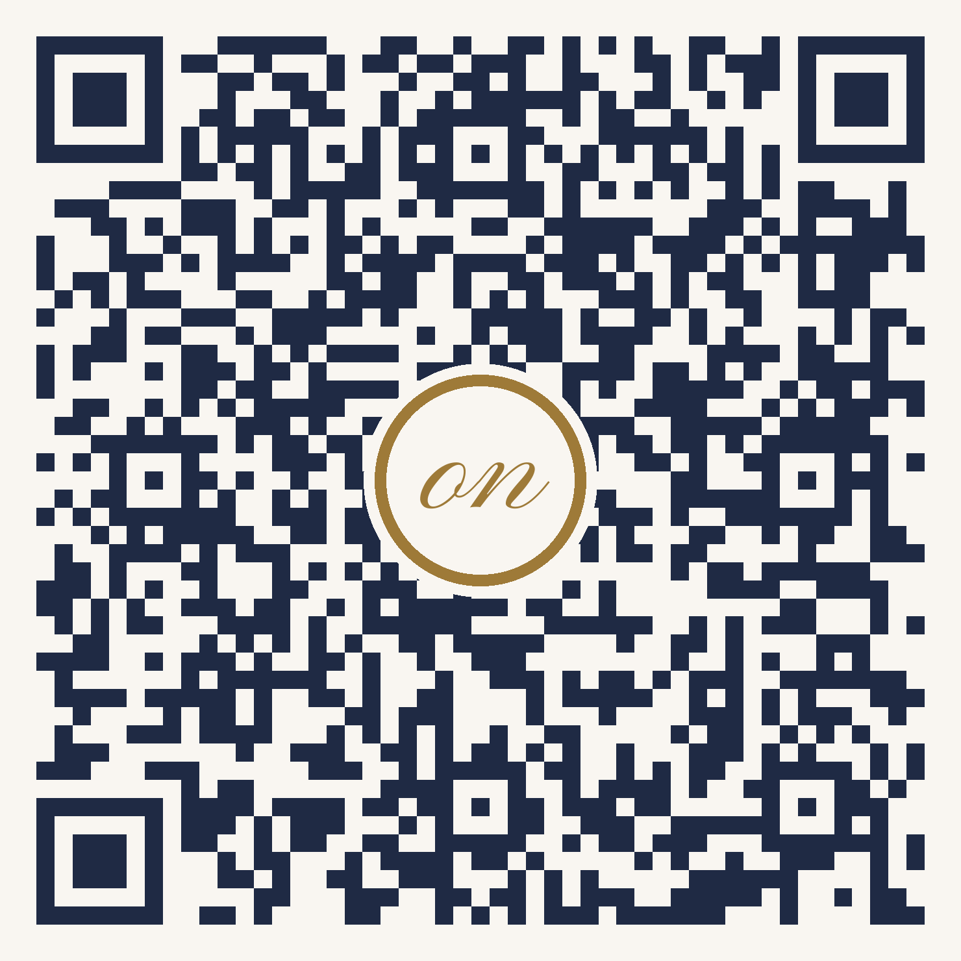
GOLF FASHION
WOMEN
on
COURSE
SINCE 2004
MEMBER GUEST DAY
SPIN THE WHEEL
Tuesday 20 October 2026 and Wednesday 21 October 2026
Follow us, Scan the QR code and
WIN up to 40% off all Women's apparel
SCAN TO WIN
1
2
3
Follow us
Scan the QR code
Show your discount
@womenoncoursegolf
and spin the wheel
at the pro shop till
One spin per person. Discount on Women's apparel in the pro shop, for a single purchase on 20 or 21 October 2026, while stocks last.

