Slide 1

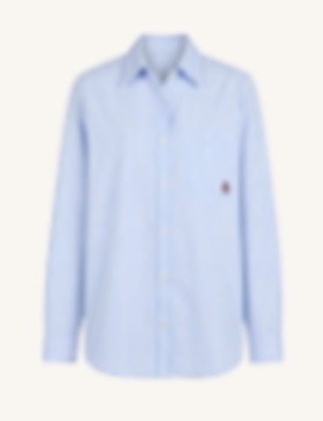
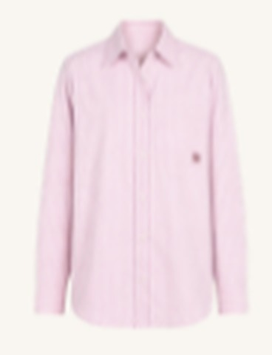
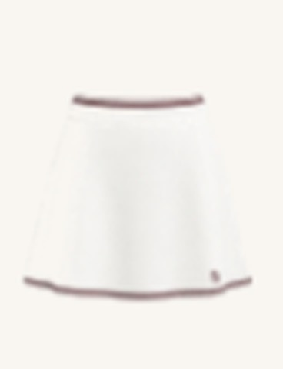
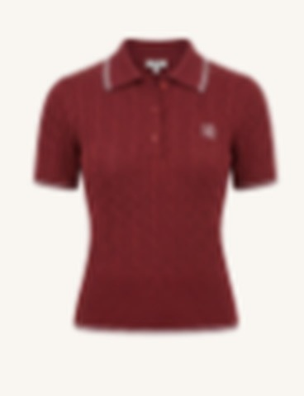
GOLF FASHION
WOMEN
on
COURSE
THE NEW SEASON EDIT
THE NEW
COURSE
LOOK
Fresh colour.
Timeless style.
From the first tee
to the clubhouse.
ON-COURSE STYLE,
EFFORTLESSLY.
THE COLLECTION
BLUE STRIPE
PINK STRIPE
SKORT
BURGUNDY KNIT
WOMEN ON COURSE
DISCOVER THE LATEST ARRIVALS IN THE PRO SHOP

