Slide 1
CARS
S.Saahithi Jyothy
800910906

Slide 2
About the Dataset
This Dataset is about different cars, classified according to their manufacturers and their origin(country).
The model year in which the car is designed is also mentioned.
Data regarding various features like Displacement, Horsepower, MPG, Weight, Acceleration is also maintained.

Slide 3
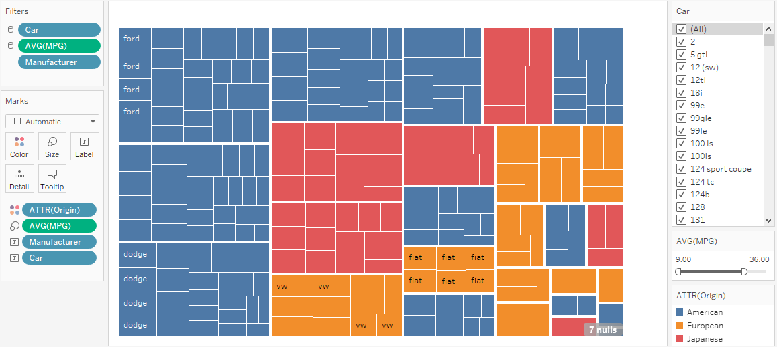
Tree Maps to distinguish cars according to their Origin and manufacturer

Slide 4
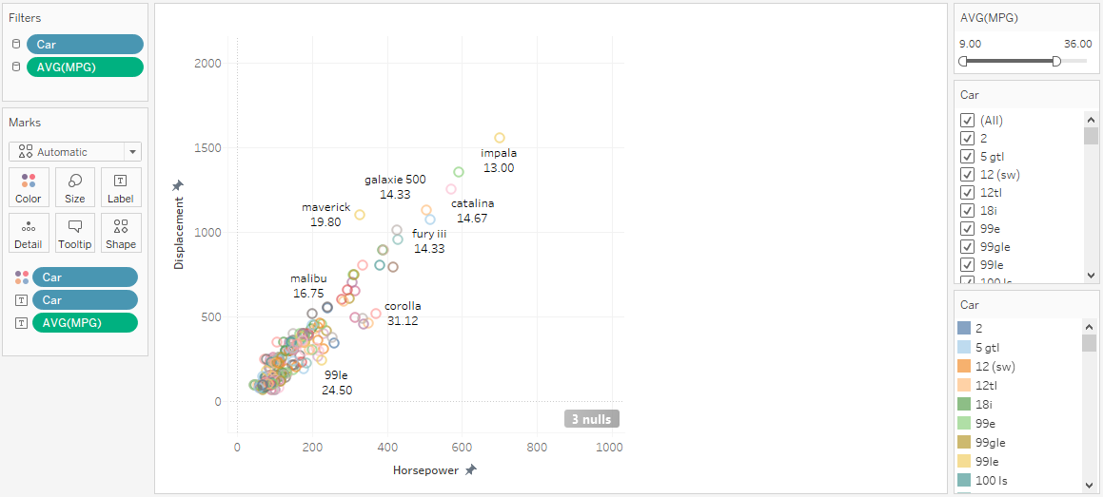
Scatter Plots graph to show relationship between Horsepower and Displacement of various cars

Slide 5
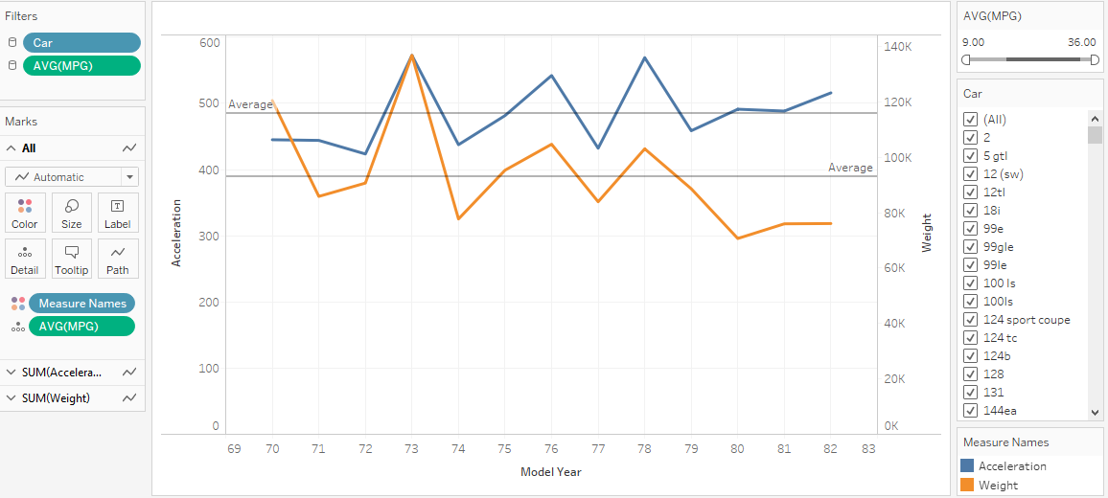
Lines graph to show average change in Weight and Acceleration of different cars along the time

Slide 6


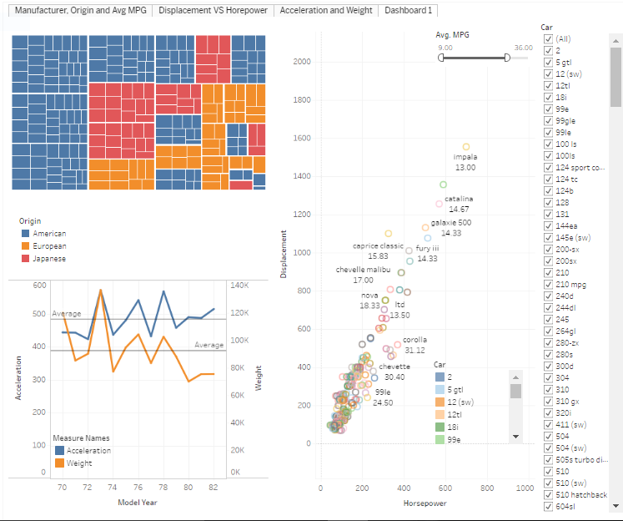
Dashboard
https://public.tableau.com/profile/saahithi.jyothy#!/vizhome/cars_30/Dashboard1

Slide 7
Thank You

