Slide 1
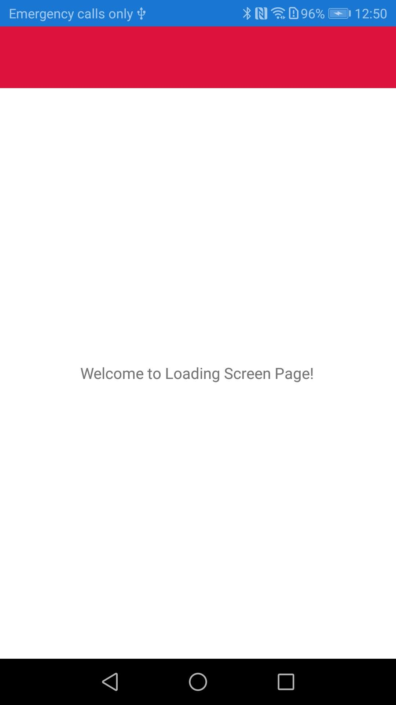
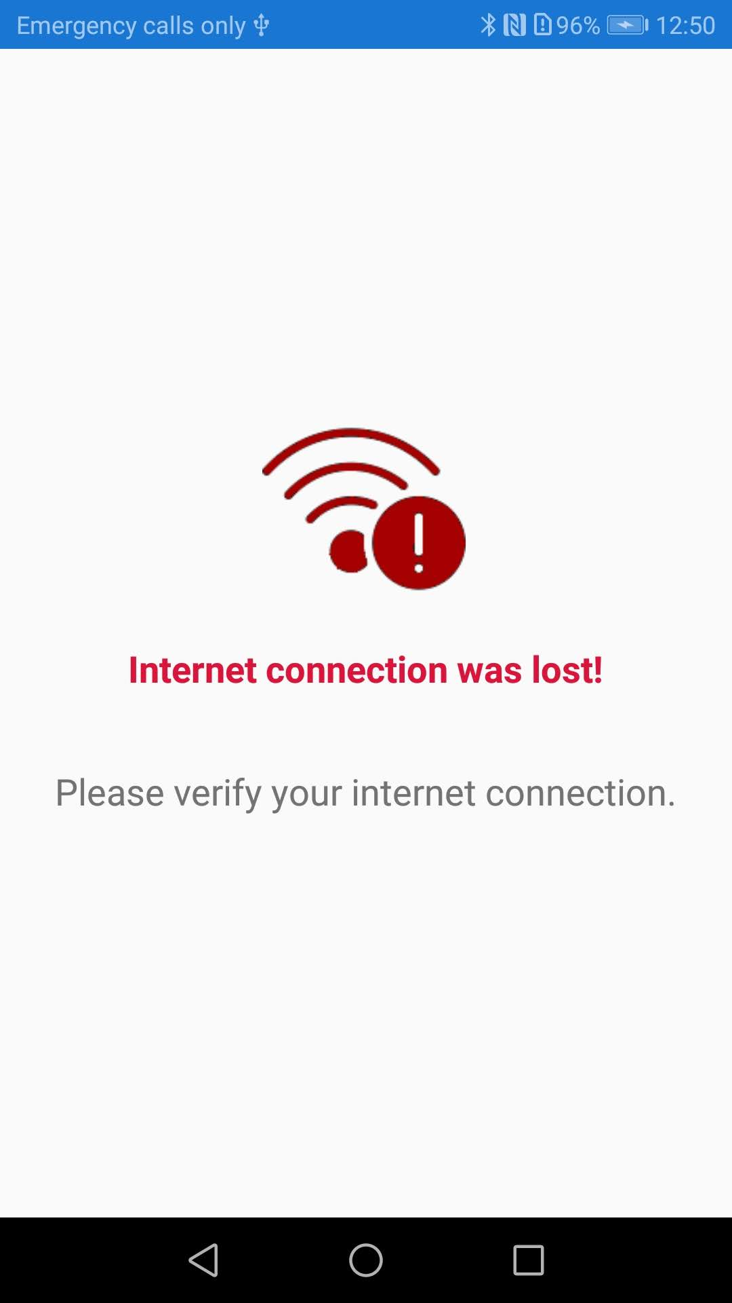
App.xaml.cs
Internet is available
Internet is not available
Internet is available
Internet is not available

