Slide 1

WATER SORT PUZZLE

Slide 2

TEAM PRESENTATION
Sara Mohammadzadeh
Farnood Sotoudeh
Parmida Hosseinmardi

Slide 3
Contents
Introduction
Problem Statement
Methods
Conclusion

Slide 4

Introduction

Slide 5
Problem Statement

Slide 6
Rules
Pour is possible only if two glasses have same colors on top
We can only pour top water from one glass to other
Two same colors are merged into one with more volume
Each glass can have certain amount of water and cannot be poured more

Slide 7
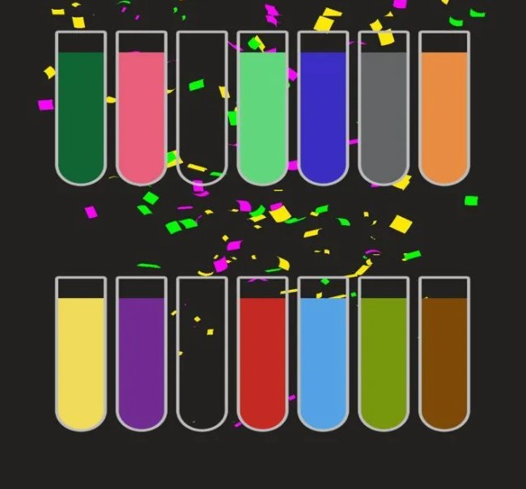
Win State
The goal is to reach the state in which same colors are poured into one glass.

Slide 8
Methods

Slide 9
Methods
A* Search
Greedy Search
UCS(Uniform Cost Search)
BFS(Breath First Search)
DFS(Depth First Search)

Slide 10
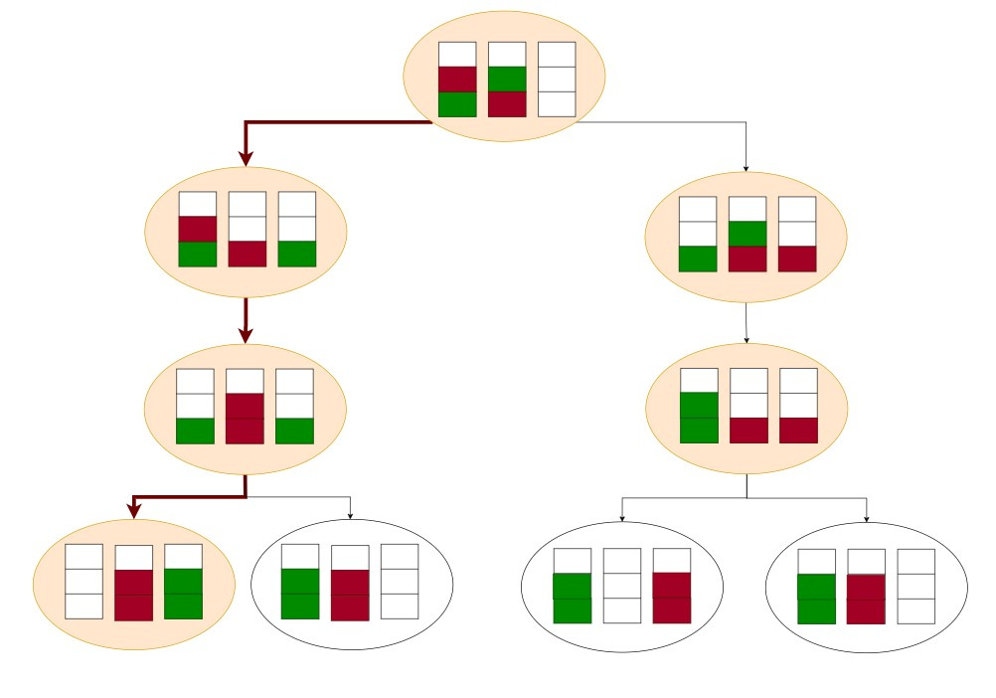
BFS:

Slide 11
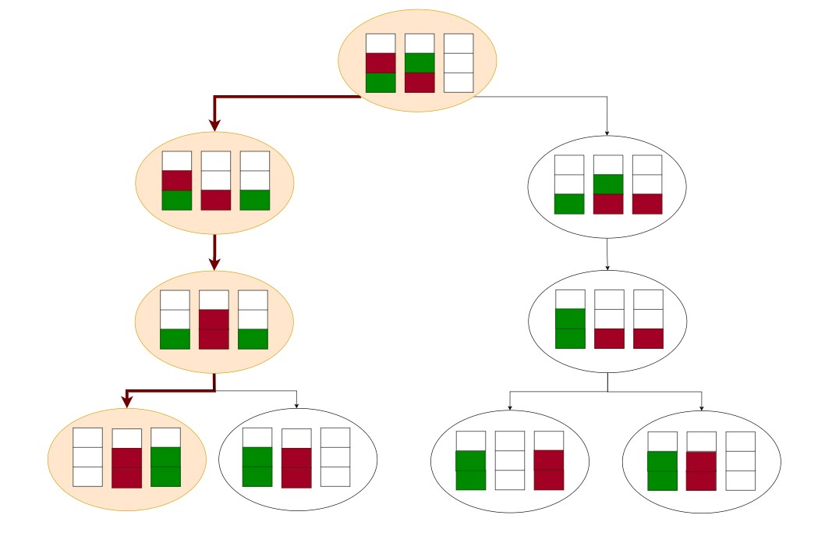
DFS:

Slide 12
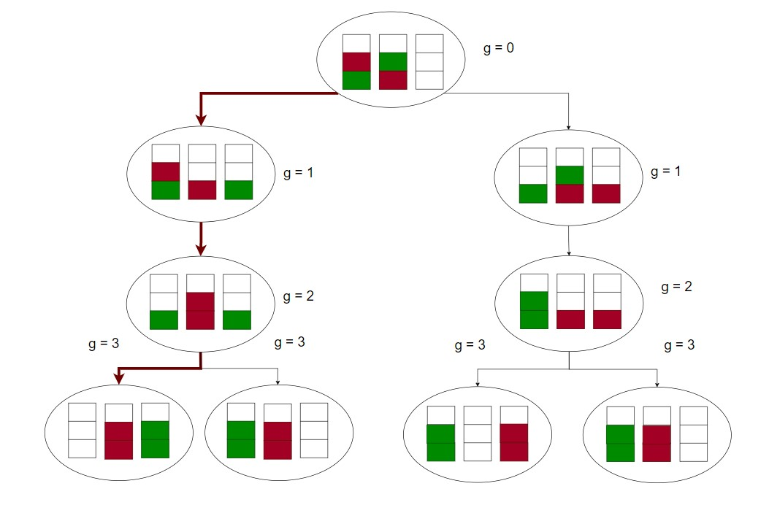
UCS:

Slide 13
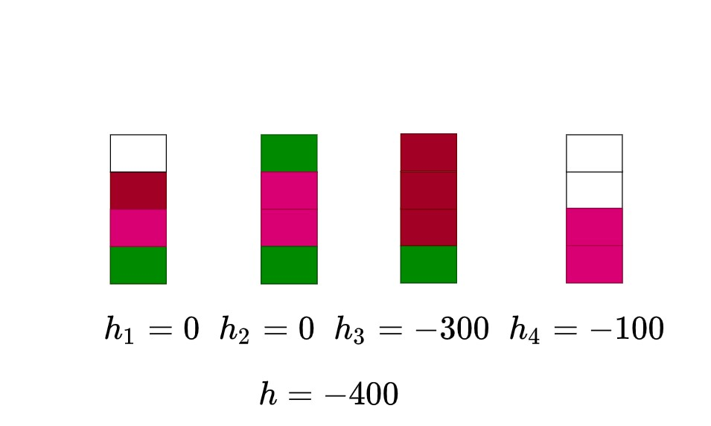
Heuristic:

Slide 14
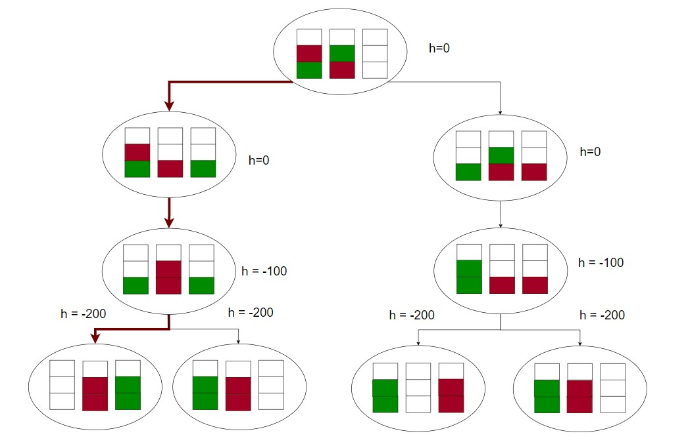
Greedy:

Slide 15
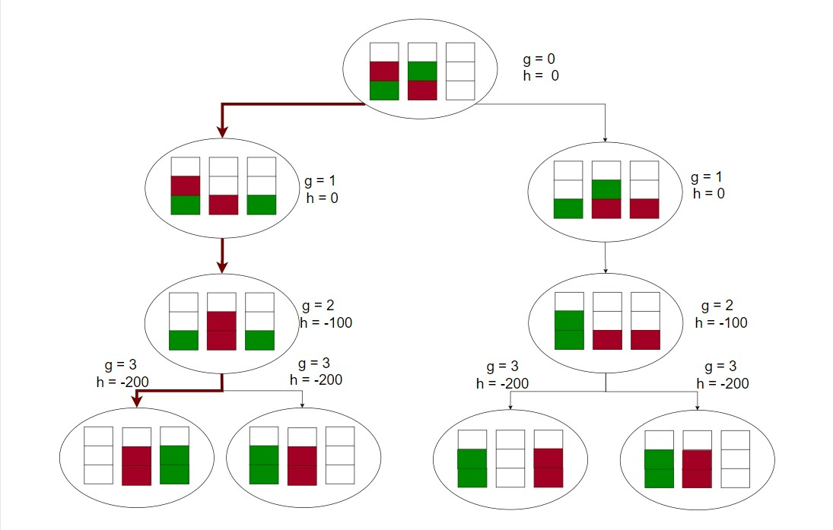
A*:

Slide 16
Result
Algorithm | Node expanded | Move’s number
DFS | 73 | 19
BFS | 1684 | 10
UCS | 1684 | 10
Greedy | 87 | 10
A* | 87 | 10

Slide 17
Conclusion

Slide 18
Thankyou For Your Attention!

