Slide 1
Lesson 4: Shared working
Year 6 – Computing systems and networks – Communication and collaboration
Notes:
Last updated: 09-05-22
Resources are updated regularly — the latest version is available at: ncce.io/tcc.
This resource is licensed under the Open Government Licence, version 3. For more information on this licence, see ncce.io/ogl.

Slide 2
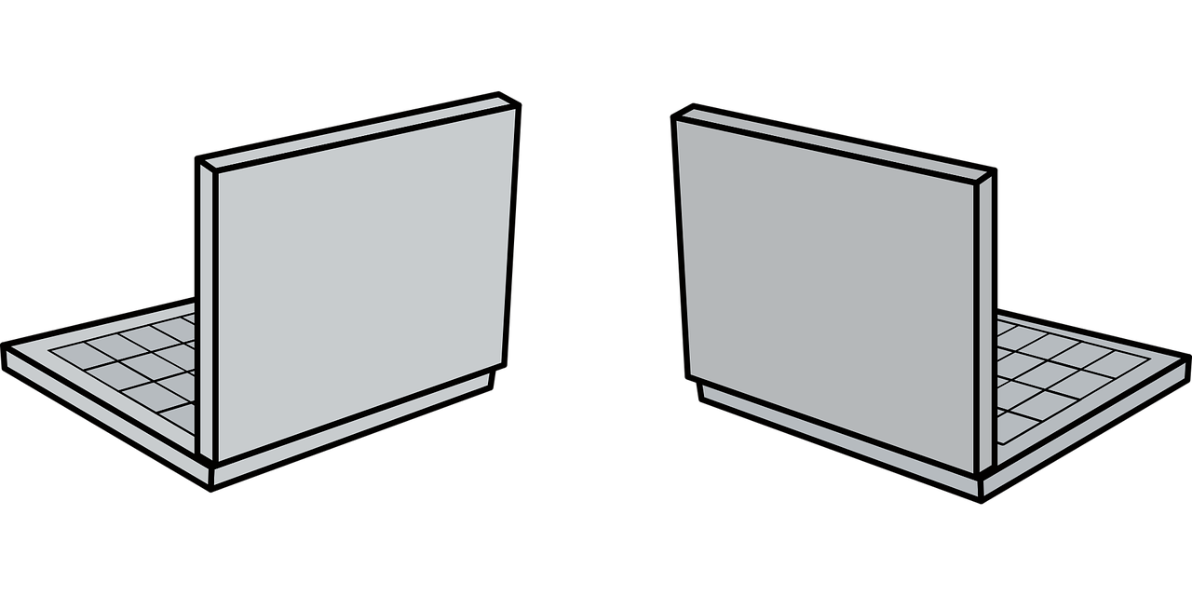

Shared working
Introduction
In the last lesson, you worked with other people online.
What are your top tips for working online collaboratively?
Notes:
Image sources:
http://pixabay.com/vectors/laptop-computer-appliances-3055413
http://pixabay.com/vectors/laptop-149342

Slide 3
Lesson 4: Shared working
Objectives
To evaluate different ways of working together online
I can identify different ways of working together
I can recognise that working together on the internet can be public or private
I can explain how the internet can enable effective collaboration

Slide 4
Shared working on paper
Activity 1
Last time, we worked together online. For this next lesson, we’re going to work together on paper and compare.

Slide 5


Shared drawing
Activity 1
Stage 1: On your paper, draw something of your choice. You have three minutes to work on your drawing. Leave room on the page for more drawing in stage 2.
Notes:
Image sources:
http://pixabay.com/illustrations/drawing-house-building-simply-516251
http://pixabay.com/vectors/pencil-green-writing-tools-37254

Slide 6
Shared drawing
Activity 1
Stage 2: Fold you piece of paper and then hand it in to me.
With the new drawing you have, add something to the drawing you are given. You also have three minutes to draw.
Notes:
Image sources:
http://pixabay.com/illustrations/drawing-house-building-simply-516251
http://pixabay.com/vectors/pencil-green-writing-tools-37254

Slide 7
Shared working on paper
Activity 1
Now that you have completed the drawing, consider how a similar activity could work on a computer.

Slide 8
Reflection
Activity 1
What are the limitations of adding to a drawing like this?
How many people can update the drawing at once?
How could lots of people add to a drawing at the same time?

Slide 9

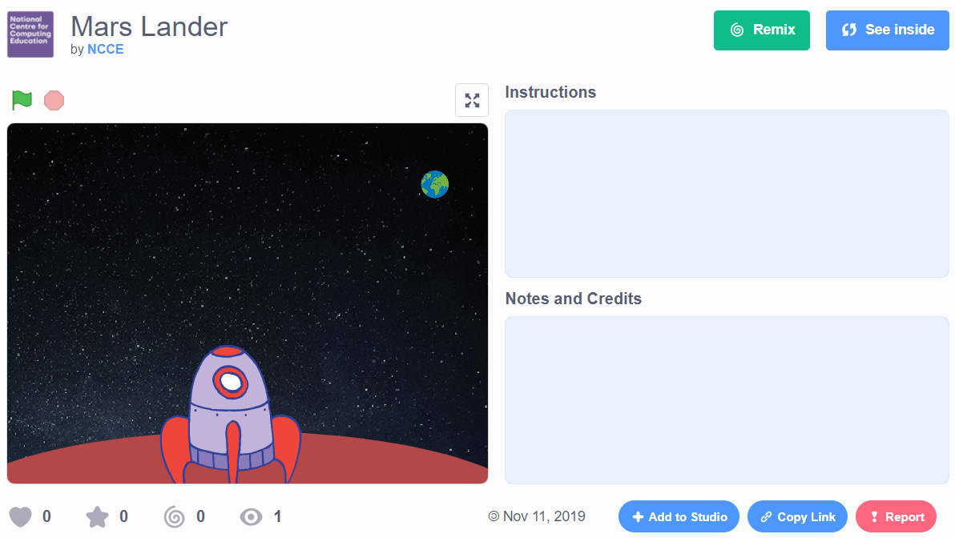
Reusing
Activity 2
In a similar way to the drawing activity, you can reuse someone else’s project in Scratch.
You can use the See inside button to see the blocks of the Scratch project. You can change these without impacting the original author’s project.
Notes:
scratch.mit.edu/projects/343870811
When you are signed in to Scratch, you will see a Remix button on every project. Clicking it will make a copy of the project, which you can then change.

Slide 10
Reusing
Activity 2
Visit this Scratch project:
ncce.io/remixproject
Click the Remix button to create your own version of this project.
Notes:
scratch.mit.edu/projects/343870811
When you are signed in to Scratch, you will see a Remix button on every project. Clicking it will make a copy of the project, which you can then change.

Slide 11

Sharing work openly
Activity 3
Can you think of examples of other people’s work being used?
When can it be useful to use someone else’s work?
Think, pair, share
Notes:
3D men: https://pixabay.com/illustrations/fax-white-male-3d-model-isolated-1889016/

Slide 12
Using other people’s work
Plenary
It’s always OK to use someone else’s work.
Think, pair, share - Do you agree or disagree?

Slide 13

Assessment
How confident are you? (1–3)
I can identify different ways of working together online
I can recognise that working together on the internet can be public or private
I can explain how the internet enables effective collaboration
3 – Very confident
2 – Unsure
1 – Not confident
Notes:
Image source: https://pixabay.com/vectors/thumb-up-hand-like-confirm-go-top-307176/

Slide 14
Next lesson
Summary
In this lesson, you...
Tried another way of collaborating together online
Developed your own ideas using someone else’s work as a starting point
Next lesson, you will…
Look at different methods of communication

