Slide 1
3'DGE data summary
Cell indexing barcodes: 96
Library
  Read1: 6bp indexing barcode +10bp UMI
  Read2, 46bp fastq reads from 3' end of genes
Total sequenced:
  Converted from BCL files directly ~ 280M reads

Slide 2
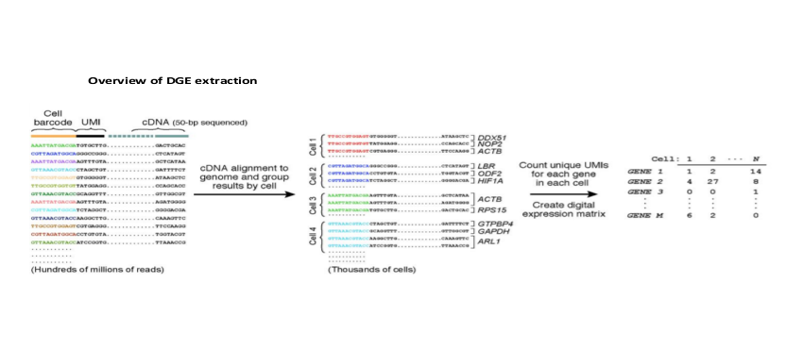
3'DGE extraction
Illustration of 3'DGE extraction

Slide 3
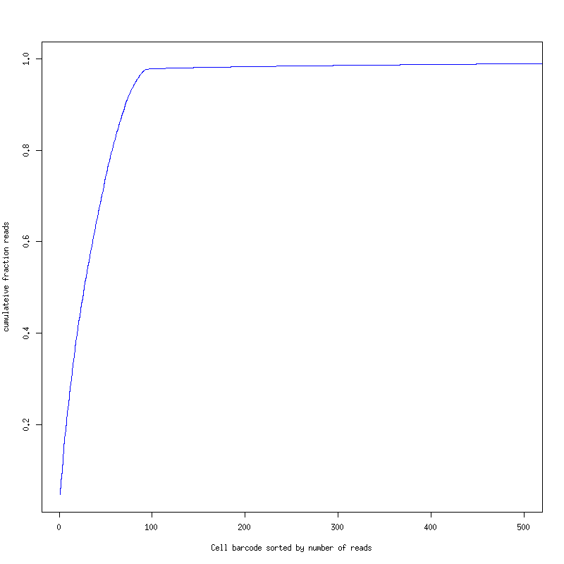
Fraction of Reads Counts of ALL cells (First 6pb of Read1)
Accumulated Fraction is near 1 after 100th cell barcode
Cumulative fraction of read counts from top 500 cell indexings

Slide 4
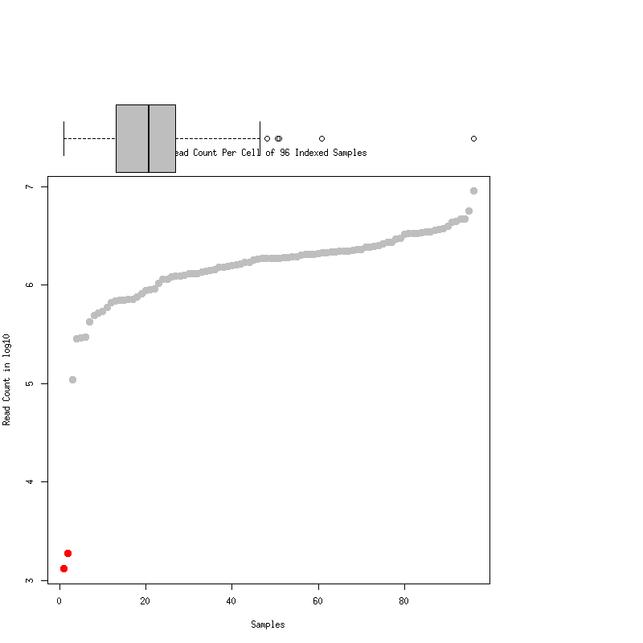
Reads Count per barcode
94 of designated barcodes are in top 100 read-count of cells
2 designated barcodes only yield ~1500 reads total
    AK4F1A_M7iNeurons_GGGGGT
    SKIC11A_M8Astrocyte_TGGGCC

Slide 5
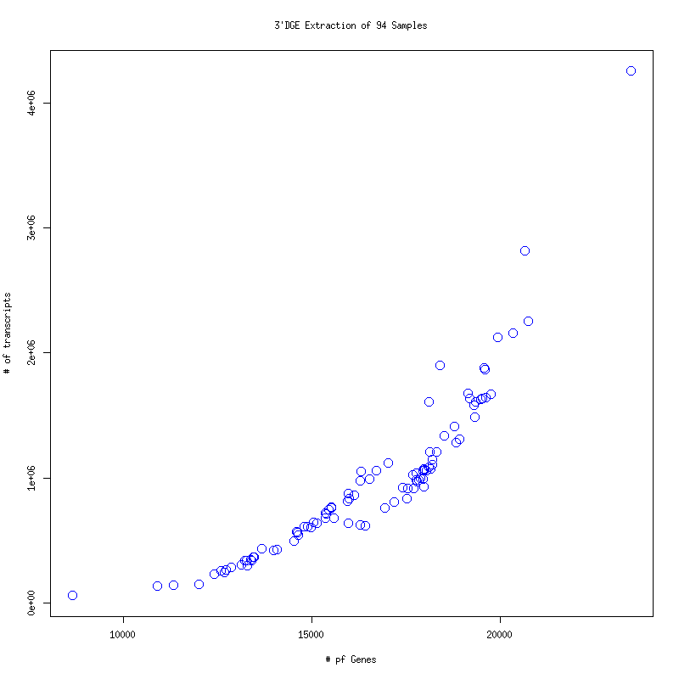
Gene vs Transcripts
Listed 94 barcoded cells
X-axis: # of genes have >0 transcripts or unique UMIs
Y-axis: # of transcripts or unique UMI per gene

Slide 6
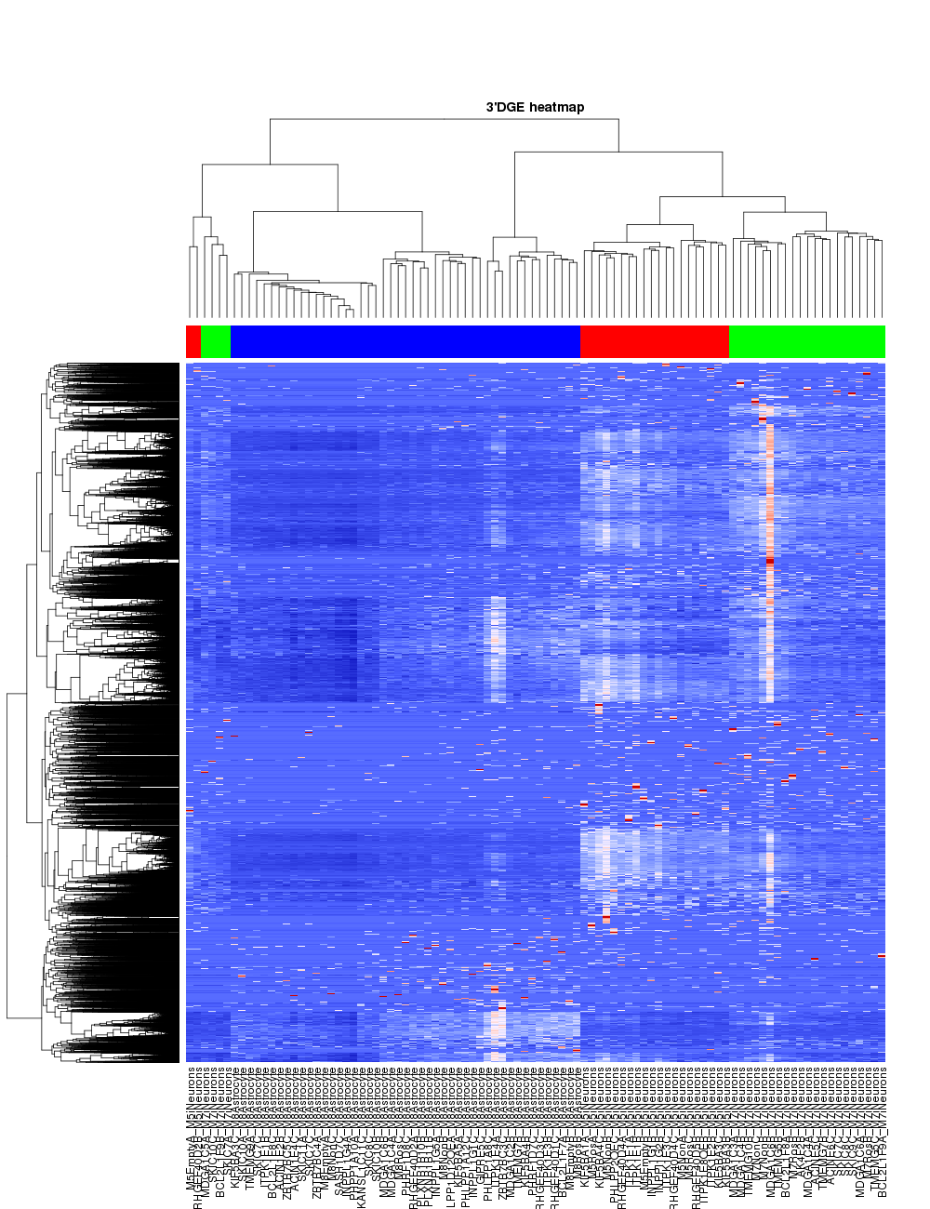
3'DGE heatmap
H-Clustering by celltype

