Slide 1
Innovative Evaluation Practices for BCSE308P - Computer Networks Lab
Design and Implementation of a Reliable Data Transfer Protocol over UDP
P. Dinesh Reddy - 24BCE0593
B. V N D Saran - 24BCT0291
School of Computer Science and Engineering | Fall Semester 2026-27

Slide 2
Problem and motivation
UDP is fast and simple, but it does not guarantee delivery, order or integrity
Packets can be lost, corrupted, duplicated or reordered
Real systems add reliability above UDP: QUIC, UDT, Reliable UDP
Problem: transfer a file completely and correctly over UDP, and measure how retransmission policies behave as the network degrades
2

Slide 3
Existing approach and its gap
Existing
Gap
TCP: reliable, but kernel-resident and not customisable
Stop-and-Wait: simple, but one packet per round trip
Go-Back-N: resends the whole window after a loss
QUIC and UDT: powerful but large and complex
Textbooks describe ARQ only abstractly
Student work often tests one scheme on a perfect network, with single runs
No compact comparison of all three schemes over real UDP sockets with repeated runs and failure analysis
3

Slide 4
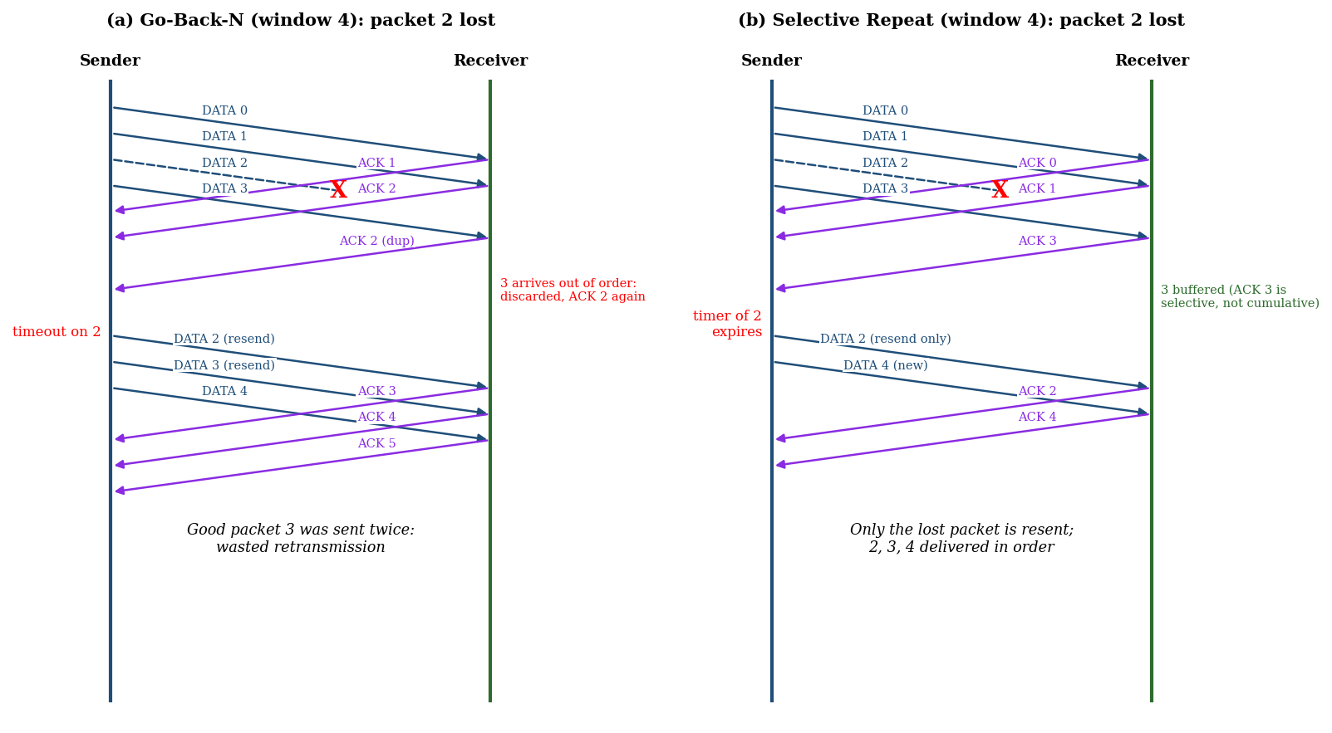
Proposed mechanism and novelty
Proposed: Selective Repeat with window W, a timer per packet and individual ACKs
Baseline: Stop-and-Wait; second reference: Go-Back-N
Only the lost packet is resent; the receiver buffers out-of-order packets
Novelty is in the integration and evaluation, not a new algorithm: one code base where the ARQ policy is the only variable, a loss/corruption/delay/reorder emulator, paired seeds and repeated runs
Loss of one packet: Go-Back-N vs Selective Repeat
4

Slide 5
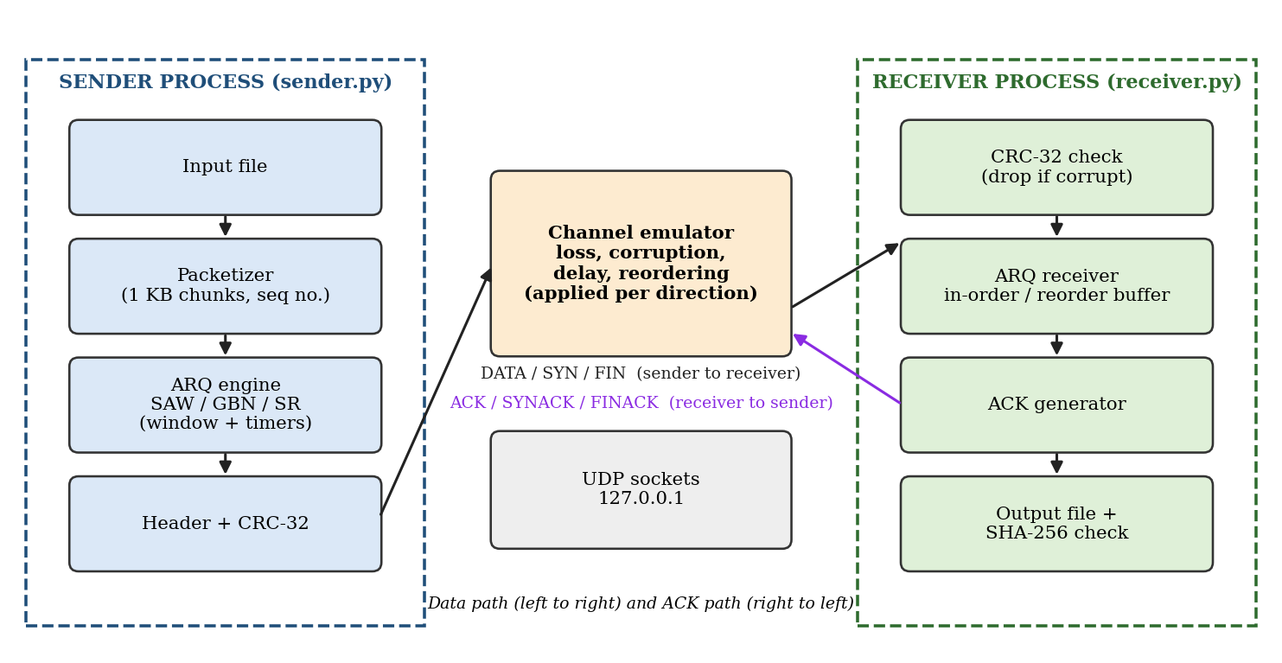
Architecture and algorithm
11-byte header: type, sequence, length, CRC-32
SYN/SYNACK set-up, FIN/FINACK teardown
Corrupt packet = lost packet; timer repairs it
Receiver delivers in order, ACKs each packet
5

Slide 6
Implementation setup
Python 3.12, standard library only (socket, struct, zlib, threading, heapq, hashlib)
Files: rdt_common.py, sender.py, receiver.py, test_transfer.py, benchmark_stats.py
Testbed: sender and receiver on 127.0.0.1 with a channel emulator in each direction
100 KB file (100 packets), 5 ms one-way delay, 60 ms timeout, window 8
Correctness: SHA-256 of received file equals the original in every run
6

Slide 7
Scenarios and metrics
Scenario | Network condition | Schemes
S0 reference | 0% loss | SAW, GBN, SR
S1 low | 5% loss | SAW, GBN, SR
S2 medium | 10% loss | SAW, GBN, SR
S3 high | 20% loss | SAW, GBN, SR
S4 reordering | 5% loss + 0-10 ms jitter | GBN, SR
Metrics
Throughput (KB/s)
Transfer time (s)
Retransmissions
Mean and SD of 10 runs
Window sweep: window 1 to 32 at 10% loss (5 runs each)
7

Slide 8
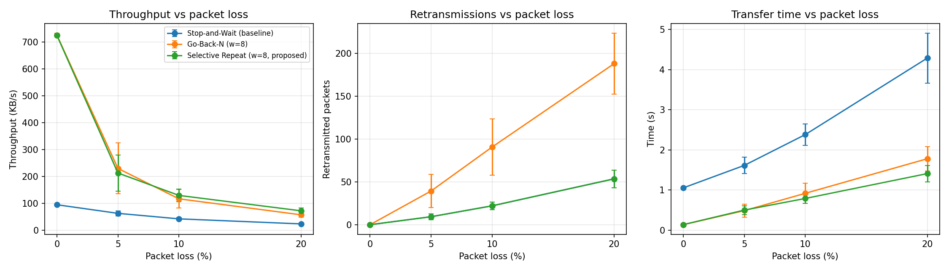
Results: baseline vs proposed
+205 to +238%
-67 to -69%
-72 to -76%
throughput vs Stop-and-Wait (5-20% loss)
transfer time vs Stop-and-Wait
retransmissions vs Go-Back-N
8

Slide 9
Analysis and limitations
Why
Where it does not help
Stop-and-Wait is bounded by one packet per RTT: 95 KB/s measured, 726 KB/s with W = 8
Go-Back-N resends good packets: retransmissions grow 24 to 269 as W grows; SR stays at 24
Reordering: Go-Back-N falls to 20 KB/s, SR keeps 166 KB/s
At 5% loss SR is not better than Go-Back-N (differences inside one SD)
Fixed 60 ms timeout; no congestion control
Loopback emulation, 100 KB file, loss up to 20% only
9

Slide 10
Conclusion, future work and references
Reliable, in-order, error-free file transfer over UDP, verified by SHA-256 in all runs
Selective Repeat is the most efficient under high loss and reordering
Future: adaptive timeout, congestion control, SACK-style ACKs, tests on a real network
References
[1] J. Postel, RFC 768, UDP, 1980. [2] J. Postel, RFC 793, TCP, 1981.
[5] M. Mathis et al., RFC 2018, TCP SACK, 1996. [6] V. Paxson et al., RFC 6298, 2011.
[8] Y. Gu and R. L. Grossman, UDT, Computer Networks, vol. 51, no. 7, 2007.
[9] J. Iyengar and M. Thomson, RFC 9000, QUIC, 2021. [10] Kurose and Ross, Computer Networking, 8th ed., 2021.
10

