Slide 1
Final Project: Finding an optimal seating chart
SYS 6003
Saran Mishra, Tom Muhlbauer, and Yihan Zhang

Slide 2
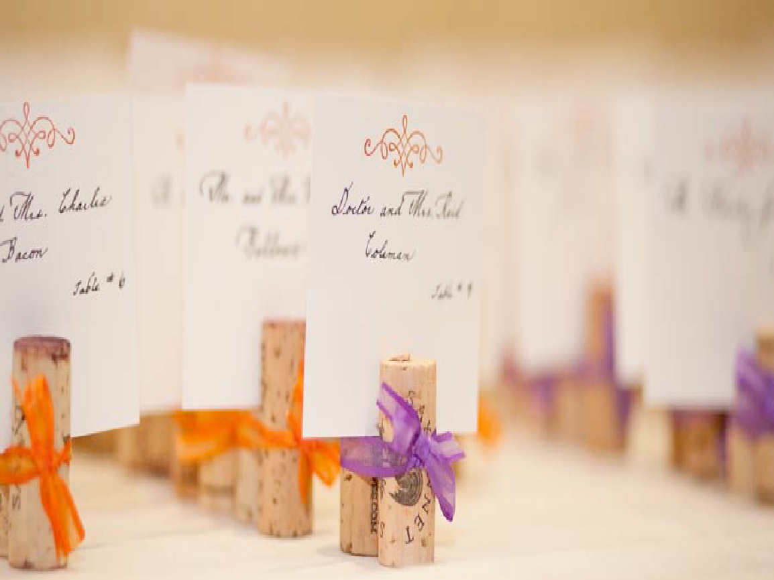
Article Summary
The optimization problem we selected was a light-hearted but very important issue for many people: optimizing the seating chart for their wedding
This task can take a lot of time, create stress, and cause arguments between the bride and groom and their mothers
Dr. Meghan Bellows and her fiancé, Dr. Luc Peterson, built this optimization program and actually used it as a starting point for their wedding
They also suggested many other uses when a seating chart needs to be made (conferences, meetings, bar mitzvahs, etc.)
Our group noted that it could be used for other integer programs such as task-assignment problems, matching problems, as well as, crossing domains into resource allocation problems, scheduling/queuing problems, etc.

Slide 3
Literature Review
The authors did not cite other academic papers in their article so we did a cursory literature review to see if others have tried to do the same thing and found a few hits:
An automatic seating plan algorithm, Kresten Lindor-Larsen, May 24, 2004, https://peerj.com/preprints/27420/ - this article (prepublished peer review in 2018) used a connection matrix that holds the possible interaction “value” between two guests but also includes a dissimilarity matrix holding a cost of personality traits the people exhibited in answering questions about themselves to improve chances that people would like the people seated with them
Congress seat allocation using mathematical optimization, Roland Oliver Hales and Sergio García, 29 April 2019, https://link.springer.com/article/10.1007/s11750-019-00515-3 - This article was very interesting. Their goal was to set up a math program to build seating charts for various congresses (Spain, EU, Canada, New Zeland were examples); the approach they used was to represent seats as points on a graph and then calculate a shortest-distance path through the seats of each political party ensuring that the party delegates all sat in a contiguous area and no one party got “better” or “worse” seats

Slide 4
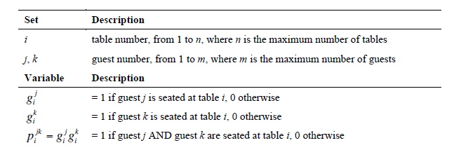
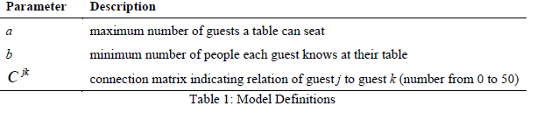
Math Problem from article (model)

Slide 5
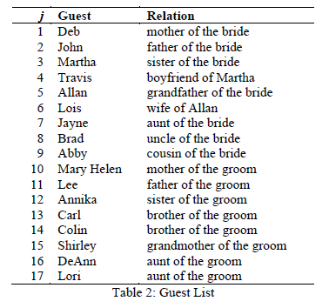
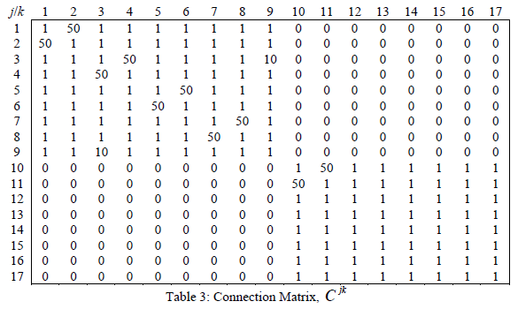
Math Problem from article (data)

Slide 6
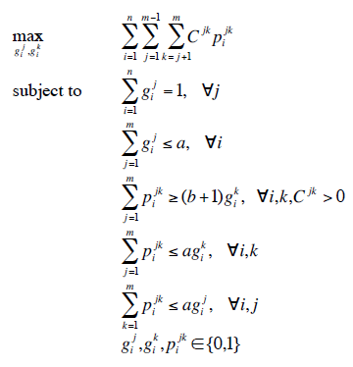
Discussion on Objective Function/Constraints
Objective Function
The objective function is trying to maximize the value received from when two people sit together. The connection matrix allows us to understand the values each individual places (based on a familial relationship) on another individual. For ex. the bride’s mother and father (we assume) would enjoy sitting next to one another and thus we give a weight of 50 if that occurs.
Constraints Translated
For all guests, maximize the number of people they know at their table.
Each guest can only sit at 1 table.
Each table has a maximum number of seats.
Guests must know a minimum number of people at their tables.
Function used to linearize tables*guests j
Function used to linearize tables*guests k
Decision Variables are binary

Slide 7
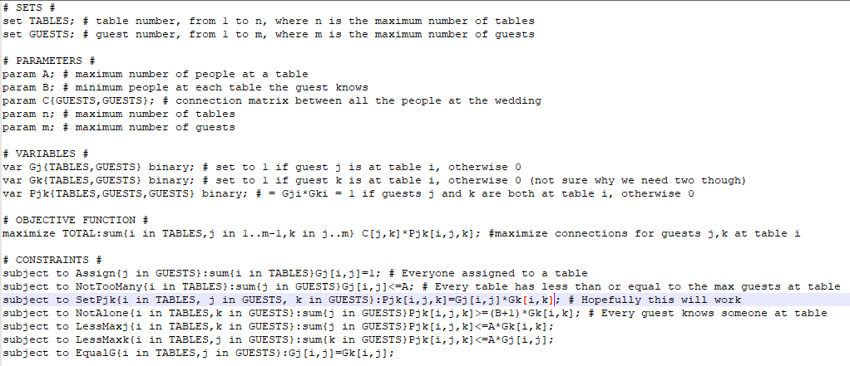
Math Problem in AMPL (model)
Initially we ran the problem without the last constraint but found that the solver would then set the Gj and Gk differently, causing incorrect assignment in Pjk and therefore an incorrect solution
Notes:
I don’t think we need the photo of the mod file

Slide 8
Results from AMPL
There were two examples in the article as written so we simulated them first:
m=17, n=2, a=10, b=1 (weddingseating)
m=17, n=5, a=4, b=1 (weddingseating_v2)
Both of these math problems, using the same connection matrix as listed in the article, generated similar solutions but the objective value changed. With 5 tables, we net an objective value of 292 while with 2 tables, we get a higher objective value: 334.

Slide 9
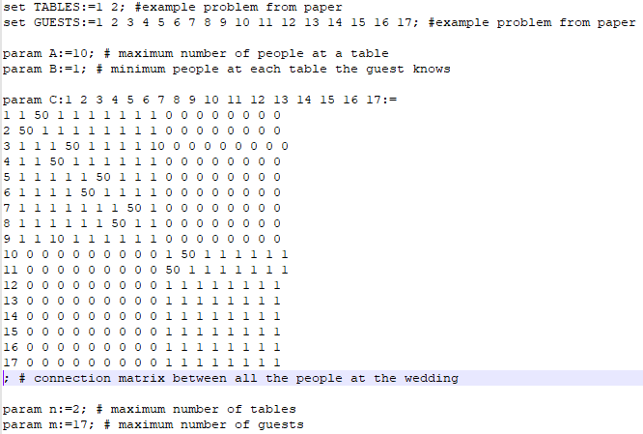
Math Problem in AMPL (data)
Notes:
I don’t think we need the photo of the dat file

Slide 10
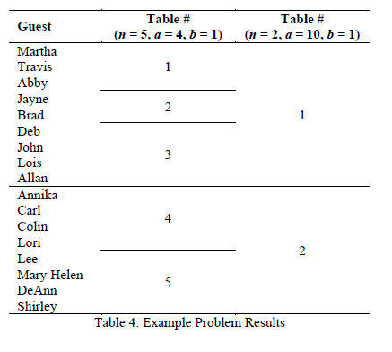
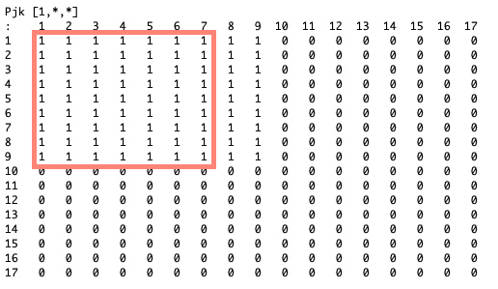
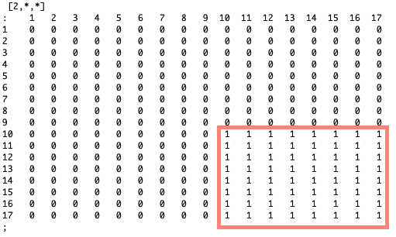
weddingseating (m=17, n=2, a=10, b=1)
Article:
AMPL:
We can see how the groups get divided in the scenario that has just two tables (persons 1 to 9 (One family) sit together and persons 10 to 17 (the other family) sit together.
Notes:
(SM - fill in AMPL matrix)

Slide 11
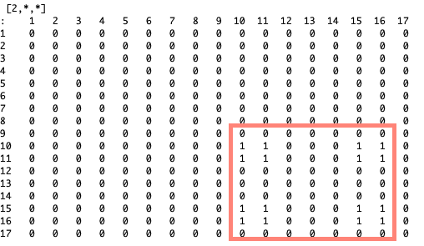
weddingseating_v2 (m=17, n=5, a=4, b=1)
Article:
AMPL:
Our Gurobi solver garnished the similar results as to the study when we take into account the allocation per table, if every table is homogenous. For example, our table 1 matches with the same people in table 1 from the paper. However, our table 2 and table 5 are flipped -- with our table 5 matching the paper’s table 2. The same with tables 3 and 4.
Notes:
(SM - fill in AMPL matrix)

Slide 12
More Difficult Problems
The authors stated that their wedding problem, m=107, n=11, a=10, and b=0, took 36 hours to run so we made some different problems for the model to run to see whether a solution could be found
weddingseatingv3.dat (m=50, n=12, a=5, b=1) added in some additional values in the connection matrix, using “2” for teenage children that should sit with their parents (or with friends if there isn’t room) and “-50” for former spouses who should not be seated at the same table. Note: this problem took 23.4 hours to find the optimal solution so it was the most difficult problem we tried
Notes:
This should be highlited way more (I can run an iteration of this too)

Slide 13
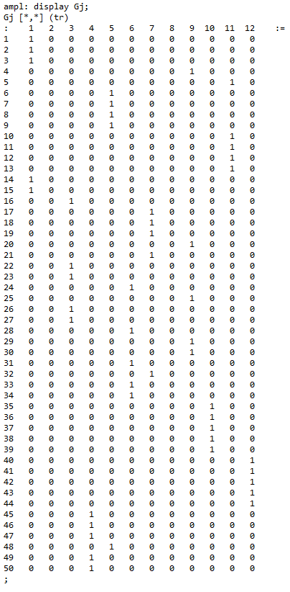
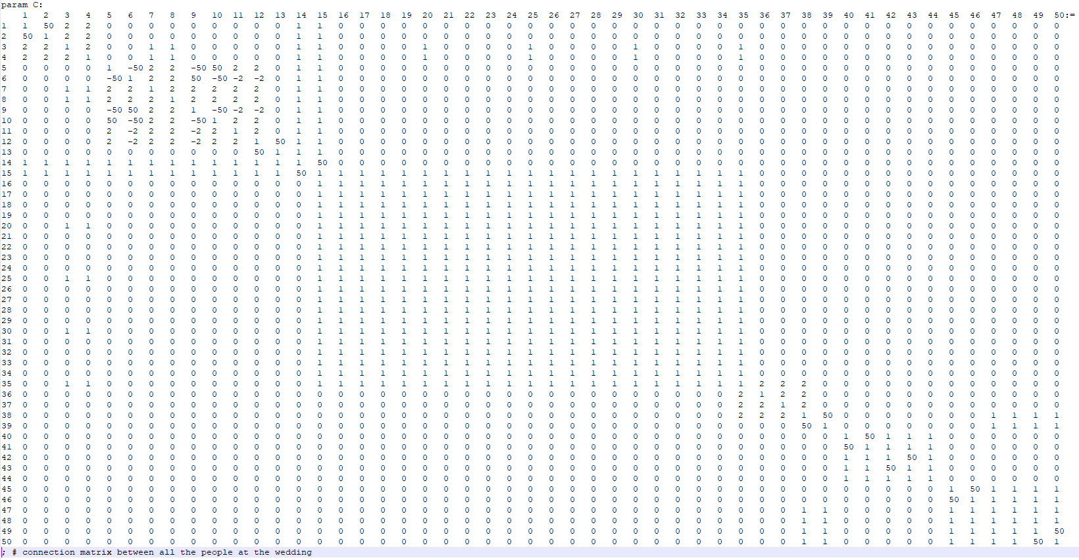
weddingseating_v3.dat
The optimal solution looks pretty good here. Children are with parents or someone they know and divorced people are not at the same table. There are also two empty tables so this particular venue could remove two tables entirely. This would be a good starting point for the bride and groom to make changes from, if desired.
Notes:
This is wonderful! (Great Job, Tom)

Slide 14
More difficult Problems: Yihan’s Model -- Baby’s banquet
Yihan and Shanshan plan to hold a 100-day banquet for the baby recently. It is estimated that 5 people per table or 9 people per table. The general situation is this. Yihan, Shanshan and baby first need to be at the same table as possible. Secondly, Yihan's parents and Shanshan's parents are best at the same table. The husband and wife should be arranged the same table first. People of similar age and of same family like to sit together or at a table with their parents. The relatives of both families are more familiar with each other, and it is more appropriate to arrange them together. Shanshan wants to introduce her roommates Ying and Ting to Yihan's cousin Yang. Yang is slightly inclined to have a table with Yihan or his parents, but Ying and Ting will be nervous with Yang's parents at the table. Yihan's grandfather likes his grandson very much and wants to be with his grandson. ZheCheng played Overwatch with Ying Shuai, and they shared many topics.

Slide 15
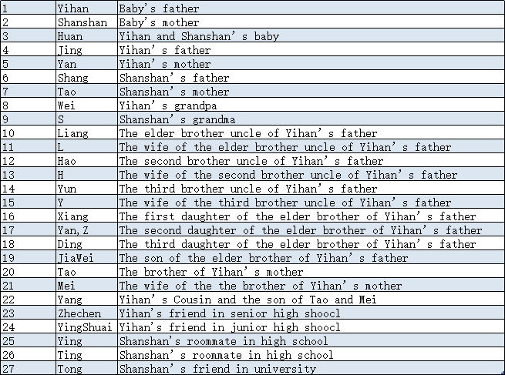
More difficult Problems: Yihan’s Model -- Baby’s banquet
Guest List

Slide 16
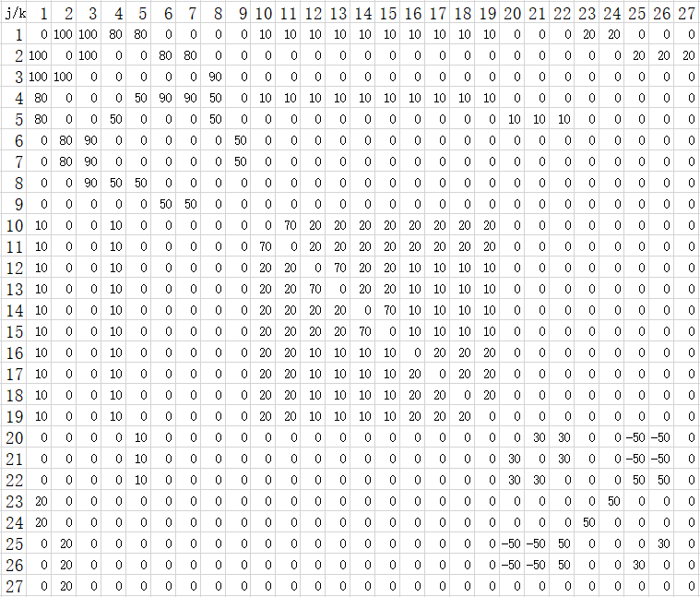
More difficult Problems: Yihan’s Model -- Baby’s banquet
Connection Matrix

Slide 17
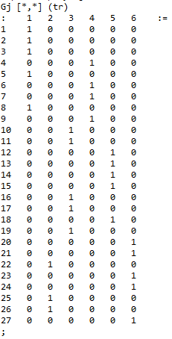
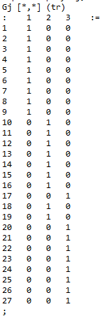
More difficult Problems: Yihan’s Model -- Baby’s banquet
When there are 6 tables, and a table can seat up to 5 people:
When there are 3 tables, and a table can seat up to 9 people:
From the perspective of the optimal solution, the second solution is more appropriate. This is indeed the case. In the first plan, the family of Yihan could not sit at a table and many close friends were forced to separate. But the second option gave a relatively better results.

Slide 18
More difficult Problems: Noncooperative Families
Set up:
In a largely theoretical exercise, we take the same group characters from the smaller examples in the paper (due to run-time issues). However, we imagine in this iteration, there are certain family members who do not get along with other family members. We iterate upon the more complicated game i.e. (m=17, n=5, a=4, b=1) for both simulations. These games allow us to ask questions of membership groups for the agents (guests).
All original constraints, parameters, variables are held.
Unwanted (but obligatory) Guest (A singular noncooperative agent -- forced discrimination)
Quarrelling Couples ( Multiple non cooperative Agents)

Slide 19
Noncooperative Families: Unwanted Guest
We imagine a scenario where Travis (guest 4) and Martha (guest 3) have gotten into an argument and now no one on the bride’s side of the family 𝞫, where 𝞫 ⊆ G (Guests) ∀ g ∈ G {1,2, … 17}, wants to sit with Travis τ ⊆ 𝞫. Utilizing the Connection Matrix, we weigh sitting with τ with a negative value, forcing a seat away from any other members of (𝞫-1). Additionally, to discriminate him out of his original membership group, we make Travis’s preferences for placement negative for all of the bridal guests (𝞫-2) except for his girlfriend Martha. This is an obvious violation of constraints (1) and (4) which were previously discussed. We find a result of τ ∪ G₁₇ where G₁₇ ⊆ Ɣ (Groom’s family) and Ɣ ⊆ G,∀ g ∈ G.
This still gives us a feasible (perhaps not optimal) solution and what we realize is that given the parameters, agent τ will always find someone to sit with at some table. But one other thing to note is that we are able to quite easily discriminate an agent out of its original membership group given our parameters.

Slide 20
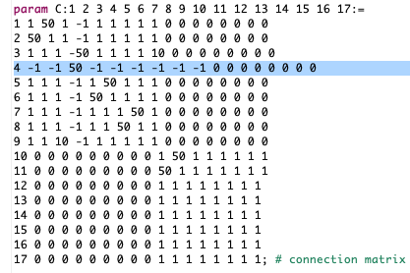
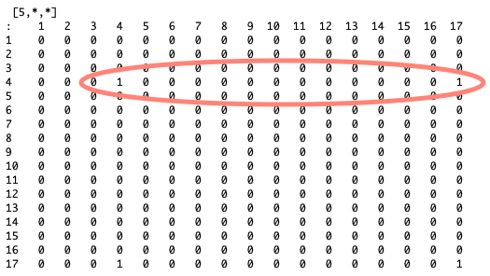
Noncooperative Families: Unwanted Guest Visualized

Slide 21
Noncooperative Families: Quarrelling Couples
We iterate further into the idea of multiple non cooperative agents. This time, every couple-pair (distinguished in the article with a positive weight of 50 for value of sitting together) is reweighted at -50 since they are in a quarrel. In this case, we identify 10 such agents, or 5 distinct pairs. This additional constraint allows us to evaluate if the quarrelling agents (q₁, q₂, ... q₁₀) ⊆ G (Guests) ∀ g ∈ G {1,2, … 17} are retaining their membership to their respective groups (q₁, q₂, .. q₈) ⊆ 𝞫 where 𝞫 ⊆ G ∀ g ∈ G and (q₉,q₁₀) ⊆ Ɣ (Groom’s family) , where Ɣ ⊆ G,∀ g ∈ G all while sitting at different tables from their own respective quarrelling partner i.e. q₁∅ q_{2,} .
Note: We identify membership retainment as whether an agent is still sitting at a table with members who are all from their original membership group or have they been shifted to a table with the other group (family).

Slide 22
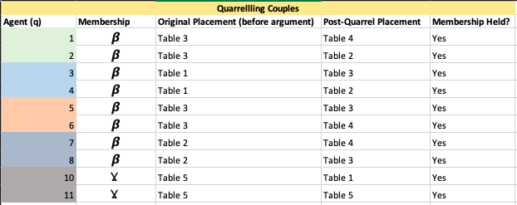
Quarrelling Couples visualized
We do find a feasible solution here, as well. Membership in this case is held for all quarrelling agents but no couple is placed at the same table as their quarrelling counterpart.

Slide 23
Conclusion
Main ideas discussed:
This article provides us with the idea of a connection matrix which is a shortcut to impute the preferences of singular agents. Obviously, we could have added more constraints to achieve the various iterations (especially the theoretical ones).
We have additionally shown how to expand this example utilizing a few real-world scenarios.

