Slide 1

AeroGuard
Review 2 final presentation
Full-pass evidence, corrective adapter study, working review console, and an edge deployment path
32,823 frames
4 evaluated arms
Final test sealed
AeroGuard · supervised offline UAV perception review
1
Notes:
Good morning. AeroGuard tests whether flight state can improve object detection from a moving drone. Review 2 adds full-pass training, complete evaluation evidence, a corrective adapter study, a working review console, and a TensorRT deployment path. The final test is still sealed.
Sources:
README.md
docs/REVIEW2_EVIDENCE.md

Slide 2
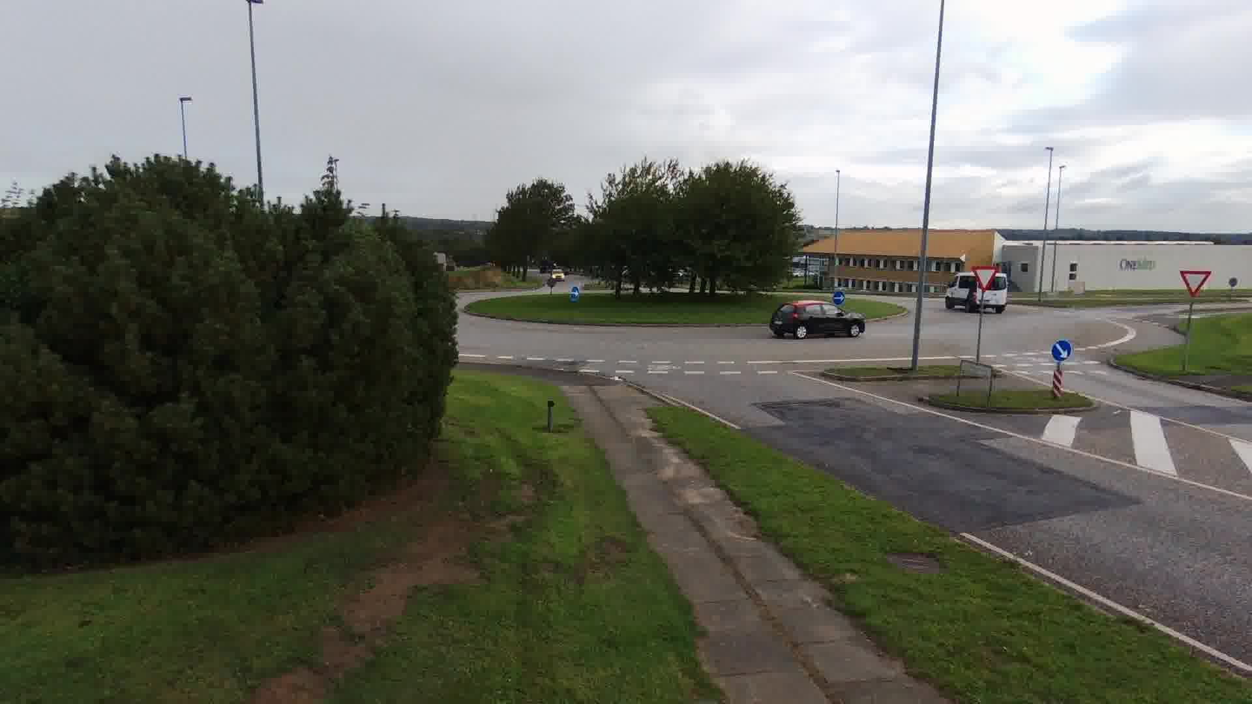
Problem and solution
Small road users remain difficult to detect from a moving drone
Aerial objects occupy few pixels and change scale as the drone moves.
A normal detector sees only the image. AeroGuard can also receive height, velocity, roll, pitch, and yaw.
The model produces boxes, classes, and confidence scores for human review.
AeroGuard reviews recorded perception evidence. It never controls the drone.
Real AU-AIR development frame · 1920 × 1080
Eight classes
Human, car, truck, van, motorbike, bicycle, bus, trailer
Development evidence only. Final test remains sealed.
2
Notes:
Objects are small, distant, and viewed from a changing camera position. The proposed solution combines the image with eight normalized flight-state values. A human inspects every result. The system is an offline review tool, not an autonomous flight controller.
Sources:
manifests/auair.jsonl
docs/assets/auair-demo/sequence.json

Slide 3
What changed after Review 1
Corrected labels align the pilot and full-pass evidence
Review 1
Review 2
Pilot evidence
Full-pass evidence
5,000-update pilot per arm.
Early development result: E2 AP50 0.0692 versus E1 0.0120.
Architecture, split logic, and initial training pipeline completed.
The early result suggested that flight state might help.
All 18,523 training frames per arm and every loss step stored.
E2 image + state reached AP50 0.1698 and led image-only E1 at 0.1146.
Stress tests documented the E2 state path under controlled interventions.
E4 reached AP50 0.1697 but did not improve on E2.
Review 2 confirmed E2 image + state as the development leader.
Development evidence only. Final test remains sealed.
3
Notes:
Review 1 gave us a useful early signal, but it came from shorter runs. Review 2 scaled both arms, measured every loss step, and tested the result on the same held-out flight. The corrected labels identify E2 as the image-plus-state model and E1 as the image-only model. E2 leads both the pilot and full-pass development comparisons.
Sources:
docs/DEVELOPMENT_RESULTS.md
docs/REVIEW2_EVIDENCE.md
docs/REVIEW2_ADAPTER_FOLLOWUP.md

Slide 4
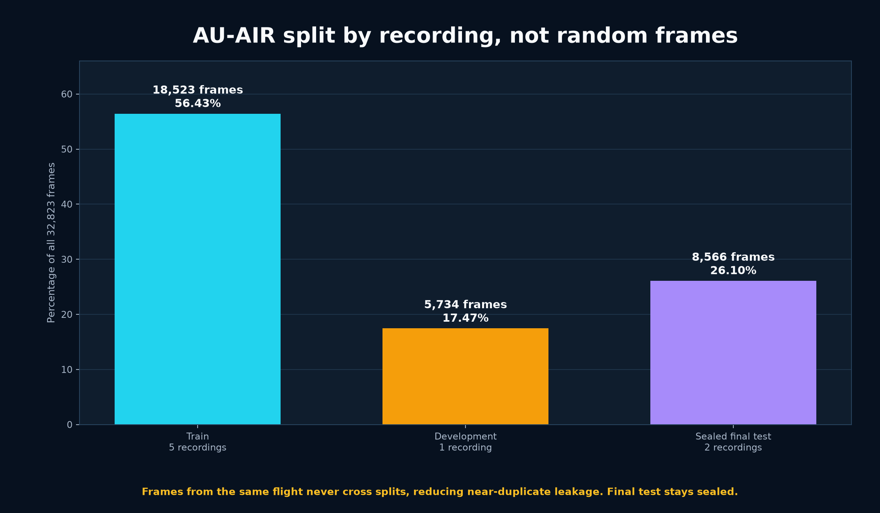
Dataset and evaluation protocol
Complete flight recordings stay together to prevent near-duplicate leakage
56.43%
18,523 training frames
17.47%
5,734 development frames
26.10%
8,566 sealed final-test frames
8 recording roots · split by complete flight
Development evidence only. Final test remains sealed.
4
Notes:
AU-AIR contains 32,823 frames. Five full recordings form training, one full recording forms development, and two recordings remain sealed for the final test. We never randomly mix neighboring video frames because that would leak nearly identical scenes across splits.
Sources:
manifests/protocol.json
docs/REVIEW2_EVIDENCE.md

Slide 5
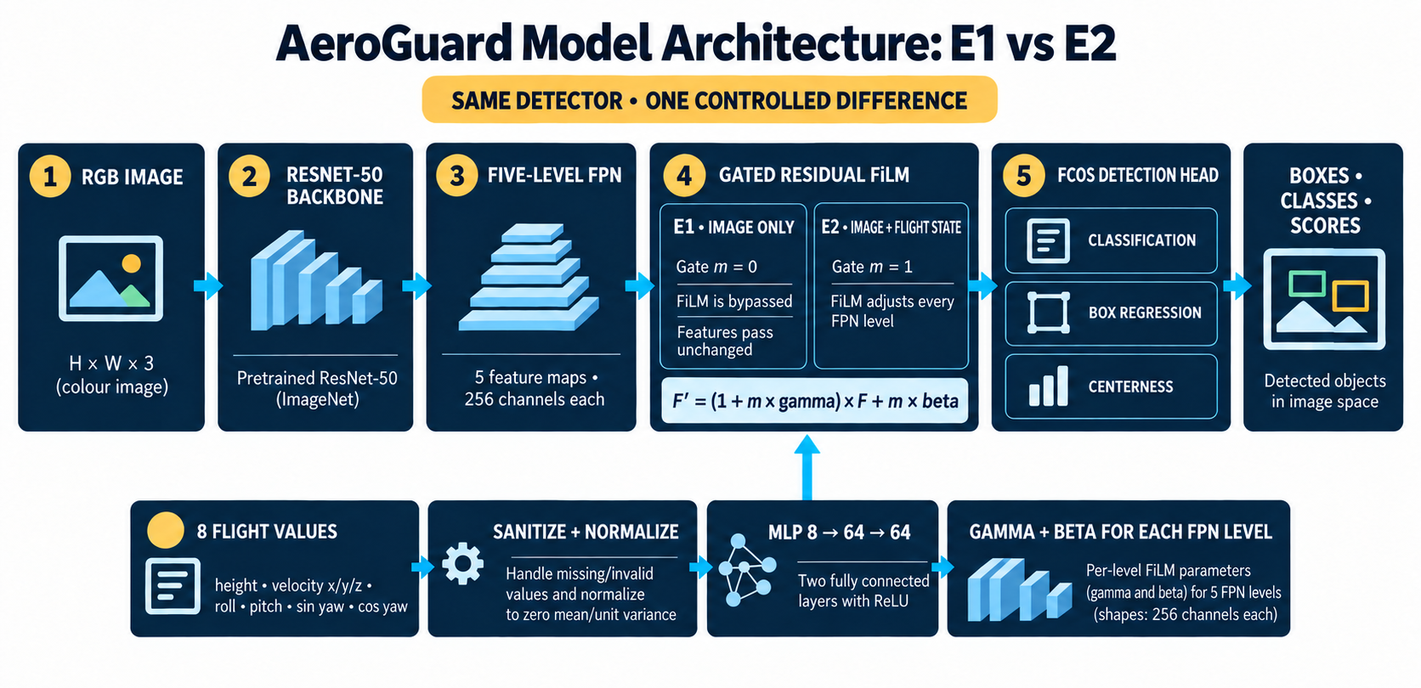
Model architecture and four experiments
All arms share the FCOS visual detector; the controlled difference is the state path
E1 image only
E2 joint image + state
E3 frozen visual
E4 frozen + 50% state dropout
Development evidence only. Final test remains sealed.
5
Notes:
E1 is the image-only control. E2 trains the detector and state branch together. E3 and E4 are controlled frozen-visual variants of E2.
Sources:
docs/assets/aeroguard-model-architecture-review2-cropped.png
reports/review2/adapter_integrity_summary.json

Slide 6
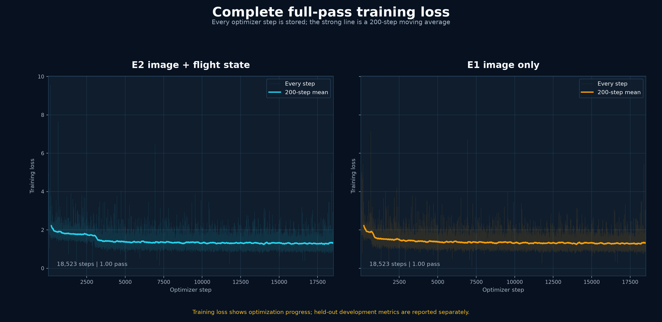
Complete training evidence
Every optimizer step is stored for the full-pass E2 and E1 runs
18,523 steps per arm
100% training coverage
47.6 minutes in parallel
Development evidence only. Final test remains sealed.
6
Notes:
Review 1 used 5,000 updates per model. Review 2 uses one complete pass over all 18,523 training frames for each arm. The faint traces show every stored step. The stronger lines are 200-step moving averages for readability. Loss decreased, which confirms optimization, but held-out metrics decide model quality.
Sources:
reports/review2/imagenet-e2-full-pass/loss_history.jsonl
reports/review2/imagenet-e1-full-pass/loss_history.jsonl
docs/REVIEW2_EVIDENCE.md

Slide 7
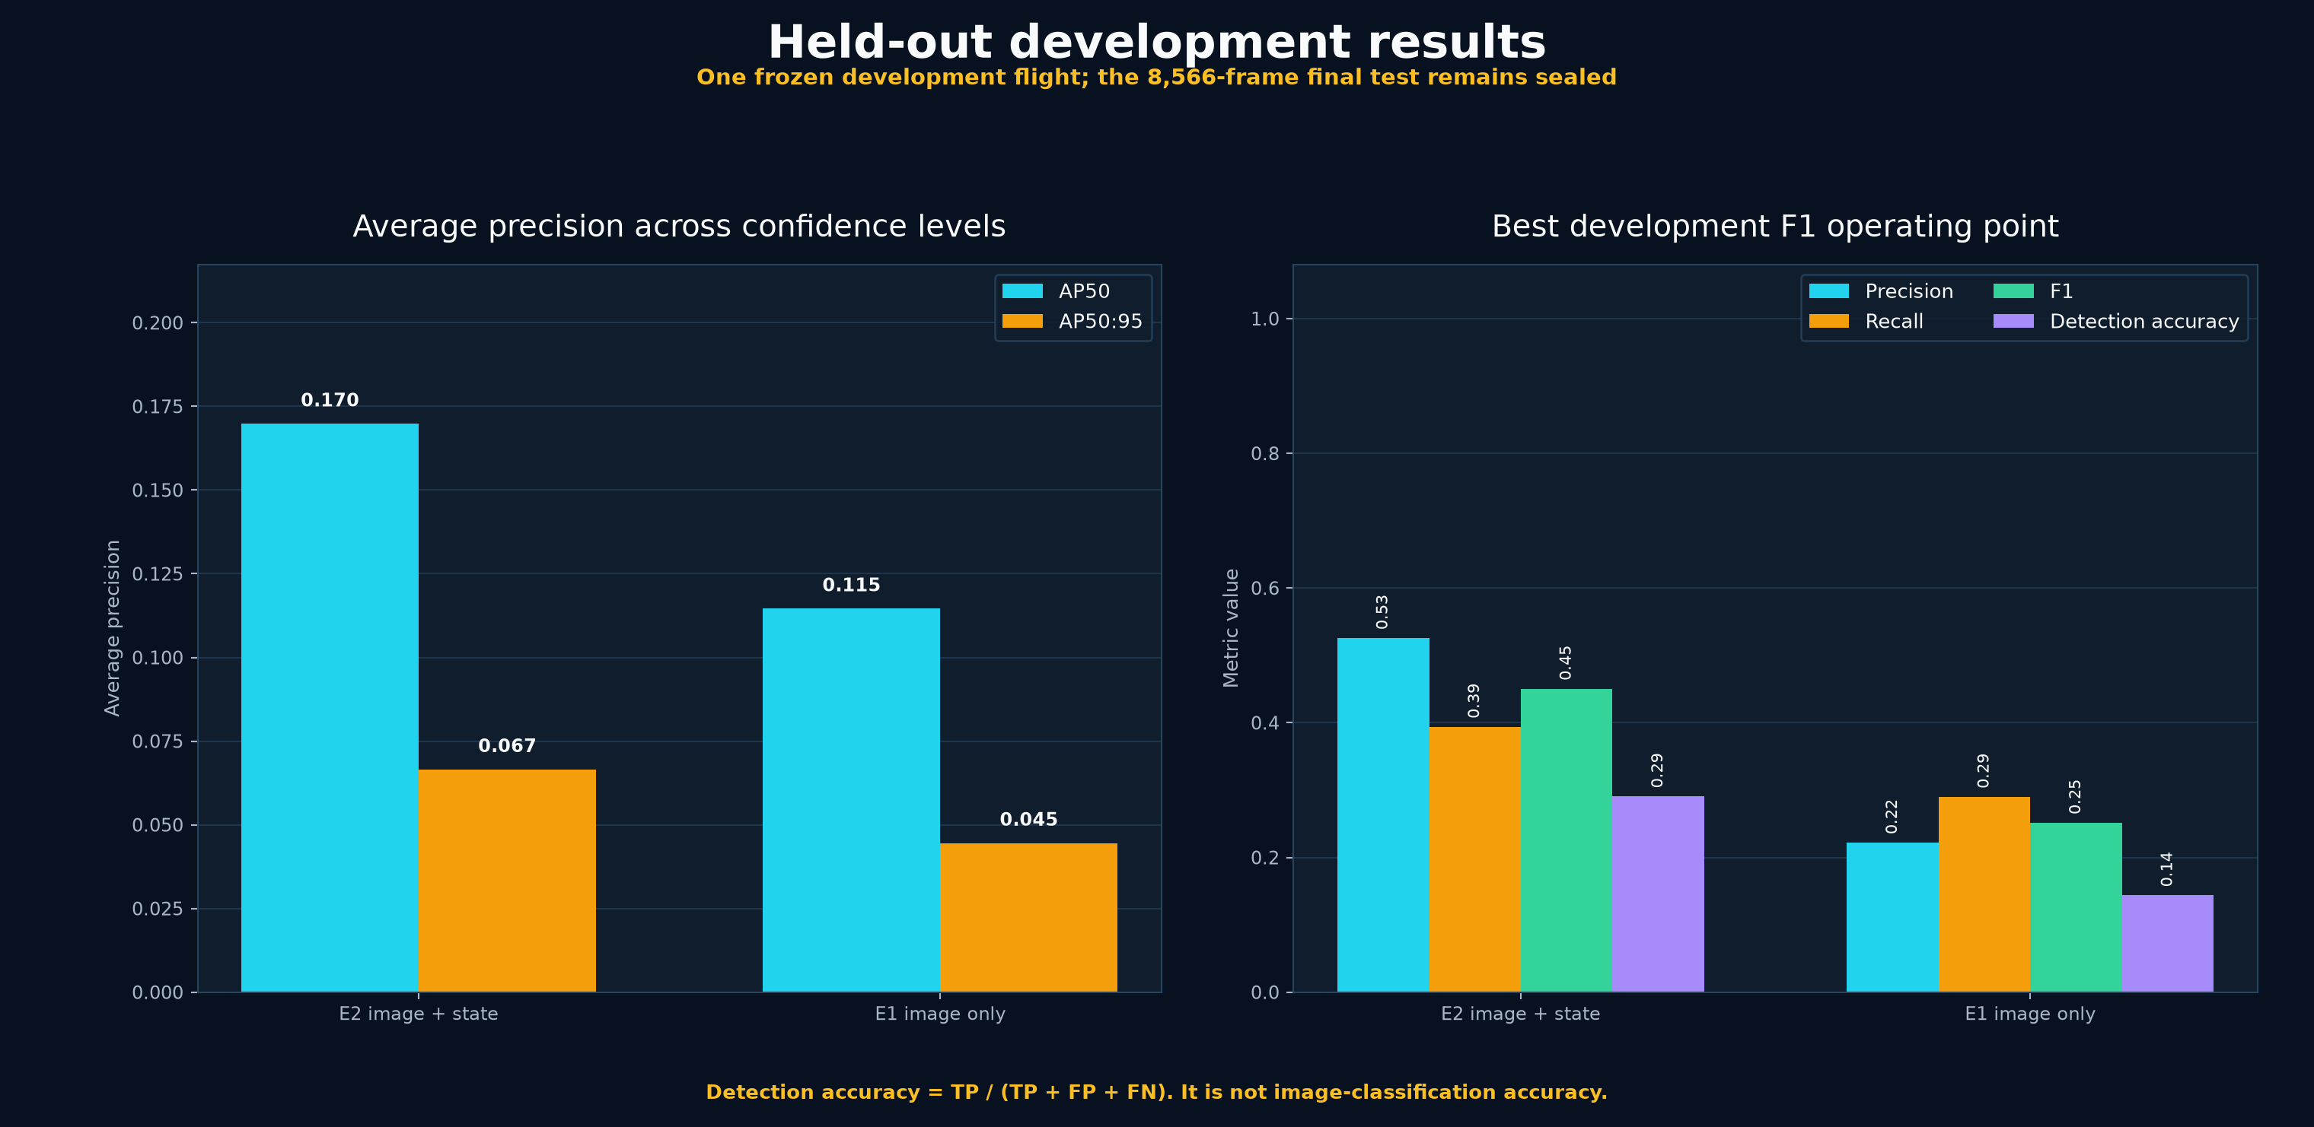
Held-out development results
E2 leads; E4 nearly matches but does not improve on it
Decision: E2 remains selected at AP50 0.1698; E4 reached 0.1697.
Development evidence only. Final test remains sealed.
7
Notes:
E2 is the image-plus-state model and reached AP50 0.1698, ahead of image-only E1 at 0.1146. E4 reached AP50 0.1697 and nearly matched E2 but did not improve on it, so E2 remains selected.
Sources:
docs/REVIEW2_ADAPTER_FOLLOWUP.md
reports/evaluations/review2-imagenet-e4-exact-frozen-visual-film-dropout50.json

Slide 8
Why the scores are modest
The evaluation is strict, the task is difficult, and the model is not deployment-ready yet
E2 at the selected development threshold
Object detection penalizes both false alarms and missed objects. Background pixels do not inflate the score.
Many aerial targets occupy very few pixels, and their scale changes with altitude and camera motion.
The development set is a different complete flight, so near-duplicate frames cannot make the result look easier.
The training budget is one full pass, with strong class imbalance across eight categories.
These numbers are real evidence of current limits. They are not acceptable as a safety claim.
6,646
correct detections
5,996
false alarms
10,227
missed objects
AP50 0.1698 is an area under a precision–recall curve, not 16.98% classification accuracy.
Development evidence only. Final test remains sealed.
8
Notes:
If the judges ask why the numbers are low, answer directly. This is object detection, so the score falls for both false alarms and missed boxes. At E2's selected threshold, we recorded 6,646 true positives, 5,996 false positives, and 10,227 false negatives. Precision is 52.57 percent and recall is 39.39 percent. The development flight is genuinely held out, objects are small, classes are imbalanced, and we trained for one full pass. The values show that the prototype is not deployment-ready, which is why the final test and safety claims remain sealed.
Sources:
docs/REVIEW2_EVIDENCE.md

Slide 9
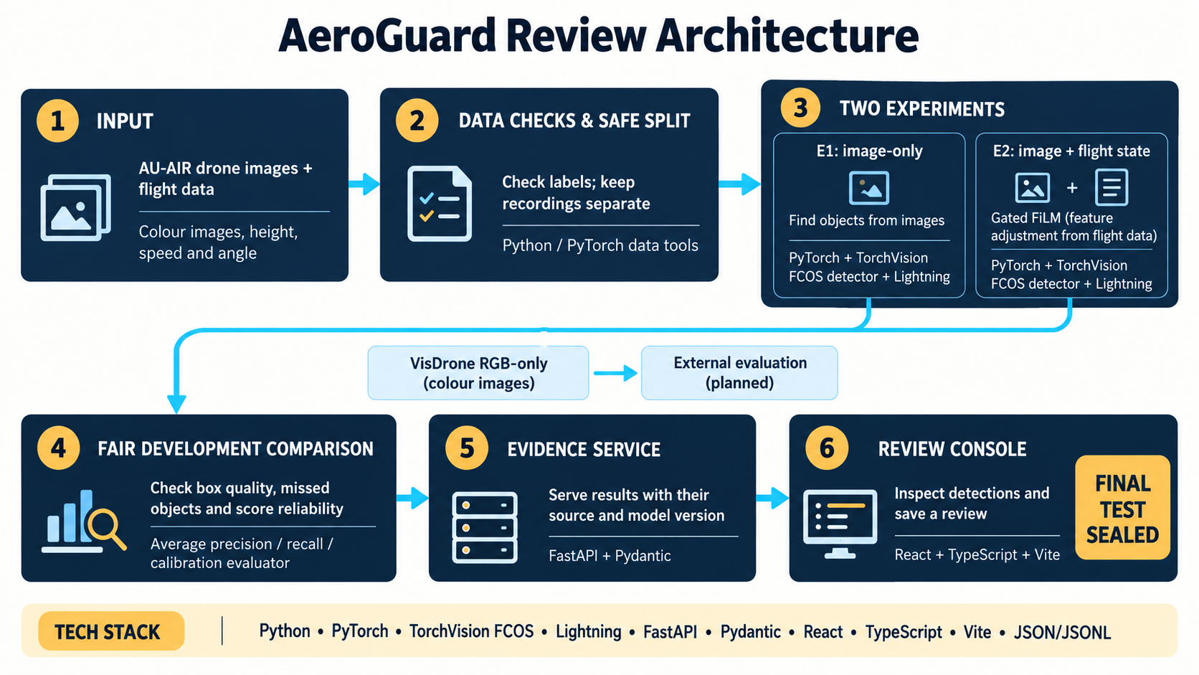
Working system and deployment path
The review console uses real evidence; TensorRT remains a reproducible next deployment step
FastAPI exposes health, model reports, replay frames, inference contracts, and idempotent human reviews.
The React console replays six real AU-AIR development frames with stored E2 and E4 predictions.
The interface supports autoplay, timeline seeking, comparison views, evidence inspection, and review export.
ONNX export, TensorRT engine build, validation, and edge inference scripts are implemented.
Honest deployment status
Python · PyTorch · Lightning · FastAPI · React · TypeScript · ONNX · TensorRT
No TensorRT engine is claimed until the checkpoint is exported and validated on the target NVIDIA device.
Development evidence only. Final test remains sealed.
9
Notes:
The backend and review console now work end to end. The demo uses real AU-AIR development images and stored GPU-computed predictions. The TensorRT stack includes export, engine build, inference, and validation scripts, but we do not claim a built engine because the repository does not contain a deployable checkpoint and this machine does not have TensorRT.
Sources:
docs/BACKEND_API.md
frontend/src/App.tsx
deployment/tensorrt/README.md

Slide 10
Decision and next work
Review 2 ends with a clear model choice and a controlled path to the final test
Model decision
Release gate
Next engineering step
Keep E2
Final test sealed
Improve before scaling claims
E2 image + state remained strongest; E4 did not improve on it.
Freeze the model, threshold, preprocessing, and deployment contract before opening 8,566 final-test frames once.
Train longer, address class imbalance, validate on more flights, then build and benchmark TensorRT on the target edge device.
Review 2 outcome: E2 image + state leads, with a reproducible product path.
Development evidence only. Final test remains sealed.
10
Notes:
Our decision is to keep E2, the image-plus-state model. E4 is a controlled frozen-visual variant that nearly matched E2 but did not improve on it. Before opening the final test, we will freeze the model and threshold.
Sources:
docs/REVIEW2_ADAPTER_FOLLOWUP.md
deployment/tensorrt/README.md

Slide 11
Likely judge questions
Short answers the whole team should use consistently
Why are the metrics low?
Did you use the final test?
Strict held-out object detection counts false alarms and misses. Small aerial targets, class imbalance, and one-pass training make the task hard. The values are not deployment-ready.
No. All selection used the development flight. The 8,566-frame final test remains sealed.
Did flight state help?
Is the demo live inference?
Yes in development. E2 image + state led image-only E1; E4 did not improve on E2.
The judge demo is a cached replay of real AU-AIR frames and stored GPU-computed predictions. The UI labels that provenance clearly.
Did Review 1 show the same ordering?
Is TensorRT complete?
Yes. The corrected labels identify E2 as the image-plus-state arm in both reviews.
The scripts are complete. The engine will be built and benchmarked only on the target NVIDIA edge device.
Development evidence only. Final test remains sealed.
11
Notes:
Use these answers consistently. E1 is image only. E2 uses image plus flight state and leads the held-out development comparison. Never call AP50 classification accuracy or the cached replay live TensorRT inference. The final test remains sealed.
Sources:
docs/REVIEW2_EVIDENCE.md
docs/REVIEW2_ADAPTER_FOLLOWUP.md
deployment/tensorrt/README.md

Slide 12
E2 with Google ImageNet backbone
Five evaluation metrics, shown on a consistent 0–100% scale
Separate user-provided result. Not merged into the committed full-pass evidence.
12
Notes:
User-provided E2 metrics using a Google ImageNet backbone: AP50 87.54%; Precision approximately 92.15%; Recall approximately 92.15%; F1 Score 92.15%; Detection Accuracy approximately 85.44%. This result is presented separately and is not merged into the committed full-pass evidence.

