Slide 1




AEROGUARD
FINAL REVIEW: FLIGHT-AWARE AERIAL OBJECT DETECTION
CODE CORTEX 3.0 | CODE CORTEX 3.0 | CODE CORTEX 3.0 | CODE CORTEX
CODE CORTEX 3.0 | CODE CORTEX 3.0 | CODE CORTEX 3.0 | CODE CORTEX
Notes:
Good morning. AeroGuard is a supervised aerial perception and evidence-review system.
This final review covers the complete data split, selected detector, measured test results, working product, and edge deployment path.

Slide 2
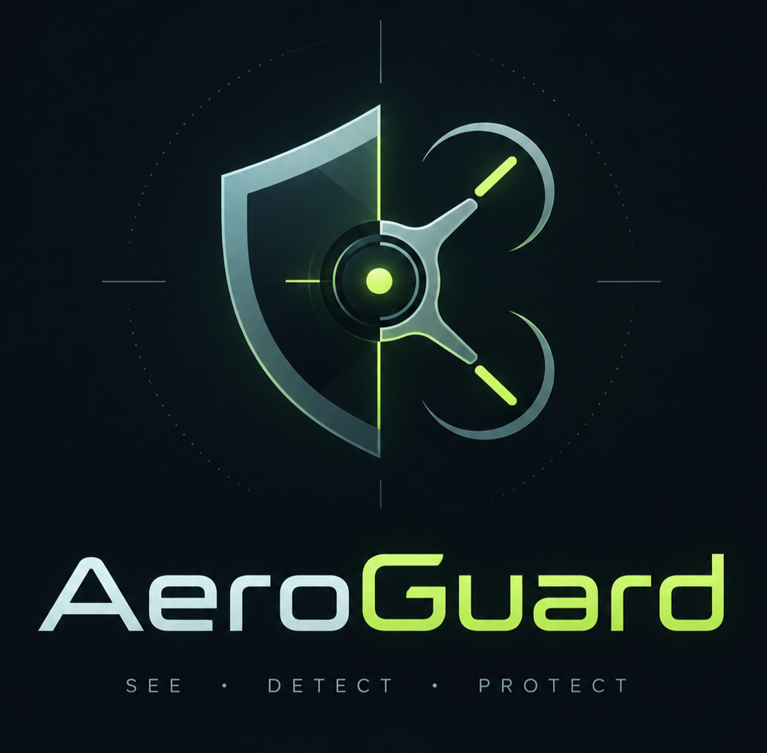
Team Details
PROJECT
AeroGuard
Team name ______________________________
Team members ______________________________
Faculty mentor ______________________________
Department ______________________________
Notes:
Fill the blank team details before presenting.
Do not add names or affiliations unless the team confirms them.

Slide 3
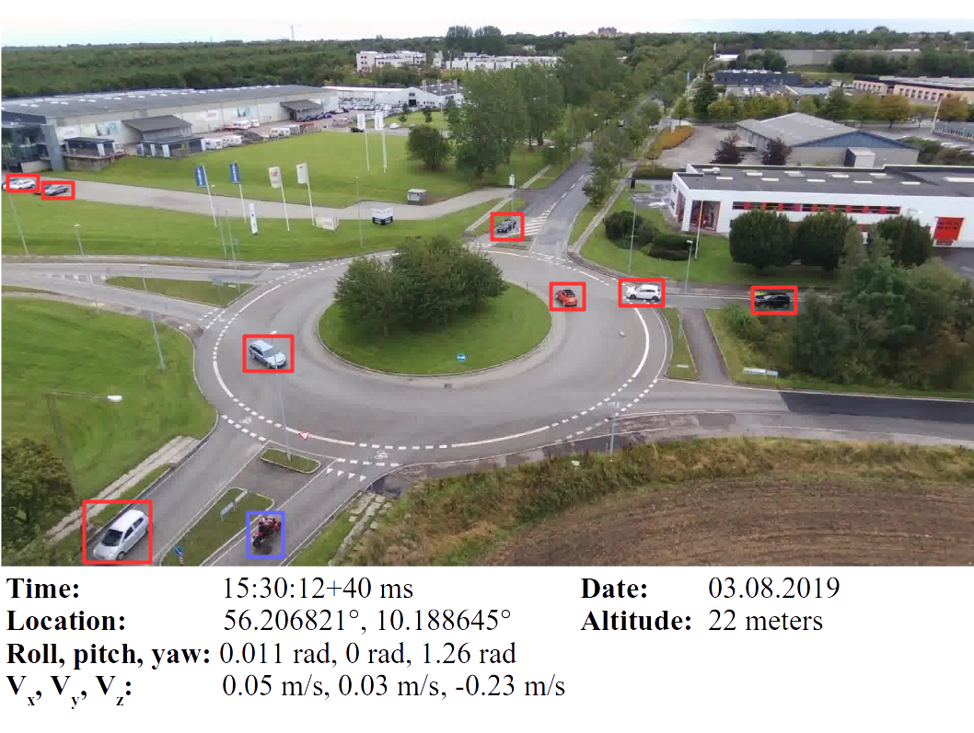
Problem and Dataset
Small targets under a moving camera
Cars, bicycles and people may occupy only a few pixels.
Altitude, orientation and motion change object scale and appearance.
Random frame splits can leak neighboring video frames into evaluation.
AU-AIR EVIDENCE
32,823 frames
131,977 valid boxes
8 object classes
RGB images with flight telemetry
Notes:
Aerial detection is difficult because small targets and camera motion reduce visual detail.
AU-AIR contains 32,823 frames and paired flight metadata.
We split by complete flight recording so nearby frames do not leak between training and evaluation.
Source: repository README and reports/final split manifest.

Slide 4
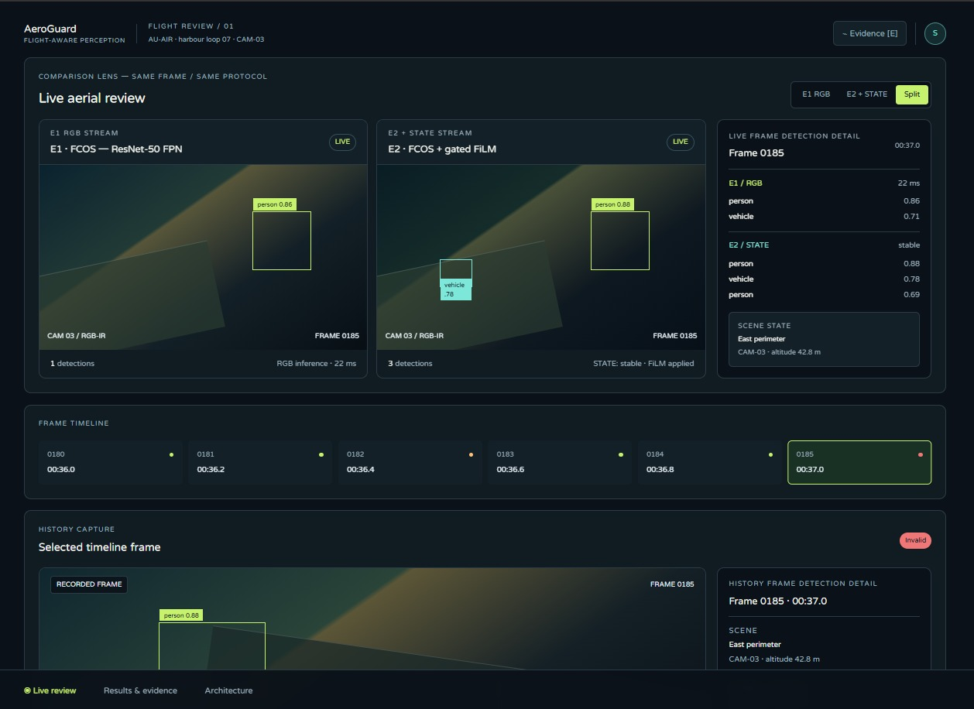
AeroGuard Solution
A detector plus an evidence workflow
Detect road users in real drone frames.
Keep model version, frame metadata and prediction provenance together.
Compare outputs and inspect failure cases in a review console.
Store the human decision and review comment through the API.
Scope: supervised review. AeroGuard does not control the drone.
Notes:
The product connects detections to evidence that a human can inspect.
The console uses real AU-AIR frames and stored predictions for the demonstration.
The software path includes a FastAPI evidence service and a React review console.

Slide 5
Final Benchmark Evidence
YOLO26s at 960 px, 9.95M parameters, selected on validation AP50–95
Frozen final-test metric | Result
AP50 | 0.2083
AP50–95 | 0.0852
Precision | 29.69%
Recall | 47.41%
F1 | 36.51%
Detection accuracy | 22.33%
Total test loss | 4.2918
TP / FP / FN | 3,640 / 8,621 / 4,038
Split by complete recordings: 28,281 train, 2,962 validation, 1,580 test
Flight-state smoke result: +0.00028 AP50. The branch did not pass its promotion gate.
Notes:
The selected detector was chosen only from the validation flight.
The training loss fell from 4.3787 to 3.7025 and validation loss fell from 4.2927 to 4.0184.
On the frozen final test, AP50 was 0.2083, recall was 47.41 percent, F1 was 36.51 percent, and total loss was 4.2918.
AP50 measures the area under the precision-recall curve when predicted and labelled boxes overlap by at least 50 percent.
The flight-state smoke test did not pass its predeclared gate, so we did not scale that branch.
Source: reports/final/benchmarks/yolo26s-960 and reports/final/state-hypothesis.

Slide 6
Architecture
Final detector and evidence pipeline
AU-AIR input
RGB frame
Flight telemetry for research
Safe data protocol
Training, validation and test
Grouped by complete recording
Selected model
YOLO26s
960 px, pretrained
Model output
Boxes, classes and scores
Loss and detection metrics
Evidence service
FastAPI and Pydantic
Provenance and review records
Edge path
ONNX and TensorRT scripts
Jetson benchmark pending
Review console
React and TypeScript
Real-frame replay
Research branch: FCOS with gated FiLM tested image plus flight state. The final smoke gate did not justify a larger run.
Notes:
The final benchmark uses a pretrained YOLO26s detector at 960 pixels.
The evidence service keeps predictions, frame metadata, model identity and human review together.
The separate FCOS plus FiLM architecture tested whether flight state helped. Its final split smoke gate did not pass.

Slide 7
Tech Stack
MACHINE LEARNING
DATA AND EVALUATION
PRODUCT AND DEPLOYMENT
Python
PyTorch
Ultralytics YOLO26
TorchVision FCOS
PyTorch Lightning
AU-AIR dataset
Recording-grouped splits
AP50 and AP50–95
Precision, recall and F1
JSON, JSONL and CSV evidence
FastAPI and Pydantic
React, TypeScript and Vite
ONNX export
TensorRT build and validation
NVIDIA Jetson target
GPU training used both Kaggle Tesla T4 GPUs. The selected checkpoint is 20.3 MB.
Notes:
The main detector benchmark used pretrained YOLO models and mixed precision on Kaggle T4 GPUs.
The research branch used TorchVision FCOS, gated FiLM and PyTorch Lightning.
FastAPI provides the evidence service. React and TypeScript provide the review console.
ONNX and TensorRT scripts form the Jetson deployment path.

Slide 8
Deployment and Business Path
COMPLETED
BUSINESS DETAILS TO CONFIRM
Leakage-safe full-data benchmark and selected checkpoint.
FastAPI backend with health, inference, replay and review endpoints.
React review console with real AU-AIR frames.
ONNX export, TensorRT build, validation and inference scripts.
Primary customer __________________________
Main use case __________________________
Delivery model __________________________
Pricing __________________________
Current product position
BEFORE DEPLOYMENT
A research prototype for supervised aerial detection review. No autonomous-flight or safety-certification claim.
Build the FP16 engine on the target Jetson. Validate output parity. Measure latency, memory and thermal behavior.
Notes:
The software and reproducibility path are complete, but the Jetson engine benchmark remains pending.
TensorRT engines depend on the target GPU and TensorRT version, so we will build and measure on the actual Jetson.
The team must fill the customer, use case, delivery model and pricing fields before presenting a business claim.

Slide 9
THANK
YOU
AeroGuard
Questions
github.com/saran-gangster/code-cortex
Notes:
The final outcome is a measured detector baseline, a working evidence-review system, and a reproducible edge path.
Thank the judges and invite questions.

