Slide 1
REVIEW 1 · SETUP & ARCHITECTURE
AeroGuard
Flight-aware object detection for aerial road scenes
Can the drone’s own height, motion and orientation help the detector find more small objects?
TEAM CODE CORTEX
AU-AIR dataset · supervised offline review
Notes:
Opening: AeroGuard tests one simple question—does paired flight state help the same aerial detector? This is a Review 1 setup and architecture deck.

Slide 2
02 / 09
The problem
02 / 09
Small aerial objects are easy to miss, and the camera view changes as the drone moves.
A detector usually sees only pixels.
AeroGuard’s idea
From the air, a person or vehicle may occupy only a tiny part of the frame. The same object can look different when height, speed or camera angle changes.
Keep the same object detector, then give one version eight flight values that describe how the drone is moving.
E1 image only
E2 image + flight state
Goal: a fair comparison where the flight state is the only controlled difference.
Notes:
Source: project README and docs/REVIEW1_OVERVIEW.md. Explain that AeroGuard is for supervised offline review, not autonomous flight control.

Slide 3
03 / 09
Dataset: AU-AIR at a glance
03 / 09
Each frame pairs a road image with object boxes and flight information.
32,823
131,977
8
1920 × 1080
total RGB frames
valid object boxes
object classes
image size
Data split
TRAIN 18,523
DEV 5,734
SEALED TEST 8,566
Classes
Human
Car
Truck
Van
Motorbike
Bicycle
Bus
Trailer
The final-test recordings stay sealed until the model and threshold are frozen.
Notes:
Sources: docs/DATA_CARD.md; manifests/build_summary.json; manifests/protocol.json; AU-AIR paper https://arxiv.org/abs/2001.11737. Project validation found 32,823 frames, 131,977 valid boxes after rejecting 54 invalid boxes, and the split 18,523 / 5,734 / 8,566.

Slide 4
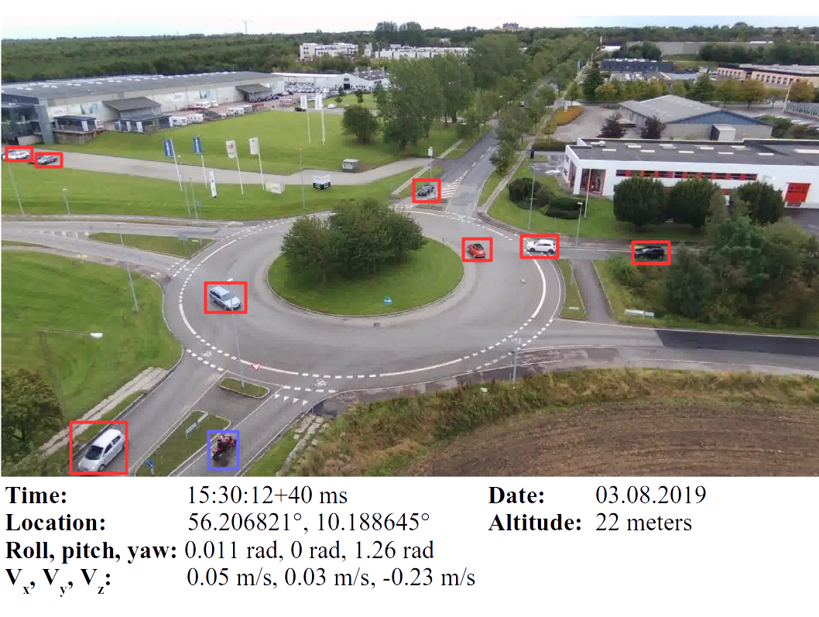
04 / 09
What one AU-AIR sample looks like
04 / 09
A sample is more than an image: labels and flight measurements travel with the frame.
Object labels
BOUNDING BOX
A rectangle that tells the model where an object is and which class it belongs to.
The red and blue rectangles in the real frame are the labels.
Flight information
Altitude 22 m
Velocity 0.05, 0.03, −0.23 m/s
Roll / pitch / yaw 0.011, 0, 1.26 rad
These values describe the drone at that moment.
Notes:
Official AU-AIR sample image source: https://raw.githubusercontent.com/bozcani/bozcani.github.io/master/assets/images/intro.png ; dataset page: https://github.com/bozcani/bozcani.github.io/blob/master/auairdataset.html. The red/blue boxes and metadata are part of the official example.

Slide 5
05 / 09
The features we give the model
05 / 09
A feature is simply a piece of information the model can use.
RGB IMAGE
What the camera sees
Road, people, vehicles, shadows and background.
1 VALUE
Height
NOT FED TO THE MODEL: GPS position · date/time · filename · platform clues
How high the drone is above the scene.
3 VALUES
Velocity x / y / z
How the drone is moving in three directions.
4 VALUES
Roll, pitch, sin(yaw), cos(yaw)
How the drone is tilted and facing. Sine/cosine avoids the 360° wrap-around problem.
Notes:
Sources: configs and docs/MODEL_CARD.md. E2 uses exactly eight flight values: altitude, velocity x/y/z, roll, pitch, sin(yaw), cos(yaw). GPS, timestamp, filename and platform identity are excluded from the model input to reduce shortcut learning.

Slide 6
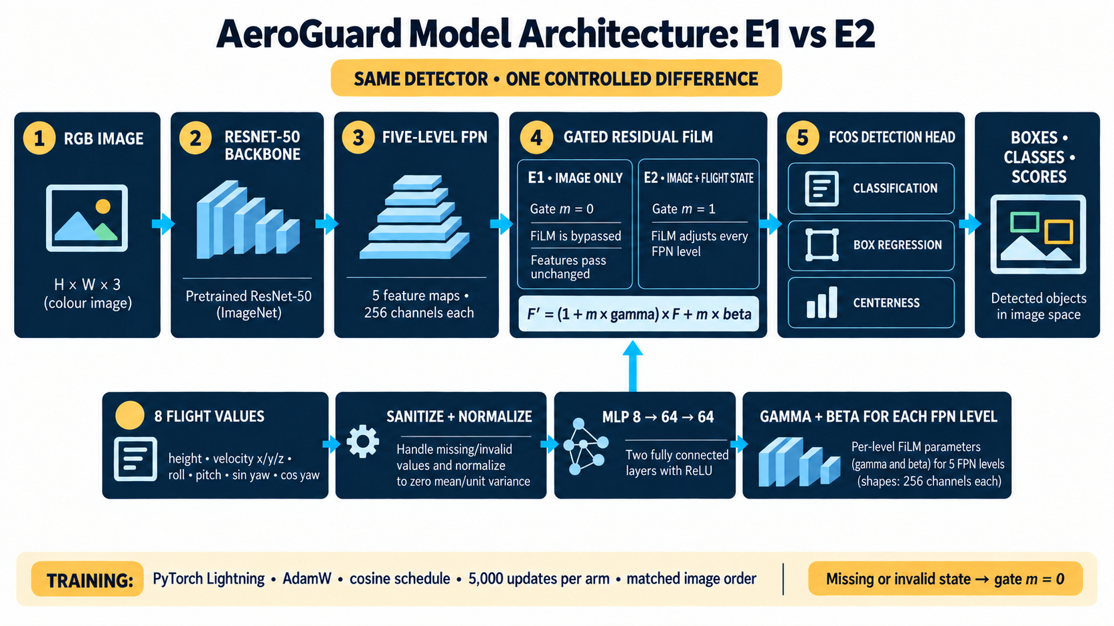
06 / 09
Notes:
Model source: docs/REVIEW1_ARCHITECTURE.md and the implemented TorchVision FCOS adapter. Both paths share an ImageNet-initialized ResNet-50 FPN and FCOS head. E1 bypasses FiLM. E2 encodes eight flight values with an 8→64→64 MLP and applies gated FiLM at five FPN levels. Missing or invalid state sets the gate to zero.

Slide 7
07 / 09
Early development result
07 / 09
One frozen development recording. The final test remains sealed.
Recall
How many labelled objects were found at the fixed confidence setting.
AP50
E1
E2
E1 · image only
1.20%
6.92%
33.3% · 5,624 / 16,873
E2 · image + flight state
AP50 rewards boxes that overlap the correct object by at least half, across different confidence cut-offs.
49.3% · 8,322 / 16,873
These scores are still low. This is early Review 1 evidence, not a production claim.
+2,698 more annotated objects found
Notes:
Source: docs/REVIEW1_SUBMISSION.md and frozen development evaluation reports. ImageNet E1: AP50 0.0120, recall 0.3333, 5,624 / 16,873 objects. ImageNet E2: AP50 0.0692, recall 0.4932, 8,322 / 16,873 objects. These are non-final development results.

Slide 8
08 / 09
Review 1 is a controlled first pass
08 / 09
Every run used the same small training budget so the comparisons stay fair.
5,000
18,523
updates per model run
training frames available
Batch size 1
Random E1
5,000 updates
32,823
Random E2
5,000 updates
frames in the full dataset
ImageNet E1
5,000 updates
Important: 5,000 updates means 5,000 sample presentations per run. Frames may repeat, so this is not 5,000 guaranteed unique images.
ImageNet E2
5,000 updates
AFTER REVIEW 1
Train longer and cover more of the available training split · tune confidence · test missing/corrupted flight state · run the sealed evaluation only after freeze
Notes:
Sources: configs/development_training.yaml, manifests/protocol.json and committed training reports. The configuration records 5,000 optimizer updates per arm with batch size 1. There are 18,523 available training frames and 32,823 total frames. We will scale training length and data coverage after Review 1.

Slide 9
09 / 09
Technology stack and deliverables
09 / 09
Simple tools, clear evidence, and a human review step.
DATA + TRAINING
Python · PyTorch · TorchVision FCOS · Lightning
EVIDENCE SERVICE
FastAPI · Pydantic · JSON / JSONL
REVIEW CONSOLE
React · TypeScript · Vite
Review 1 delivers reproducible code, saved training evidence, a comparison model, evaluation graphs, architecture documentation, an evidence API and a human review console.
Notes:
Sources: README.md, docs/REVIEW1_OVERVIEW.md and docs/REVIEW1_SUBMISSION.md. Do not claim a production database or autonomous flight control. Current evidence storage is local JSON/JSONL plus checkpoints.

