Slide 1
AeroGuard
Review 2 evidence
Full training history, held-out accuracy measures, telemetry stress tests, and a safer adapter experiment
32,823 AU-AIR frames
2 Tesla T4 GPUs
Final test sealed
AeroGuard • supervised offline UAV perception review
1
Notes:
Today we show exactly what changed after Review 1. We trained on the full training split, kept every loss value, measured held-out detection metrics, and tested whether the telemetry branch really helps.

Slide 2
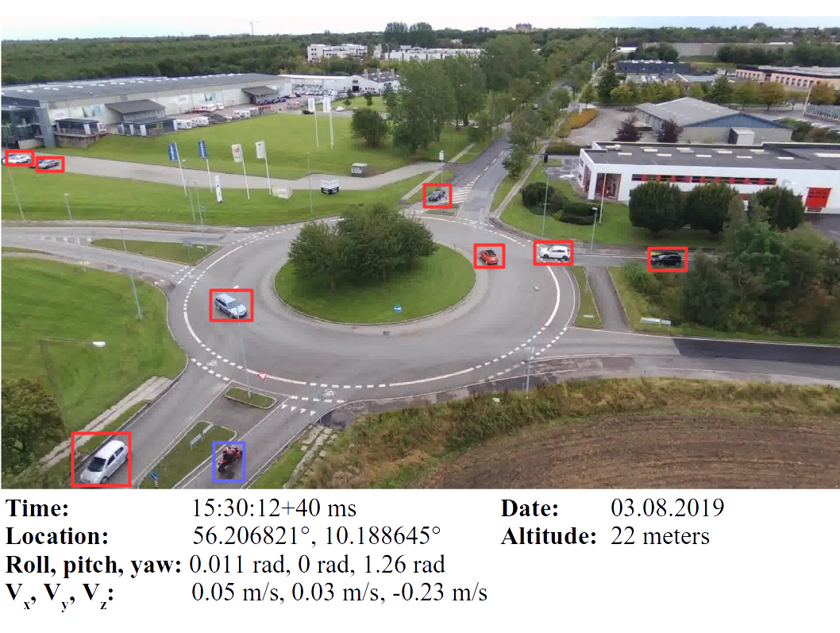
The problem
Small road users are hard to detect from a moving drone
Aerial objects are small and change scale as the drone moves.
Normal image detectors ignore flight height, speed, and orientation.
AeroGuard tests whether correctly paired flight state improves detection.
A human reviews every result. The system never controls the drone.
Eight object classes
Human, car, truck, van, motorbike, bicycle, bus, trailer
Development evidence only. Final test remains sealed.
2
Notes:
The image is an official AU-AIR sample. The dataset gives RGB frames, boxes, and flight state. Our question is narrow: does the paired state improve object detection on a different flight recording?

Slide 3
Dataset split
Complete flight recordings stay together to prevent near-duplicate leakage
56.43%
training
17.47%
development
26.10%
sealed test
Development evidence only. Final test remains sealed.
3
Notes:
The total is 32,823 frames. We use five recordings for training, one complete recording for development, and two recordings for the final test. We split by flight rather than random frames because neighboring video frames look almost identical.

Slide 4
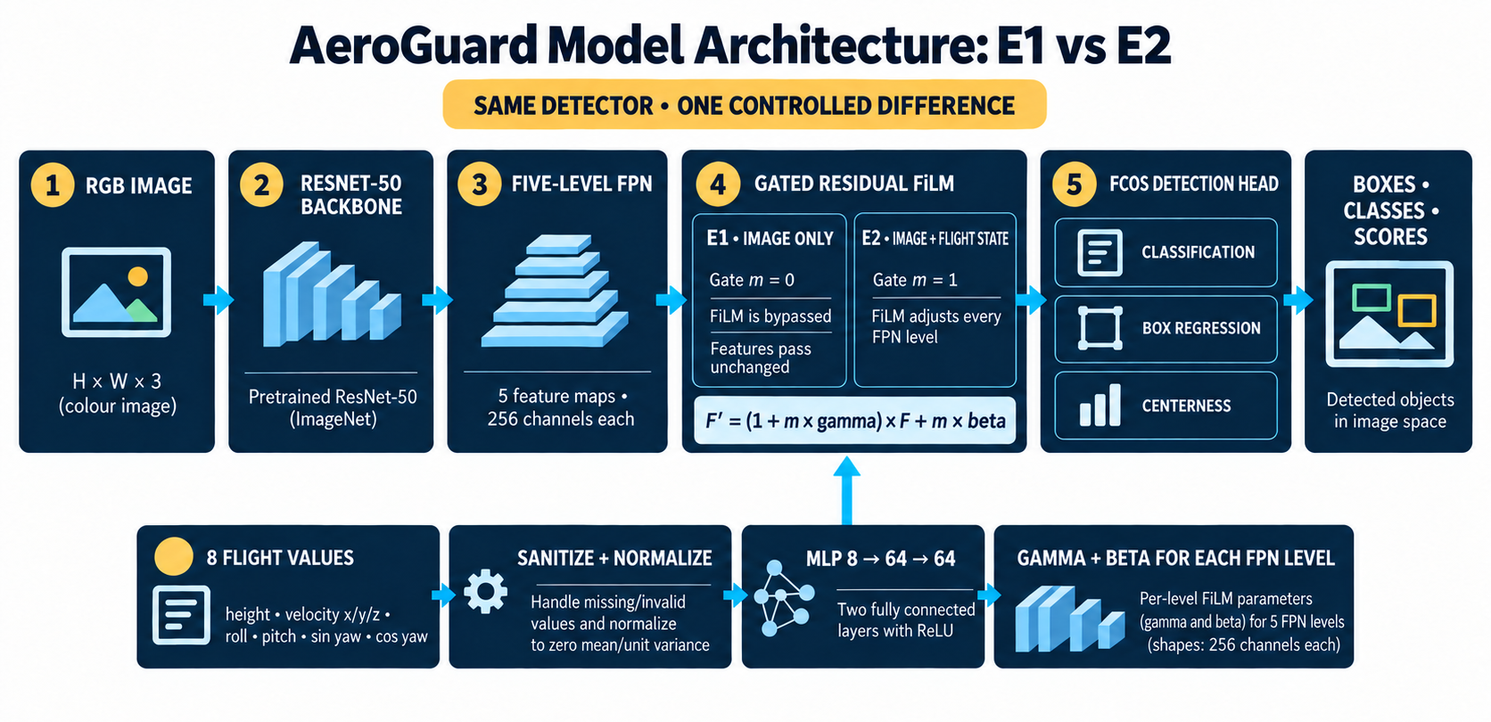
Matched model architecture
E1 and E2 share the same detector, initialization, and frame order
Review 2: 18,523 steps per arm. E1 masks state. E2 applies gated FiLM to five feature levels.
Development evidence only. Final test remains sealed.
4
Notes:
Both arms use FCOS with a ResNet 50 feature pyramid. E1 receives a zero state mask. E2 receives normalized altitude, velocity, roll, pitch, and yaw. The FiLM branch starts as an exact identity, so both models begin from the same visual detector.

Slide 5
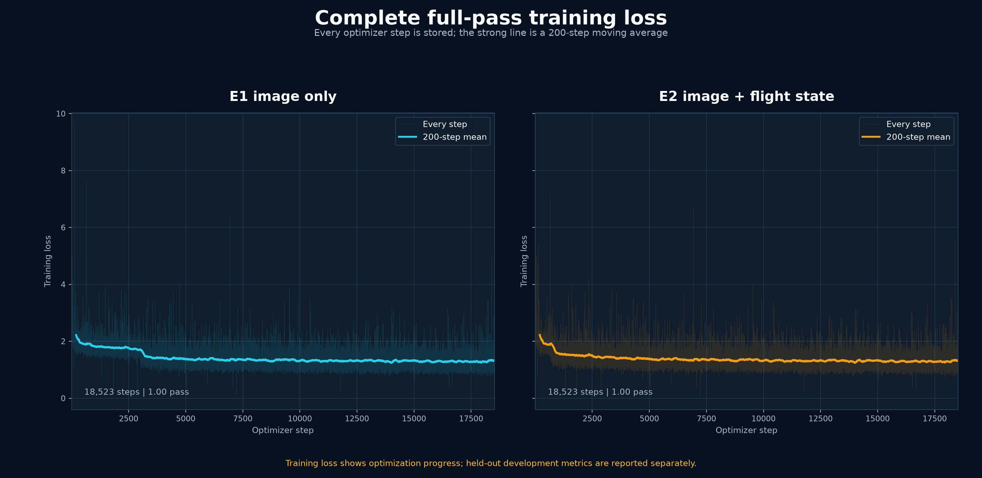
Complete training record
Every optimizer step is stored for both full-pass runs
18,523 steps each
100% training coverage
47.6 minutes in parallel
Development evidence only. Final test remains sealed.
5
Notes:
Review 1 used 5,000 training samples per arm. These runs scale to all 18,523 training frames, one complete pass. The faint lines contain every stored loss value. The stronger lines are 200 step moving averages only for readability.

Slide 6
Held-out development results
The full pass improved both models, but E1 now leads the jointly trained E2
E1
AP50 0.1698
F1 0.4503
Accuracy 0.2906
E2
AP50 0.1146
F1 0.2515
Accuracy 0.1438
Accuracy means TP / (TP + FP + FN)
Development evidence only. Final test remains sealed.
6
Notes:
At the best development threshold, E1 found 6,646 correct objects with 5,996 false alarms and 10,227 misses. Detection accuracy is TP divided by TP plus FP plus FN. AP50 measures the whole precision recall curve at 50 percent box overlap.

Slide 7
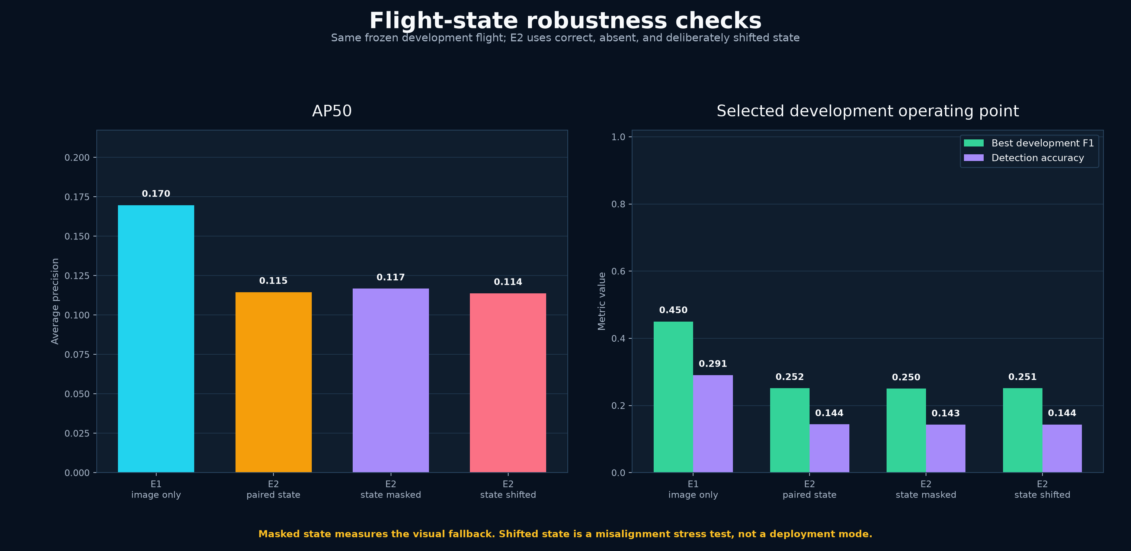
Why E2 fell behind
Correct, absent, and shifted telemetry give almost the same E2 result
Paired
0.1146 AP50
Masked
0.1167 AP50
Shifted
0.1138 AP50
Main finding: joint training changed the visual weights more than the state values changed the output.
Development evidence only. Final test remains sealed.
7
Notes:
This is the key scientific finding. The E2 score barely changes when state is correct, missing, or deliberately shifted by 1,000 frames. The visual branch drifted during joint training. We should preserve the stronger E1 image detector and let state learn only a small residual.

Slide 8
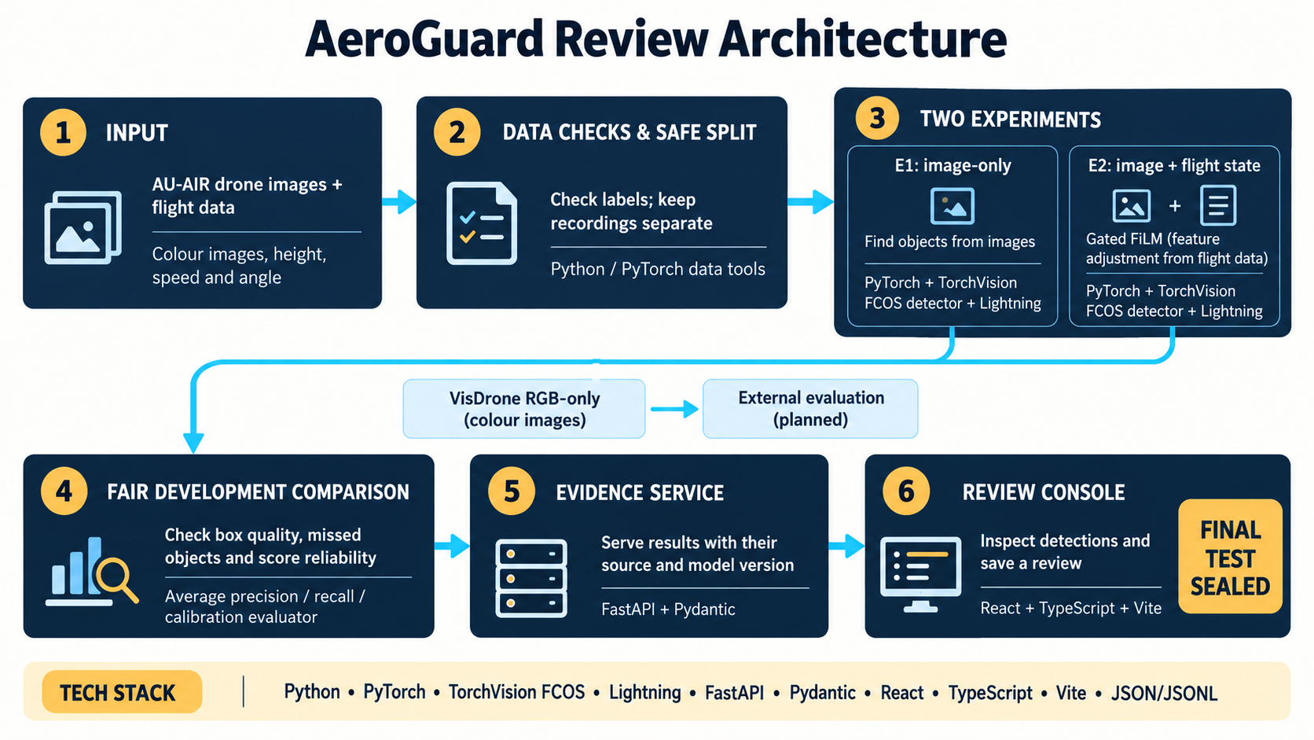
Ready for the next review
Evidence, backend, and a safer telemetry experiment now move in parallel
FastAPI backend is complete for health, reports, inference, replay, and human reviews.
Graphs cover the exact split, every loss step, AP, precision, recall, F1, and detection accuracy.
E3 and E4 freeze the stronger E1 visual detector and train only the state adapter. One adapter also drops state on half the training steps.
The final test remains sealed until the model and threshold are frozen.
Decision rule
Keep E1 unless a frozen-visual adapter beats it on development without weakening the masked fallback.
Development evidence only. Final test remains sealed.
8
Notes:
The backend is ready for UI work now. The new E3 and E4 runs use E1 as the parent, freeze every visual detector weight, and train only the small FiLM adapter. If paired state does not beat E1, we keep E1 and report that the current telemetry does not add reliable value.

