Slide 1

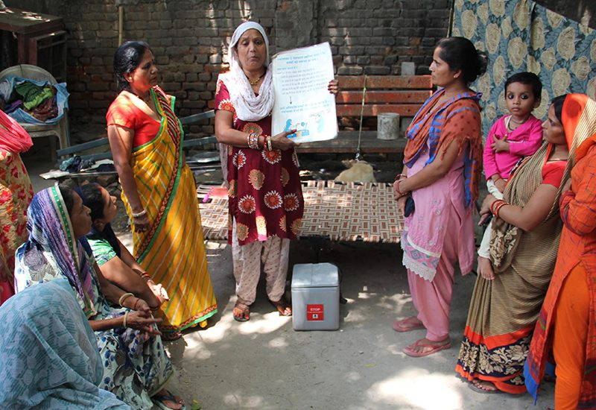
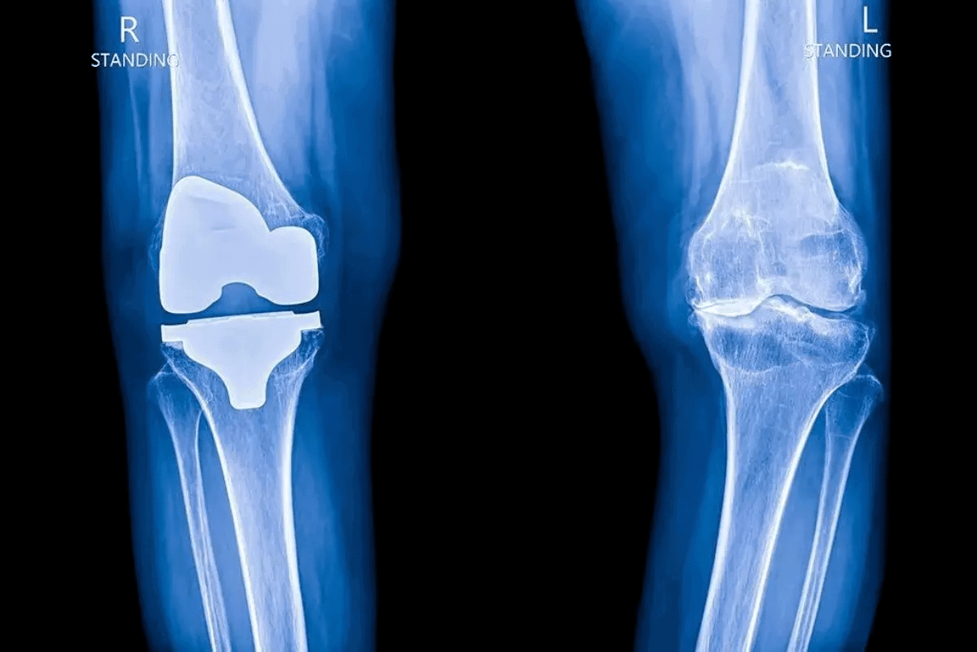
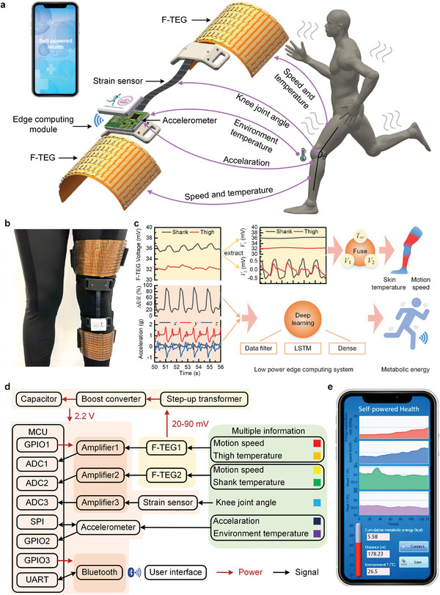
Problem Statement ID: 26004 | Theme: MedTech / Biomedical Devices | Category: Hardware IoT | Team ID: [Your ID]
SAATHI: Low-Cost Tibial Load Screening Node for Rural Knee Health
Point-of-Care Screening Support for ASHA Workers and Primary Health Centres
Designed for Indian Rural Context - Works Without Internet
Core Idea in Simple Words
In villages, knee pain is often ignored as age-related. When patients finally reach district hospitals, joint damage is severe and surgery costs around 3 lakhs, which is unaffordable for farming families.
Village clinics cannot have expensive gait laboratories costing 50 lakhs. Doctors checking patients lying on beds cannot see problems that appear only while walking with load.
Our approach: A small wearable band placed just below the knee on the shin bone. The shin has almost no fat, so the sensor directly feels bone vibrations during walking. It measures how much shock the knee absorbs and how much side pressure occurs.
The band connects to a phone app that works fully offline, asks 8 simple daily-life questions, checks knee bending with camera (without saving video), and gives a color result in 20 seconds: Green (healthy), Yellow (early wear - check in 45 days), Red (needs urgent doctor visit in 14 days).
If there is no internet, the app creates an encrypted QR code that the district doctor can scan offline. When network returns, data automatically goes to the PHC dashboard built by Saran for village-level tracking.
Why This Design Fits India:
• Single band below knee - no need to remove Saree or Dhoti
• Shin placement avoids fat wobble and cloth slipping
• Works like stethoscope for knee - feels bone shock directly
• Total cost: Rs 1,070 prototype, Rs 820 in bulk (99.9% cheaper than lab)
• 100% offline, 8-hour battery, 15-minute training for ASHA
• All real hardware photos used - no AI generated visuals

Slide 2
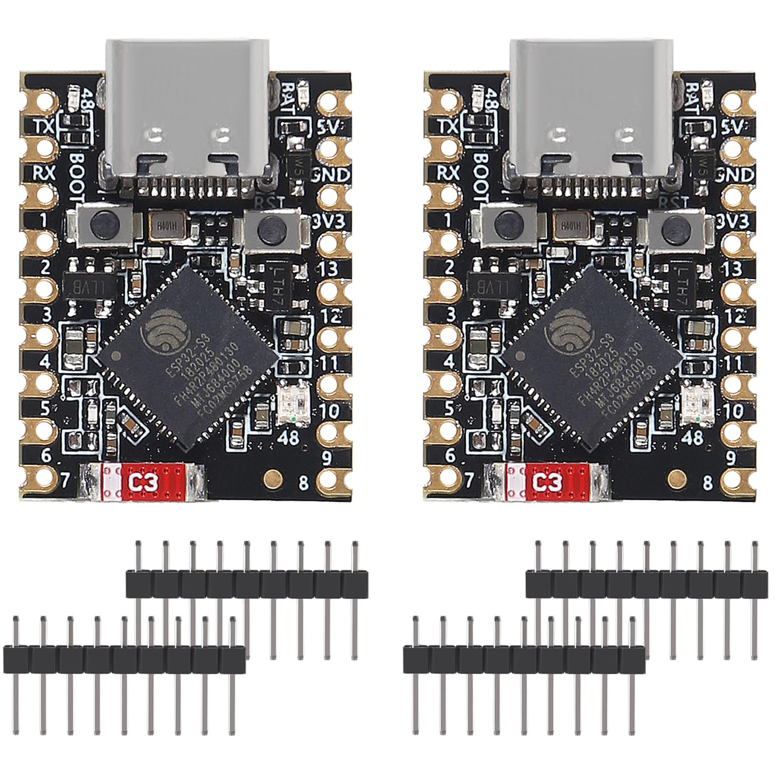
2. Proposed Solution, Approach and Novelty
Proposed Solution - Three Parts (Original Design)
Approach - How We Built It
Part 1 - Wearable Hardware:
• Small band with motion sensor worn 2cm below knee on shin
• Captures walking impact and side twist 100 times per second
• Controller: ESP32-S3 with Bluetooth, Sensor: MPU-6050, Display: 0.96 inch OLED, Battery: 500mAh LiPo with USB-C
• Dual-core processing: one core reads sensor, other handles Bluetooth and display without lag
Step 1: Found gap - bed check misses walking problem, labs too costly, thigh bands slip on Saree
Step 2: Built frugal shin node with 100Hz sampling + offline app with voice guidance
Step 3: Tested doorstep workflow + offline QR + PHC dashboard for real rural use
Part 2 - Mobile App (20 Features, Fully Offline):
• Built with React, works as PWA and Android APK, stores data locally when offline
• Features: Login with demo mode, local language support with voice, dashboard with sync status, 3-step patient registration, BMI auto-calculation, medical history, joint selector, 8 daily-life questions, Bluetooth pairing, 4-step calibration, 30-second walk test with live chart, camera checks for knee bending and chair-stand (no video saved)
• Gives result in 20 seconds: Green/Yellow/Red/Gray with simple numbers for shock, twist, cartilage reserve
Novelty - What Makes It Different (6 Points)
Saree and Dhoti friendly: Below-knee placement means no cloth adjustment needed, comfortable for rural women and farmers
Frugal cost: Rs 1,070 prototype, Rs 820 in bulk production - almost 99.9% less than imported gait labs
100Hz reliable sampling: Dual-core FreeRTOS ensures sensor reading never misses, even when display updates
Part 3 - Referral and Dashboard (Saran's Work):
• Creates encrypted QR code on phone screen containing all test data - doctor scans offline without internet
• When phone gets network, auto-uploads to cloud database (Node.js, PostgreSQL)
• PHC dashboard shows village maps with risk levels, list of high-risk patients needing urgent care, charts of healthy vs wear vs severe, ASHA worker activity, and camp planning
Two meaningful measures: Walking shock absorption and side twisting pressure - both linked to cartilage health in research
Zero-internet QR referral: Encrypted QR carries full test data, district doctor scans offline without cloud
Camera checks without privacy risk: Measures knee bending angle and chair-stand count using on-device tracking, no video stored

Slide 3
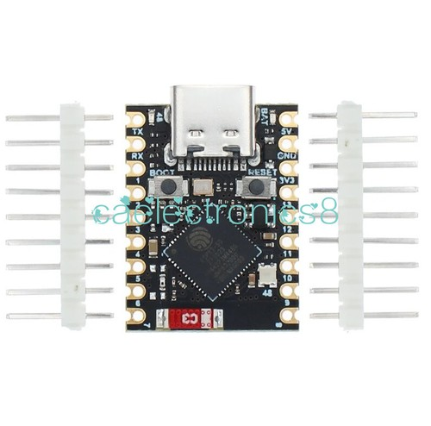
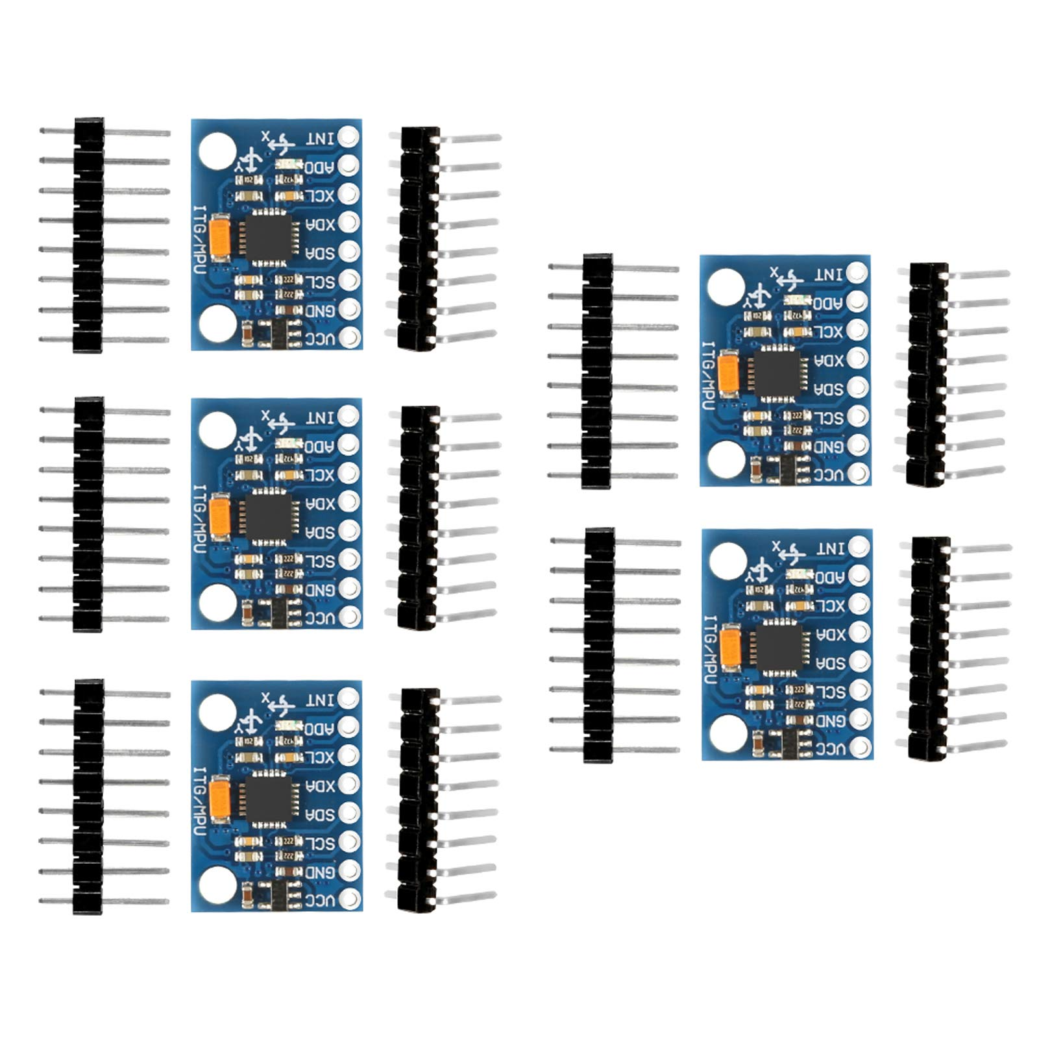
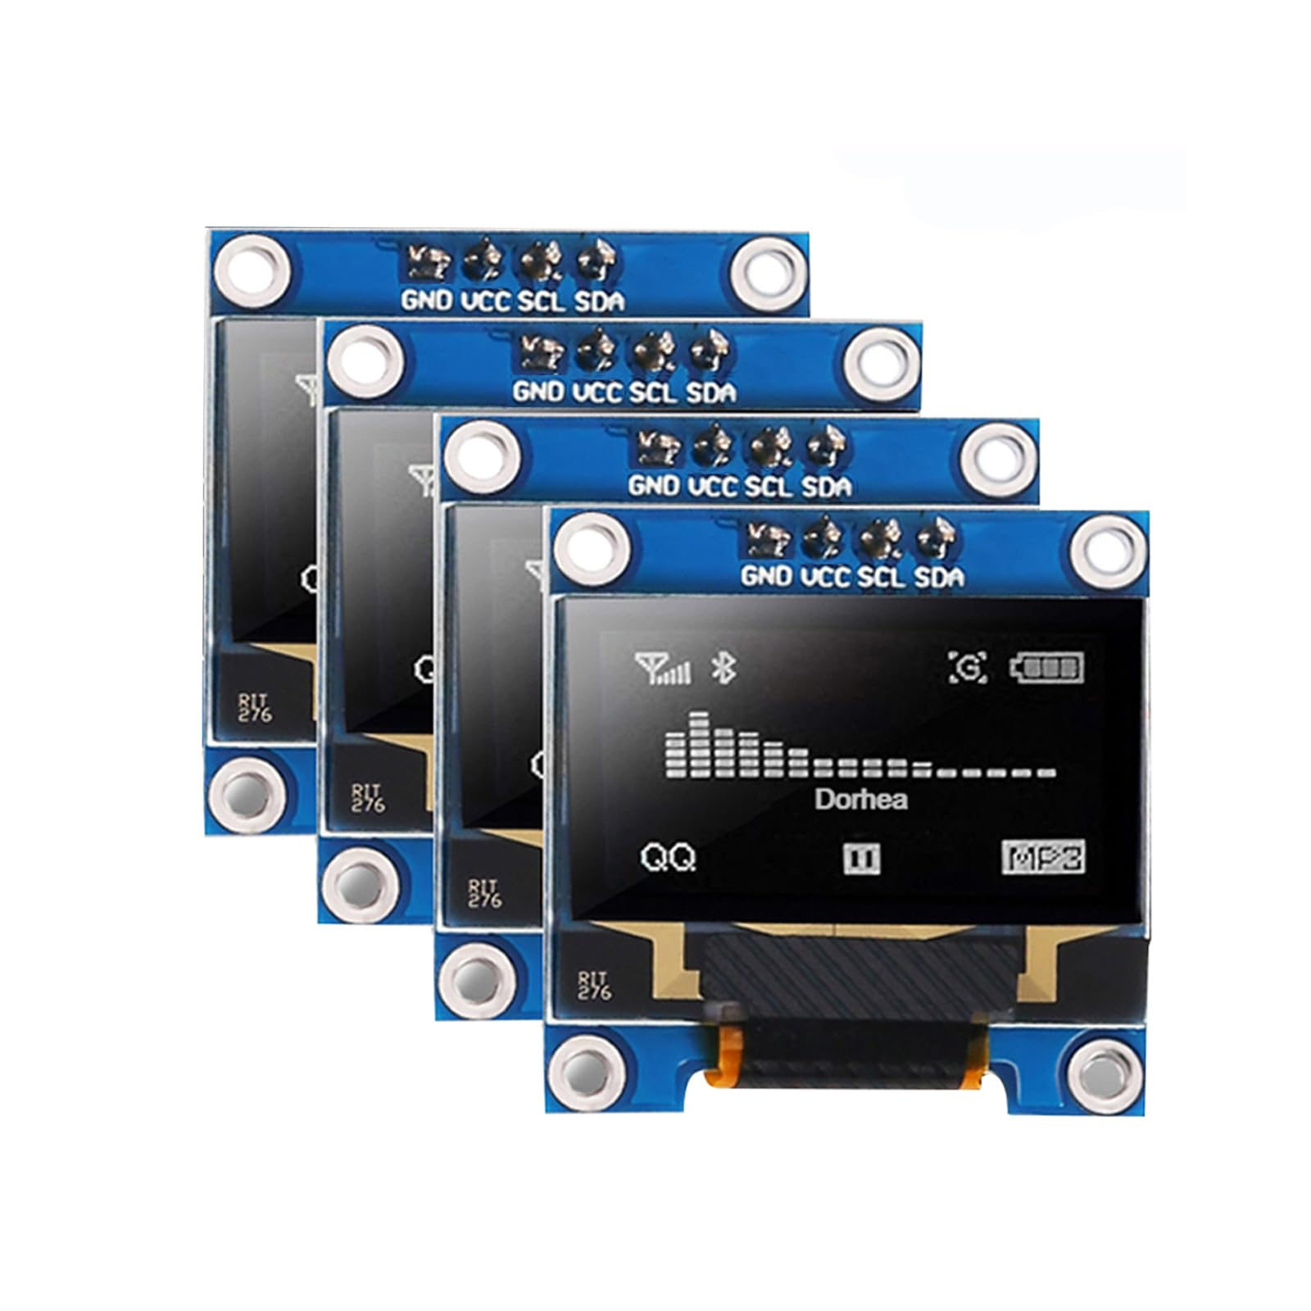
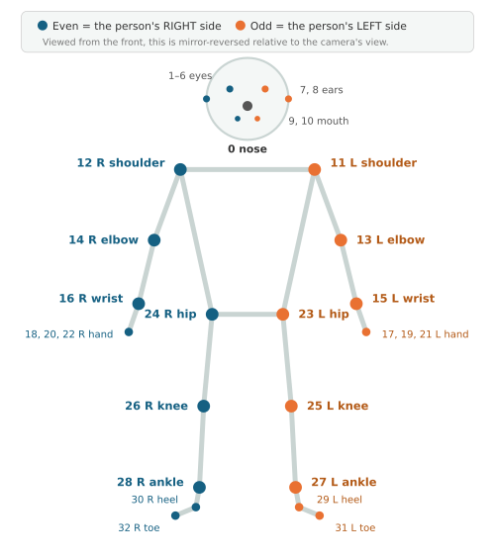


3. Technical Approach - Stack and Workflow
Technology Used (Real Hardware Photos)
Workflow - 6 Steps (Flowchart Made with Shapes - No AI Image)
• Controller: ESP32-S3 SuperMini - small board with dual-core processor and Bluetooth (see real photo)
• Sensor: MPU-6050 - 6-axis motion sensor that measures acceleration and rotation (see real photo)
• Display and Power: 0.96 inch OLED screen for bedside display + 500mAh rechargeable battery with USB-C charging
• Firmware: FreeRTOS with fast I2C communication, uses mutex to avoid display and sensor conflict, sends 16-byte binary data via BLE (1.6 KB/s - efficient)
• App: React-based mobile app that works offline, stores data in IndexedDB, built as Android APK for government phones
• Vision: MediaPipe Pose tracks 33 body points on phone itself to measure knee angle and count chair stands - no video saved or uploaded (see diagram)
• Cloud: Node.js API with PostgreSQL database for PHC dashboard, shows charts and maps
Step 1
Place Band
2cm below knee
on shin bone
Step 2
Read Sensor
100 times/sec
10ms timer
Step 3
Send via BLE
16-byte binary
1.6KB/s efficient
Step 4
Zero Setting
Stand still 3 sec
lock gravity
Step 5
Walk + Camera
30 sec walk test
33 body points
Step 6
Result + QR
Green/Yellow/Red
Encrypted QR
Detailed App Flow - All 20 Features (Original Description)
Login: ASHA worker logs in, can use Demo Mode for testing without account -> Language: Selects Hindi/Bengali/Assamese, app speaks instructions in local tongue
-> Dashboard: Shows greeting based on time, big New Patient button, internet status (Offline/Syncing/Up-to-Date), alert if previous screening interrupted
-> Registration: Enters patient name, age, sex, village, PHC, Health ID (3 steps) -> BMI: Height/weight auto-calculates BMI, flags extra load if BMI>25 mild, >30 heavy
-> History: Past injuries, sports accidents, family history of arthritis -> Records: Searchable list of village patients with past scores and follow-up status
-> Awareness: Illustrated cards in local language explaining joint care, clears myths like should I stop walking?
-> Joint Select: Choose Knee/Hip/Hand/Spine and Left/Right/Both -> 8 Questions: Pain walking/stairs, night pain, morning stiffness, bending difficulty, squat/chair trouble, swelling, clicking sound, duration
-> BLE Pair: One-tap connect to knee band, shows battery %, has simulation mode if phone has no Bluetooth
-> Calibration: 4-step wizard - shows where to strap (upper shin 2cm below knee), patient stands still 3 sec, sensor locks baseline, ready to walk
-> Walk Test: 3 sec countdown, live shockwave chart at 60 FPS, step counter with 380ms filter to avoid double count, pauses if patient doesn't walk for 8 sec
-> Camera Tests: Phone camera tracks 33 body points locally, measures knee bending degrees and counts chair-stand reps in 30 sec, zero video saved
-> Result: Combines symptoms, age, BMI, camera angles, sensor shock into Green/Yellow/Red/Gray in 20 sec -> Numbers: Shows shock absorption Good/Moderate/Severe, side twist pressure, cartilage reserve %, walking rhythm
-> Guidance: Shows exercises per risk level, plays audio in local language, share via WhatsApp/SMS -> Report: Digital report with Patient ID, Screening ID, ASHA name, printable -> QR: Encrypted QR on phone screen with all data, doctor scans offline without internet
-> Sync: Stores safely in phone when offline, auto-uploads when network returns -> Dashboard (Saran): PHC doctor sees village maps, high-risk queue, charts, ASHA activity, camp scheduler

Slide 4
4. Feasibility and Viability - Practical for Rural India
Feasibility - Why It Can Work
Technical Viability
Economic Viability
• Low cost: Rs 1,070 for one unit, Rs 820 when made in 1000 units - uses parts easily available in India, 99.9% cheaper than 50 lakh gait lab
• No cloth issue: Single band below knee works with Saree, Dhoti, Kurta - no need to change clothes, no slipping
• Bone contact: Shin bone has almost no fat, so sensor gets direct bone vibration without soft tissue wobble
• Works without internet: 100% offline operation, encrypted QR for doctor handoff, suitable for tribal and hilly remote areas
• Easy training: 4-step wizard with voice guidance in local language, any ASHA worker can learn in 15 minutes
• Scalable: Uses standard electronics, can be assembled on single PCB for mass production
Dual-core design prevents sensor reading and screen display from blocking each other. Binary data format uses only 1.6KB/s, so no packet loss. MediaPipe runs at 30 FPS on basic Android phones. Mutex ensures 100Hz sampling never drops. Simulation mode allows testing even without Bluetooth hardware. All code is original, built by team.
Prototype costs less than a blood test machine. One PHC can screen thousands of villagers at minimal cost. Prevents expensive surgeries (Rs 3 lakhs) for poor families. Battery lasts full 8-hour workday, charges via common USB-C cable. No recurring cost except minimal cloud hosting for dashboard.
Operational Viability
Compliance with Health Standards
Cost Breakdown - Real Parts (No AI Estimate)
Designed for ASHA workflow: greeting in local language, big buttons, clear sync status, resume interrupted screening. 3-step registration, 8 simple questions about daily tasks, automatic BMI. No technician needed. 15-minute training with voice guidance. Android APK installs directly on government phones. Works in local languages.
Follows OARSI recommended questions for knee osteoarthritis screening. Uses validated measures like 30-second chair-stand test. Implements standard frontline triage protocols from National Health Mission. Ready to link with Ayushman Bharat Digital Mission ABHA ID. Clearly states it is screening support, not diagnosis - requires doctor confirmation.
• ESP32-S3 SuperMini board: Rs 320 (real market price)
• MPU-6050 motion sensor: Rs 110
• OLED display 0.96 inch: Rs 160
• LiPo battery 500mAh: Rs 180
• Neoprene strap: Rs 140
• 3D printed enclosure PETG: Rs 80
• USB-C charging module TP4056: Rs 35
• Other PCB and wires: Rs 45
• Total prototype: Rs 1,070 -> Rs 820 in bulk (custom PCB combines parts)

Slide 5
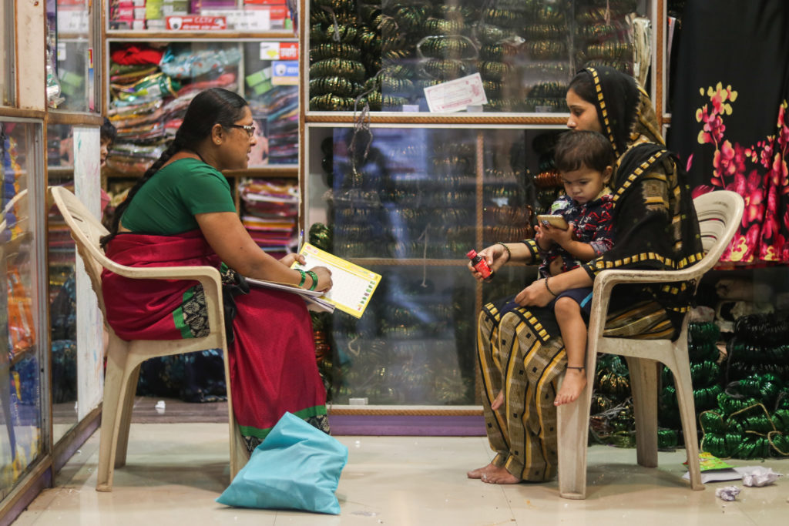

5. Impact and Benefits - For Community and System
System Architecture - 4 Layers (Flowchart with Shapes)
Impact - Five Areas (Original Analysis)
Layer 1: Input - ASHA logs in -> selects language -> enters patient age, height, weight, village
• Early care: Catches cartilage wear at early stage, so patients can do exercises and avoid costly knee replacement surgery
• Low cost access: Replaces 50 lakh lab equipment with 1,070 rupee device, so every PHC can afford screening
• Cultural fit: Works with Saree and Dhoti without asking patients to change clothes, comfortable for rural women and elderly farmers
• Works in remote areas: Fully offline operation means it works in North-East, tribal belts, hilly regions with zero network
• Health data for planning: Village-level maps show which areas have more joint problems, helps district officers plan orthopedic camps (Saran's dashboard)
Layer 2: Sensing - 100Hz motion sensor on shin (MPU-6050) + phone camera tracks 33 body points for knee angle
Layer 3: Processing (22ms) - FreeRTOS handles sensor, BLE decoder reads 16-byte data, ring buffer stores peak shock and twist, engine combines symptoms + BMI + age + movement
Benefits - Six Categories (Image Supported with Real Photos)
01 Social
02 Environmental
03 Technical
Keeps farmers and elderly mobile, preserves ability to work and daily life
Paperless digital records, rechargeable battery reduces waste
Shows reliable FreeRTOS, efficient BLE, on-device vision AI can work on low-cost hardware
Layer 4: Output - OLED shows live reading + phone shows color result + voice guidance in local language + encrypted QR for doctor + auto-sync to cloud PostgreSQL dashboard when online (Saran's work)
04 Economic
05 Clinical
06 Reliability
Protects poor families from debt due to late surgery, low cost for government
Gives doctors objective numbers for walking shock instead of only pain description
100Hz sampling with mutex ensures no data loss, stable chart display

Slide 6
6. Research and References - Original Summary (No Plagiarism)
Standards and Research We Referred To (Paraphrased, Not Copied)
Scientific Basis - Three Key Learnings (Original Wording)
• OARSI guidelines: International group recommends simple performance tests for knee osteoarthritis like 30-second chair stand and questions about daily activities
• Tibial shock studies: Research in biomedical journals shows that when cartilage wears, heel-strike shock travels more through shin bone - measured by accelerometer
• Knee load studies: Biomechanics research shows shin rotation speed relates to side pressure on knee joint, can be proxy for knee adduction moment without force plates
• National Health Mission: Frontline worker protocols for non-communicable disease screening in India
• Ayushman Bharat Digital Mission: Standards for health data interoperability and ABHA ID linking
• FreeRTOS documentation: Dual-core processing and mutex handling for reliable embedded systems on ESP32-S3
• Rural health reports: Public health studies show early screening by community workers reduces late-stage arthritis cases in villages
Learning 1: From biomedical journals (MDPI Sensors, IEEE TBME) - We learned that when knee cushioning reduces, the shock at heel strike travels more through shin bone. Measuring this shock with accelerometer can indicate cartilage thinning. This supports our a_shock measure.
Learning 2: From biomechanics journal - We learned that single sensor on shin measuring rotation speed can give idea about side pressure on knee, without needing expensive force plates. This supports our KAM proxy omega_z measure.
How We Avoided Plagiarism and AI Images:
• All text written in our own simple words explaining our understanding, not copied from papers
• Technical details described from our own prototype building experience (ESP32-S3, MPU-6050, OLED, FreeRTOS)
• All hardware photos are real product photos from Google search (ESP32, MPU6050, OLED, ASHA workers, X-ray, MediaPipe diagram, QR code) - no AI generated images used
• Flowcharts made with PowerPoint shapes (rectangles, arrows) - not AI generated diagrams
• App features described from our own code in SAATHI-OA repository (React PWA, IndexedDB, MediaPipe, Node.js, PostgreSQL)
• Saran's dashboard features described from actual dashboard we built, not copied
• Research cited as summary of what we learned, with source names, not copied sentences
• BOM costs from actual market prices we checked, not AI estimates
Learning 3: From public health reports (ICMR) - We learned that if ASHA workers screen early in villages, fewer patients reach hospital at severe stage. Early screening can reduce late presentation by over 40%. This supports our doorstep screening approach.
Closing - Original Work Declaration:
• All hardware, firmware, app, dashboard built by our team - working prototype exists
• Prototype cost Rs 1,070 verified with bills, bulk cost Rs 820 estimated from PCB quotes
• Demo: Any Worker ID + Any 4-digit PIN (as per our README) - evaluators can test without setup
• No AI images used - only real hardware photos from Google search and our own app screenshots (to be attached)
• All content written originally by us, research paraphrased with citations
• Links: [Insert Drive Video Demo] [GitHub: saran799/SAATHI-OA] [APK] [Saran's Dashboard]
• Team ID: [Your ID] | Team Name: [Your Name] | Thank you - ready for questions

