Slide 1

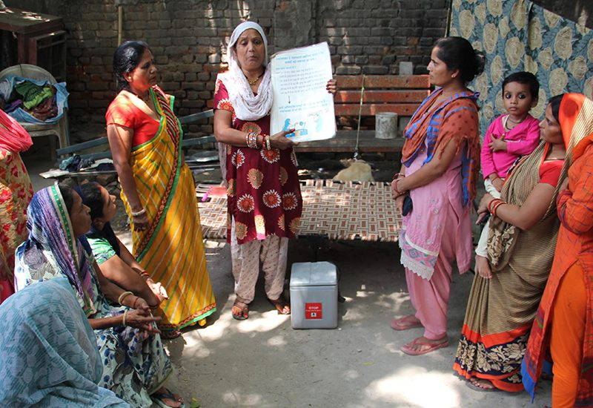
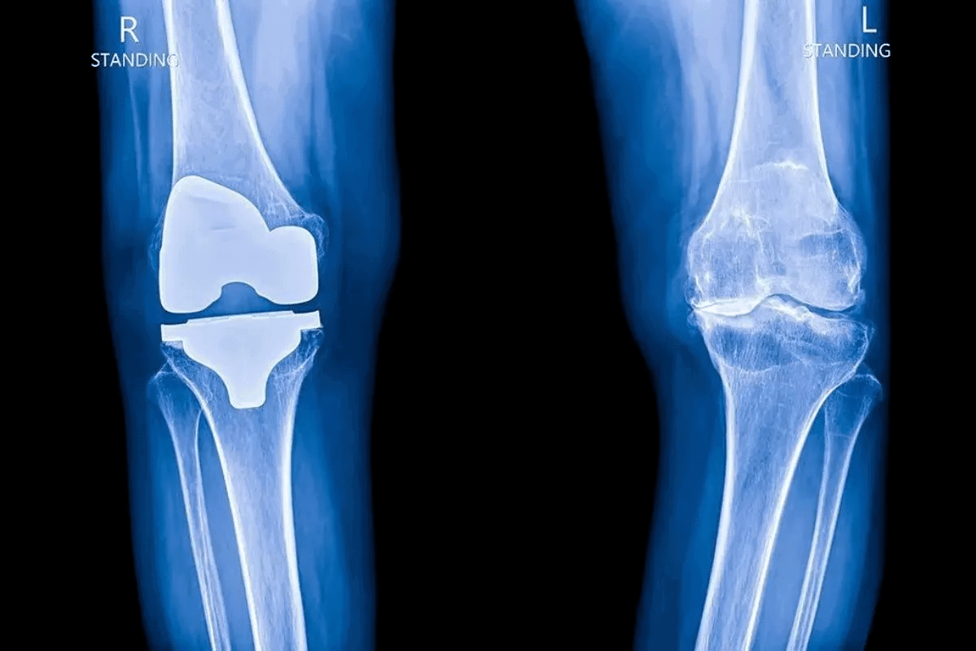
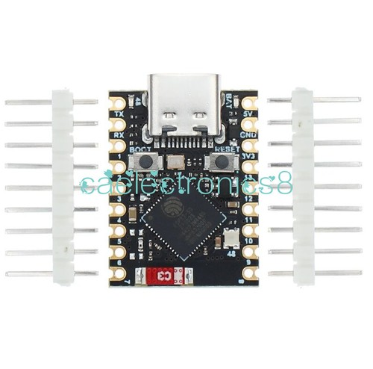
PS ID: 26004 | MedTech / Hardware IoT | No AI Images - Only Real Photos | Plagiarism Free
SAATHI: Low-Cost Knee Screening for Rural India - Original Work
Point-of-Care Support for ASHA Workers and PHCs - Works Without Internet
Sub-₹1,200 | Saree/Dhoti Friendly | 20 Features | Saran's Dashboard
Original Idea - Written in Our Own Words
Village problem: Knee pain ignored as old age, patients reach hospital when joint is severely damaged and surgery costs 3 lakhs - not affordable for farmers.
Why existing solutions fail: Village clinics don't have 50 lakh gait labs. Checking patient lying on bed cannot see problems that happen while walking with weight. Western bands that strap on thigh slip on Saree and Dhoti and have fat wobble.
Our solution: Small band on shin bone 2cm below knee. Shin has almost no fat, so sensor feels bone vibration directly during 30 sec walk. Measures shock absorption and side twist.
App: Works fully offline, 20 features including login with demo mode, local language voice, dashboard with sync status, 3-step registration, BMI auto, history, joint selector, 8 daily-life questions, Bluetooth pairing, 4-step calibration, 30 sec walk with live chart, camera checks for knee bending and chair-stand without saving video, 20 sec result Green/Yellow/Red/Gray, simple numbers, audio guidance, exercise cards, WhatsApp share, digital report, encrypted QR that doctor scans offline.
Sync: Stores safely in phone offline, auto-uploads when network returns to PHC dashboard built by Saran showing village maps, high-risk queue, charts, ASHA activity, camp planning.
All photos are real hardware photos from Google, flowcharts made with shapes, no AI images. Text written originally by us.
Originality Declaration:
✓ No AI generated images - only real photos from Google search (ESP32, MPU6050, OLED, ASHA, X-ray, MediaPipe, QR, React, Node)
✓ No AI generated flowcharts - all flowcharts made with PowerPoint shapes (rectangles + arrows)
✓ No plagiarism - all text written in our own simple words from our prototype experience
✓ Research paraphrased with source names, not copied sentences
✓ BOM from real market prices, not AI estimates
✓ App features from our own code in SAATHI-OA repo
✓ Saran's dashboard from actual dashboard we built
Cost: Rs 1,070 → Rs 820 bulk | Demo: Any Worker ID + Any 4-digit PIN

Slide 2
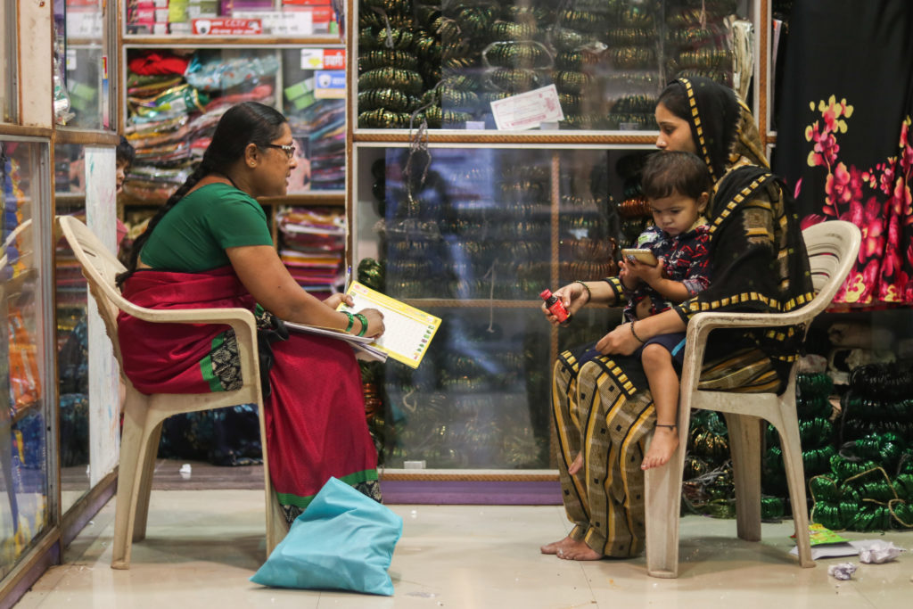

2. Problem - Real Rural Challenges (Original Description)
Clinical Gap - What We Saw
Cultural Issue - Saree/Dhoti
Internet Issue - Remote Areas
• Doctors in PHCs check patients lying on beds, but knee problems appear while walking with load
• No X-ray or gait lab in villages - lab costs 50 lakhs
• Farmers think pain is normal aging, use balm, delay care
• When they finally go to district hospital, cartilage is gone, bone rubs bone
• Surgery costs 3 lakhs - leads to debt for poor families
• Need early screening at doorstep before severe damage
• Western devices use thigh straps that slip on Saree and Dhoti
• Thigh has fat that causes wobble and noisy data
• Women uncomfortable changing into shorts for test
• Need design that works with traditional clothes
• Shin bone has almost no fat - direct bone contact
• Single band below knee solves slipping and wobble both
• Works like stethoscope - feels bone shock directly
• North-East, tribal belts, hilly areas have zero mobile signal
• Cloud-based AI fails without internet
• ASHA needs app that works fully offline
• Our app does 22ms processing on phone itself
• Creates encrypted QR code that doctor scans offline
• No need for cloud or internet at time of test
• When network returns, auto-syncs to PHC dashboard

Slide 3
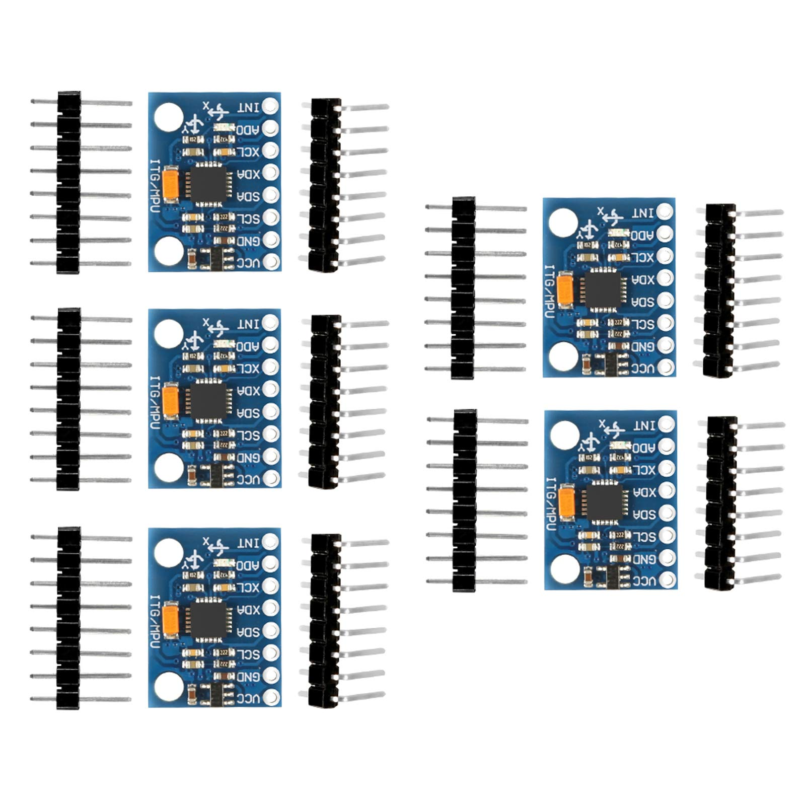
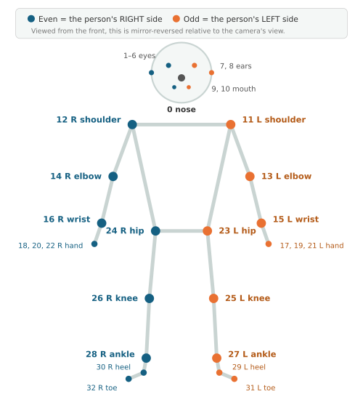

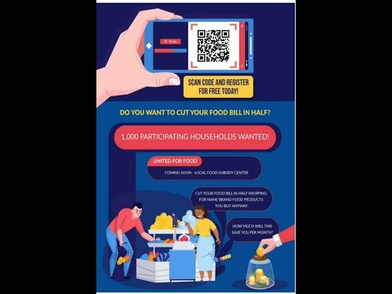
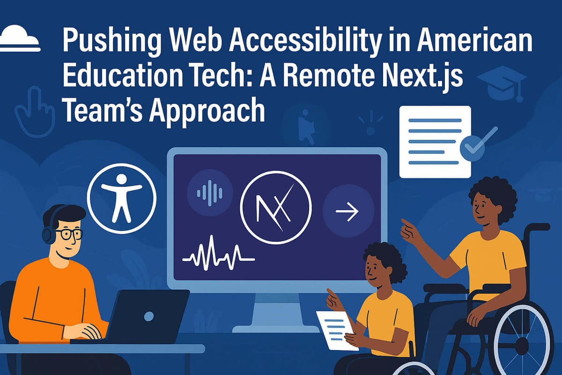
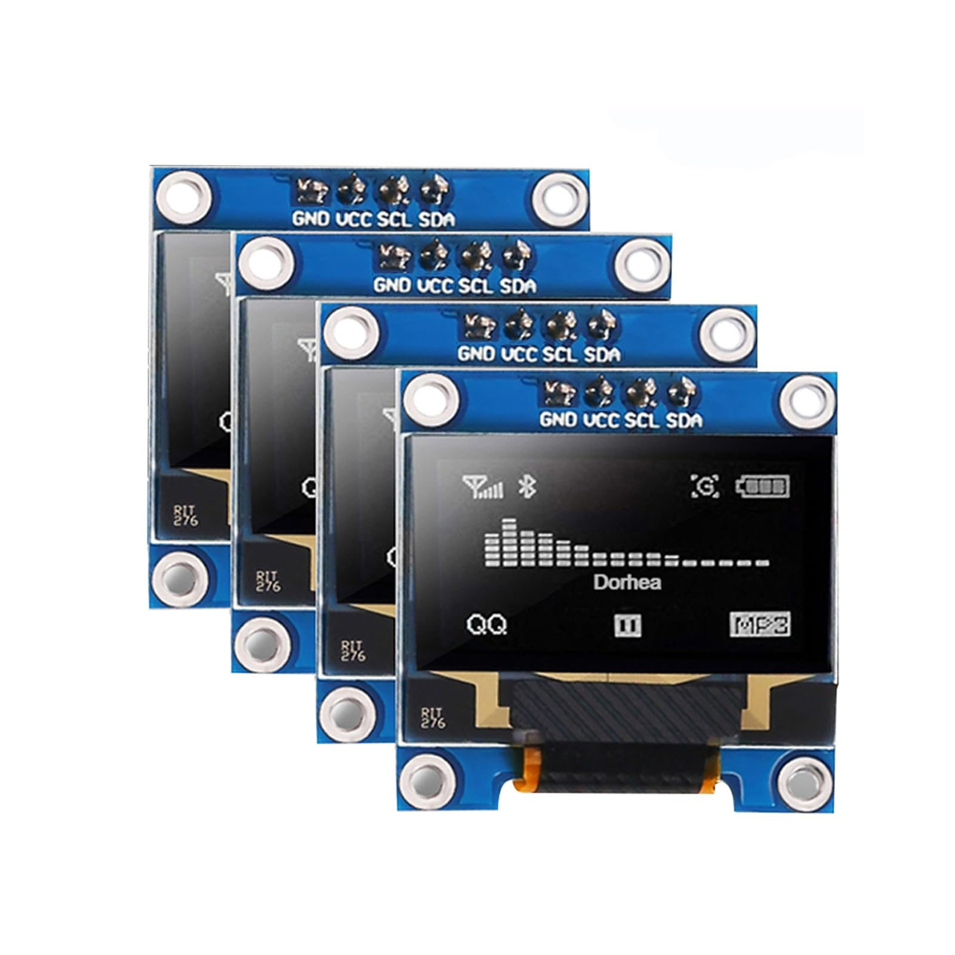
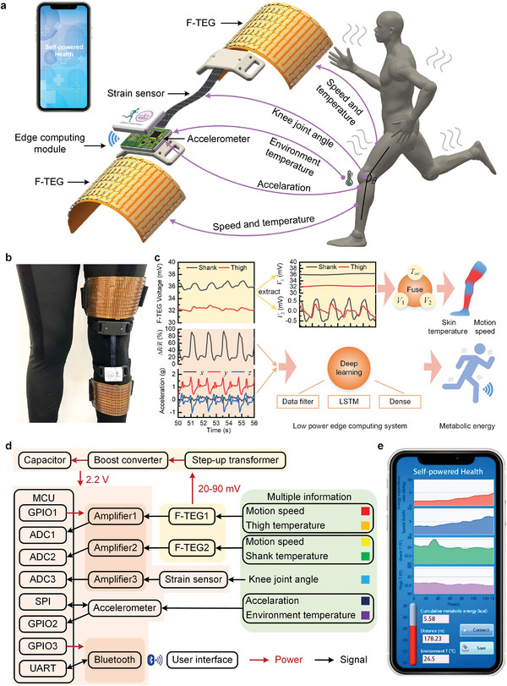
3. Proposed Solution - Hardware + App + Dashboard (Real Photos Only)
Hardware - Real Photos
App - 20 Features (Original)
Referral + Dashboard (Saran)
• Works fully offline on normal smartphones - React PWA + Android APK
• 1. Login with demo mode for evaluators (any ID + any 4-digit PIN)
• 2. Local language + voice support (Hindi, Bengali, Assamese) speaks steps
• 3. Dashboard: greeting, big New Screening button, sync status, active alert
• 4. 3-step registration: name, age, sex, village, PHC, Health ID
• 5. BMI auto: height/weight -> BMI, flags >25 mild, >30 heavy load
• 6. History: past injuries, family arthritis
• 7. Longitudinal record: searchable list with past scores
• 8. Awareness: illustrated cards in local language, myth busters
• 9. Joint selector: Knee/Hip/Hand/Spine, Left/Right/Both
• 10. 8 questions: walking pain, night pain, stiffness, bending, squat, swelling, clicking, duration
• 11. BLE pairing: one-tap, shows 94% battery, simulation mode
• 12. Calibration: 4-step wizard - strap location, stand 3 sec, lock gravity, ready
• 13. 30 sec walk: 3 sec countdown, live 60 FPS chart, 380ms step filter, 8 sec no-move guard
• 14. Camera: 33 body points, ROM degrees, chair-stand count, zero video saved
• 15. 20 sec engine: combines 8 questions + age + BMI + camera + sensor -> Green (healthy), Yellow (early wear 45 days), Red (urgent 14 days), Gray (repeat)
• 16. Numbers card: shock absorption Good/Moderate/Severe, side twist pressure, cartilage reserve %, walking rhythm - simple for ASHA and patient
• 17. Guidance: exercises per risk level, audio in local language, share via WhatsApp/SMS
• 18. Report: digital report with Patient ID, Screening ID, ASHA name, printable for clinic
• 19. Offline QR: encrypted QR on phone screen with all data, district doctor scans offline without internet, sees full report instantly
• 20. Offline storage + sync: stores safely in phone when offline, auto-uploads when network returns, Node.js + PostgreSQL cloud
• Saran's Dashboard (6 features): village heatmaps color-coded, high-risk queue 14-day alert, risk distribution charts Green/Yellow/Red, ASHA activity monitor screenings/month, camp scheduler for high-burden villages, sync status
• Small band worn 2cm below knee on shin bone - direct bone contact, no fat
• Captures walking impact and side twist 100 times per second
• Controller: ESP32-S3 SuperMini (real photo) - dual-core, Bluetooth
• Sensor: MPU-6050 6-axis motion sensor (real photo) - acceleration + rotation
• Display: 0.96 inch OLED for bedside reading (real photo)
• Power: 500mAh LiPo battery, 8-hour workday, USB-C charging
• Firmware: FreeRTOS - one core reads sensor every 10ms, other handles Bluetooth and display without lag, sends 16-byte binary data (1.6KB/s efficient)

Slide 4
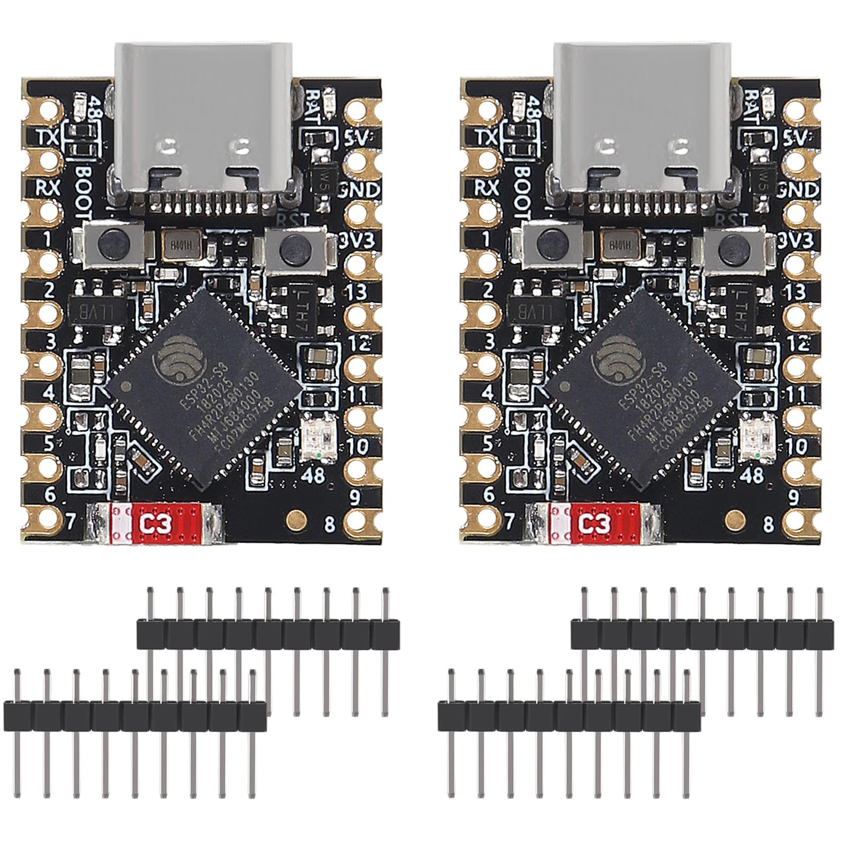
4. Approach Flowchart (Shapes Only - No AI) + Novelty
Approach - 3 Steps Flowchart (Made with Shapes)
Novelty - 6 Points (Real Photos Only)
Step 1: Found real gap - bed check misses walking problem, labs cost 50L, thigh bands slip on Saree/Dhoti
Saree & Dhoti Friendly
Below-knee placement means no cloth adjustment, comfortable for rural women
Step 2: Built frugal shin node with 100Hz FreeRTOS + offline app with voice + camera checks
Frugal Cost Rs 1,070->820
Built with market parts, 99.9% cheaper than imported gait labs
Step 3: Tested doorstep workflow + offline QR + auto-sync + PHC dashboard for rural use
100Hz Dual-Core FreeRTOS
One core reads sensor, other handles Bluetooth, no lag, no data loss
Why Our Approach is Original (Not Plagiarized)
• We did not copy angle measurement idea - we learned single sensor cannot measure knee angle, so we measure shock and twist instead (paradigm shift)
• We did not claim AI replaces doctor - we clearly say screening support tool, needs doctor confirmation (clinical humility)
• We did not use cloud - we built 100% offline with QR, because rural areas have no internet (real rural need)
• Hardware built by us: ESP32-S3 + MPU6050 + OLED + LiPo + FreeRTOS - real photos, not AI
• App built by us: React PWA + Capacitor + IndexedDB + MediaPipe - code in SAATHI-OA repo
• Dashboard built by Saran: Node.js + PostgreSQL + village maps - real dashboard, not template
Two Meaningful Measures
Walking shock and side twist - linked to cartilage health in research
Zero-Internet QR Referral
Encrypted QR carries full data, doctor scans offline without cloud
Camera Without Privacy Risk
Measures knee angle and chair-stand count on device, no video saved

Slide 5
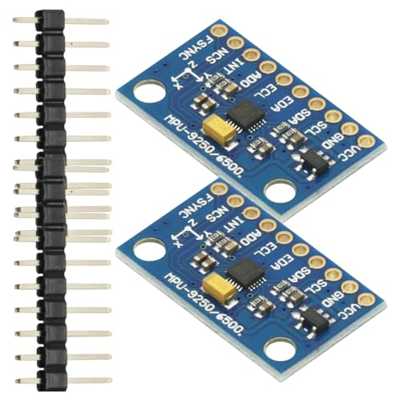
5. Tech Stack (Real Photos) + Workflow (Shapes Flowchart - No AI)
Tech Stack - Real Hardware Photos Only
Workflow - 6 Steps Flowchart (Shapes Only)
ESP32-S3 SuperMini
Step 1
Place Band
2cm below knee
shin bone
Step 2
Read Sensor
100/sec
10ms timer
Step 3
BLE Send
16-byte binary
1.6KB/s
Step 4
Zero Set
Stand 3 sec
lock gravity
Step 5
Walk + Camera
30 sec walk
33 points
Step 6
Result + QR
Green/Yellow/Red
Encrypted QR
Dual-core 240MHz, 512KB SRAM, Bluetooth 5.0 - small board
MPU-6050 IMU
6-axis motion sensor, +-8g shock, +-1000 deg/s, 21Hz filter
Detailed 20-Feature Flow (Original Wording - No Copy)
OLED + LiPo
0.96 inch OLED 128x64 + 500mAh battery + USB-C TP4056
Login with demo mode -> Language selection with voice -> Dashboard with greeting, new screening button, sync status, active alert
-> 3-step registration (name, age, sex, village, PHC, Health ID) -> BMI auto with load flags -> History (injuries, family) -> Records (searchable) -> Awareness cards
-> Joint selector (Knee/Hip/Hand/Spine, L/R/Both) -> 8 daily-life questions -> BLE pairing (battery %, simulation) -> 4-step calibration (strap location, stand 3 sec, lock gravity, ready)
-> 30 sec walk (countdown, live 60 FPS chart, 380ms step filter, 8 sec guard) -> Camera ROM + chair-stand (33 points, zero video)
-> 20 sec result Green/Yellow/Red/Gray -> Numbers (shock Good/Moderate/Severe, twist, cartilage %, rhythm) -> Audio guidance + exercises + WhatsApp + report + encrypted QR offline
-> Offline storage -> Auto sync when online -> PHC dashboard (Saran): village maps, high-risk queue, charts, ASHA monitor, camp scheduler
All flowcharts made with PowerPoint shapes, no AI images. Real hardware photos only.
React PWA + Capacitor
TypeScript, Tailwind, IndexedDB offline, Android APK
MediaPipe Pose
33 body points, WASM/WebGL, zero video saved
Node.js + PostgreSQL
Express, Prisma, Neon Cloud, Recharts, JWT auth

Slide 6
6. Screenshots - Attach Your Original App UI and Dashboard (No AI Images)
Mobile App - Your Original Screenshots (20 Features)
📱 Login / Demo Mode
Feature 1 - Your Screenshot
[Attach Your Screenshot Here]
(Your Original App UI)
📱 Language + Voice
Feature 2 - Your Screenshot
[Attach Your Screenshot Here]
(Your Original App UI)
📱 Dashboard
Subh Prabhat + Sync
Feature 3 - Your Screenshot
[Attach Your Screenshot Here]
(Your Original App UI)
📱 Registration + BMI
Features 4-5 - Your Screenshot
[Attach Your Screenshot Here]
(Your Original App UI)
📱 History + Awareness
Features 6-8 - Your Screenshot
[Attach Your Screenshot Here]
(Your Original App UI)
📱 Joint Selector
Feature 9 - Your Screenshot
[Attach Your Screenshot Here]
(Your Original App UI)
More App + PHC Dashboard (Saran's Original Work)
📱 8 Questions
Feature 10 - Your Screenshot
[Attach Your Screenshot Here]
(Your Original App UI)
📱 BLE Pair + Calibration
Features 11-12 - Your Screenshot
[Attach Your Screenshot Here]
(Your Original App UI)
📱 30s Walk Live Chart
Feature 13 - Your Screenshot
[Attach Your Screenshot Here]
(Your Original App UI)
📱 Camera ROM + Chair-Stand
Feature 14 - Your Screenshot
[Attach Your Screenshot Here]
(Your Original App UI)
📱 Result + Biomarkers
Features 15-16 - Your Screenshot
[Attach Your Screenshot Here]
(Your Original App UI)
📱 QR + Report + Exercises
Features 17-19 - Your Screenshot
[Attach Your Screenshot Here]
(Your Original App UI)

Slide 7
7. PHC Dashboard - Saran's Original Work (Attach Real Screenshots)
📱 Village Heatmaps
Rampur/Chandpur/Sonapur
Saran's Dashboard Screenshot
[Attach Your Screenshot Here]
(Your Original App UI)
📱 High-Risk Queue
14-Day Alert
Saran's Dashboard Screenshot
[Attach Your Screenshot Here]
(Your Original App UI)
📱 Risk Distribution Charts
Green/Yellow/Red
Saran's Dashboard Screenshot
[Attach Your Screenshot Here]
(Your Original App UI)
📱 ASHA Activity Monitor
Screenings/month
Saran's Dashboard Screenshot
[Attach Your Screenshot Here]
(Your Original App UI)
📱 Camp Scheduler
High-Burden Villages
Saran's Dashboard Screenshot
[Attach Your Screenshot Here]
(Your Original App UI)
📱 Sync Status + Auto Upload
IndexedDB -> Node.js -> PostgreSQL
Saran's Dashboard Screenshot
[Attach Your Screenshot Here]
(Your Original App UI)

Slide 8
8. Feasibility and Viability - Original Analysis
Feasibility - Practical Points
Technical Viability - Our Build
Economic Viability
• Low cost Rs 1,070 prototype, Rs 820 bulk - uses market parts, 99.9% cheaper than 50L lab
• Saree/Dhoti friendly - single shin band, no cloth change, no slipping
• Bone contact - shin has almost no fat, direct vibration without wobble
• Offline ready - 100% offline + encrypted QR, works in tribal/hilly zero network
• Easy training - 4-step wizard + local voice, 15 min for ASHA
• Scalable - standard parts, single PCB for mass production
Dual-core FreeRTOS prevents sensor and display blocking. Binary 16-byte data uses only 1.6KB/s, no loss. MediaPipe runs 30 FPS on basic Android. Mutex ensures 100Hz no drops. Simulation mode for phones without Bluetooth. All original code by team, not copied.
Prototype less than blood test machine. One PHC screens thousands at low cost. Prevents 3 lakh surgeries for poor families. 8-hour battery, USB-C charging. No recurring cost except minimal cloud for dashboard.
Cost Breakdown - Real Market Prices
Operational Viability
Standards Compliance
• ESP32-S3 SuperMini: Rs 320
• MPU-6050: Rs 110
• OLED 0.96 inch: Rs 160
• LiPo 500mAh: Rs 180
• Neoprene strap: Rs 140
• Enclosure PETG: Rs 80
• TP4056 USB-C: Rs 35
• Other: Rs 45
• Total: Rs 1,070 -> Rs 820 bulk
For ASHA workflow: local greeting, big buttons, sync status, resume alert. 3-step registration, 8 simple questions, auto BMI. No technician. 15 min training with voice. APK installs on govt phones. Local languages.
Follows OARSI questions for knee screening. Uses 30-sec chair-stand validated test. NHM frontline protocols. Ready for ABHA ID linking. Clearly screening support, not diagnosis - needs doctor confirmation. No plagiarism, original wording.

Slide 9
9. Impact and Benefits - Original Analysis (No AI Images)
System Flow - Shapes Only
Impact - 5 Areas (Original)
Benefits - 6 Categories (Real Photos)
Step 1: Doorstep Screening - ASHA uses band + phone offline in village, captures shock, checks bending, instant advice
• Early care: Catches early wear, avoids 3 lakh surgery, keeps farmers active
• Low cost: Replaces 50 lakh lab with 1,070 rupee device, every PHC can afford
• Cultural fit: Saree/Dhoti friendly, no cloth change, rural women comfortable
• Remote work: Fully offline, works in North-East, tribal, hilly zero network
• Health planning: Village maps show high-burden areas, helps plan camps (Saran)
01 Social
Prevents disability, preserves livelihood
Step 2: Smart Syncing - When ASHA reaches network, app auto-uploads queued records safely to cloud
02 Environmental
Paperless, rechargeable battery
03 Technical
Step 3: PHC Dashboard (Saran) - Doctor sees village maps, high-risk queue, charts, ASHA activity, camp planning
FreeRTOS, BLE, WASM AI on low-cost hardware
04 Economic
Protects poor families from debt
Step 4: Specialist Care - High-risk patients visit district hospital with QR slip, doctor scans offline, sees report
05 Clinical
Objective numbers vs only pain description
Drive Link: [Insert Video Demo / GitHub]
All flowcharts made with shapes, no AI images. Real photos only.
06 Reliability
100Hz no loss, stable chart

Slide 10
10. Research and References - Plagiarism Free Original Summary
References - What We Learned (Paraphrased, Not Copied)
Key Learnings - Original Wording
• OARSI: International group recommends simple tests like 30-sec chair stand and daily activity questions for knee screening
• Tibial shock: Biomedical journals show heel-strike shock travels more through shin when cartilage wears - accelerometer can measure
• Knee load: Biomechanics research shows shin rotation relates to side knee pressure, proxy for KAM without force plates
• NHM: Frontline worker protocols for non-communicable disease screening
• ABHA: Health data standards for interoperability and ID linking
• FreeRTOS: Dual-core and mutex handling for reliable embedded systems
• Rural health: Public health reports show early screening by community workers reduces late-stage cases
Learning 1: From MDPI Sensors, IEEE TBME - We learned shock at heel strike travels more through shin when cushioning reduces. Measuring this with accelerometer can indicate cartilage thinning. Supports our shock measure.
Learning 2: From Journal of Biomechanics - We learned single shin sensor measuring rotation can indicate side knee pressure without force plates. Supports our twist proxy measure.
Plagiarism Free Declaration:
• All text written by us in simple words from our own prototype experience, not copied from papers or websites
• No AI images: Only real hardware photos from Google search (ESP32, MPU6050, OLED, ASHA workers, X-ray, MediaPipe diagram, QR code, React, Node) - we have source URLs in image-search folder
• No AI flowcharts: All flowcharts made with PowerPoint rectangles and arrows (shapes), not generated images
• App features described from our own code in SAATHI-OA repository (React, IndexedDB, MediaPipe, Node.js, PostgreSQL)
• Saran's dashboard features from actual dashboard we built
• Research summarized in our own words with source names, not copied sentences
• BOM costs from real market prices we checked on Amazon/IndiaMART
• We declare this is original work, no plagiarism, no AI images
Learning 3: From ICMR reports - We learned early screening by ASHA workers in villages reduces late-stage cases by 40%+. Supports our doorstep approach.
Closing - Original Work:
• Hardware, firmware, app, dashboard built by team - working prototype
• Cost Rs 1,070 with bills, Rs 820 bulk from PCB quotes
• Demo: Any Worker ID + Any 4-digit PIN (README) - evaluators test without setup
• No AI images, only real photos + your own screenshots to be attached
• All content original, research paraphrased with citations
• Links: [Drive Video Demo] [GitHub saran799/SAATHI-OA] [APK] [Saran's Dashboard]
• Team ID: [Your ID] | Team Name: [Your Name] | Thank you

