Slide 1

Real-time Package Temperature and Location Monitoring using RF-ID and GPS technologies
Vivek Ashwin Raman (MS NSSA Student)
Xi(Simon) Ouyang (MS CS Student)
Yu Sun (MS NSSA Student)
Advisors:
Tom Oh, Spencer Kim and Changfeng Ge

Slide 2
Monitoring Package Temperature and Location Real-time using RF-ID & GPS technologies
Goal
  Focused on obtaining temperature and location of critical packages transported in moving vehicles real-time by integrating RF-ID sensors, GPS and 4G technologies
  Implemented a variety of back-end processes on the remote server which contains the package information that allows the client to use a smart phone/Tablet/Laptop to view this server information online

Slide 3
Products required to implement this project
  A set of RF ID tags with an inbuilt temperature sensor that constantly records the temperature of the material inside several packages placed in a truck
  An RF ID reader attached to a laptop/tablet that can read this temperature data from the sensor and send this data to a laptop / tablet
  A GPS device that sends the GPS co-ordinates of the truck to the laptop / tablet
  Using a 3G or a 4G network, the temperature sensor information along with their current location is sent onto a server at a remote location
  The server which can be accessed over the Internet through applications developed on a smart phone/laptop/tablet and access this information as per requirement to monitor temperature and location real-time

Slide 4
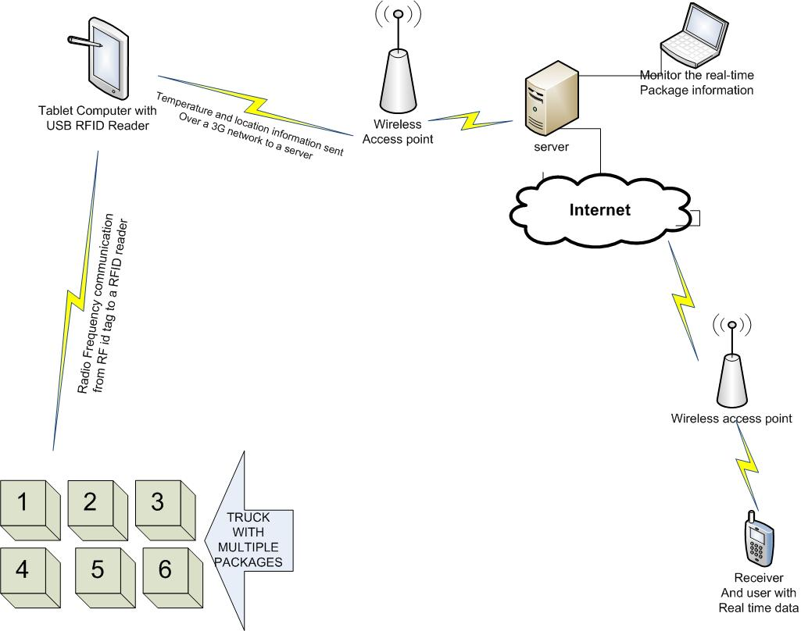
General architecture used to implement this project

Slide 5
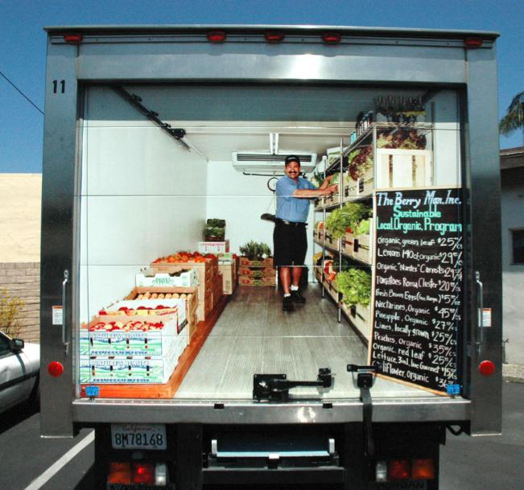
Pictorial representation
  The truck contains
packages with
temperature
sensing RFID tag
  It also contains the
RFID reader
attached to a tablet
in front of the truck

Slide 6
Front End of the System
  Using an RF ID tag with an inbuilt temperature sensor and a frequency of 2.45 GHz ( manufactured by GAO RF ID inc) and using a RF ID reader (fixed) of same frequency this information can be forwarded to a Tablet/Laptop and further to the server
  In order to monitor the location, we use a Garmin 18 PC/LVC serial GPS device and connect it to a Laptop/tablet using Belkin serial port to USB converter which allows the GPS co-ordinates to be sent in the GPGGA format

Slide 7
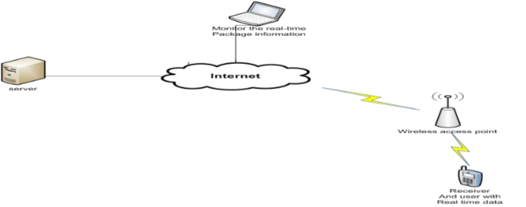
Back end of the System
  The back end has a server to which both these information are to be sent and such a information is to be stored onto a database server
  Any person who tries to access this information can reach the server through internet from their smart phone/laptop/tablet and after access credentials are checked can view this real time information

Slide 8
Hardware & Software
Hardware
  2.45 GHz Active RF-ID USB Reader 217003 (GAO RF-ID)
  2.45 GHz Active RFID Temperature Sensor Tag (GAO RF-ID)
  127003
  GARMIN 18x PC/LVC Serial port GPS device
  Belkin F5U409 Serial port to USB converter
  AT & T USB Connect Shockwave 4G
  Car charger to AC adapter
  Tablet / Laptop for Client and server computers
Software
  RF-ID_debug(USB) V4.0
  GARMIN Sensor Configuration Software SNSRCFG_320
  Microsoft Visual Studio 2010/08
  CDYNE SMS notify application
  Google Map API
  Programming Language:C#

Slide 9
Project Discussion & Flowchart
This system is built in a Client-Server Model
  Server
    Terminal server
    Database server
    Web server
  Client
    Laptop/Tablet with GPS and RF-ID receiver
    Web Browser

Slide 10
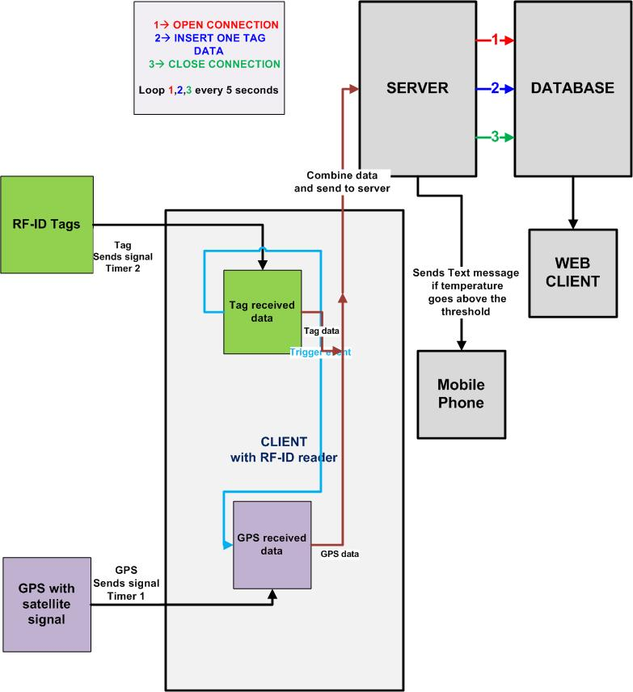
RF-ID Client-Server Flowchart

Slide 11
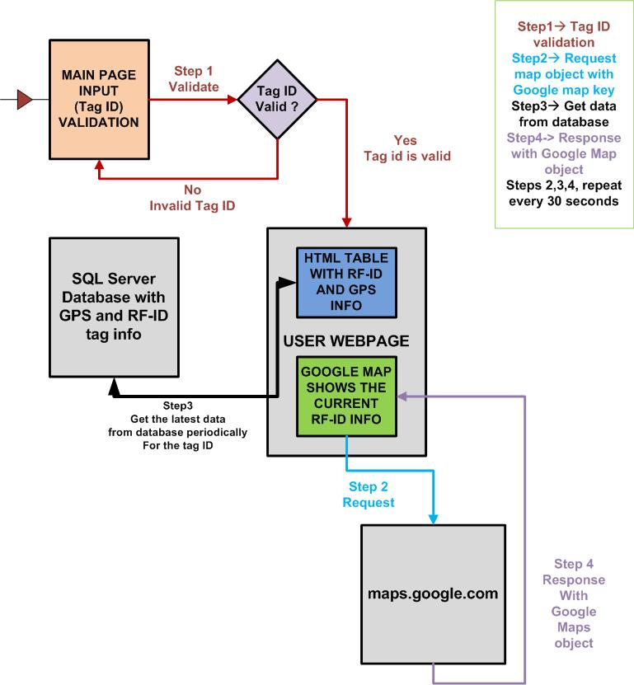
Web Client Flowchart

Slide 12
Project Discussion & Flowchart
The users could track the information of the packages that includes both temperature and GPS information through the following ways:
  SMS on cell phone
    Passively Receive the package information via SMS on his smart phone if the temperature is abnormal
  Web browser on any device with Internet availability
    Positively acquire the latest information of single package on our website built in ASP.net. If the temperature is abnormal, background color of marker’s window will change from green to red.
  Database on the server
    Positively obtain the package information on the database.
  Opening Console on the server
    Positively gain all the package information on the console

Slide 13
Testing Results & Snapshots
The following are the testing results for the implementation
  The client was able to successfully communicate the Temperature and GPS co-ordinates to the remote server periodically
  The server plots the GPS co-ordinates onto the Google maps and updates the information constantly
  Any temperature that goes beyond the threshold is plotted with a red background on the update box and is communicated to the back end client via text message

Slide 14
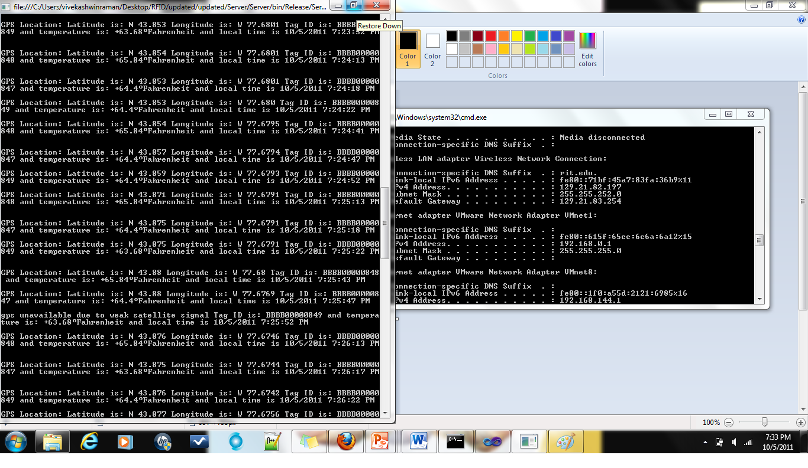
Testing Results & Snapshots
Console Snapshot:

Slide 15
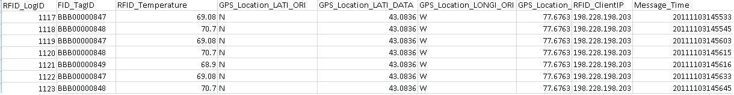
Testing Result & Snapshots
Database and snapshot

Slide 16
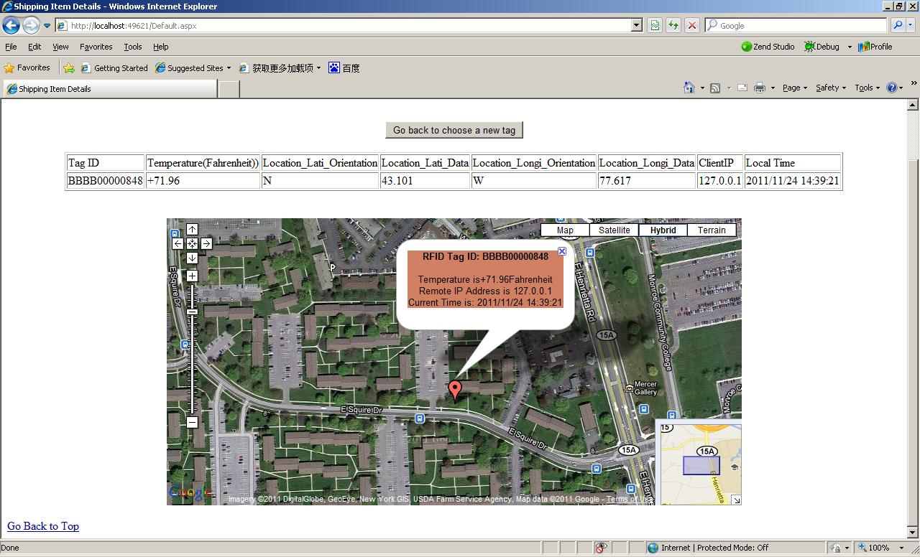
Webpage snapshot when the truck is stationary & the temperature is above threshold

Slide 17
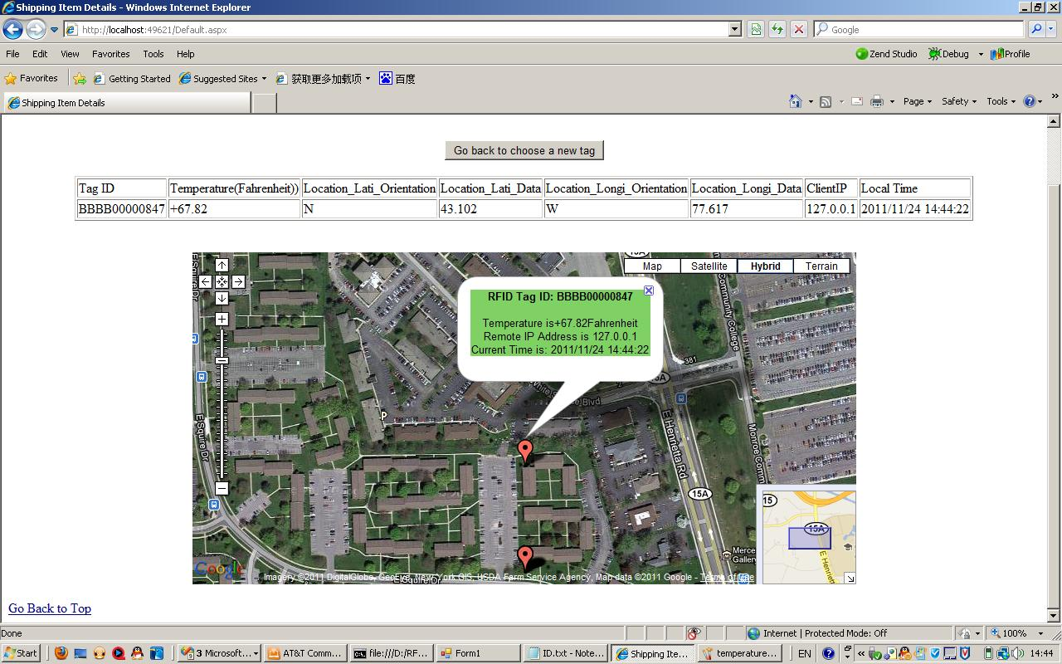
Webpage snapshot when the truck is moving and the temperature is below threshold

Slide 18
Future Work
  Track multiple packages within the same truck. Concerning the Google Map, we could enable the tracking of truck with the given IP address assigned with 3G network. We could track multiple packages on the same truck
  We can use additional sensors that could monitor the package vibration which would prevent theft and humidity sensors that could prevent spoilage of perishable products due to moisture
  Add the geometry altitude and velocity of the package in the truck as features in the record. As advised by the sponsor, concerning the Google Map, we could track the velocity and the geometry altitude of the automobile for the sake of ensuring the good condition of the package
  Auto save the daily/weekly/monthly data in SQL server to csv file to specified external folder for data mining using Excel
  Change the Client/Server Model to support communication between one server and multiple clients

Slide 19
Thank you!!!
Questions???

