Slide 1

PRE-OWNED CAR PRICE PREDICTION MODEL
by Data Pioneers

Slide 2

CONTENT
01
ABOUT THE MODEL
02
DATA VISUALISATION AND PREPROCESSING
03
DATA ENCODING
04
RANDOM FOREST REGRESSOR
05
MODEL INSIGHTS
06
FRONTEND WITH HTML AND CSS
07
INTEGRATION WITH FLASK

Slide 3

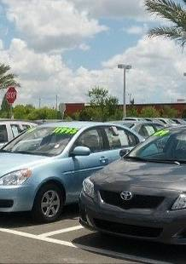
ABOUT THE MODEL
This predictive model is designed to estimate the price of pre-owned cars on the basis of various factors.
It has been trained on an extensive dataset taken from CarDekho - which contains the data of cars sold over the last 20 years or so. It is up to date with the prices of cars on the Indian market and contains parameters like: brand, model, transmission and fuel type, kilometers driven and so on.
This algorithm handles diverse features and complex patterns in data and delivers prices with increased accuracy.

Slide 4
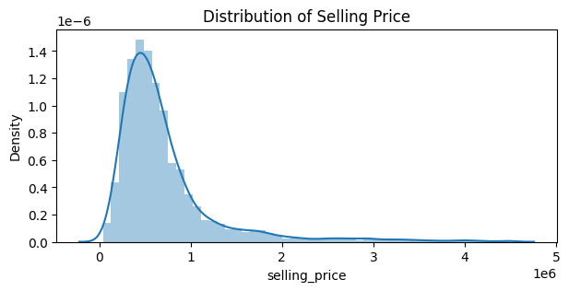
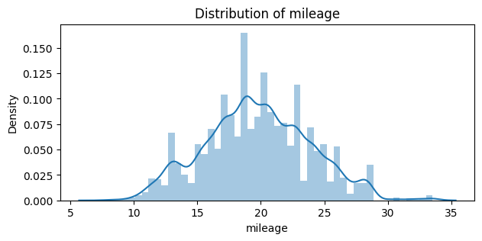
DATA VISUALISING & PREPROCESSING
Cleaning
Feature engineering
Dealing with outliers
Checked for null and duplicate values in the dataset
Removed unnecessary features from the dataset
Removing extreme values in the dataset that may skew result

Slide 5
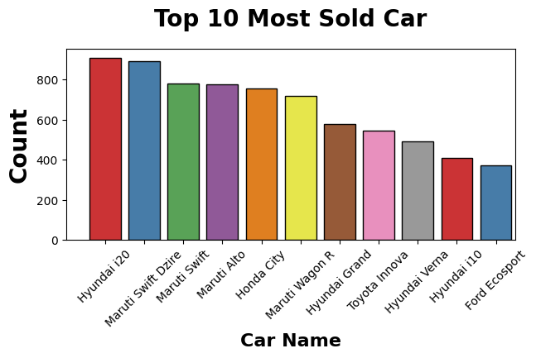

Slide 6

DATA ENCODING
Why do we need to encode data?
Models are inherently mathematical and require numerical input to perform calculations. Numerical encoding helps the model understand and find patterns in the data.
It enhances model performance and is essential for compatibility with machine learning algorithms.
Label Encoder vs One Hot Encoding
Label Encoder - It assigns a unique for each category, leading to a single column for each feature. For a model using RandomForestRegressor, Label Encoding is more straightforward and can handle features effectively.
Due to its very high dimensional space, One Hot Encoder can cause the model to become more complex and can potentially overfit.

Slide 7
RANDOM FOREST REGRESSOR
The model utilizes an ensemble of decision trees, each trained on a random subset of features and data points. This reduces the risk of overfitting and improves generalization.
It assigns importance scores to each feature based on its contribution to the prediction process.
The model's parameters, are optimized to maximize prediction accuracy and minimize errors.

Slide 8
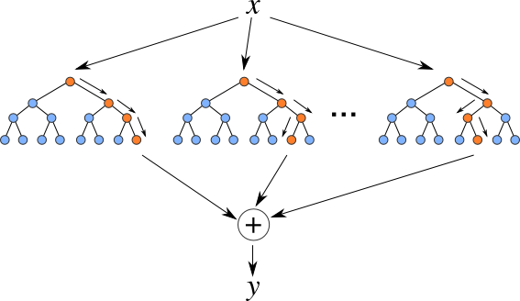

Slide 9

MODEL INSIGHTS
PERFORMANCE METRICS
R squared score: 0.927
Mean Absolute Error Percentage: 12.9%
FEATURE IMPORTANT ANALYSIS
Understanding which features have the greatest impact on price,
allowing for more effective pricing strategies and a deeper understanding of the market.

Slide 10


FRONTEND

Slide 11
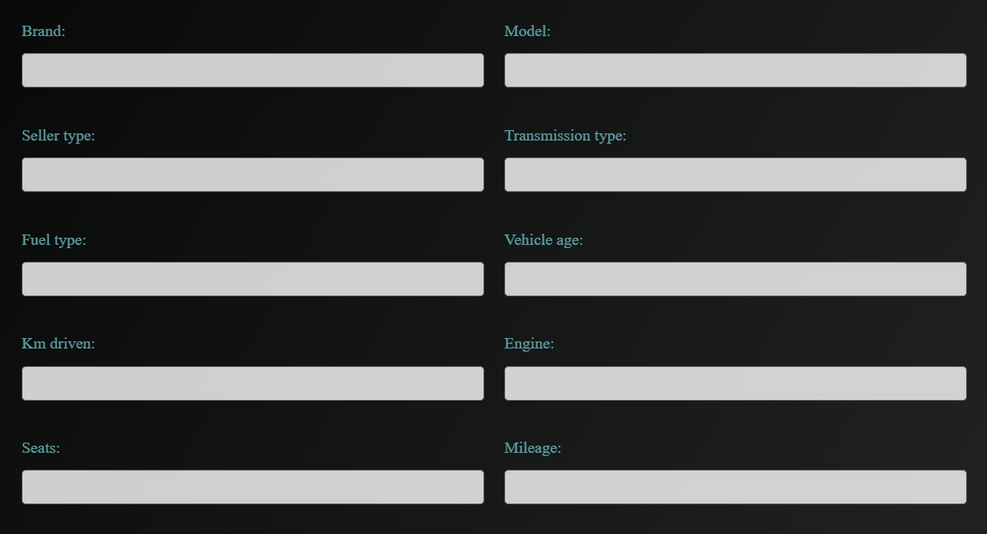

Slide 12
UI DESIGN
Our visually appealing user-friendly interface allows you to input different features of the vehicle you want to buy.
INTERACTIVE FEATURES
It includes interactive elements such as suggestions for previously entered data as well as sliders to adjust mileage, vehicle age and kilometers driven.

Slide 13

INTEGRATION
The backend containing the model was integrated with the frontend using the Flask framework.

Slide 14

The application is deployed on a web server, making it accessible to users through a web browser, allowing for seamless interaction with the price prediction model.
The Flask framework enables efficient integration of the frontend with the backend model.
API endpoints are defined to handle requests from the frontend, receive user input, process it through the model, and return predictions to the frontend.
FLASK FRAMEWORK
DEPLOYMENT
API ENDPOINTS

Slide 15
CONCLUSION
Our machine learning model effectively predicts the prices of second-hand cars and accurately captures the intricate patterns and factors influencing car valuations in the Indian market.
This application not only demonstrates the practical application of machine learning in real-world scenarios but also provides a valuable tool for both buyers and sellers in the second-hand car market, fostering transparency and informed decision-making.

Slide 16




OUR TEAM
Isha Shah
Siddharth Kumbharkar
Sara Nambiar

Slide 17

THANK'S FOR WATCHING

