Slide 1
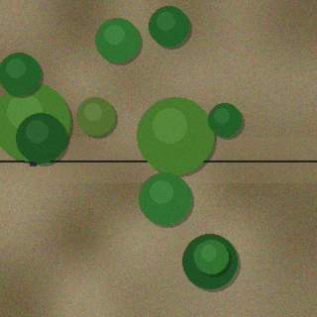
GridAI
Drone-enhanced vegetation encroachment detection for power transmission lines
Synthetic drone tile: canopy touching the conductor
PROJECT WALKTHROUGH
Notes:
GridAI predicts where vegetation threatens transmission lines. This project upgrade adds drone imagery as a second source of evidence, alongside the original tabular model. The picture is a synthetic tile produced by the project's own generator.

Slide 2
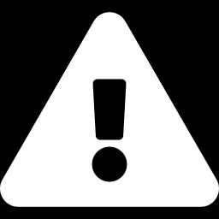
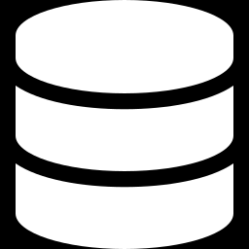
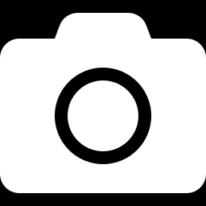
What we set out to do
The problem
Starting point
This upgrade
Trees growing into transmission corridors cause outages and fire risk. Crews need to know which spans to trim first.
A Streamlit dashboard scored 100 line spans from tabular vegetation metrics with a Random Forest, then simulated storm isolation.
Drone images are classified by the best of several trained models, and the result is blended into each line's risk score.
Notes:
Three beats: the real-world problem, what the project already did, and what this upgrade adds. The tabular model alone only knows numbers about each span; drone images give a direct view of the canopy near the conductor.

Slide 3
How the pieces fit together
Utility CSVs
lines, vegetation metrics, substations
Tabular model
Random Forest on distance, height, growth, moisture, voltage
Risk fusion
weighted blend with safety floor
Dashboard
map, ranking, storm plan
Drone images
uploaded, or demo samples
Drone model
best of the compared candidates
Code: app.py · drone_model.py · train_drone_model.py · drone_data_generator.py
Notes:
Two evidence streams. The CSV metrics feed the original Random Forest. Drone images go through the image model that train_drone_model.py selected. The fusion step blends both into one risk score per line, and every dashboard view reads that score.

Slide 4
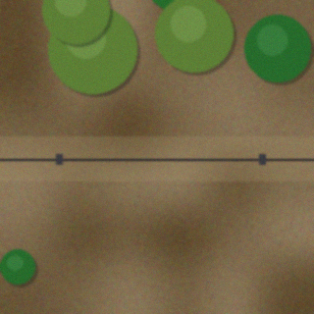
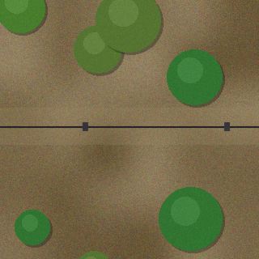
What the drone model sees
Clear
Near
Encroaching
Canopy more than 15% of the tile away from the line
Risk weight 0
Canopy 3–15% of the tile away from the line
Risk weight 0.5
Canopy within 3% of the line or overlapping it
Risk weight 1.0
Tiles are synthetic stand-ins. Real labelled tiles go in the same three folders and are picked up by the training script.
Notes:
The drone model classifies a corridor-aligned tile into clear, near or encroaching, based on the gap between the nearest canopy and the conductor. Each class carries a severity weight that becomes the image risk. These tiles are generated, not real photographs, so they demonstrate the pipeline rather than real-world accuracy.

Slide 5
Picking the best model
Selected model
Logistic Regression
0.978
macro-F1 on 135 held-out test images
Three models tied on validation. A 1–2 image gap out of 135 is noise, so treat the top three as equals.
Run with --cnn to add MobileNetV3, ResNet18 and EfficientNet-B0.
Notes:
train_drone_model.py trains five classical models on hand-built image features, ranks them by validation macro-F1, then scores only the winner on a held-out test split. With the --cnn flag it also fine-tunes three CNNs. The top three classical models are statistically indistinguishable on this synthetic data, and the scores say nothing about real-world accuracy.

Slide 6
Fusing image and tabular risk
risk = (1 − w) × tabular + w × drone
w is the sidebar slider, default 0.5
Line | Tabular | Drone | Fused
LN-1002 | 0.03 | 0.98 | 0.98
LN-1004 | 0.04 | 0.50 | 0.27
LN-1006 | 0.20 | 0.00 | 0.10
LN-1008 | 0.94 | 1.00 | 1.00
Drone risk = Σ P(class) × severity
clear 0 · near 0.5 · encroaching 1
Safety floor: an image risk of 0.8 or more is never averaged below itself
Demo run, w = 0.5. Without the floor, LN-1002 would blend to 0.50 and slip under the 0.65 alert threshold. Lines with no image keep their tabular score.
Notes:
Each uploaded image becomes an image-risk number between 0 and 1. For lines with an image, the final score blends tabular and image risk using the slider weight. We found in testing that a confident encroachment sighting on a line with a low tabular score was being averaged below the alert threshold, so we added a floor: image risk of 0.8 or above is never reduced by the blend. Lines without images keep their original score.

Slide 7
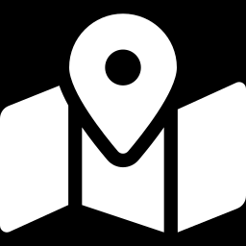
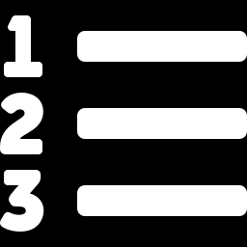
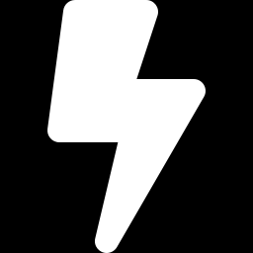

Inside the dashboard
Geospatial risk map
Risk ranking
Spans colored by fused risk, with storm-mode isolations in orange.
Tabular, drone and fused scores side by side, sorted by priority.
Restoration plan
Drone image analysis
Simulated isolation and backup routing for lines above 0.7 fused risk.
Upload images, see class probabilities, and review the model comparison.
Sidebar: storm mode, alert threshold, drone-weight slider, image upload and demo samples.
Notes:
The existing three tabs now use the fused risk score, and a fourth tab handles the drone images. Files named with a line ID, for example LN-1004_span.jpg, are matched to that line automatically. If several images match one line, the highest-risk one is used.

Slide 8



Where it stands, what's next
Verified
Not yet verified
Next steps
Training, model comparison and saving ran end to end
Fusion logic checked on 9 demo lines
0.978 macro-F1 on a synthetic held-out set
Streamlit UI run only against a stub
CNN training untested (no PyTorch here)
No real drone imagery tried
Train on real labelled tiles with --cnn
Crop and rotate imagery so the line runs left to right
Replace rule-based tabular labels with real trim records
Notes:
Be clear about the limits. The pipeline runs, but the accuracy figure comes from synthetic tiles and the dashboard UI itself was not launched in the build environment. The most valuable next step is real labelled drone imagery of the actual network.

