Slide 1
Android Application Model
Saranya CR
NetId : aj2727

Slide 2
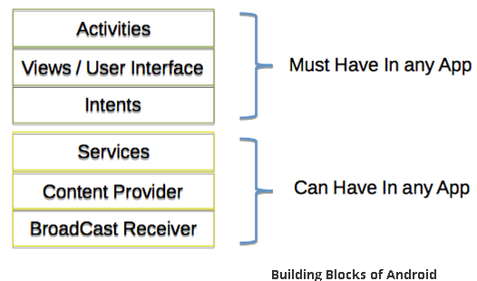
Application Components
There are four different types of components available
Each component is a different point through which the system can enter into the app

Slide 3
Activity
Visual representation of a screen
Every activity will always have a User Interface
Usually, there will be more than one activity in an app
Launcher or main activity is the entry point
Activities may use below two components
Views - XML Layout file that contains UI elements like Buttons, Text, Menu
Fragments - Reusable components which run in the context of an activity

Slide 4
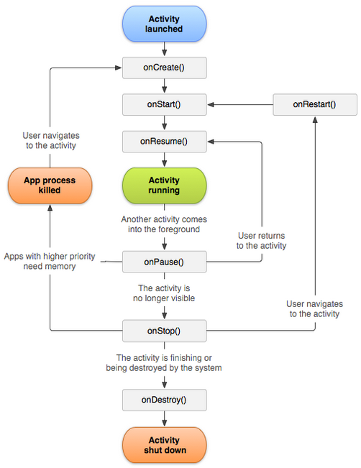
Activity Life Cycle

Slide 5
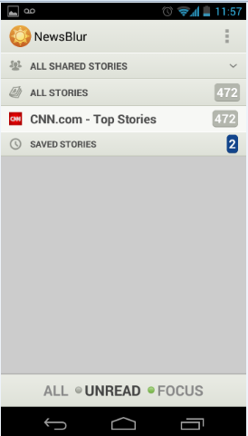
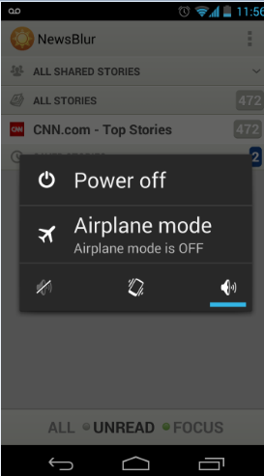
Activity States
Active or Running
Activity appear in the foreground
Gets highest priority
Get killed only on extreme case like app becomes unresponsive
Paused
Activity covered partially or completely
Gets second highest priority
Get killed only to keep the Running activity responsive
Stopped
Completely hidden or in the background
Gets Lowest priority

Slide 6
Android Intent
A simple message object which is used by activity to go from one to another
The following tasks are performed using Intent:
Start a new Activity or Service from the current Activity
Pass data between Activities and Services

Slide 7
Service
Runs in background without user interface
Uses broadcast receivers to communicate
Notifies users through notification framework
Runs in hosting process’s main thread unless specified to create its own thread
Recommended to run in own thread for CPU intensive tasks, E.g. File download
Also consider to use AsyncTask, HandlerThread instead of Service for CPU intensive work

Slide 8
Service States
Started State
Application components start service by calling startService() method
Runs indefinitely in the background even if the component that started destroyed
Stops itself once the task is completed or can be stopped by the component
Bound State
Application components start service by calling bindService() method
Provides client-server like interface, so component can directly call service methods and get results
More than one component can bind the same service
Destroyed when no component bound to it

Slide 9
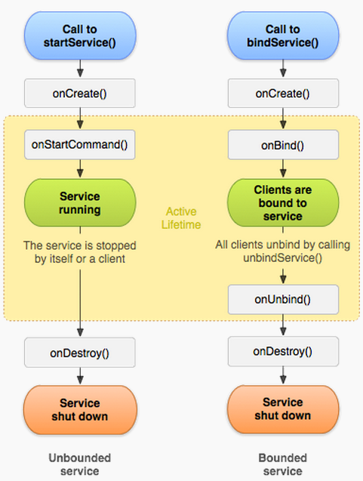
Service Life cycle

Slide 10
Broadcast Receivers
A component used to register for system wide or applications broadcast events
Notified by Android system when broadcast event occur
Not providing user interface, may notify the users through notification status message
There are two kind of events
System level events : Originated from Android system
E.g. Boot completed, power connected, power disconnected, battery low, battery OK
Application level events: Originated from user application
E.g. MP3 file downloaded, Picture captured

Slide 11
Broadcast Receivers
Life cycle : Once the onReceive() of the receiver class has finished, the Android system recycles the receiver
Able to work even if the application is not running

Slide 12
Content Provider
App can store data locally in the file systems, SQLite database
App runs in its own process and permission that keeps data hidden from another app
Content Providers offers data sharing between apps
Contacts app provides data multiple apps such as SMS app, Dialer app etc
Data can be queried, modified, deleted and added through Content Provider
The below URI can be used for querying
<prefix>://<authority>/<data_type>/<id>

Slide 13
Android manifest
Describes components and settings of an app
File placed in root of the project structure
Read by the system during startup
Provides Java package name which is an unique identifier of an app
Describes the components – Activities, Services, Broadcast receivers, Content providers
Defines various permissions
Declares required minimum level of API

Slide 14
NewsBlur Demo Application
Open sourced NewsBlur app
Available in Google play store
Capabilities:
User sign up, login
Search feeds, Add and delete RSS, Atom news feeds
Multiple category views : All stories, saved stories etc
Read news feed one by one
Background news feed syncing
Offline news reading from local storage (DB)
Share news, mark as read or unread

Slide 15
Thank You

