Slide 1
E-SHOPPING
Management system
PRESENTED BY
LOYO JESWIN
SARANRAJ M
SIDDHARTH
ARACHNA
GOWTHAMI
PAVIThRA
Under the guidance of
Mrs. Pooja

Slide 2
INTRODUCTION
E-Shopping also known as electronic Shopping or internet Shopping, refers to the buying and selling of goods or services using the internet, and the transfer of money and data to execute these transactions. E-Shopping is often used to refer to the sale of physical products online, but it can also describe any kind of commercial transaction that is facilitated through the internet.
Whereas e-business refers to all aspects of operating an online business, E-Shopping refers specifically to the transaction of goods and services.

Slide 3
Analysis
SOFTWARE SPECFICATIONS
TECHNOLOGY : JAVA
BUSINESS LAYER :SpringBoot,Spring Framework,RestAPI.JPA,Hibernate
DATABASE :MY SQL
TESTING TOOL :POSTMAN
WEB SERVER :TOMCAT SERVER

Slide 4
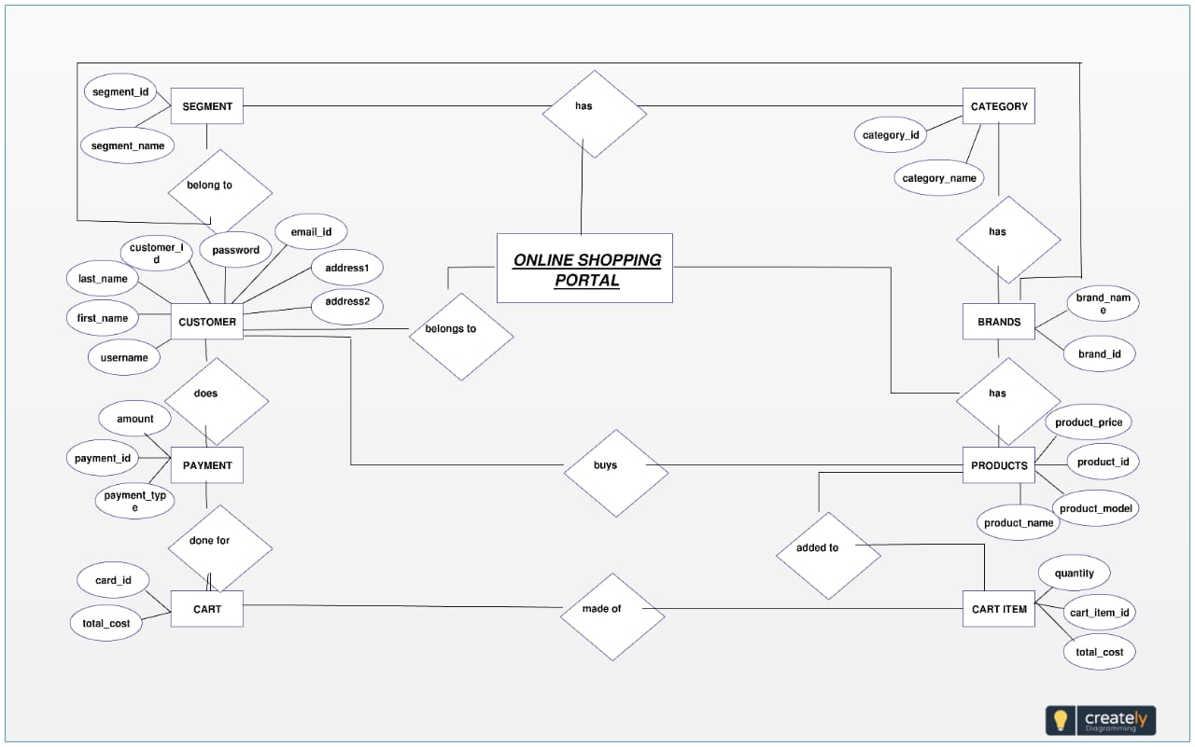
Er diagram

Slide 5
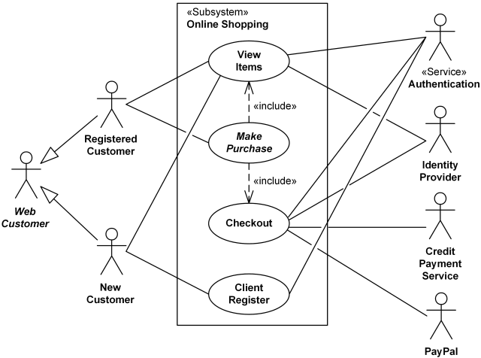
Usecase diagram

Slide 6
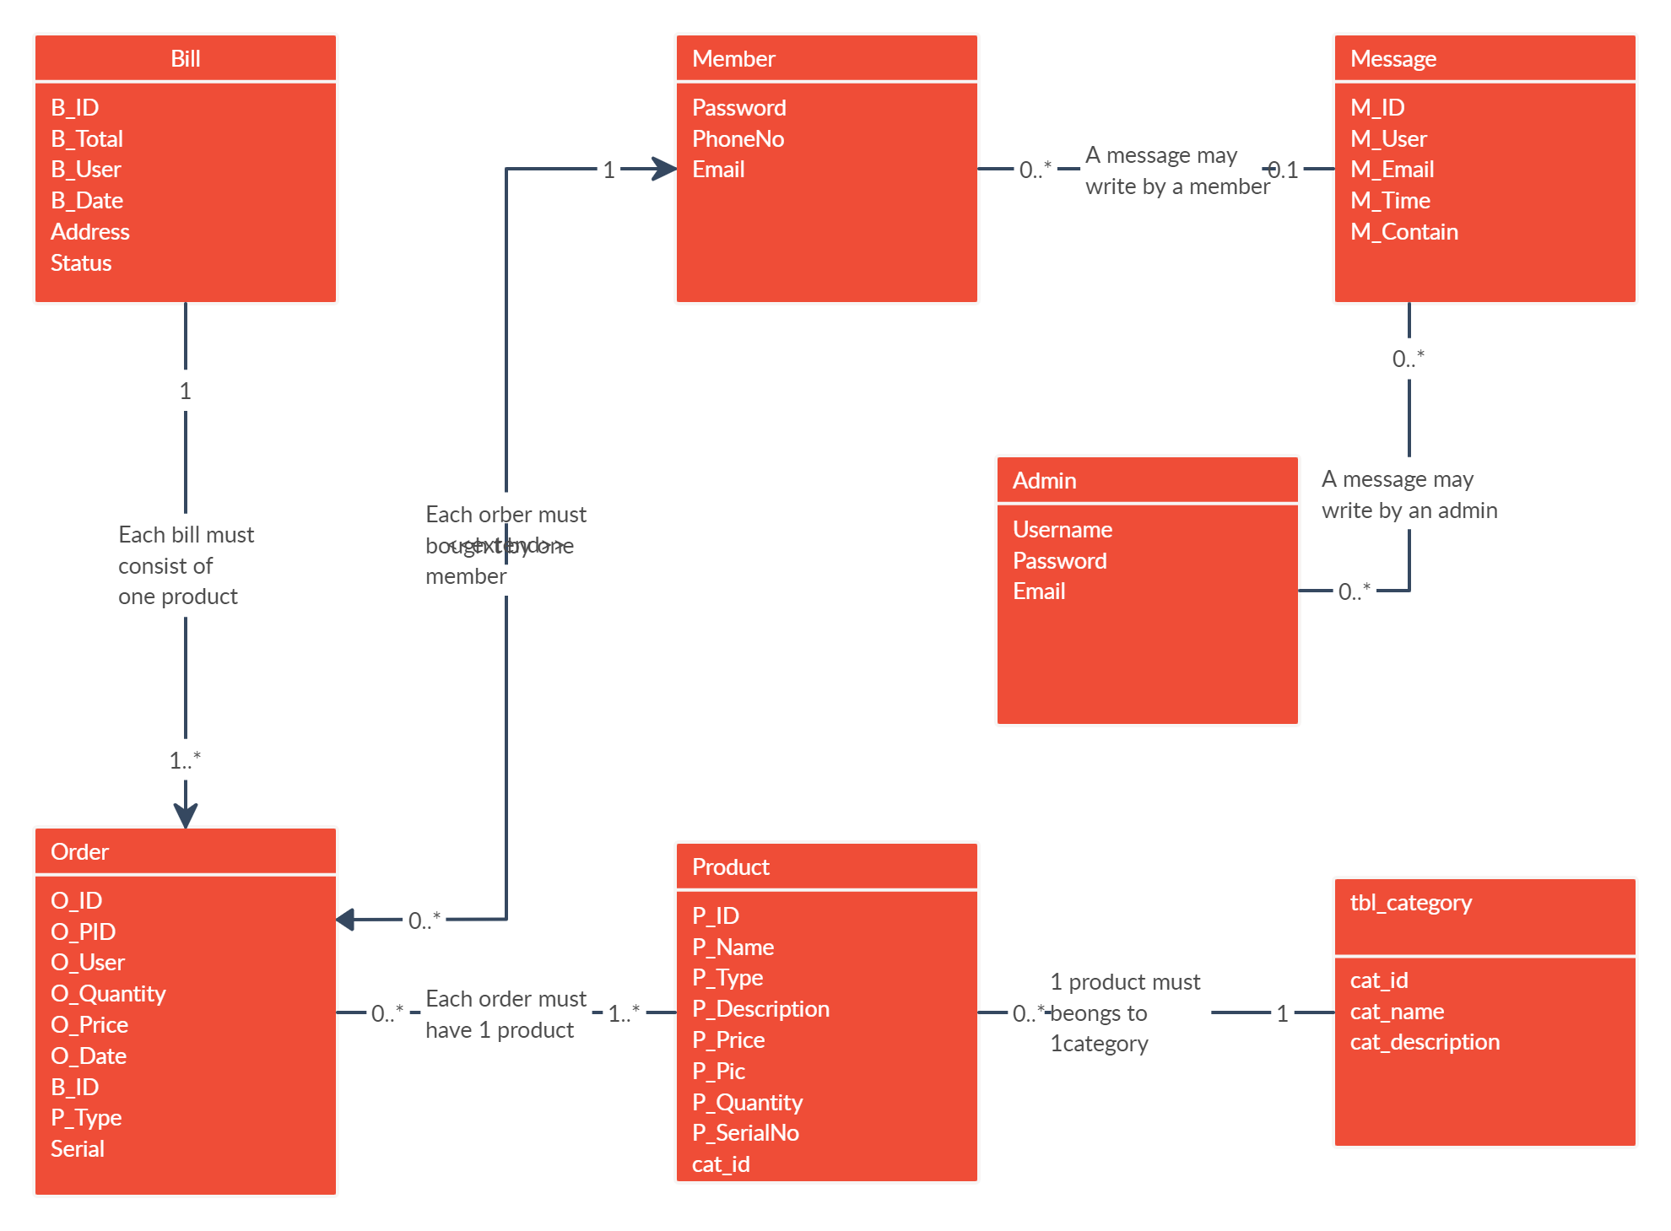
Class diagram

Slide 7
Implementation
E-shopping implementation consists of all the steps related to the launch, update, and maintenance of an online store. E-shopping allows businesses to sell products from anywhere at any time, and it connects businesses to new customers who were previously unreachable due to distance and hours of operation.
It involves careful planning, investigation of the current system and its constraints on implementation, design of methods to achieve the changeover, and an evalua, the notion of change over methods a part of planning.
Two major tasks of preparing the implementation are education and training of the users and testing of the system.

Slide 8
Feasibility study
E-Shopping offers potential in the form of enhanced participation in the international value chain and public relations. • The feasibility can be improved by providing suitable ICT infrastructure and improving cross-country regulatory differences.
All plans feasible – given limitless resources and immeasurable time. All the conceivable ways to deliver a solution to the given problem are found by the feasibility study.
This planned answer would please all the workers need and must be flexible plenty so that future studies can be simply done founded on the future imminent supplies.

Slide 9
Economic feasibilirty
This is very important aspects to be considered while developing a project.
We decided the technology for our project founded on smallest conceivable charge influence.
Entirely tools and system fee obligates to be done by developer.
Completely we have projected that the benefits the creator is going to receive from the planned system will surely dazed the initial prices and the later on organizational cost for system.

Slide 10
Technical feasibility
The technical feasibility education contains a study of function, presentation, and restraints that may move the ability to achieve a suitable system.
For this possibility study, we deliberate the whole functionality to be in the organization, as labeled in the System Obligation Specification (SOS), and checked if the whole thing was possible using the different types of frontend and backend operations.

Slide 11
modules
Admin :
Admin has the official powers to control the flow of data from one part of the system to the other.
He can manipulate the access of the users to the data.
Hence all the data will be reflected in clean and well data in the interfaces.
Customer :
Check all products and give orders for the products. Check order status and see recently add cart products.
Order:
The order from the dealer is a tough phone and the products; quality is entered by an employee. After that it reses tools be saved in the database and a crystal account will have produced for billing purposes.

Slide 12
modules
Cart :
After the trade, the products will be directed to the cart. In the cart unit, we can get the total quantity of products available.
Payment :
Configurable to permit and charge, or authorize only on the conception of invoices.
Cash on delivery is available.
Product :
Detail information about the product is provided by the admin.

Slide 13
OVERVIEW OF TECHNOLOGIES USED

Slide 14
JAVA
JAVA was developed by James Gosling at Sun Microsystems Inc in the year 1995, later acquired by Oracle Corporation.
It is a simple programming language. Java makes writing, compiling, and debugging programming easy. It helps to create reusable code and modular programs.
Java is a class-based, object-oriented programming language and is designed to have as few implementation dependencies as possible.
A general-purpose programming language made for developers to write once run anywhere that is compiled Java code can run on all platforms that support Java.
Java applications are compiled to byte code that can run on any Java Virtual Machine. The syntax of Java is similar to c/c++.

Slide 15
Springboot
Spring Boot is an open-source micro framework maintained by a company called Pivotal.
It provides Java developers with a platform to get started with an auto configurable production-grade Spring application.
With it, developers can get started quickly without losing time on preparing and configuring their Spring application.
Spring Boot is built on top of the Spring framework, and it comes with many dependencies that can be plugged into the Spring application.
Some examples are Spring Kafka, Spring LDAP, Spring Web Services, and Spring Security.
However, developers have to configure each building brick themselves using a lot of XML configuration files or annotations
The main goal of the Spring Boot framework is to reduce overall development time and increase efficiency by having a default setup for unit and integration tests.
If you want to get started quickly with your Java application, you can easily accept all defaults and avoid the XML configuration completely.

Slide 16
Difference between spring and springboot
Well, the Spring framework focuses on providing flexibility through its dependency injection feature.
It helps to inject the required dependencies quickly but also to develop your application in a loosely coupled fashion.
Some other benefits include: A lightweight framework. Helps with loose coupling dependencies and testability. The modular architecture allows you to pick the parts you need and isolate them.
Has support for both XML and annotation configuration.
Spring Boot, on the other hand, is focused on shortening the code length and providing you with an easy way to run your Spring application

Slide 17
Features of springboot
Auto configuration: Developers can automatically configure their Spring application.
However, Spring Boot is also capable of changing the configuration based on the dependencies you list.
For example, when you list “MySQL” as a dependency, it will configure your Spring application with the “MySQL connector” included.
And if you want to add a custom configuration, you can create a class that overrides the default configuration for your “MySQL connector”.
Standalone: There’s no need to deploy your application to a web server. You simply enter the run command to start the application.

Slide 18
Rest api
Representational State Transfer (REST) is an architectural style that defines a set of constraints to be used for creating web services. REST API is a way of accessing web services simply and flexibly without any processing.
It’s used to fetch or give some information from a web service. All communication done via REST API uses only HTT requests.
An API for a website is code that allows two software programs to communicate with each other. The API spells out the proper way for a developer to write a program requesting services from an operating system or o application.
Working: A request is sent from client to server in the form of a web URL as HTTP GET or POST or PUT or DELETE request. After that, a response comes back from the server in the form of a resource which can be anything like HTML, XML, Image, or JSON. But now JSON is the most popular format being used in Web Services.

Slide 19
Rest api
In HTTP 4 methods are commonly used in a REST-based Architecture i.e., POST, GET, PUT, and DELETE.
GET: The HTTP GET method is used to read (or retrieve) a representation of a resource. In the safe path, GET returns a representation in XML or JSON and an HTTP response code of 200 (OK). In an error case, it most often returns a 4 (NOT FOUND) or 400 (BAD REQUEST).
POST: The POST verb is most often utilized to create new resources. In particular, it’s used to create subordinate resources That are, subordinate to some other (e.g. parent) resource. On successful creation, return HTTP status 201, returning a Location header with a link to the newly-created resource with the 201 HTTP status.
PUT: It is used for updating the capabilities. However, PUT can also be used to create a resource in the case that e resource ID is chosen by the client instead of by the server. In other words, if the PUT is to a URI that con the value of a non-existent resource ID. On successful update, return 200 (or 204 if not returning any con in the body) from a PUT.
DELETE: It is used to delete a resource identified by a URI. On successful deletion, return HTTP status 200 (OK) along with a response body.

Slide 20
Jpa(java persistence api)
JPA stands for Java Persistence API (Application Programming Interface). It was initially released on 11 May 2006.
It is a Java specification that gives some functionality and standard to ORM tools. It is used to examine, control, and persist data between Java objects and relational databases.
The JPA specification defines the object-relational mapping internally, rather than relying on vendor-specific mapping implementations.
JPA is based on the Java programming model that applies to Java Enterprise Edition (Java EE) environments, but JPA can function within a Java SE environment for testing application functions.
JPA represents a simplification of the persistence programming model.
The JPA specification explicitly defines the object-relational mapping, rather than relying on vendor-specific mapping implementations.
JPA standardizes the important task of object-relational mapping by using annotations or XML to map objects into one or more tables of a database.

Slide 21
hibernate
Hibernate is a framework in Java that comes with an abstraction layer and handles the implementations internally.
The implementations include tasks like writing a query for CRUD operations or establishing a connection with the databases, etc
Hibernate is an aanORM tool means which supports Object-relational mapping. Whereas JDBC is not object-oriented moreover e are dealing with values that are primitive data. In hibernate each record is represented as an object but in JDBC each record is nothing but data which is nothing but primitive values.
Benefits of Hibernate :
Any changes made are encapsulated in the data source itself, so that when those sources or their application programming interfaces (APIs) change, the applications that use ORM don't have to make changes or even be aware of that information.
Similarly, programmers can have a consistent view of objects over time, although the sources that deliver them, the sinks that receive them, and the applications that access them may change.
Hibernate is freely available to download and is licensed under the open-source GNU Lesser General Public License (LGPL).

Slide 22
postman
Postman is an Application Programming Interface (API) testing tool. API acts like an interface between a couple of applications and establishes a connection between them.
Thus, an API is a collection of agreements, functions, and tools that an application can provide to its users for successful communication with another application.
We require an API whenever we access an application like checking news over the phone, Facebook, and so on.
Postman was designed in the year 2012 by software developer and entrepreneur Abhinav Asthana to make API development and testing straightforward.
It is a tool for testing the software of an API. It can be used to design, document, verify, create, and change APIs.
Postman has the feature of sending and observing the Hypertext Transfer Protocol (HTTP) requests and responses.
It has a graphical user interface (GUI) and can be used in platforms like Linux, Windows and Mac.
It can build multiple HTTP requests − POST, PUT, GET, PATCH and translate them to code.
There are a large number of database management systems currently available, some commercial and some free. Some of them: are Oracle, Microsoft Access, Mysql.
These database systems are powerful, feature-rich software, capable of organizing and searching millions of records at very high speeds.
Understanding Databases, Records, and Primary Keys :
Every Database is composed of one or more tables.These Tables, which structure data into rows and columns, Impose organization on the data.
The records in a table(below) are not arranged in any particular order.To make it easy to identify a specific record, therefore, it becomes necessary.

Slide 23
Mysql
There are a large number of database management systems currently available, some commercial and some free. Some of them are Oracle, Microsoft Access, and Mysql.
These database systems are powerful, feature-rich software, capable of organizing and searching millions of records at very high speeds.
Understanding Databases, Records, and Primary Keys :
Every Database is composed of one or more tables. These Tables, which structure data into row columns, Impose organization on the data.
The records in the table(below) are not arranged in any particular order. To make it easy to identify a specific record, therefore, it becomes necessary.

Slide 24
Front end backend connection

Slide 25
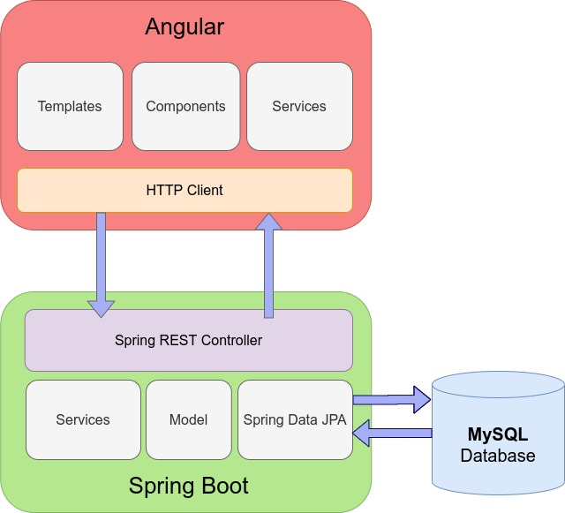

Slide 26
Output screens

Slide 27
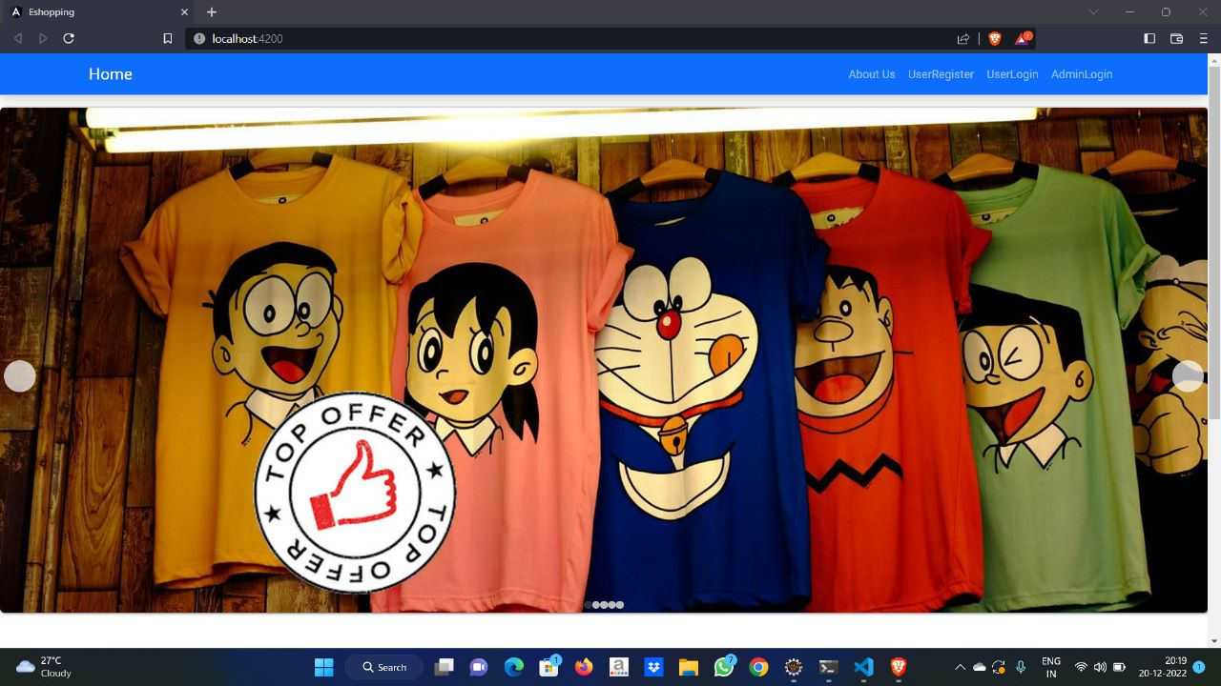

Slide 28
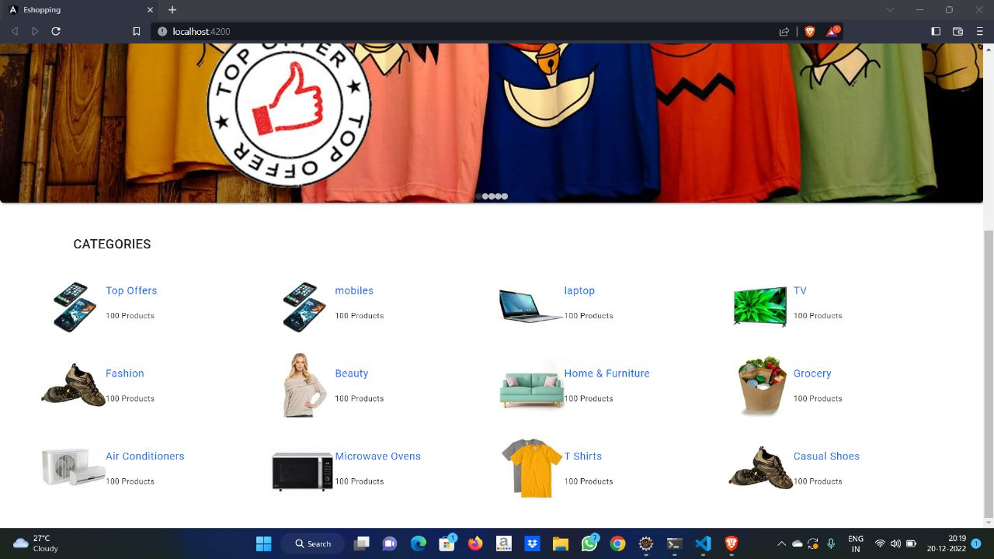

Slide 29
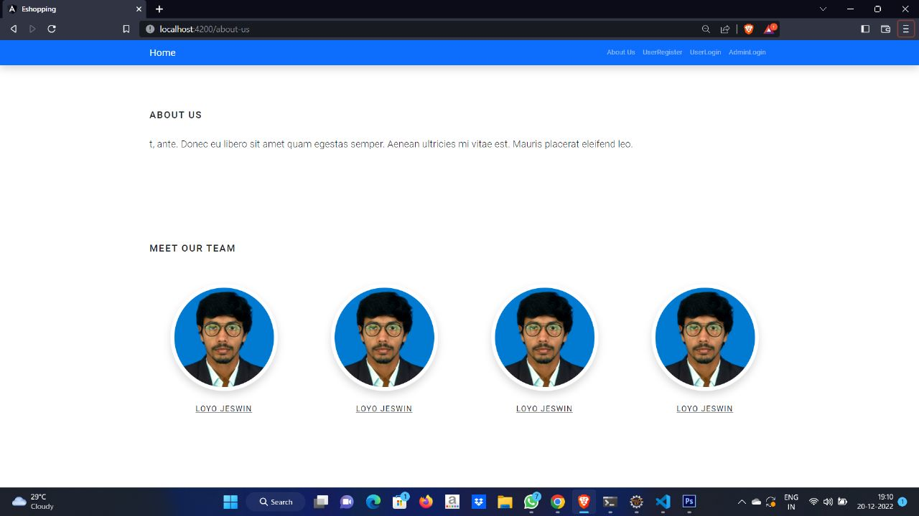

Slide 30
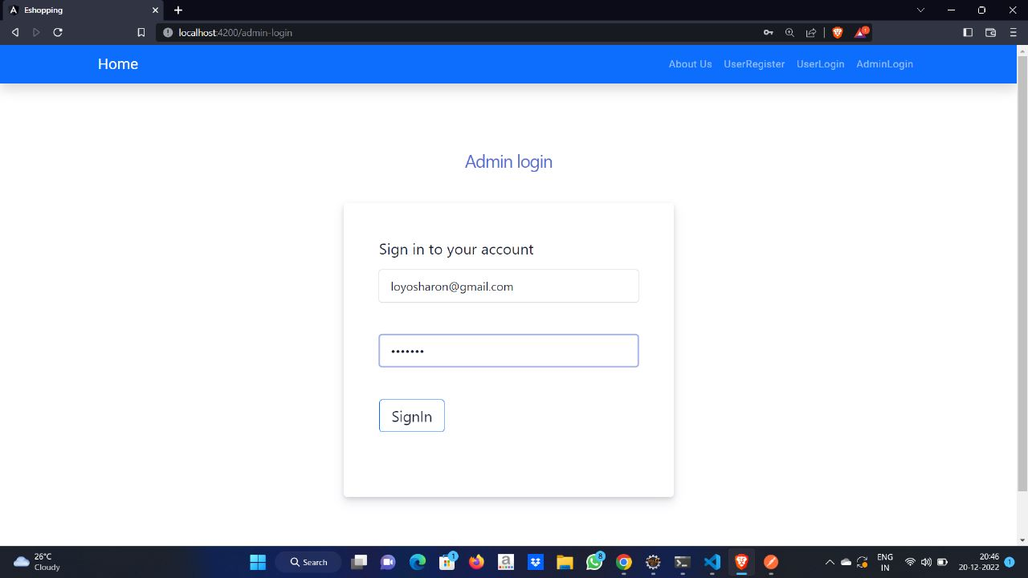

Slide 31
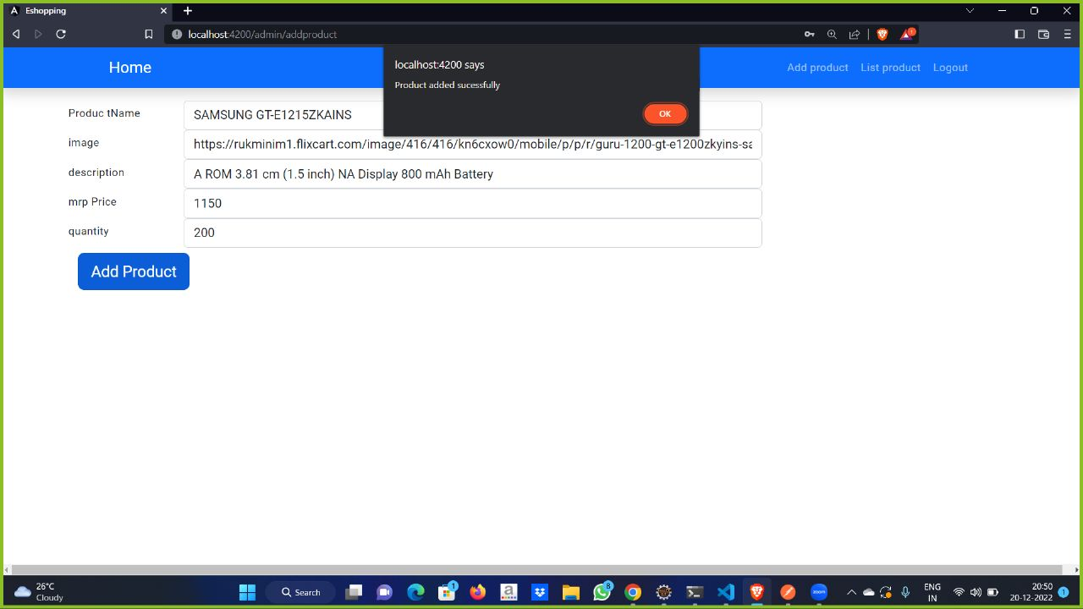

Slide 32
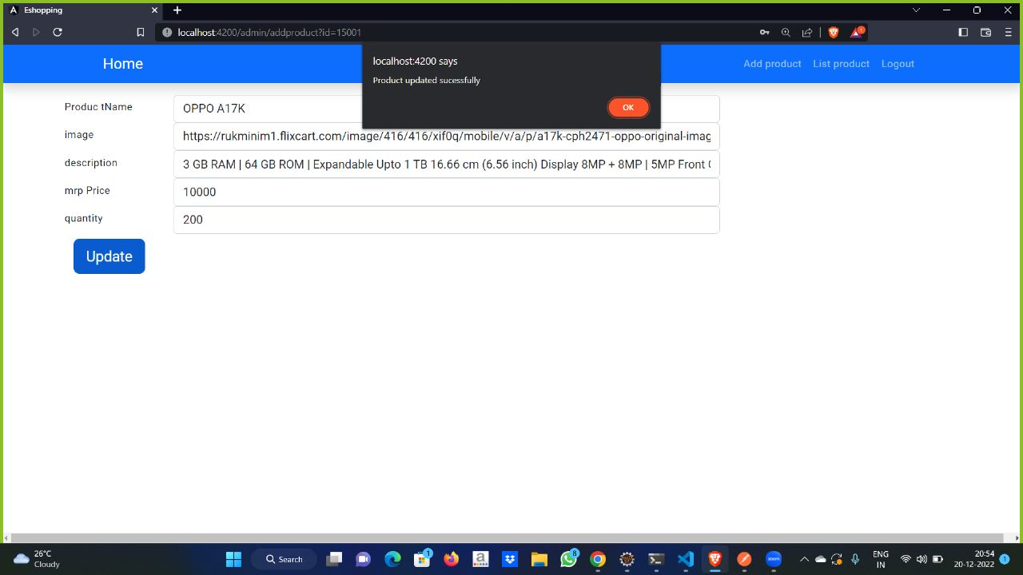

Slide 33
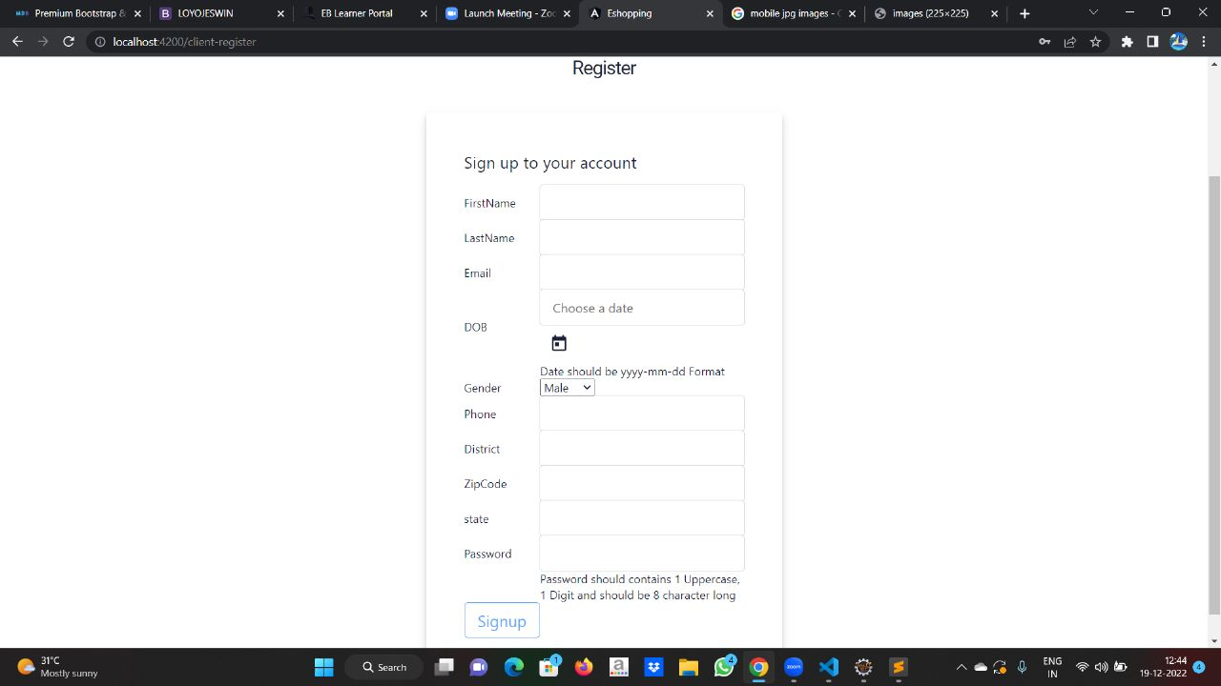

Slide 34
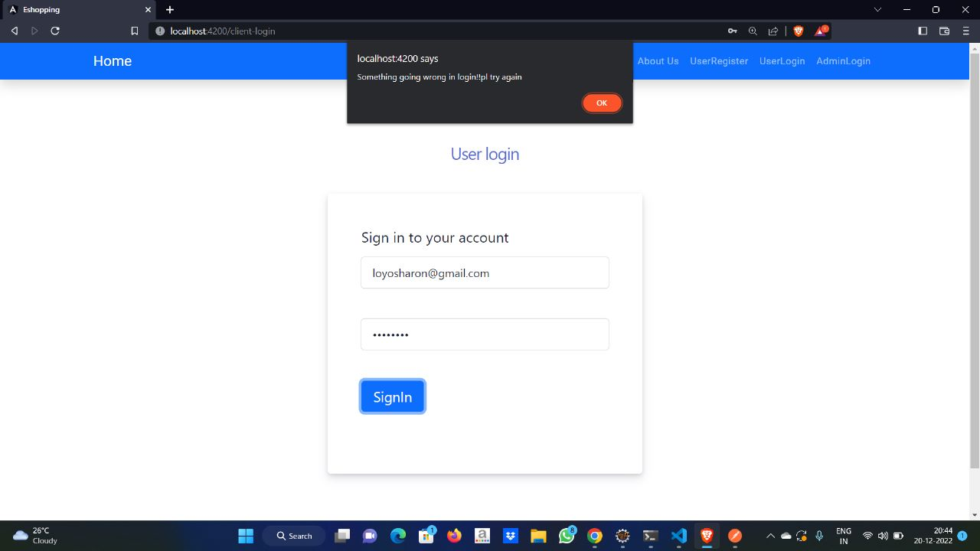

Slide 35
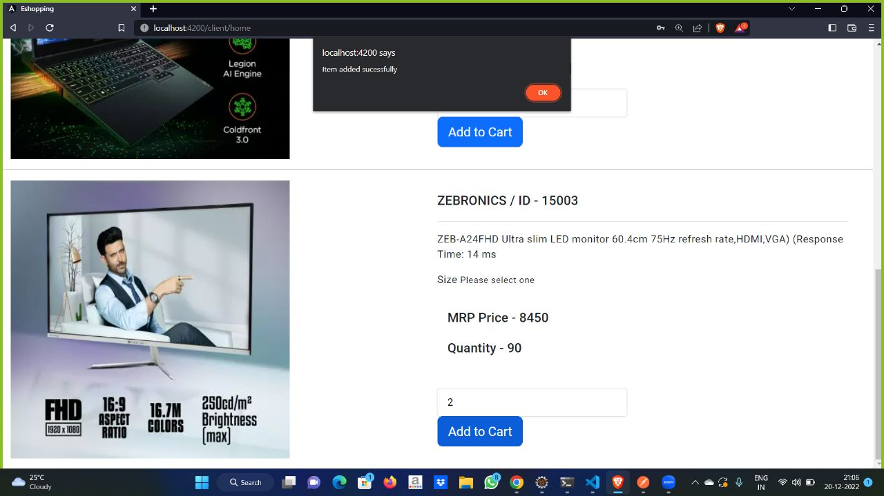

Slide 36
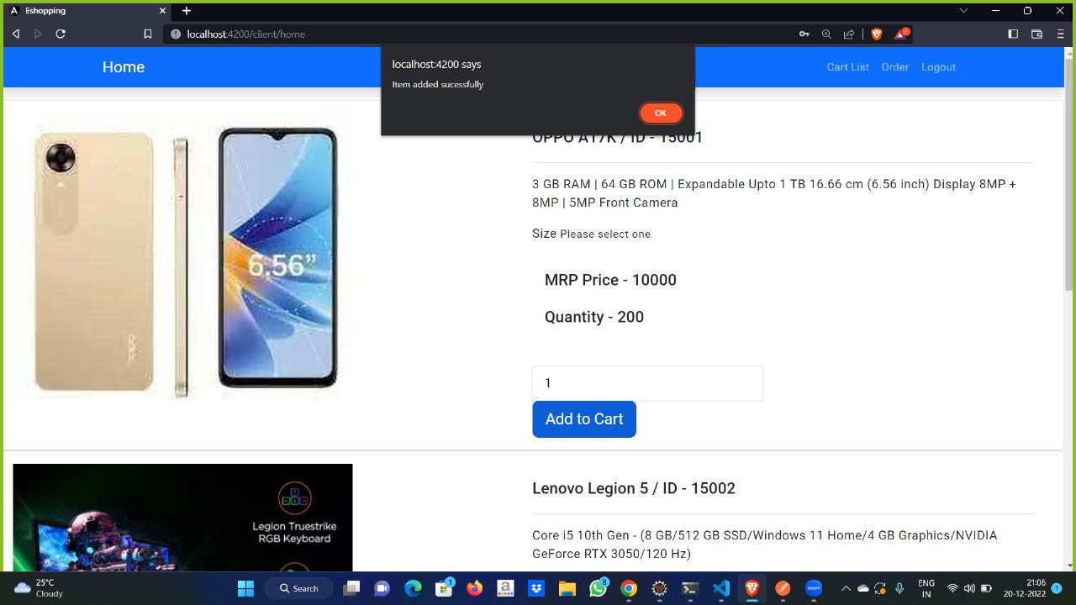

Slide 37
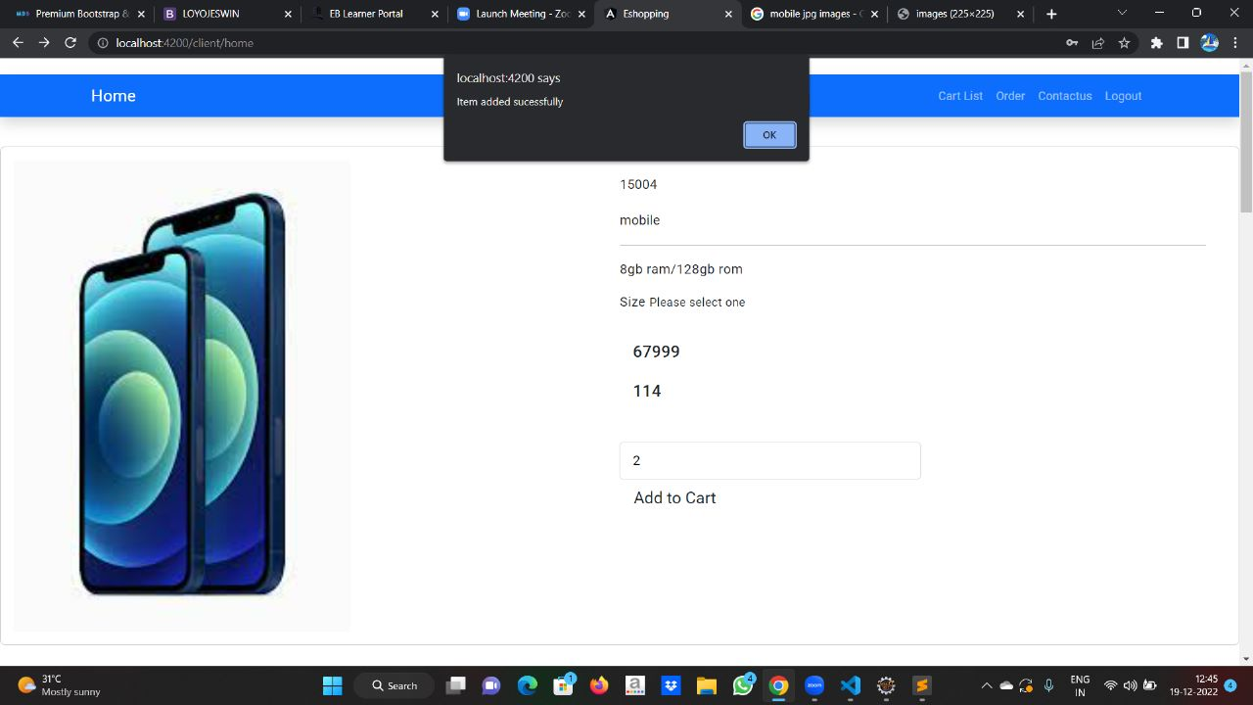

Slide 38
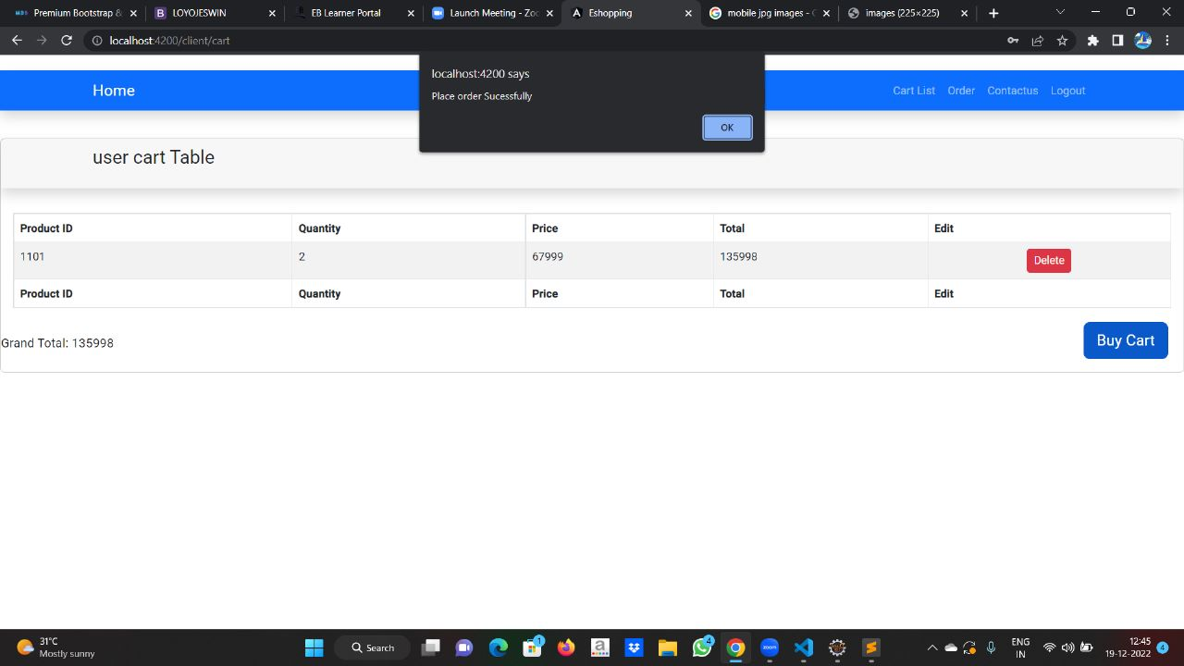

Slide 39
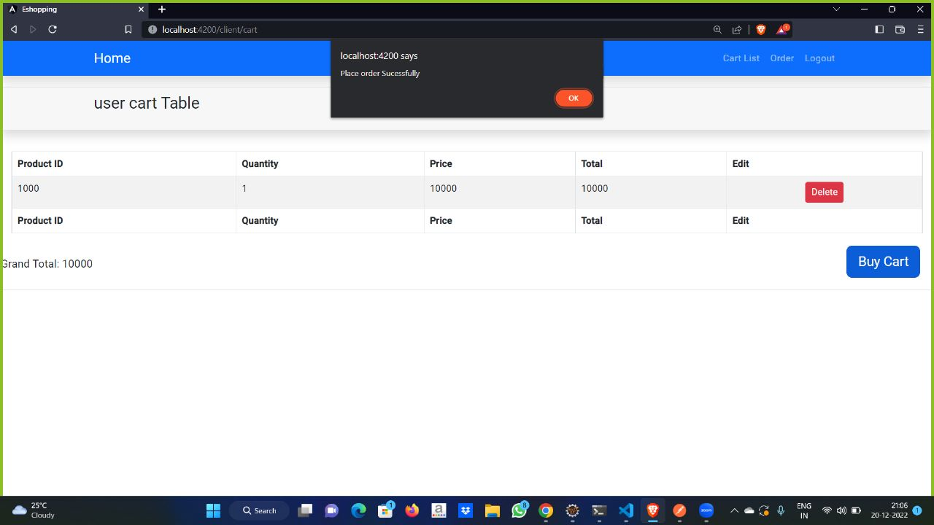

Slide 40
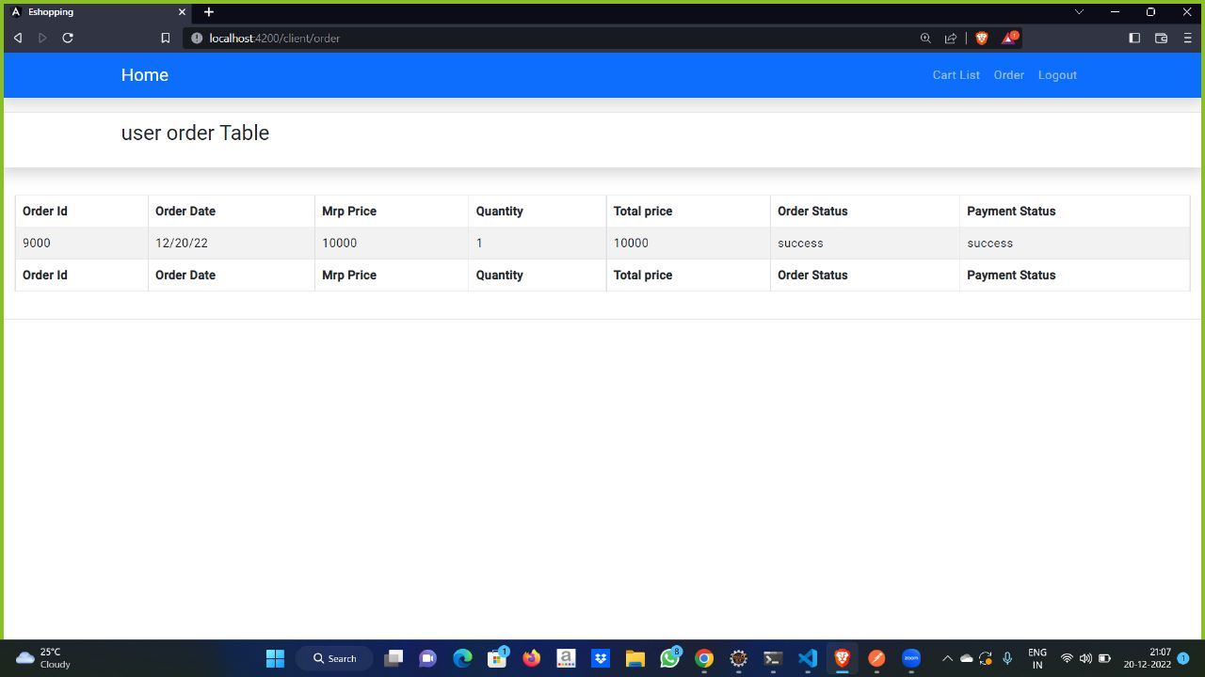

Slide 41
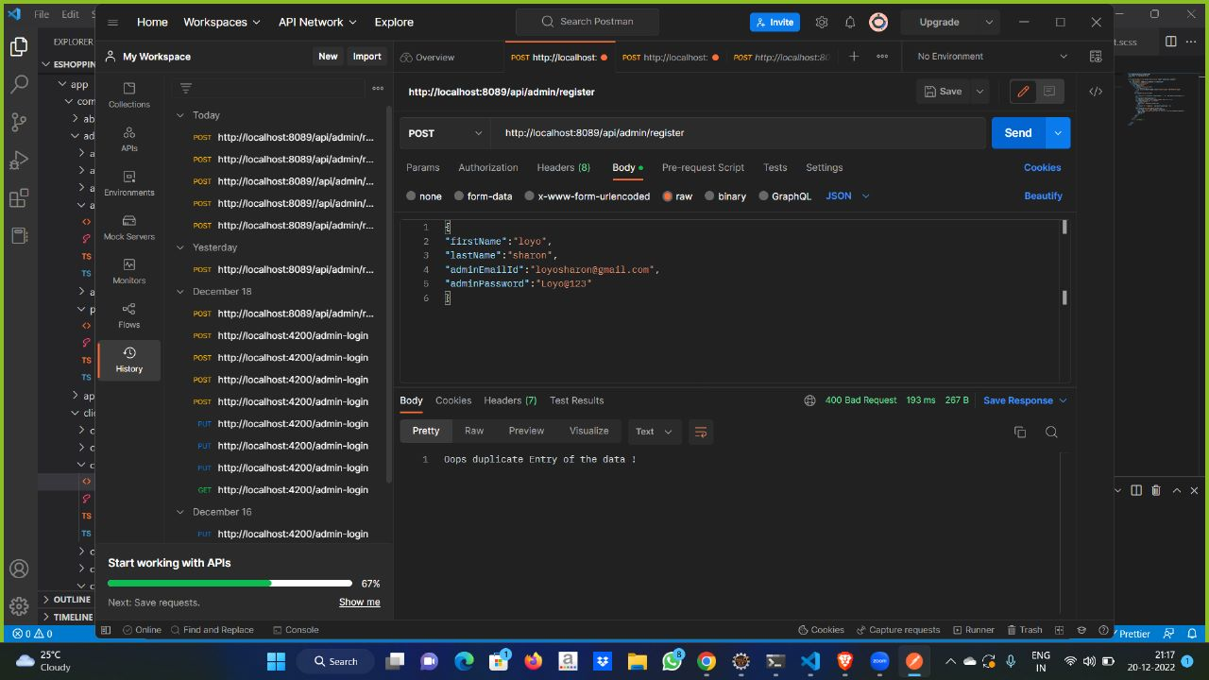

Slide 42
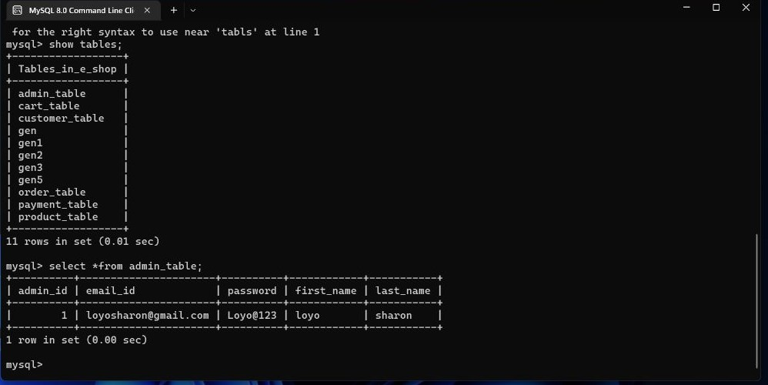

Slide 43
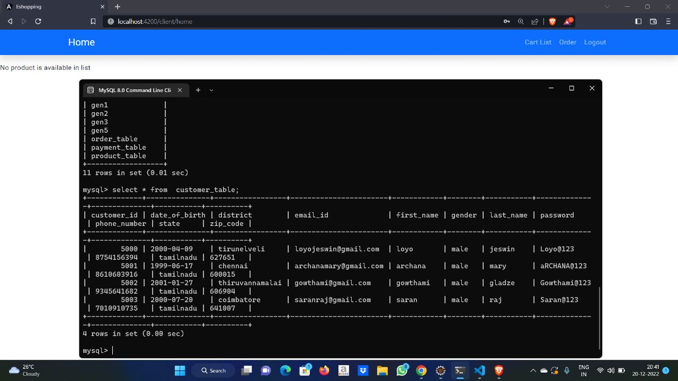

Slide 44
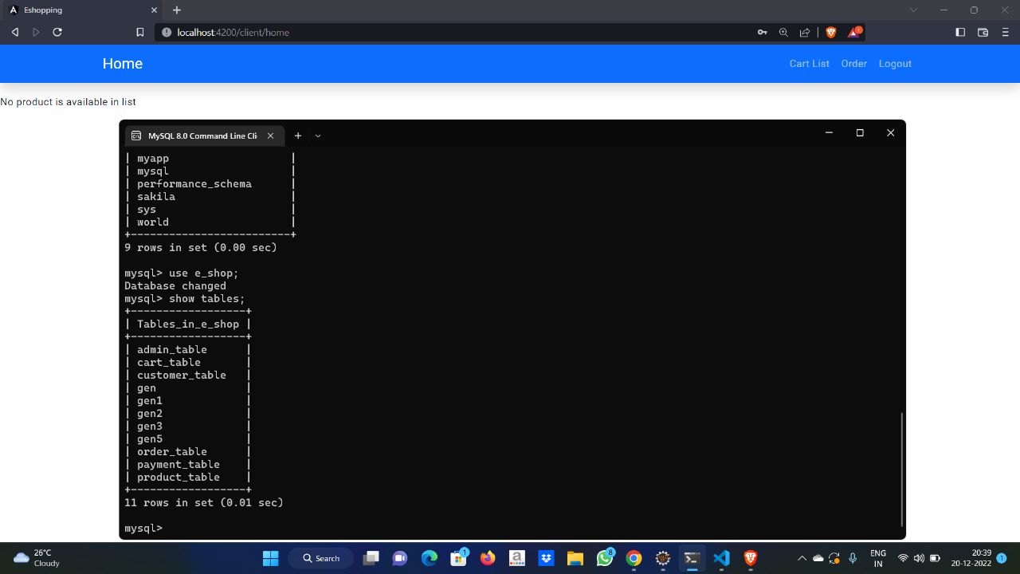

Slide 45
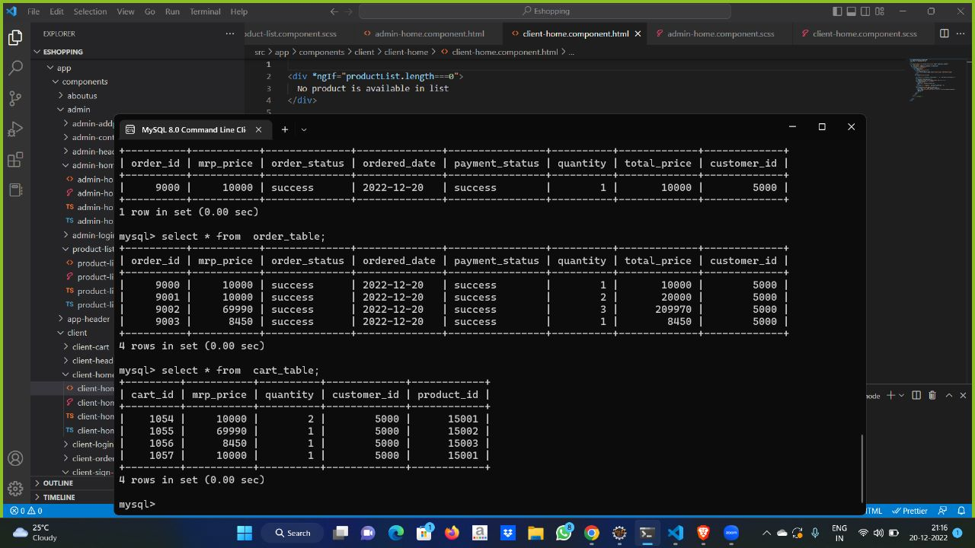

Slide 46
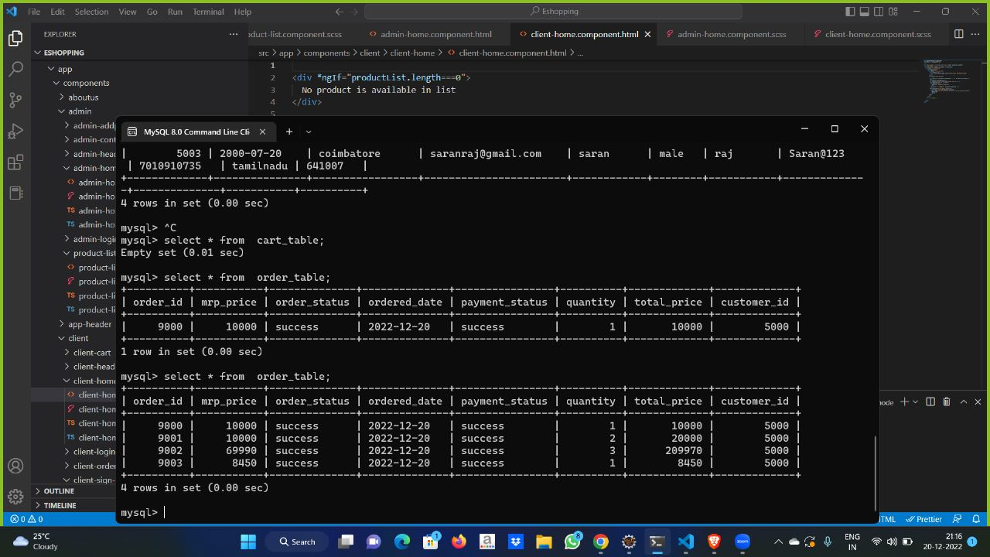

Slide 47
conclusion
E-shopping is not an IT issue but a whole business undertaking Companies that use it as a reason for completely re-designing their business processes are likely to reap the greatest benefits. Moreover, E-Shopping is a helpful technology that gives the consumer access to businesses and companies all over the world.

Slide 48
Future scope
The Management Information System makes the whole process of managing the details of the E-shopping. e.g. details of Items sold, profit, details of the transactions made i.e. sales of items to the customer and purchase of items from the supplier.
the scope of e-commerce businesses is largely a mobile-first approach. Those that haven't made their e-stores mobile-friendly would be losing a lot of business opportunities. A big part of making your e-store website mobile-friendly is ensuring its responsiveness.
The software has been tested for various test cases and has shown satisfactory results. Further it was noticed that it performed fairly well even, the size of the database is large. As the size of database increases the response time of the application may increase.

Slide 49
enhancement
We are confident that in the next release of the Management Information System we shall incorporate the enhanced features as mentioned below.
This project can be further developed. Further enhancement can be delivered by drones and handled by artificial intellengence.
In future we can fix the bugs and issues.

Slide 50
referance
https://www.mageplaza.com/blog/ecommerce-project-management.html
https://www.projecttimes.com/articles/principles-of-ecommerce-project-management/

Slide 51


