Slide 1
Introduction To Machine Learning
-Sarang Mete

Slide 2
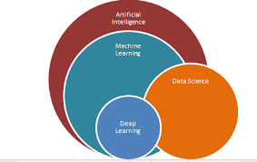
What is Machine Learning?

Slide 3
Types of ML Problems
Supervised Learning: Regression, Classification
Unsupervised Learning
Reinforcement Learning

Slide 4
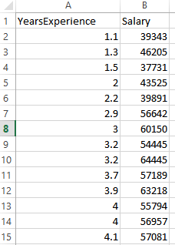
Regression: Predict Salary

Slide 5
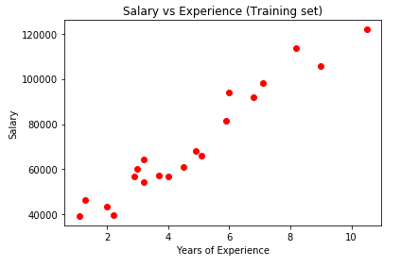

Slide 6
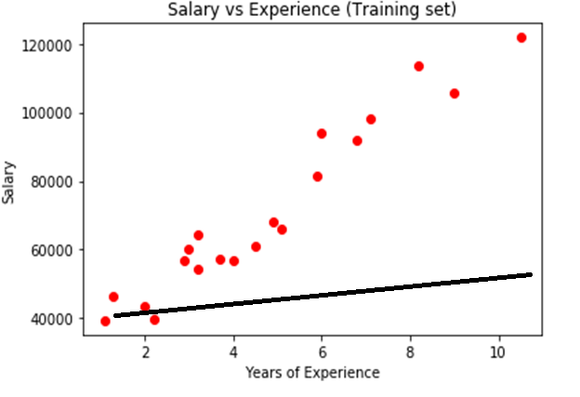

Slide 7
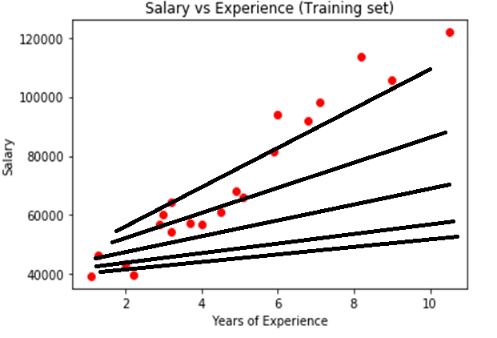

Slide 8
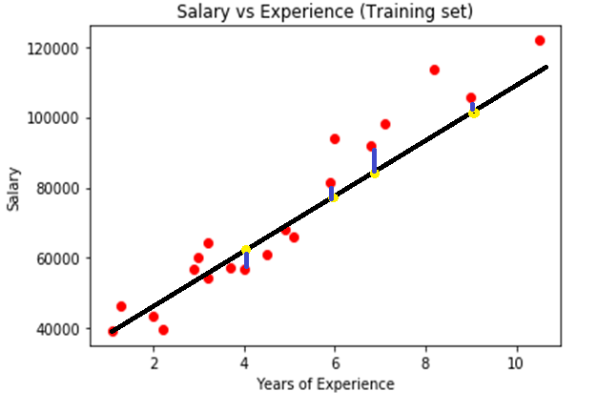

Slide 9
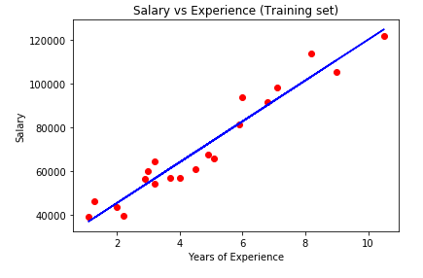

Slide 10
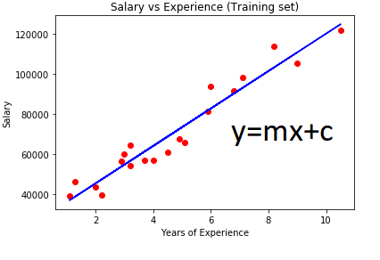

Slide 11
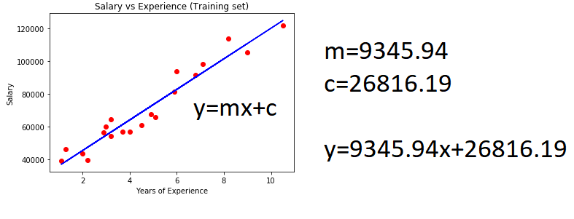

Slide 12
Steps for Problem Solving
1.Get Data
2.Exploratory Analysis
3.Split data into training and test set
4.Data Preprocessing
5.Apply different ML models on training set
6.Tuning best ML model
7.Apply chosen model on test set

Slide 13
Scope in CLS
Chatbot
System Performance Measure
Predicting a value(buy volume, exchange rates, etc.)

