Slide 1
OCR

Slide 2
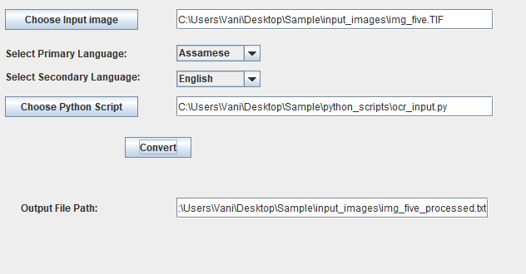
Current Stage of Product

Slide 3
Technology Specifications
Product layer | Technology
User Interface | Java Swing
Controller | Java
OCR Engine | Python, OpenCV, Tesseract

Slide 4
Tesseract
Pixel data is organized in text lines
Depending on character spacing text is divided into characters and words
Median height determination helps separate character from special characters
Recognition of character is two pass process
Clean image improves Tesseract accuracy
Tuning parameters depends on language and image quality

Slide 5
Image Processing and OCR
Steps
Load single image or folder containing multiple images in any image format (bmp, jpg, png,tiff)
Pre-process image for better detection, for example: convert to gray scale, de-skew.
Make boundaries of character thinner. Remove noise from outside and inside of character.
Apply tesseract engine on processed image.

Slide 6
Accuracy comparison
Steps | Description | img_five
 |  | Accuracy% | Processing Time (seconds)
0 | Without any customized preprocessing | 75.74 | 87
1 | Tesseract tuning parameters | 90.59 | 64
2 | Image Binarization(character white,backgroung black) | 90.59 | 75
3 | Automatic deskewing | 92.07 | 60
4 | Noise reduction
5 | Image cropping/Page segmentation

Slide 7
Areas to explore
Explore more on available Opencv functionalities.
Create customized image transformation techniques.
Create generic and robust image processing pipeline for catering different types of images(different fonts, background,noises etc.)
Tesseract-OCR is the most popular OCR engine used. However we may need to train Tesseract for better accuracy by providing training data created using qt-box-editor/jTessBoxEditor.
Explore hardware requirements for better speed.

