Slide 1
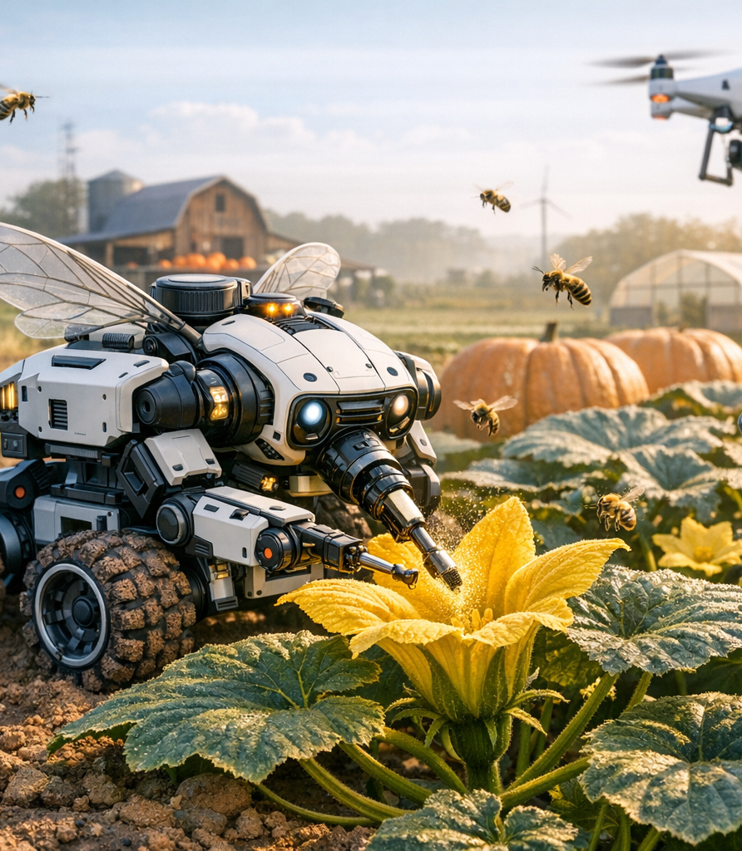

Smart Pollination Assistant for Pumpkin Farming
IT4010 – Progress Presentation 2 (PP2)
Group: 25-26J-189

Slide 2
Problem Statement & Stakeholders
Primary users: Farmers
Secondary users: agricultural researchers
Decision makers: farm owners/policymakers
Pumpkin farming in Sri Lanka relies on manual pollination and farmer experience.
Problem: Pollination must occur within a short time window and requires accurate identification of female flowers, but current methods rely on manual observation.
Impact: Leads to reduced yield, higher labor costs, and inconsistent crop quality.
Manual identification of pumpkin female flowers and timing pollination in the short morning window is difficult, causing missed pollination and reduced crop yield.
Incorrect pollination timing and flower identification lead to lower fruit yield, increased labor effort, and inconsistent crop quality, directly affecting farmer income and agricultural productivity.
Notes:
Pumpkin farming requires precise pollination timing to ensure successful fruit set. However, farmers currently rely on manual observation and natural pollinators, which are inconsistent due to climate variability, labor shortages, and declining pollinator populations.

Slide 3
Research Gap & Objectives
S
Develop an AI + IoT smart pollination assistant for pumpkin farming.
Research Gap
M
≥90% flower detection accuracy and improved fruit set rate.
introduces a novel precision agriculture approach by integrating IoT-based environmental sensing, smartphone-based computer vision, and adaptive machine learning to support real-time pollination decisions
A
Implement using IoT sensors, computer vision, and mobile app.
R
Improves pollination efficiency and farmer productivity.
T
Completed and validated within one cultivation season.

Slide 4
Solution Overview
A smart agriculture system combining IoT sensors and smartphone-based AI to determine optimal pumpkin pollination timing and guide farmers during the pollination window
FR1 – Flower Detection
Detect male and female pumpkin flowers using deep learning.
FR2 – Environmental Monitoring
Sensors collect temperature, humidity, light intensity, and soil moisture.
FR3 – Pollination Recommendation
System determines if pollination should be performed.
FR4 – Disease Detection
Detect plant health issues using image processing.
FR5 – Active Learning
Improve model accuracy using farmer feedback.
Non-Functional Requirements
Real-time performance
Low cost for farmers
Mobile usability
Reliable IoT data collection
70%

Slide 5
System Architecture Overview
link

Slide 6
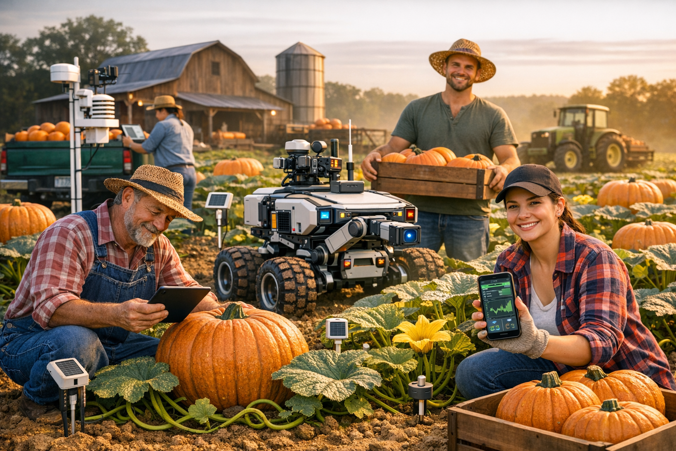
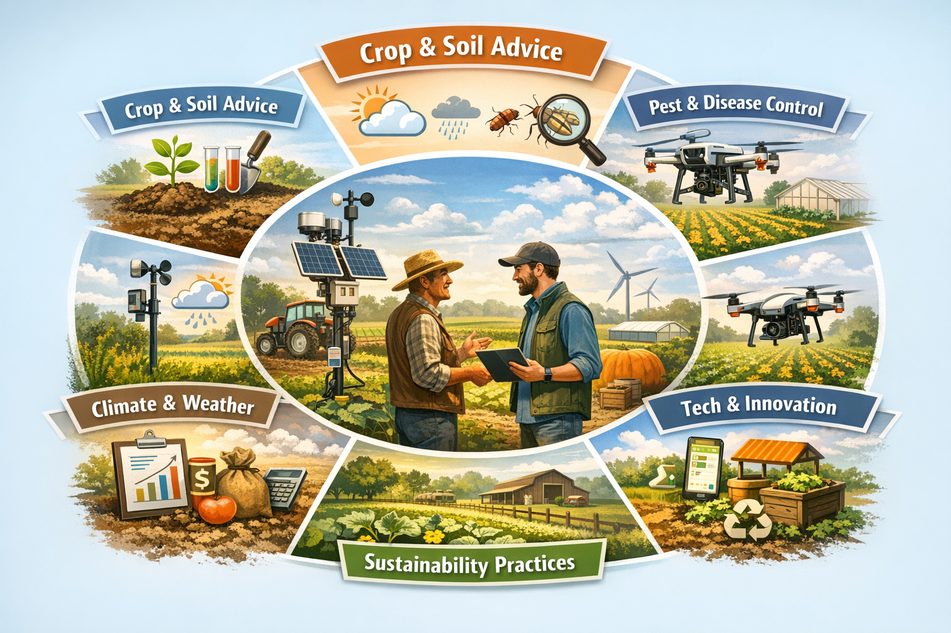
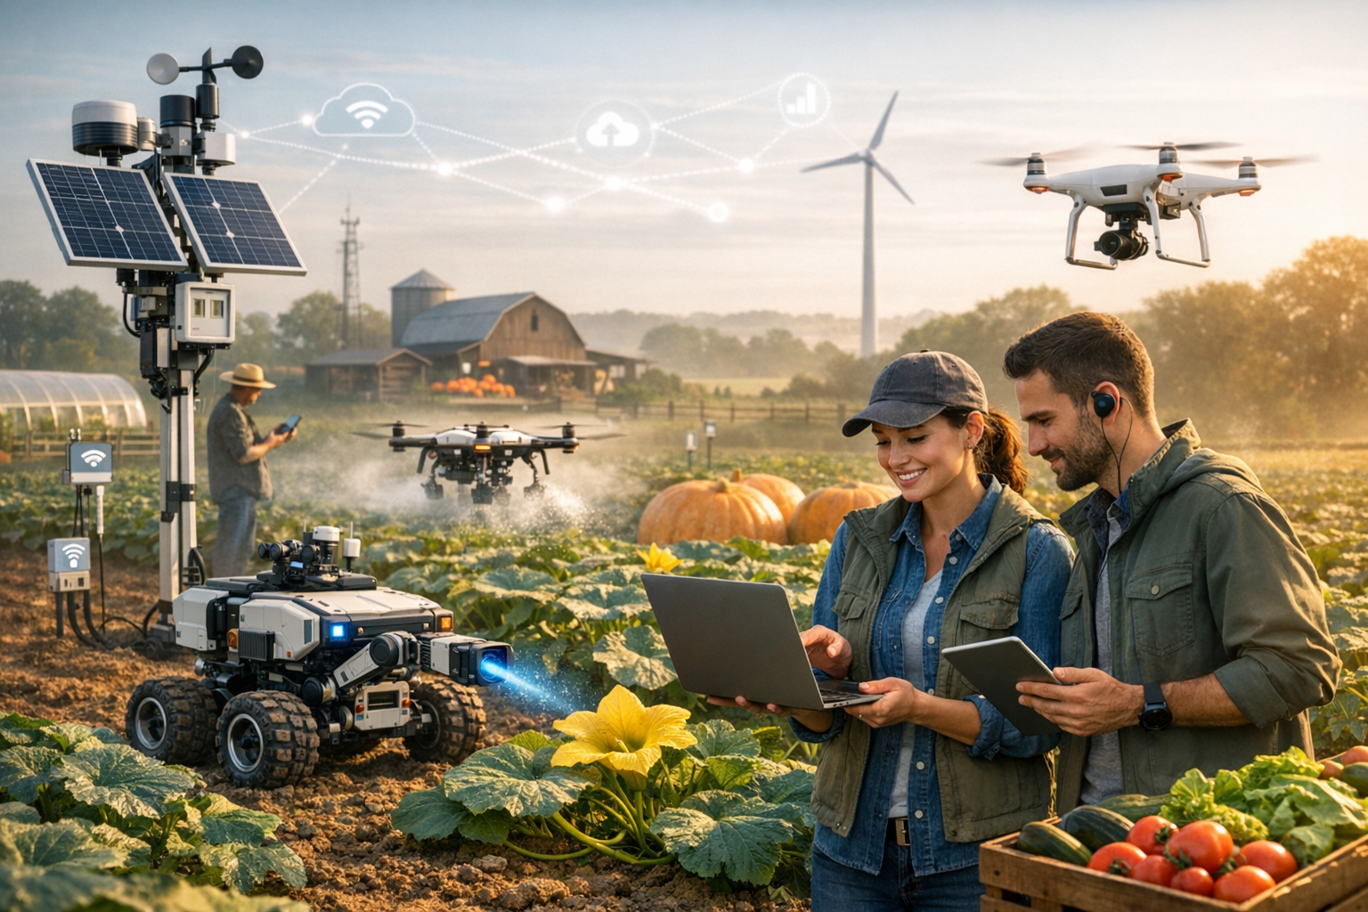
Commercialization / Impact
small‑ and medium‑scale pumpkin farmers
Agricultural Advisory Services
Smart Agriculture Startups

Slide 7
Value Proposition
AI + IoT system that detects female flowers and optimal pollination time
Improves pollination accuracy and crop yield
Reduces manual labor and farmer guesswork
Enables data-driven farming decisions
Cost & Feasibility
Low-cost hardware: ESP32 + environmental sensors
Uses existing farmer smartphones
Estimated setup cost: ~$80–$120 per farm
Affordable for small and medium-scale farmers
Adoption Plan
Pilot testing with local pumpkin farmers
Collect farmer feedback and real field data
Improve AI model and system accuracy
Scale deployment through agricultural organizations and farming cooperatives

Slide 8


Slide 9
