Slide 1


Dialysis of Patients
Group members
(Group No.5)
Mr. Mudavath Naik
Mr. Sarang Javalekar
Miss. Dhanshree Kumbhar
Mr. Pathak Vinay
Mr. Rajeev Sahukar
Mr. Rakesh Kumar

Slide 2
KPI’S
Number of patients in various summaries
Profit vs Non profit stats
Total performance score based on chain organisation
Dialysis station stats
# of Category text as Expected
Average Payment Reduction

Slide 3
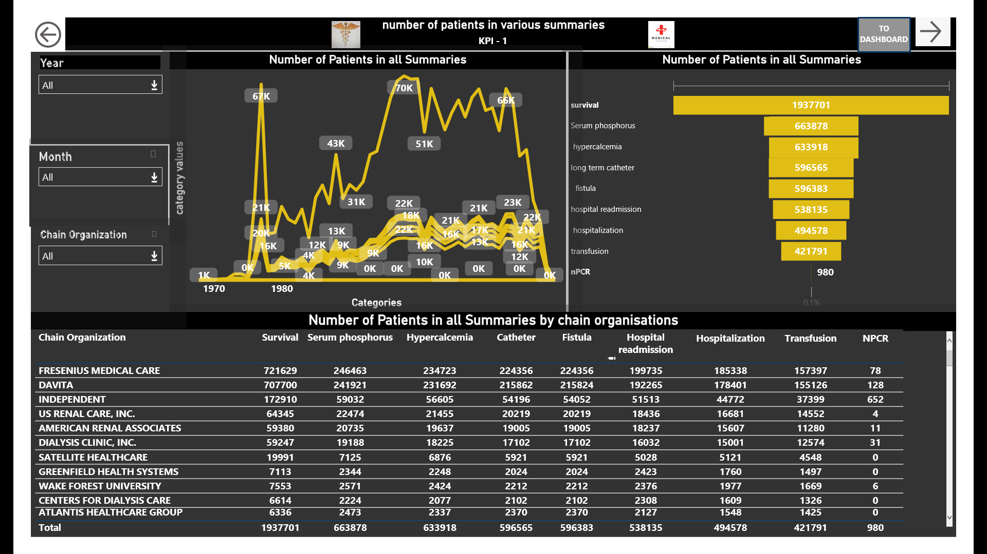
KPI 1
The survival summary have highest count of patients as well as npcr summary have lowest count of patients which is good sign.
Fresenius Medical care and DAVITA have highest survival count which is good sign and Fresenius Medical care and DAVITA have highest in hospitalization and readmission , need to focus why readmission count is so high?
Patients count is continually falling from 2013 to 2018 in all summaries. Why this trend decreasing? Is it a cost or any other reason , find out.

Slide 4
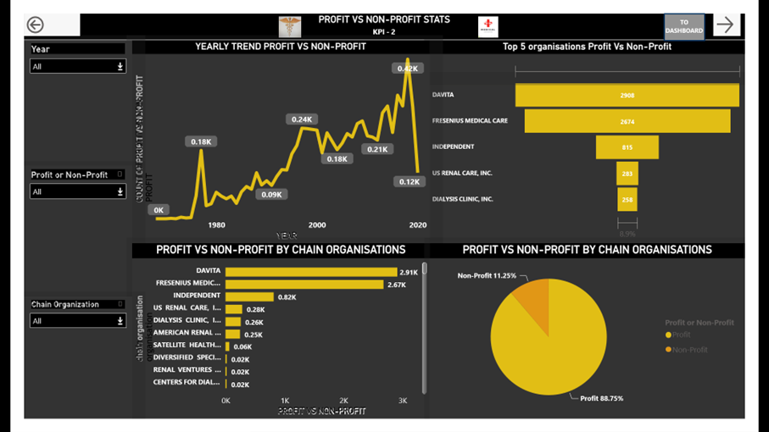

KPI 2
Highest count of profit in facilities is 389 in 2018 and lowest was in 1968. after 2018 to 2020 trend is falling to 114 count of facilities in profit. Its not good sign. Focus on falling count of facilities to make them under profit.
Davita and FRESENIUS MEDICAL CARE are working good and most of facilities under these organizations are in profit.
Profit count of facilities are 88.75% which is good and for non profit facilities go deep to find reasons of being non profit.

Slide 5
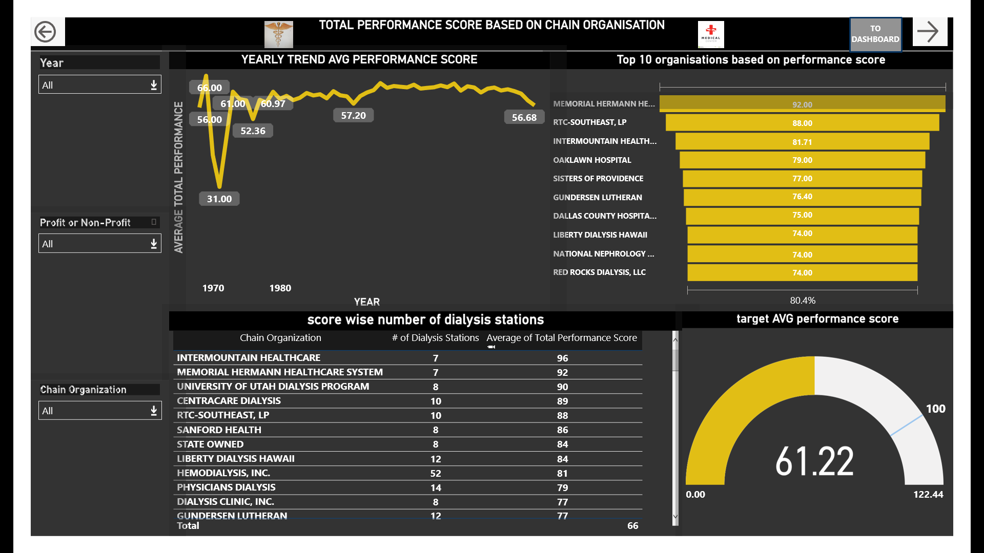

KPI 3
Average highest performance in all the years is 66 in 1969 year where as lowest performance is 31 recorded in 1971. latest performance score is 56.68 and its towards highest so it’s a good performance.
INTERMOUNTAIN HEALTHCARE, MEMORIAL HERMANN HEALTHCARE SYSTEM have high performance scores where as PHYSICIANS CHOICE DIALYSIS, NCPDC KIDNEY CENTER, LLC having lowest performance score.
To improve performance scores in lowest score organizations plan is required to visit , audit to those organizations. Go deep down find reasons for lowest performance scores.

Slide 6
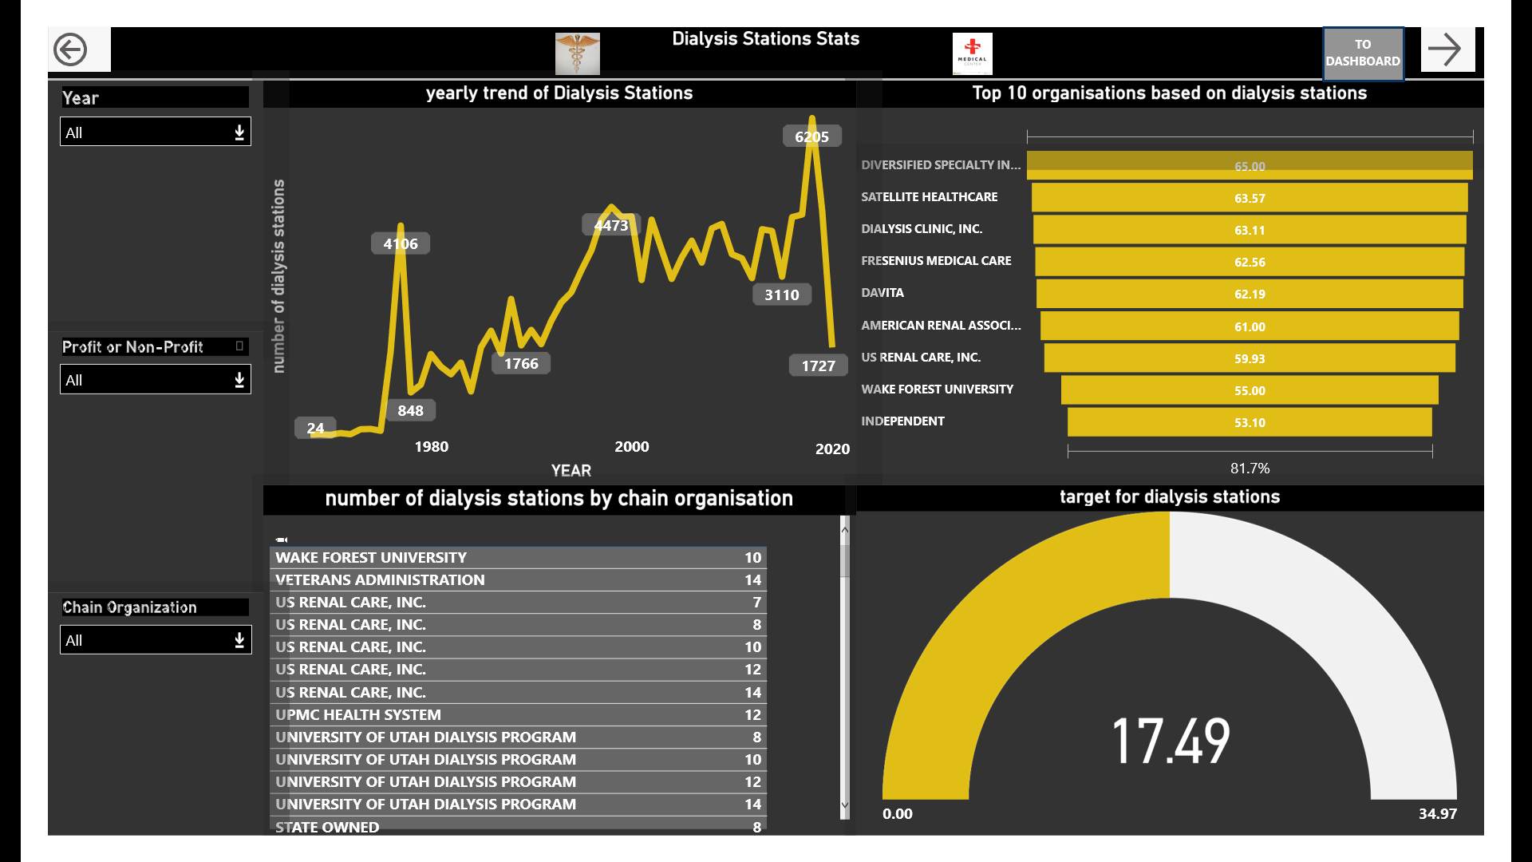

KPI 4
From 1978 to 2018 dialysis stations trend is increasing and then continuously decreasing up to 2018, which is not good sign.
In over all scenario number of stations defines business we can do. Find out reasons what is root cause of falling trend in terms of stations.

Slide 7
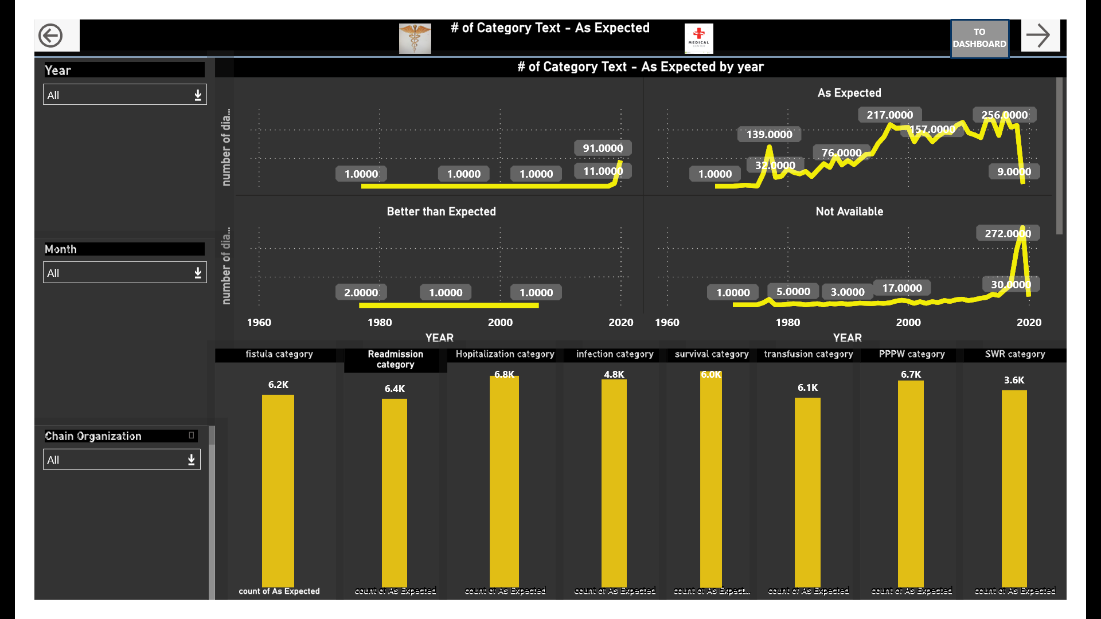

KPI 5
Expected trend is increasing through most of years and falling from 2016 to 2019. verify methods for as expected criteria.
Not available category trend looks constant between year 1982 to 2000 and increasing in year 2020 . Find out why not data available for this category and make it available.
The survival category have good count of patients which is good sign. Hospitalization have highest count of patients which indicates frequency of patients staying in hospital is long.
In comparison to other categories SWR having lowest count of patients which is good sign .

Slide 8
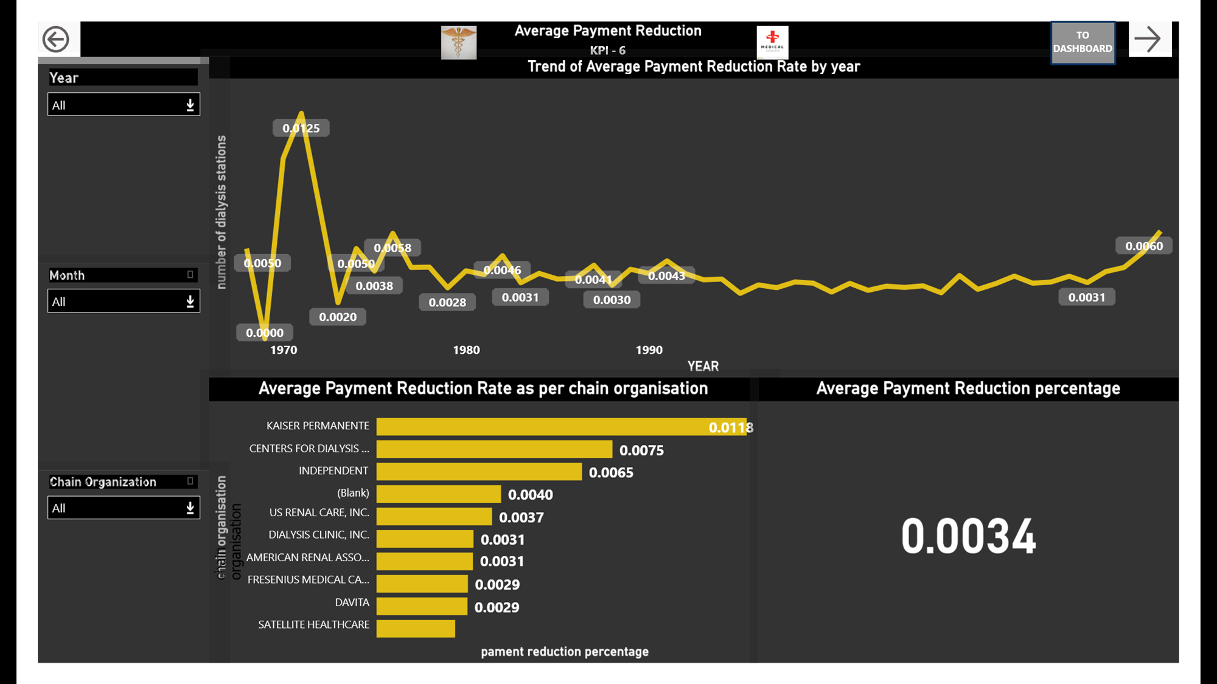

KPI 6
Cost Containment Strategies: aim to is reduce more costs by implementing various strategies such as improving operational efficiency, optimizing supply chain management, or negotiating better pricing with vendors. These strategies can contribute to payment reduction rates.
Reimbursement Models: The payment reduction rate can be influenced by the reimbursement model used in the healthcare project. For example, if the project involves transitioning from a fee-for-service model to a value-based care model, payment reductions might be achieved by focusing on preventive care and reducing unnecessary services.
Technology and Innovation: Utilizing advanced technologies, such as electronic health records (EHRs), telemedicine, or artificial intelligence (AI), can optimize healthcare delivery, reduce administrative costs, and improve patient outcomes, potentially leading to payment reductions.
Quality Improvement Initiatives: we should prioritize quality improvement, such as reducing hospital readmissions, preventing medical errors, or managing chronic conditions more effectively, can lead to cost savings and payment reduction rates.

Slide 9
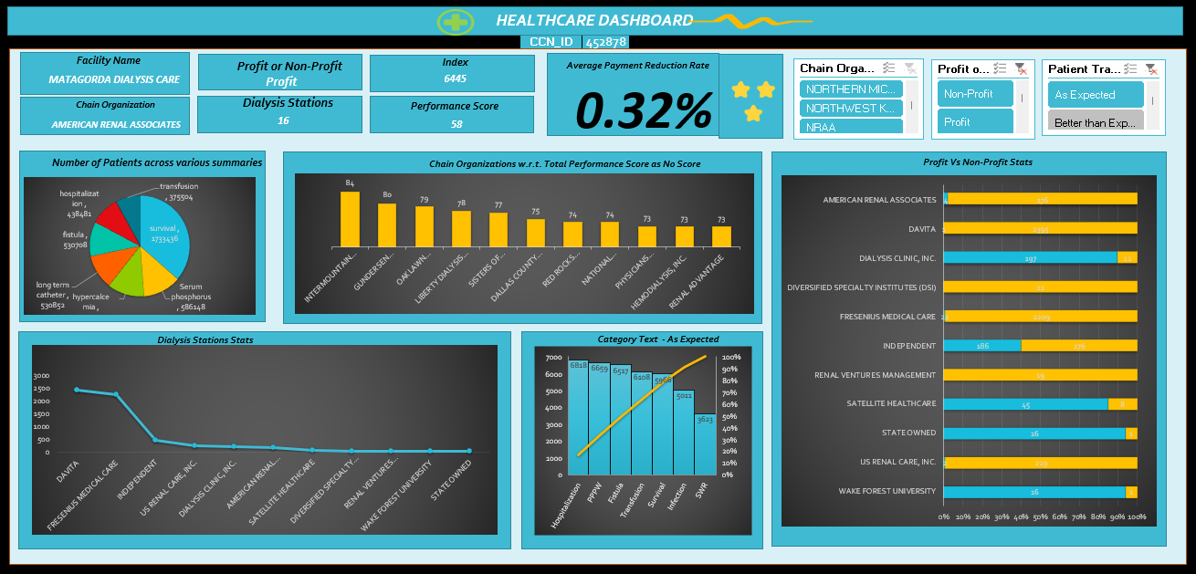
Excel Module Dashboard

Slide 10
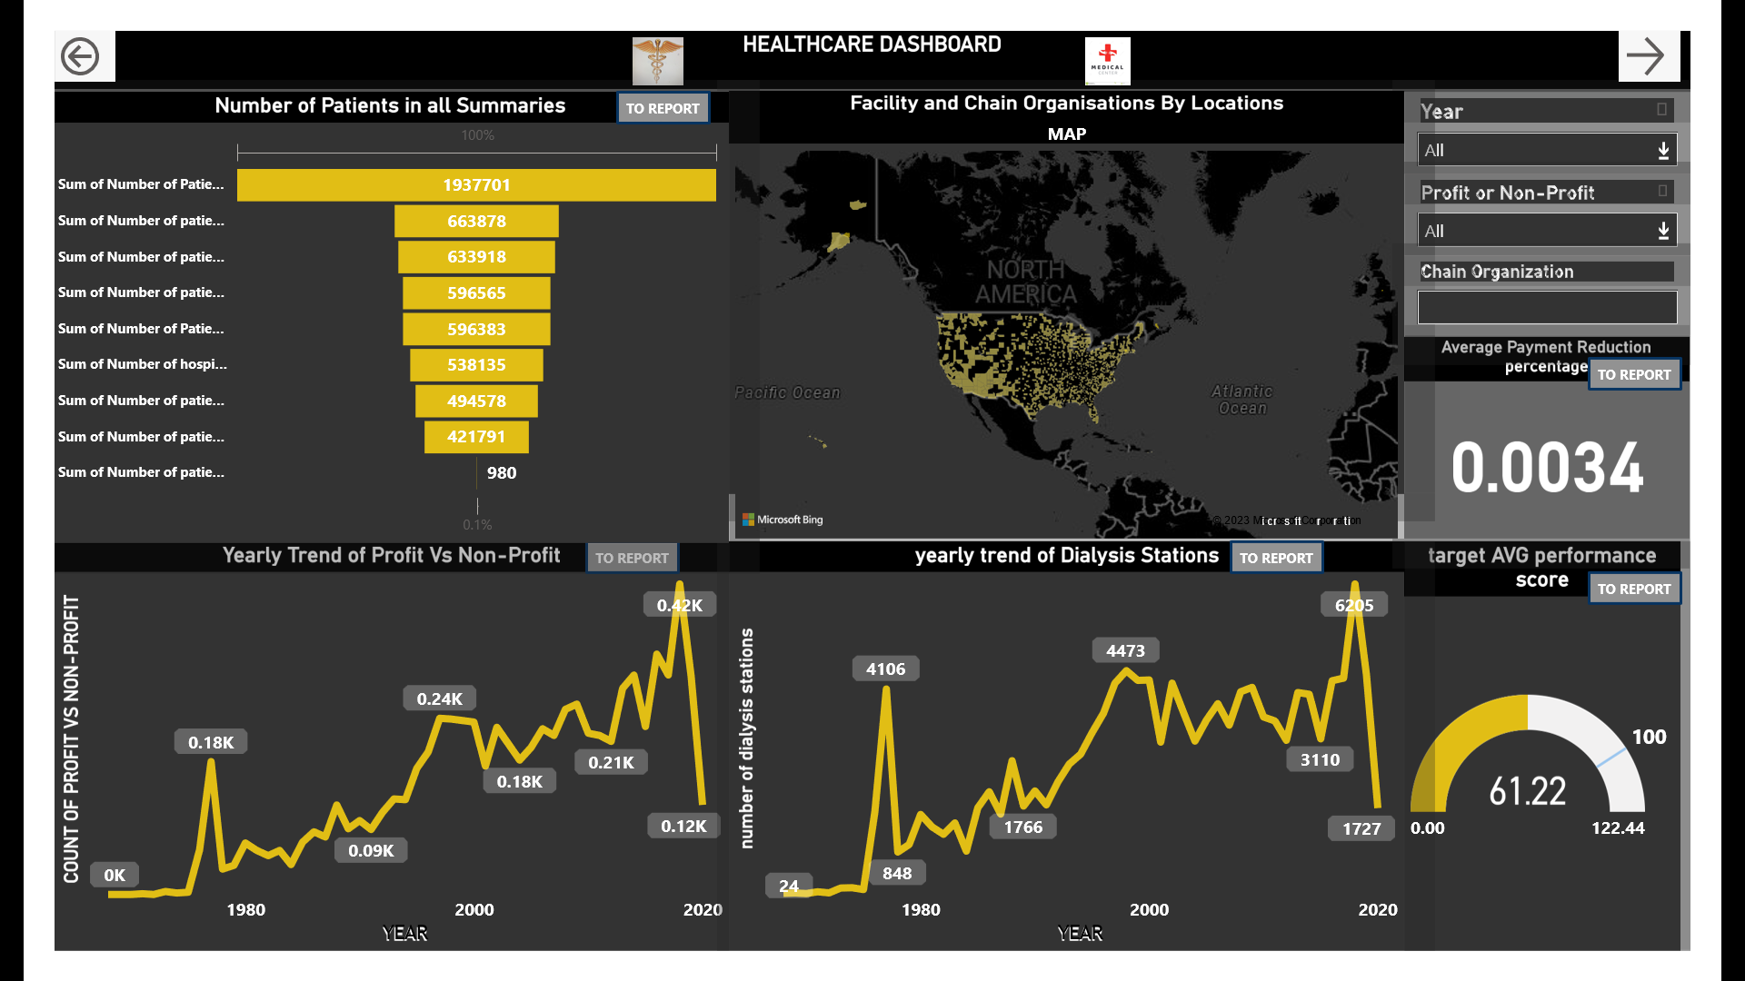
Power BI Module Dashboard

Slide 11
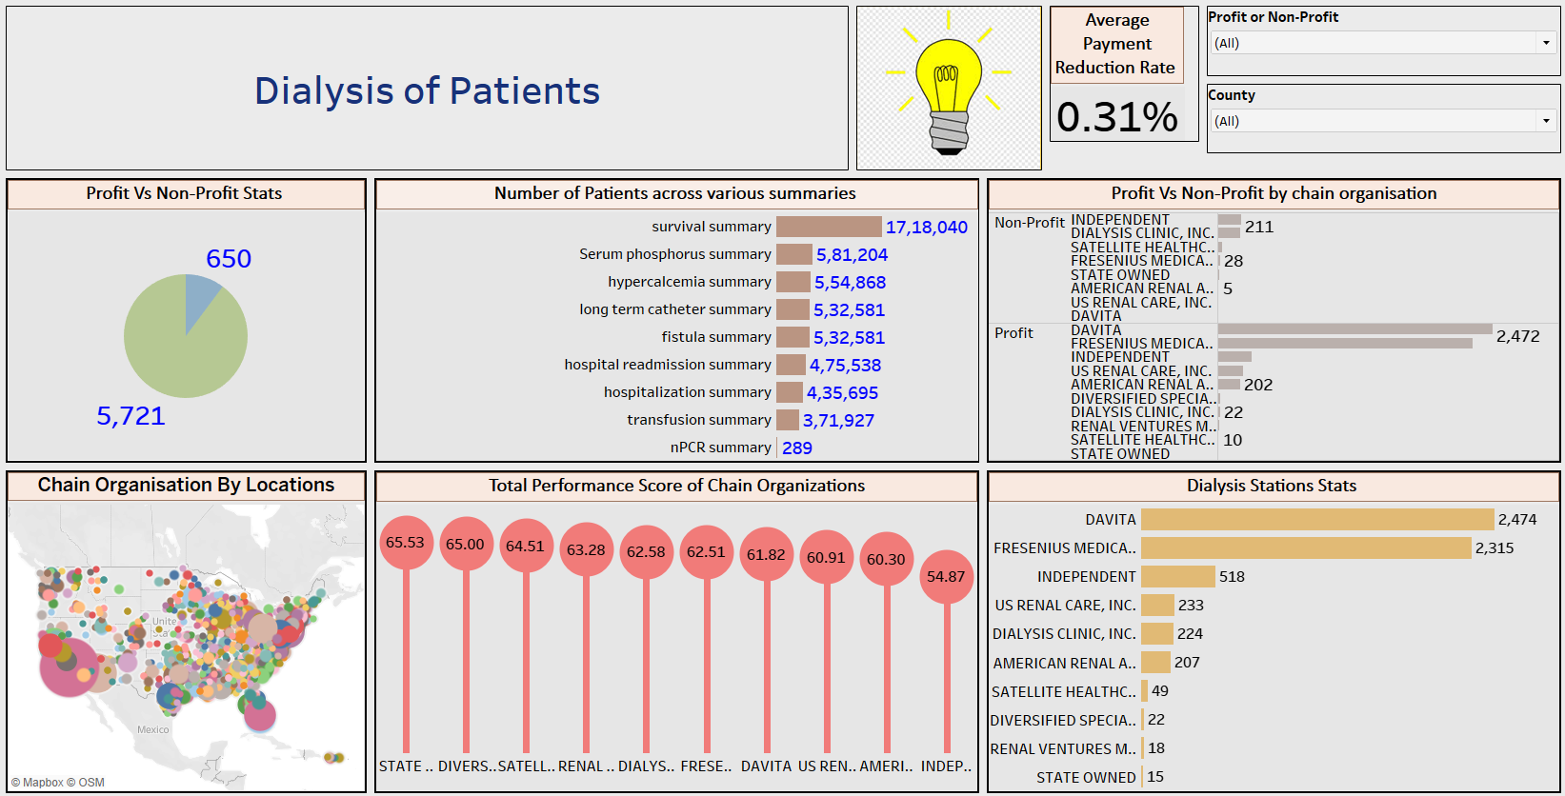
Tableau Module Dashboard

Slide 12
Thank You..

