Slide 1
AI for Content Generation – Blog/Article Generator
Project Report & Final Analysis

Slide 2
Project Overview
Developed an AI-powered blog/article generator using Llama 2 and LangChain.
Frontend implemented with Streamlit for interactive user experience.
Supports customizable blog styles and word limits.
Uses prompt engineering to generate human-like articles.
Designed for fast content generation with minimal user input.

Slide 3
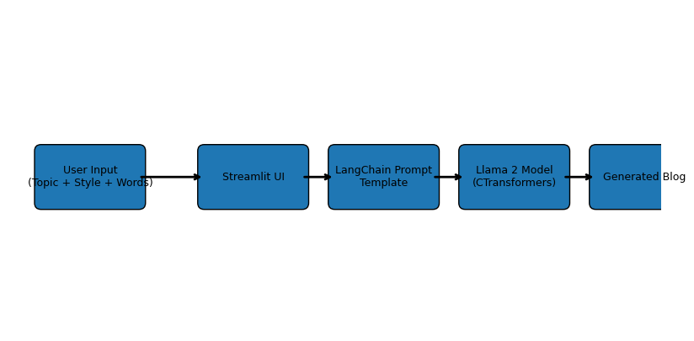
Architecture Diagram

Slide 4
Workflow Explanation
User enters topic, blog style and required word count.
Streamlit UI captures user request.
LangChain PromptTemplate formats the query.
CTransformers loads Llama 2 GGML model.
LLM generates a contextual and coherent blog article.
Generated content is displayed in the Streamlit interface.

Slide 5
Technology Stack
Python
Streamlit
LangChain
Llama 2
CTransformers
Prompt Engineering

Slide 6
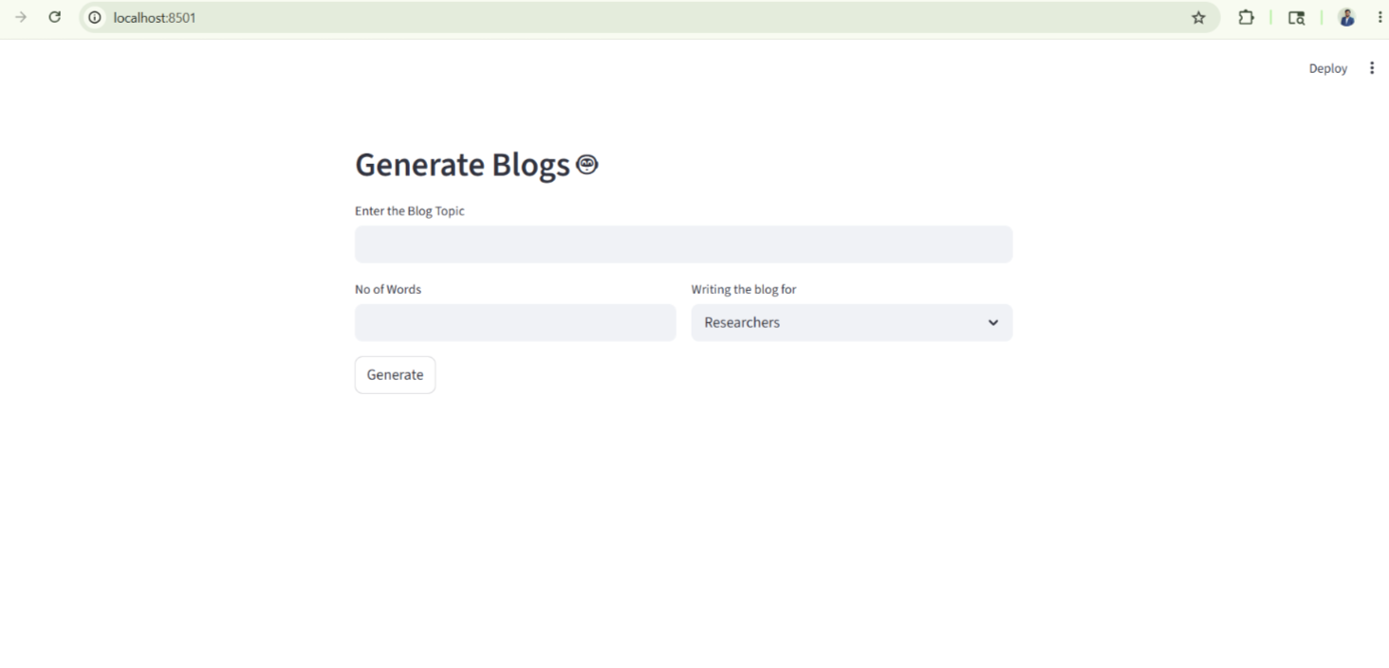
Results & Screenshots

Slide 7
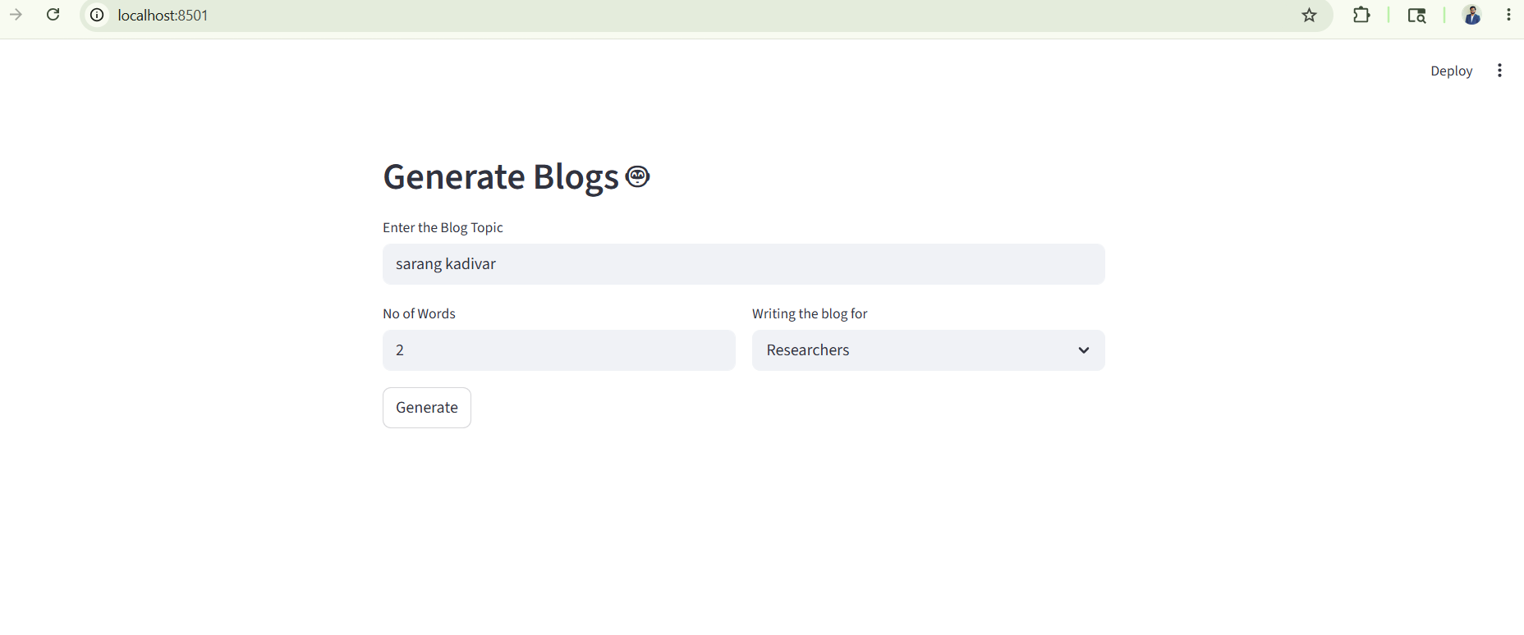
Results & Screenshots

Slide 8
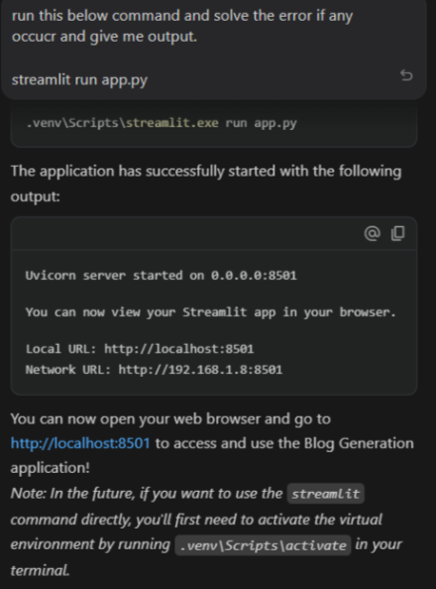
Results & Screenshots
Predicted Final Output: The system successfully generated high-quality, human-readable blogs with low latency and contextual accuracy.

Slide 9
Challenges Faced
Large model size causing higher memory usage.
Inference latency during blog generation.
Prompt tuning required for quality output.
Managing local model dependencies and configurations.
Ensuring generated content remains relevant and non-repetitive.

Slide 10
Future Improvements
Deploy application on cloud platforms like AWS or Azure.
Add multilingual content generation support.
Integrate SEO optimization features.
Enable export to PDF/DOCX formats.
Implement fine-tuned domain-specific models.
Add plagiarism and grammar checking.

Slide 11
Conclusion
The AI Blog Generator project demonstrates the practical implementation of Large Language Models for automated content generation. The system provides scalable and efficient blog generation with interactive user inputs and customizable outputs.

