Slide 1
Anomaly Detection
Part II

Slide 2
Agenda
Recap
Univariate Methods
Interquartile Range – IQR (Univariate)
Direct Anomaly Detection
Isolation Forest (Uni/Multivariate)
Density-based Methods
Local Outlier Factor
DBScan etc.

Slide 3
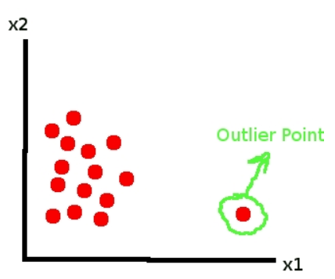
Anomalies/Outliers
RECAP
What is anomaly or outlier?
Set of data points or observations which deviate from rest of the data

Slide 4
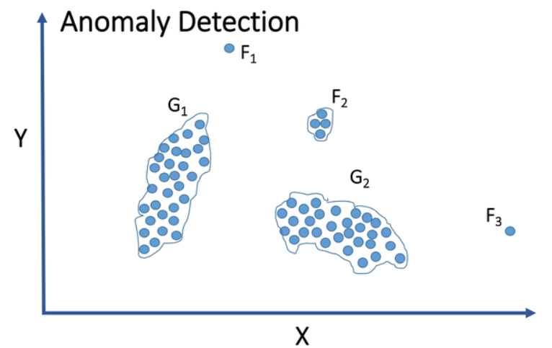
Anomaly Detection
RECAP
Anomaly detection is the process of identifying data points, events, and/or observations that deviate from the dataset's normal behavioral patterns.

Slide 5
Data Analysis
RECAP
Primary Statistical Approaches
Parametric
Non-parametric
Types of Data Analysis
Univariate
Multivariate

Slide 6
Anomaly Detection Algorithms - Discussed
RECAP
Distance-based Anomaly Detection
Mahalanobis Distance using Chi-squared Distribution
Distance-based Multivariate Methods
Hoteling T-squared
Parameter Optimization and Feature Reduction
Mahalanobis-Taguchi System
Uses Mahalanobis Distance
Signal to Noise Ratio
Orthogonal Arrays

Slide 7
Univariate Anomaly Detection
Using Univariate Data

Slide 8
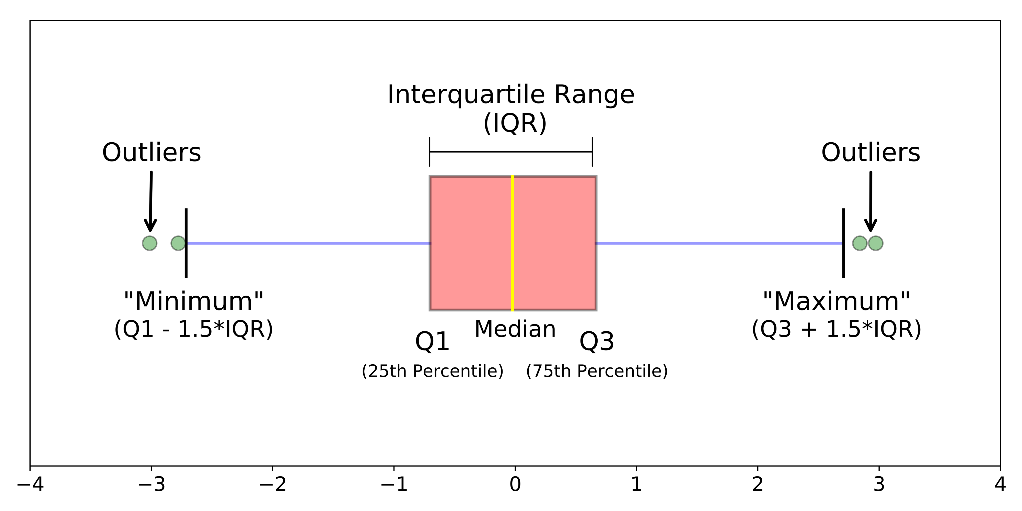
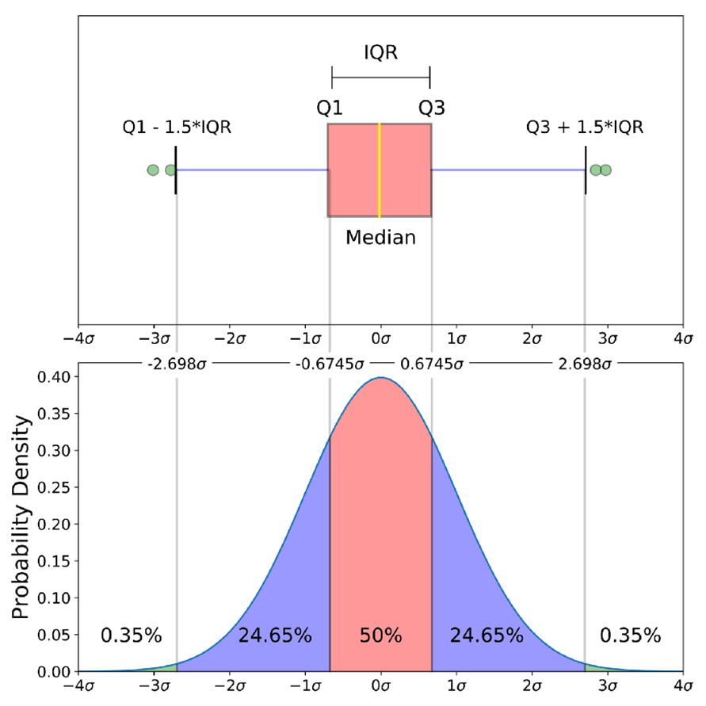
Nonparametric Test - Univariate
Interquartile Range (IQR)
The IQR is a measure of variability, based on dividing a data set into Interquartile Range, which is the difference between the first and third quartiles.
It is also called the middle 50%, which equals to the difference between 75th and 25th percentiles, or between upper and lower quartiles, IQR = Q₃ − Q₁
When a data set has outliers or extreme values, it is often used to find the outliers in the data.

Slide 9
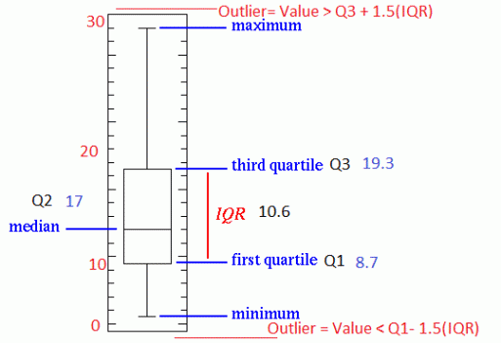
Nonparametric Test - Univariate
Interquartile Range (IQR) - Example (box plot)
IQR = Q3- Q1
How to calculate IQR and find outliers
Step 1: Order from low to high
Step 2: Find the median or in other words Q2
Step 3: Then find Q1 by looking the median of the left side of Q2
Step 4: Similarly find Q3 by looking the median of the right of Q2
Step 5: Now subtract Q1 from Q3 to get IQR.
As a rule of thumb, observations can be qualified as outliers when they lie more than 1.5 IQR below the first quartile or 1.5 IQR above the third quartile.
Outliers = Q1 – 1.5* IQR OR Q3 + 1.5*IQR

Slide 10
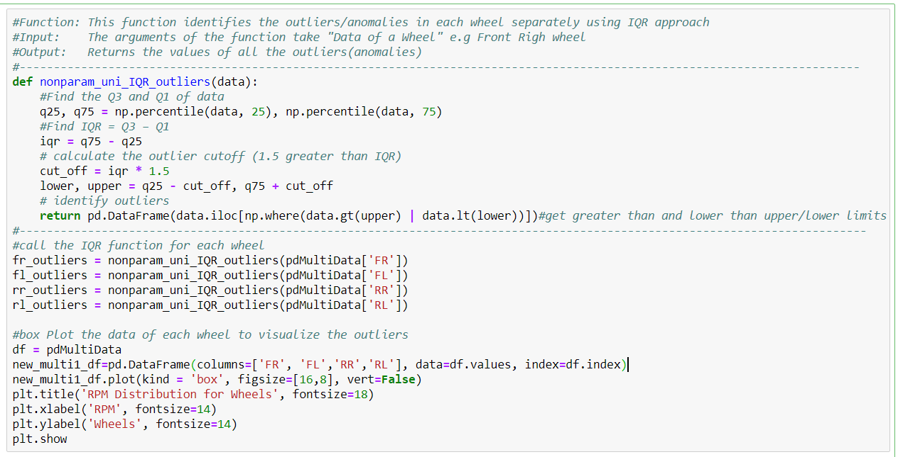
Nonparametric Test - Univariate
Interquartile Range (IQR) –
Implementation using Python

Slide 11
Direct Anomaly Detection
Using Univariate and Multivariate Data

Slide 12
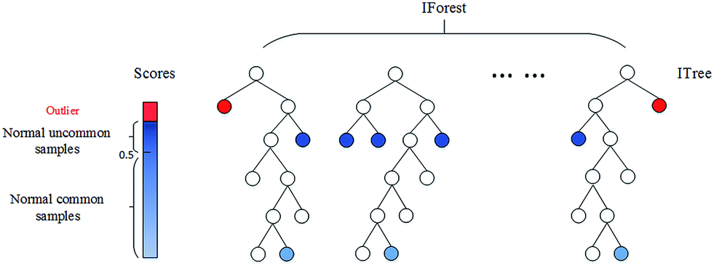
Nonparametric Test – Univariate/Multivariate
Directly Anomaly Detection
Identifies anomalies directly instead of first defining a normal behavior
Isolation Forest
This is a non-parametric method for large datasets in a one or multi-dimensional feature space. And, is an example of Direct Anomaly Detection.
A tree-based model, in which multiple trees are created randomly for a given data set, and anomalies are samples with shortest average path length.

Slide 13
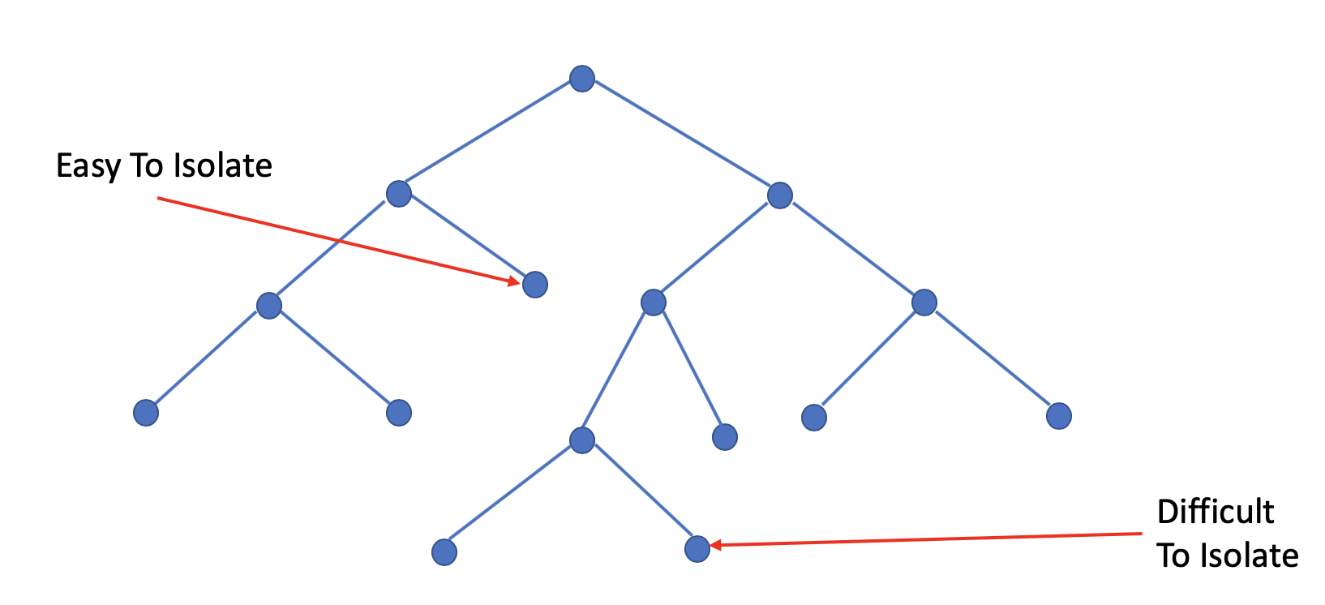
Nonparametric Test - Univariate/Multivariate
A data point is defined as an outlier if it can be easily isolated using only a few partitions.

Slide 14
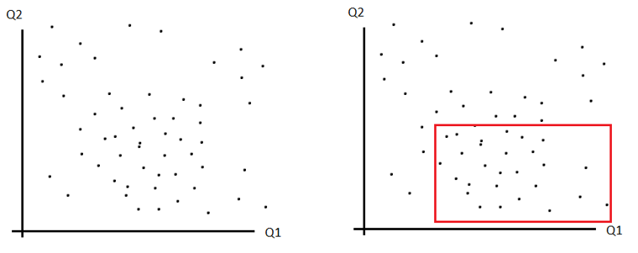
Nonparametric Test – Univariate/Multivariate
Isolation Forest – How it works?
Step 1: Sampling
The very first step is sampling for training a model
For the simplicity, 2-D visualization is selected. You can think of Q1 and Q2 as two different attributes in your data set.

Slide 15
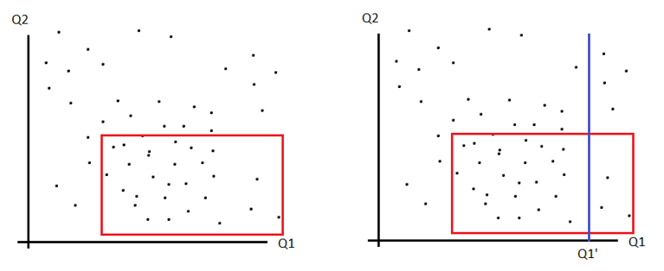
Nonparametric Test – Univariate/Multivariate
Step 2: Binary decision tree
The following step essentially involves making a tree for the sample we drew from step 1
This step involves two random elements: random choice of an attribute (i.e. Q1 or Q2) / random choice of a Q1 or Q2 value between its min and max (i.e. Q1’)

Slide 16
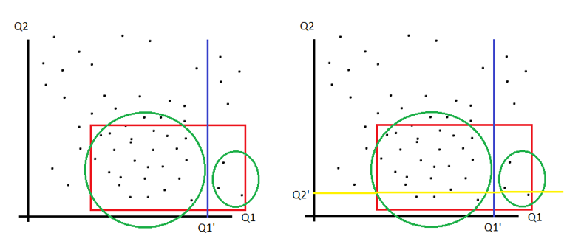
Nonparametric Test – Univariate/Multivariate
Step 3: Repeat step 2 Iteratively
Do step 2 for two sub-data set based on the binary split from step 2
Do this iteratively to create a forest, a collection of trees

Slide 17

Nonparametric Test – Univariate/Multivariate
Step 4: Calculating anomaly score
Feed each data point into model to calculate anomaly score
The anomaly score can be calculated using
where h(x) is the path length of observation x,
c(n) is the average path length of unsuccessful search in a Binary Search Tree
n is the number of external nodes.
After giving each observation a score ranging from 0 to -1; -1 meaning more outlier and 0 meaning more normality. A threshold can be specified as a decision point to declare a sample as outlier.

Slide 18
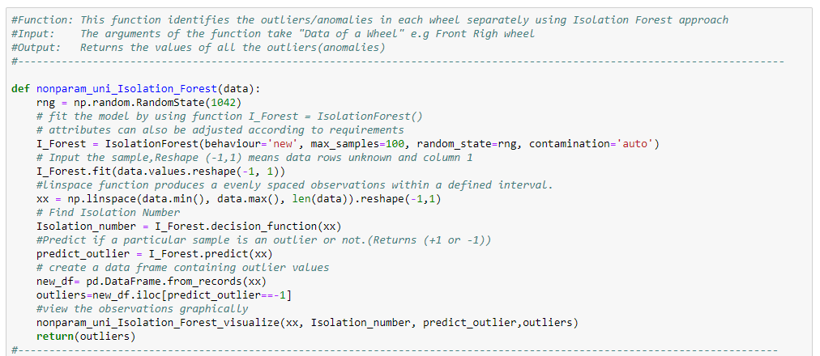
Nonparametric Test – Univariate/Multivariate
Isolation Forest –
Implementation using Python

Slide 19
Density-based Anomaly Detection
Using Univariate and Multivariate Data

Slide 20
Nonparametric Test – Univariate/Multivariate
Density-based Anomaly Detection
It’s part of a wider set of methods known as Proximity-based anomaly detection and uses density as a measure of proximity.
Density-based outlier detection method investigates the density of an object and that of its neighbors
An object is an outlier/anomaly if its density is relatively much lower than that of its neighbors
In other words, a data point is defined as an outlier when its locality is sparsely populated

Slide 21
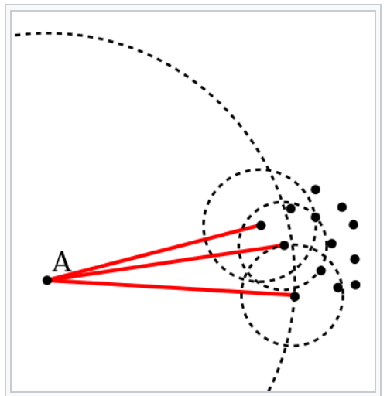
Nonparametric Test – Univariate/Multivariate
Local Outlier Factor - LOF
LOF is based on a concept of a local density, where locality is given by k nearest neighbors, whose distance is used to estimate the density.
By comparing the local density of an object to the local densities of its neighbors, one can identify regions of similar density, and points that have a substantially lower density than their neighbors. These are considered to be outliers.
Basic idea of LOF: comparing the local density of a point with the densities of its neighbors. A has a much lower density than its neighbors.

Slide 22
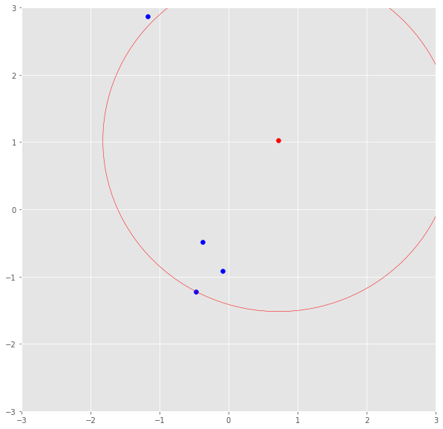
Nonparametric Test – Univariate/Multivariate
How LOF Works?
Step 1: calculate k-distance, the distance of a point to its kth neighbor.
(E.g. If k was 3, the k-distance would be the distance of a point to the third closest point.)
The red point’s k-distance is illustrated by the red line if k=3.

Slide 23
Nonparametric Test – Univariate/Multivariate
How LOF Works?
Step 2: The k-distance is now used to calculate the reachability distance. This distance measure is simply the maximum of the distance of two points and the k-distance of the second point.
Basically, if point A is within the k neighbors of point B, the reach-dist(A,B) will be the k-distance of B. Otherwise, it will be the real distance of A and B.

Slide 24

Nonparametric Test – Univariate/Multivariate
How LOF Works?
Step 3: The reach-dist is then used to calculate another concept — the local reachability density (LRD)
To get the LRD for a point A, first calculate the reachability distance of A to all its k nearest neighbors and take the average of that number. The LRD is then simply the inverse of that average.

Slide 25
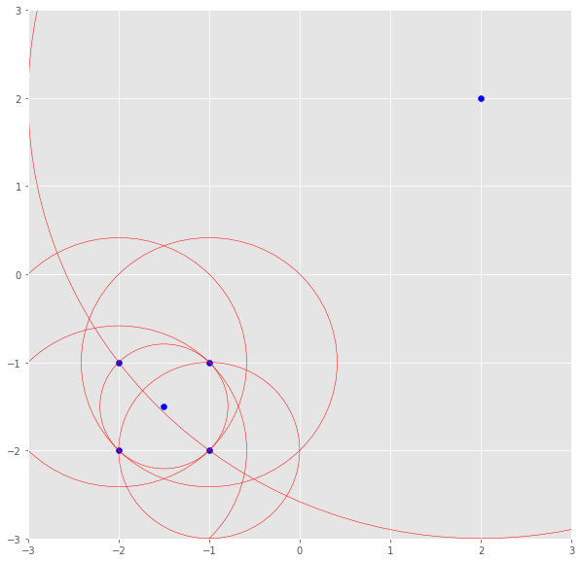
Nonparametric Test – Univariate/Multivariate
How LOF Works?
Step 4: The LRD of each point is then compared to the LRD of their k neighbors and averaged.
LOF is the average ratio of the LRD of the neighbors of A to the LRD of A. If the ratio is greater than 1, the density of point A is on average smaller than the density of its neighbors.
The LRD of the upper right point is the average reachability distance to its nearest neighbors which are points (-1, -1), (-1.5, -1.5) and (-1, -2).
These neighbors, however, have other LRDs as their nearest neighbors don’t include the upper right point

Slide 26
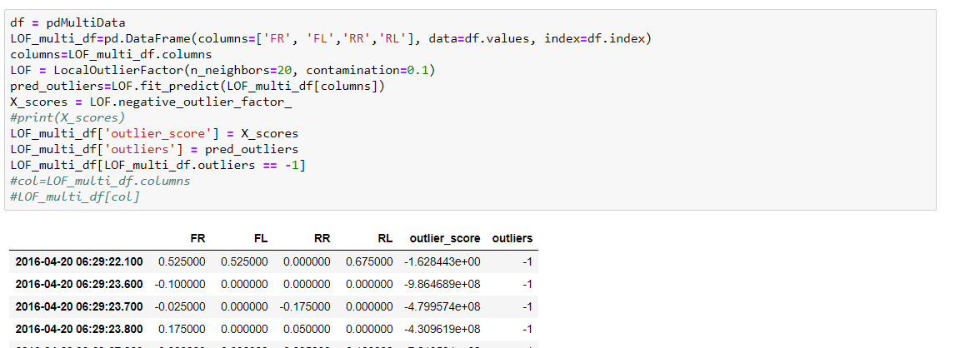
Nonparametric Test - Univariate
Local Outlier Factor (LOF) –
Implementation using Python

Slide 27
References
http://www.erogol.com/anomaly-detection-and-a-simple-algorithm-with-probabilistic-approach/
https://www.quora.com/Can-reinforcement-learning-be-used-for-anomaly-detection
https://medium.com/@alhadpofali_5697/anomaly-and-outlier-detection-concepts-1f82498851a2
https://medium.com/@mehulved1503/outlier-detection-and-anomaly-detection-with-machine-learning-caa96b34b7f6
https://en.wikipedia.org/wiki/Interquartile_range
http://sphweb.bumc.bu.edu/otlt/mph-modules/bs/bs704_summarizingdata/bs704_summarizingdata7.html
http://makemeanalyst.com/explore-your-data-range-interquartile-range-and-box-plot/
https://dzone.com/articles/four-techniques-for-outlier-detection-knime
https://towardsdatascience.com/a-brief-overview-of-outlier-detection-techniques-1e0b2c19e561
https://dzone.com/articles/spotting-outliers-with-isolation-forest-using-skle
https://www.analyticsvidhya.com/blog/2019/02/outlier-detection-python-pyod/
https://quantdare.com/isolation-forest-algorithm/
https://medium.com/walmartlabs/swamping-and-masking-in-anomaly-detection-how-subsampling-in-isolation-forests-helps-mitigate-bb192a8f8dd5
https://www.youtube.com/watch?v=RyFQXQf4w4w (Isolation Tree)
https://dzone.com/articles/spotting-outliers-with-isolation-forest-using-skle
https://towardsdatascience.com/anomaly-detection-for-dummies-15f148e559c1
https://towardsdatascience.com/anomaly-detection-with-isolation-forest-visualization-23cd75c281e2

Slide 28
References
https://www.machinelearningplus.com/statistics/mahalanobis-distance/
https://mccormickml.com/2013/08/15/the-gaussian-kernel/
https://en.wikipedia.org/wiki/Mahalanobis_distance
https://www.statisticshowto.datasciencecentral.com/mahalanobis-distance/
https://mccormickml.com/2014/07/22/mahalanobis-distance/
https://onlinelibrary.wiley.com/doi/full/10.1002/cem.2763
https://www.youtube.com/watch?v=ch97ZqH0XdM
https://ncss-wpengine.netdna-ssl.com/wp-content/themes/ncss/pdf/Procedures/NCSS/Hotellings_Two-Sample_T2.pdf
https://www.statisticshowto.datasciencecentral.com/hotellings-t-squared/
https://en.wikipedia.org/wiki/Hotelling%27s_T-squared_distribution
https://www.youtube.com/watch?v=ch97ZqH0XdM
https://www.tandfonline.com/doi/abs/10.1198/004017002188618626
https://towardsdatascience.com/density-based-algorithm-for-outlier-detection-8f278d2f7983
https://en.wikipedia.org/wiki/Local_outlier_factor
https://towardsdatascience.com/local-outlier-factor-for-anomaly-detection-cc0c770d2ebe

