Slide 1
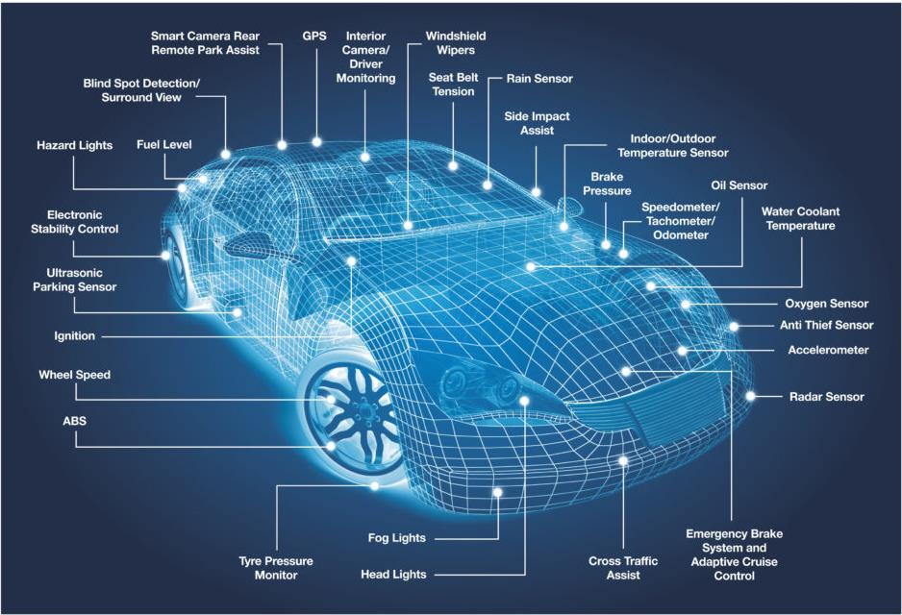
CAN(Controller Area Network) Protocol

Slide 2
Introduction
Originally developed by Robert Bosch for automobile in-vehicle network in the 1980s
Multi-master, Broadcasting, Serial communication protocol
Priority-based bit-wise arbitration
For reliable and Robust data exchange between ECUs especially in noisy environments
Cost effective, Compact and fast
It is a message-based protocol. ie, there are no defined addresses, just defined messages.

Slide 3
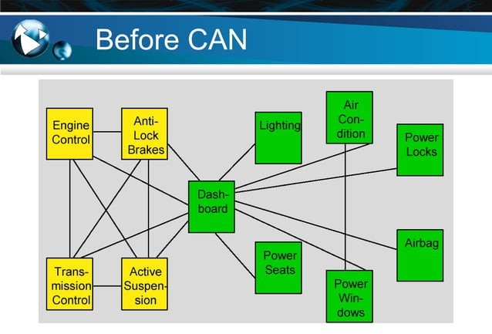

Slide 4
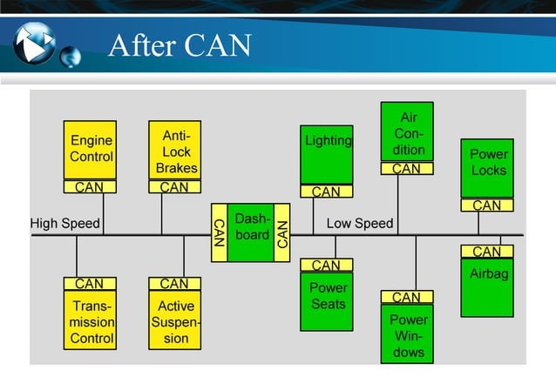

Slide 5
CAN Characteristics
All messages are broadcast
Any node is allowed to broadcast a message
Each message contains an ID that identifies the source or content of a message
Each receiver decides to process or ignore each message

Slide 6
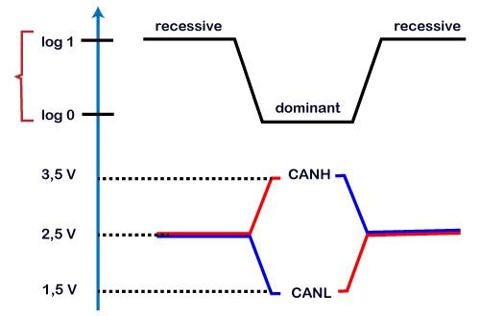
Logic 1 is a recessive state. To transmit 1 on CAN bus, both CAN high and CAN low should be applied with 2.5V.
Logic 0 is a dominant state. To transmit 0 on CAN bus, CAN high should be applied at 3.5V and CAN low should be applied at 1.5V.
The ideal state of the bus is recessive.
If the node reaches the dominant state, it cannot move back to the recessive state by any other node.

Slide 7
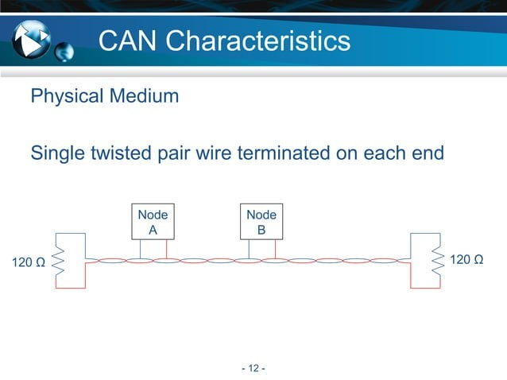
The maximum number of nodes is not specified.
Networks are limited by electrical loading, up to 64 nodes is normal

Slide 8
CAN data rate
Bit Rate I Bus Length
1M bit/sec 500K bit/sec 250K bit/sec 125K bit/sec
40 meters (131 feet)
100 meters (328 feet)
200 meters (656 feet)
500 meters (1640 feet)

Slide 9
CAN Message Types
Four Message Types
Data Frame
Used to transmit data
Remote Frame
Used to request data transmission
Error Frame
Sent by a node that detects an error
Overload Frame
Sent by a node to request a delay in transmission

Slide 10
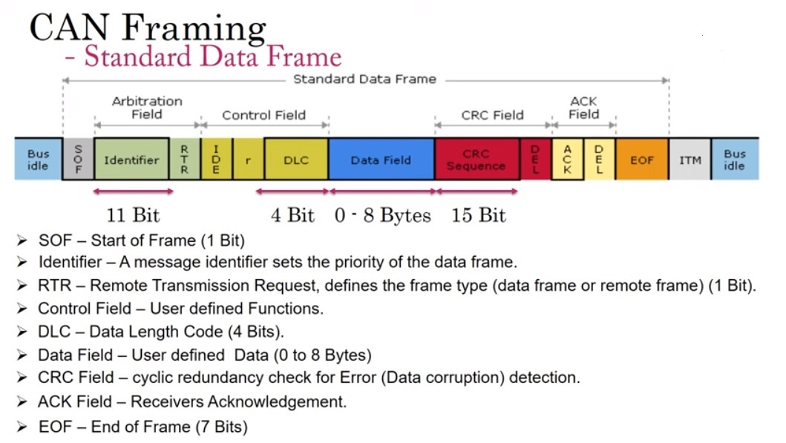

Slide 11
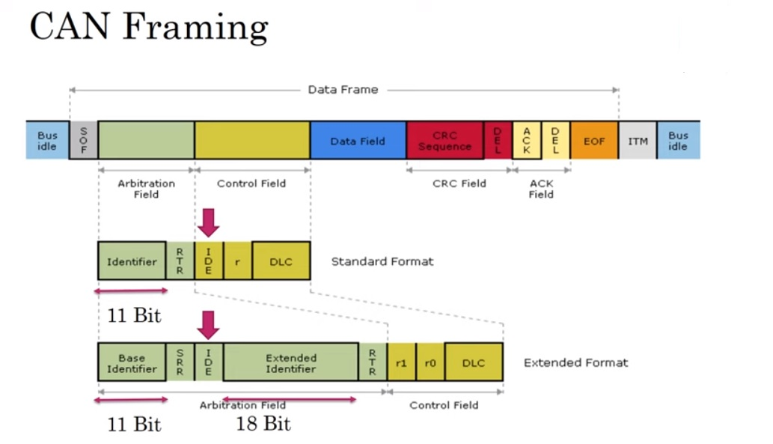

Slide 12
CAN ARBITRATION
CSMA/CA scheme is employed
All nodes must wait for an idle bus condition.
If two nodes begin transmitting simultaneously, then they participate in an arbitration process.
Wired-AND mechanism is used.
The node with the lower ID number wins the arbitration and continues transmitting its message.
The loser of the arbitration backs off and re-tries.

Slide 13
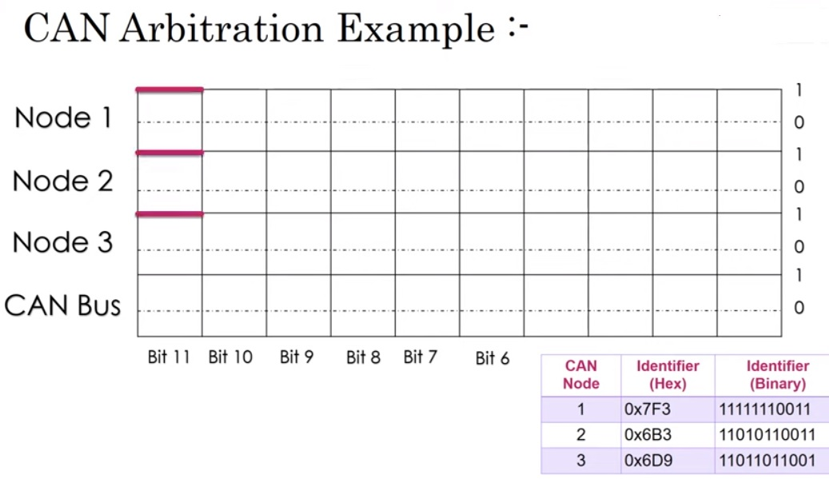

Slide 14
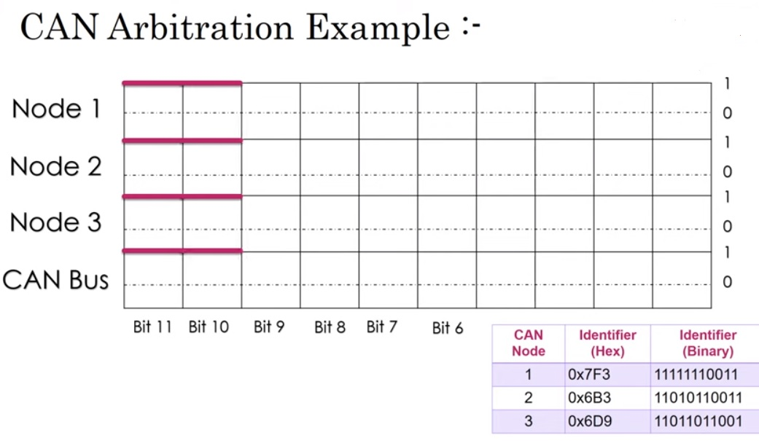

Slide 15
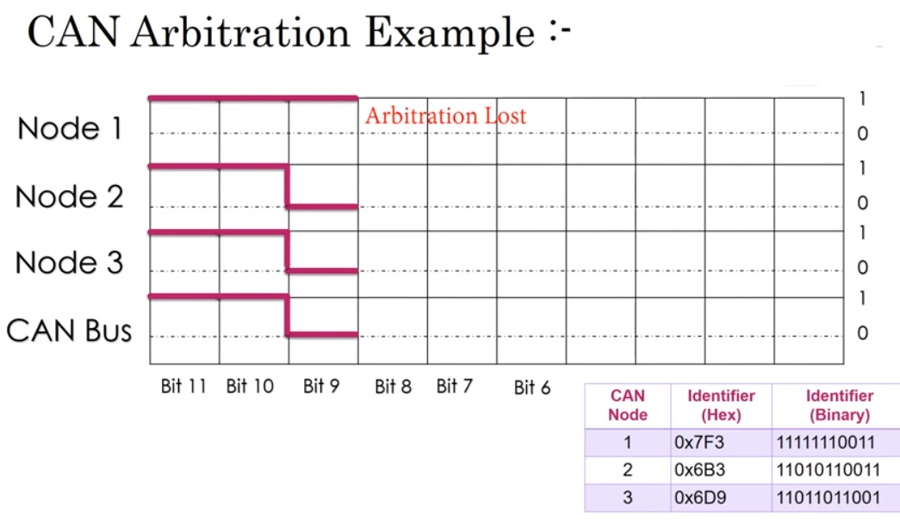

Slide 16
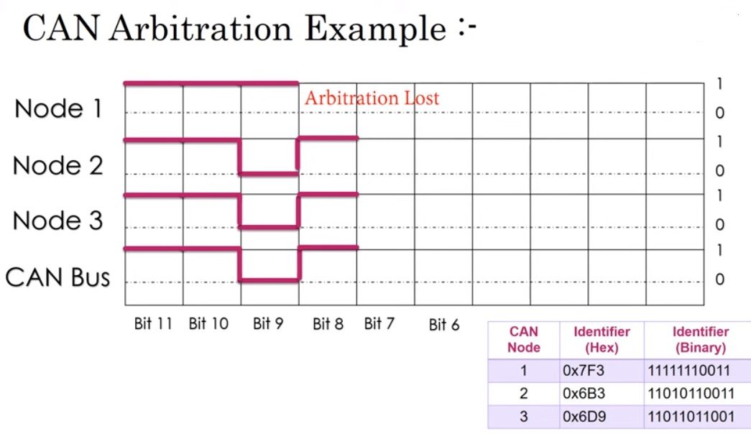

Slide 17
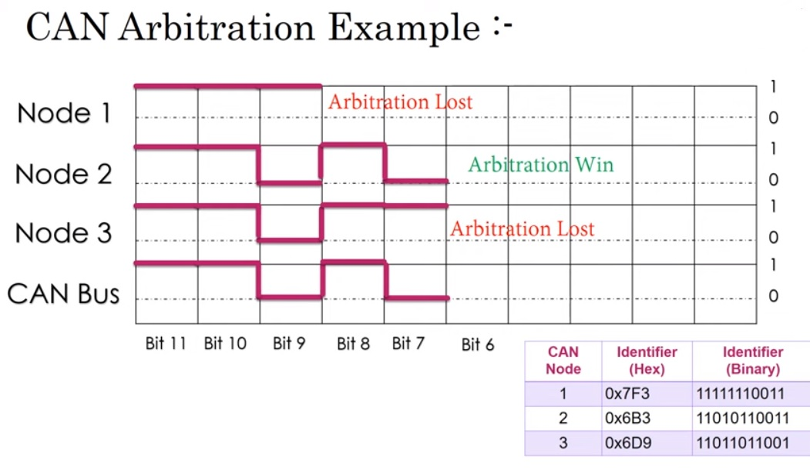

Slide 18
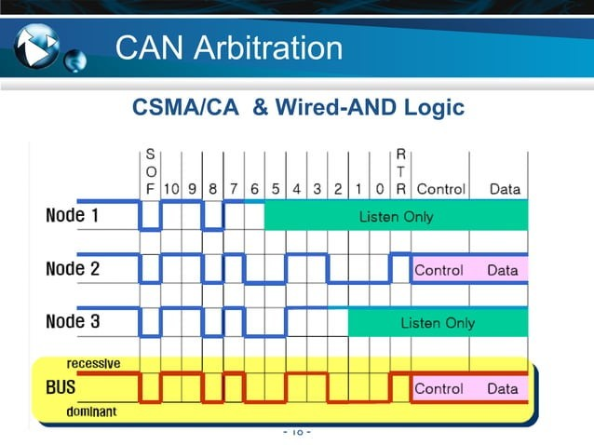

Slide 19
CAN Data Protection­
Error Detection
Bit Monitoring;
- Sender’s Task
•
•!• Compares every bit placed on the CAN bus with the actual bus level
!• Discrepancy indicates a bit monitoring error and results in error handling

Slide 20
Stuff Check
•!• Receiver Task
Compares arriving bit stream for a sequence of six homogeneous bits.
Detection of a sixth homogeneous bit indicates bit stuffing error and results in error handling

Slide 21
Form Check
•!• Receiver Task
Comparison of the arriving bit stream with the message format
Detection of a dominant delimiter bit (CRC delimiter, ACK delimiter) or a dominant bit within EOF indicates a format error and results in error handling

Slide 22
Cyclic Redundancy Check
•!• Receiver Task
Utilizes the arriving bit stream and generator polynomial for the Cyclic Redundancy Check defined in ISO 11898-1
Detection of a CRC error results in error handling

Slide 23
ACK Check
•!• Sender Task
Acknowledge error (ACK error) is detected if the recessive level placed by the sender is not overwritten
Detection of an ACK error results in error handling

Slide 24
CAN Advantages
High performance under light loads
Low cost
Reliable
Robust

Slide 25
CAN Disadvantages
Unfair access: Node with high priority can hog the network
Starvation for some particular nodes

Slide 26
Applications
Automotive
Military vehicles
Industrial machinery
Medical systems
Agricultural machinery
Marine control and navigation
Elevator control systems

Slide 27
Conclusion
CAN is ideally suited in applications requiring a large number of short messages with high reliability in rugged operating environments.
Because CAN is message-based and not address­ based, it is especially well-suited when data is needed by more than one location and system-wide data consistency is mandatory.

