Slide 1


SMART INDIA HACKATHON 2025
Problem Statement ID – SIH 25050 & SIH 25119
Problem Statement Title –
1.Smart Traffic Management
System For Urban Congestion
2.Student Innovation - Creating Intelligent
Devices To Improve The Commutation Sector
Theme – Transportation & Logistics
PS Category - Software
Team ID – NIL
Organization – Government of Odisha
Team Name - TraffIQ Titans

Slide 2
SMART TRAFFIC MANAGEMENT SYSTEM FOR URBAN CONGESTION
TraffIQ Titans
PROPOSED SOLUTION | PROBLEM ADDRESSED | INNOVATION & UNIQUENESS
Use existing CCTV feeds to process video in edge devices for real-time decisions. Dynamic signal timing based on vehicle intensity from all directions. Violation detection → capture license plate → Issue fine. Emergency vehicle prioritization → instant green corridor for ambulances/fire trucks. IoT dashboard & mobile app for live monitoring and secure manual overrides. Predictive analytics to forecast peak traffic times and alert authorities in advance. | Fixed Signal Timings → Cause unnecessary waiting & traffic build-up which in-turn increases pollution. No Real-Time Control → Signals don’t adapt to sudden vehicle surges. Inefficient Violation Monitoring → Many offenders escape fines. Emergency Delays → Ambulances & fire services stuck in traffic. No Congestion Prediction → Authorities react late instead of preventing jams. Limited Remote Access → Traffic police can’t easily override signals. | Emergency Priority Logic – Automatic signal override for ambulances & police vehicles. Mobile-Based Manual Control – Legal authorities can instantly change signals on-the-go. Predictive Intelligence – Anticipates peak congestion before it happens. Dynamic Signal timing – Signal timing varied based on intensity of vehicles. Dual-Purpose Cameras – Same feed used for traffic density analysis and violation detection.
Turning every red light into a green future.

Slide 3
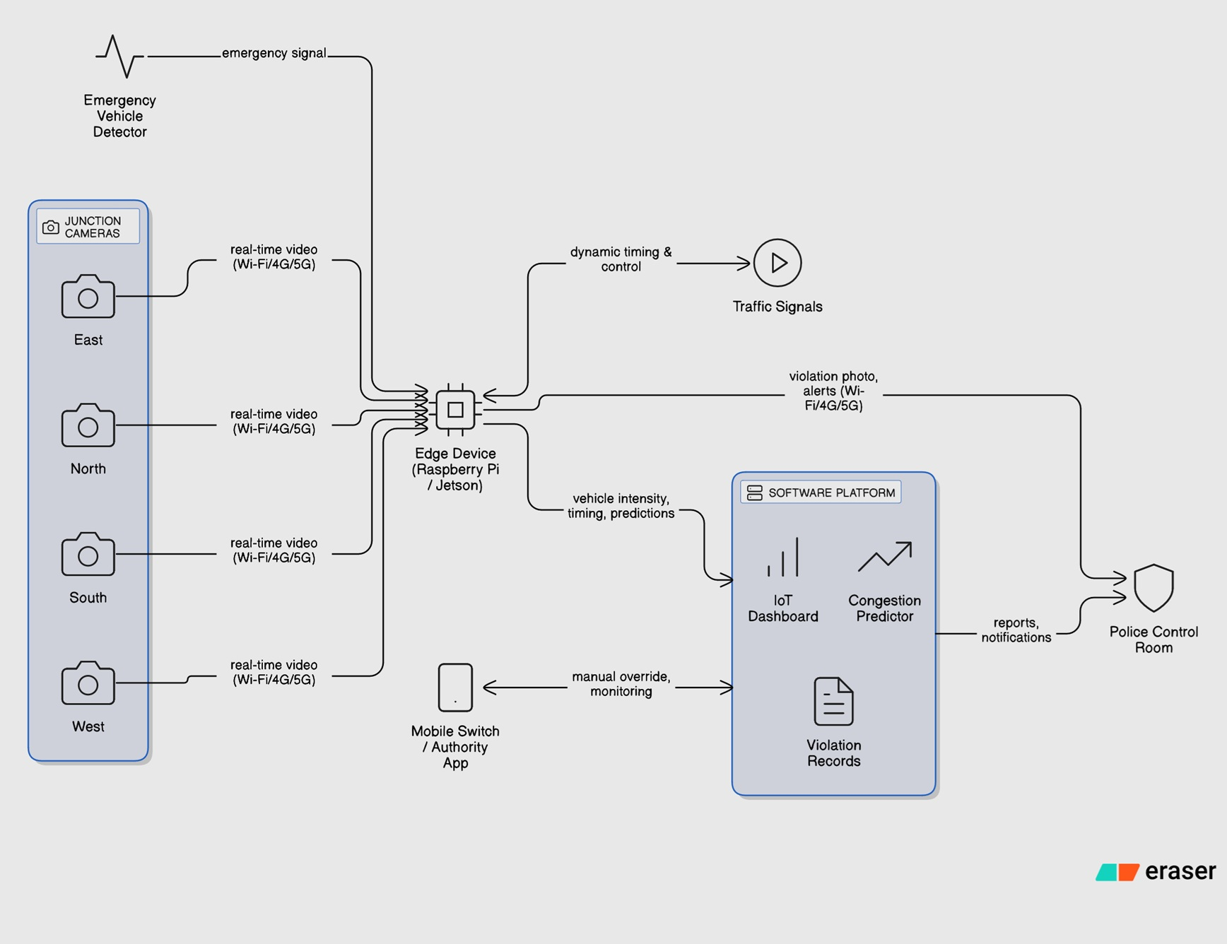
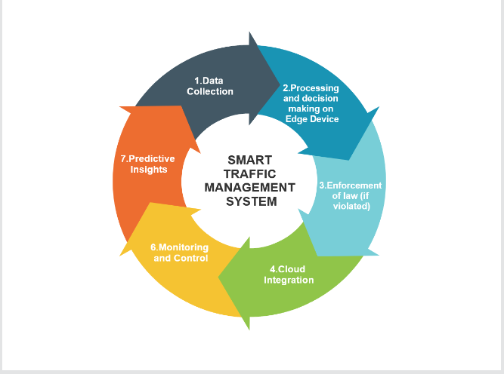
TECHNICAL APPROACH
TraffIQ Titans
FLOW CHART
PROTOTYPE LINK :
Tools and Technology: Computer Vision IoT Edge Computing Mobile/Web Application
METHODOLOGY

Slide 4
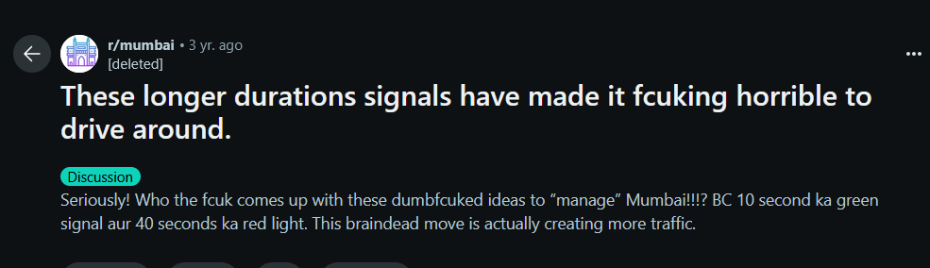
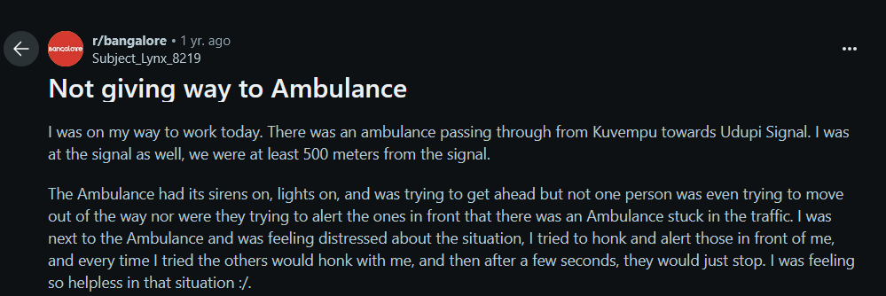
FEASIBILITY AND VIABILITY
TraffIQ Titans
VIABILITY
Highly Scalable:
Adaptable to both urban and rural infrastructure, ensuring broad applicability
Cost-Efficient Technology:
Uses affordable, accessible tools to lower costs.
Wide Coverage and Sustainability:
Ensures reliable traffic management for all communities, including emergencies
Technical Feasibility: ➢ Minimal Infrastructure Overhaul: Leverages existing camera networks for implementation without major infrastructure changes. ➢ Emergency Vehicle Prioritization: Identification of emergency vehicles using image processing and Siren sound to dynamically adjust traffic signals.
Operational Feasibility: ➢ 24/7 Monitoring: Continuous real-time surveillance to manage traffic flow and emergency vehicles around the clock. ➢ Scalable Deployment: The system can be deployed in both small towns and large cities, requiring minimal changes to the operational workflow.
Economical Feasibility: ➢ No Need for New Equipment: The system integrates with existing infrastructure, requiring minimal upgrades, which helps in reducing initial setup costs. ➢ Low Operational Costs: Automates traffic management, reducing long-term expenses related to infrastructure, system maintenance and labour cost.

Slide 5
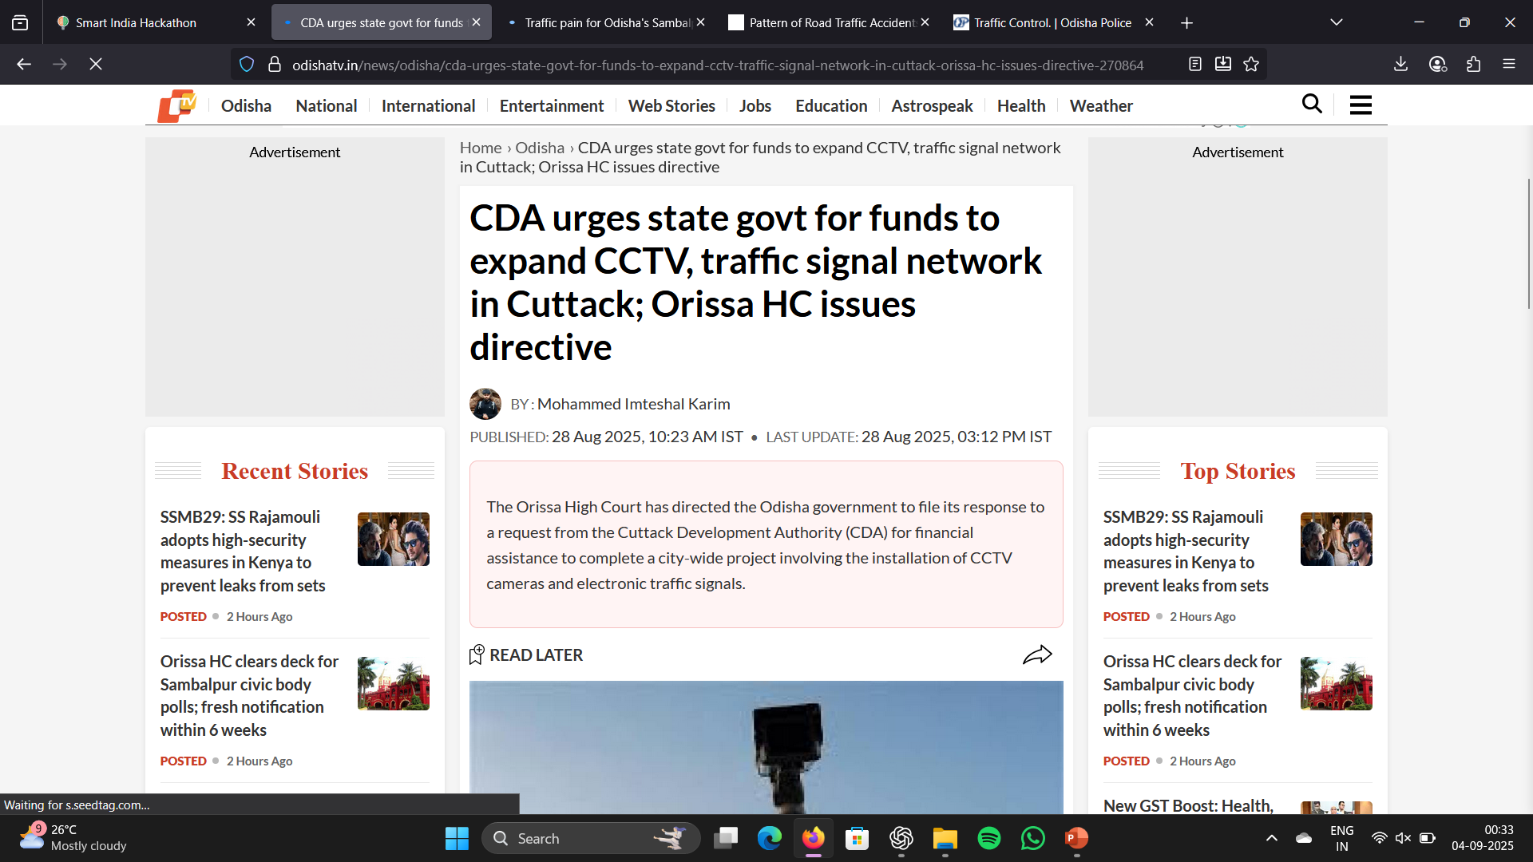
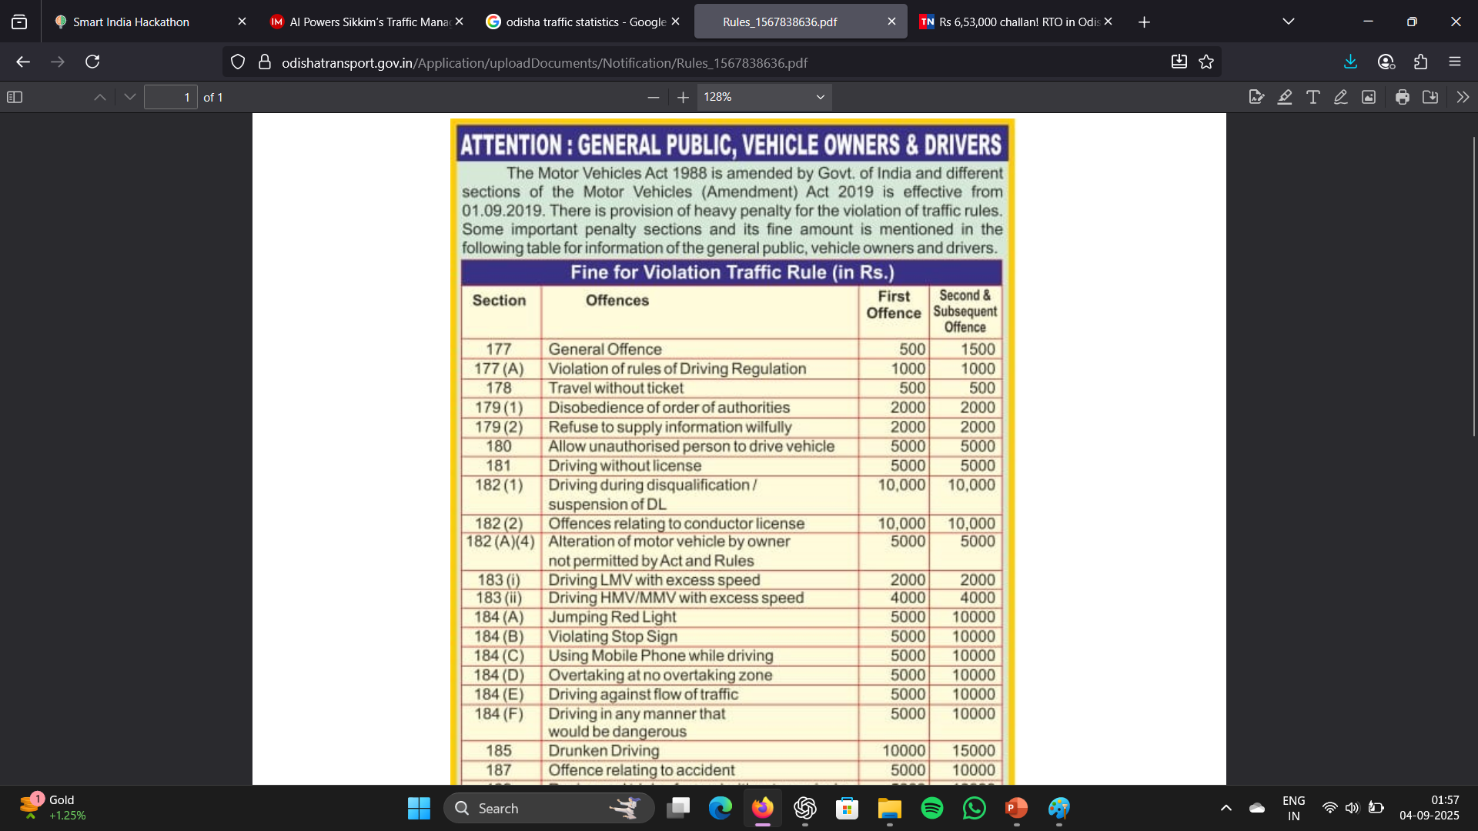
IMPACT AND BENEFITS (PROJECTED)
TraffIQ Titans
Traffic Efficiency
10–15% ↓ in average commute time
20–25% ↑ vehicle clearance at peak hours
Fuel & Environment
8–12% ↓ in fuel wastage
10–15% ↓ in CO₂ emissions
Safety & Law Enforcement
30–40% ↓ signal-jumping violations
50% ↑ emergency vehicle clearance
Economic Impact
₹20–30 lakhs/yr revenue per city via fines
High ROI with minimal infrastructure cost
Citizen Benefits
Smoother driving experience
Higher public satisfaction & trust in governance

Slide 6
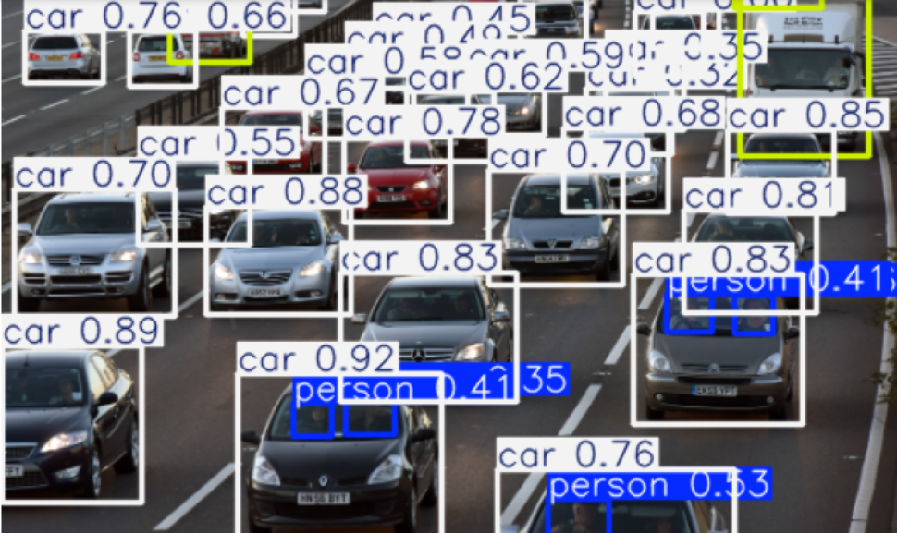
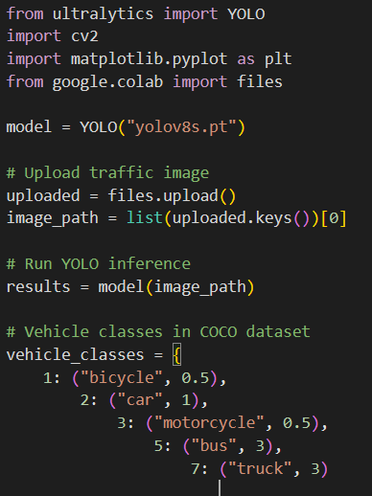
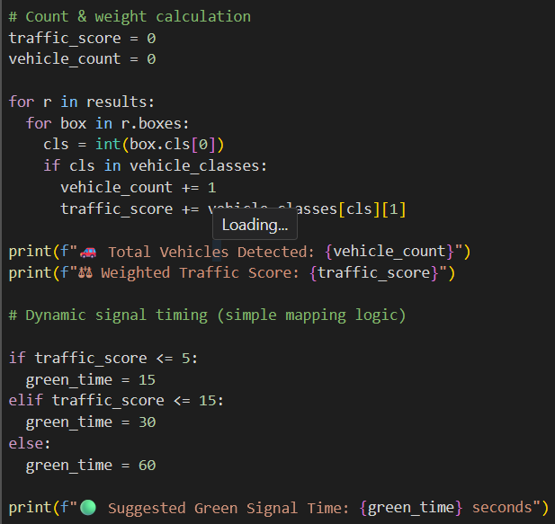
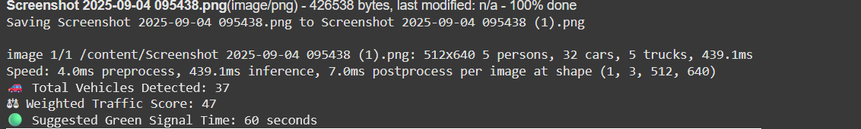
PROTOTYPE – WORK PROGRESS
TraffIQ Titans
DETECTION:
PROGRAM:
OUTPUT :

Slide 7
RESEARCH AND REFERENCES
TraffIQ Titans
JOURNALS : 1. Ouallane, A. A., Bahnasse, A., Bakali, A., & Talea, M. (2022). Overview of road traffic management solutions based on IoT and AI. Procedia Computer Science, 198, 518-523.
2. Sharma, A., Awasthi, Y., & Kumar, S. (2020, October). The role of blockchain, AI and IoT for smart road traffic management system. In 2020 IEEE India Council International Subsections Conference (INDISCON) (pp. 289-296). IEEE.
3. Nallaperuma, D., Nawaratne, R., Bandaragoda, T., Adikari, A., Nguyen, S., Kempitiya, T., ... & Pothuhera, D. (2019). Online incremental machine learning platform for big data-driven smart traffic management. IEEE Transactions on Intelligent Transportation Systems, 20(12), 4679-4690.

