Slide 1
BOUTIQYE SALES PREDICTION BY MACHINE LEARNING
Guide : Mrs. S.Josephine stella
BY
SARAN MP (23MCA042)

Slide 2
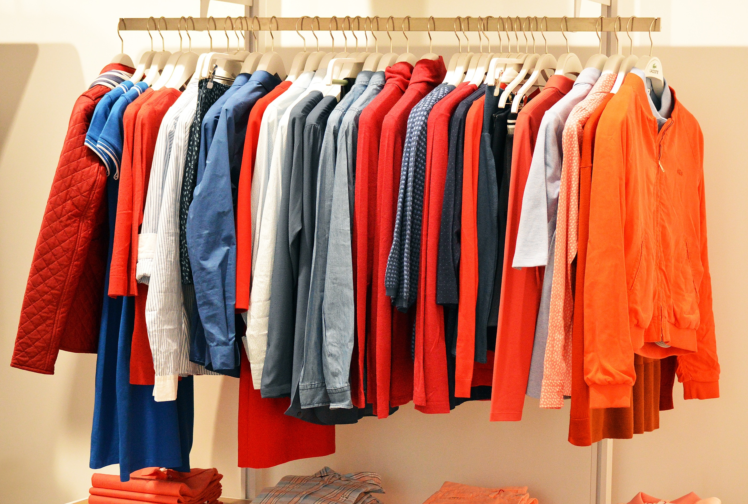
Abstract
This project is entitled as Log Predictive analysis for big Mart sales using machine learning.This project is to be developed Microsoft Visual Studio using as front end with SQL Server as back end. The E-commerce website is based on the sales transaction of products in a store. The first activity is based on adding the products to the system along with the rate which are present in the store and the name of the product which the E- commerce website will agree to sell. This authority is given only to admin. This system is used to maintain the following product using the above-mentioned software. In this, project will store all the categories of product in the dataset. If the user buy the product through software. Any periodic records can be viewed at any time. The stock is not available; the retailer orders and buys from a prescribed vendor. It can maintain product details of the stock in an appropriate format. In case some product stock level is low and finished stock level will notification display to the owner (retailer

Slide 3
SYSTEM REQUIREMENTS:
Front end Language | : HTML, CSS, Bootstrap, JavaScript : python with Django
Back end | : SQLite
Operating system | : Windows 10
Tools | : python IDLE, Sublime

Slide 4
HARDWARE SPECIFICATIONS:
Processor | : Intel icore 7 5th gen
Hard disk | : 500 GB
Ram | : 2 GB
Server Storage | : 100 GB
Internal memory capacity | : 50 GB
Keyboard | : Logitech of 104 keys
Mouse | : Logitech mouse
Monitor | : 14 inch samtron monitor

Slide 5
Existing System
In existing system, the admin can have the rights to add and delete the product and they have the option to predict their yearly and monthly sales report and also the admin don’t have an option to predict the sales analysis of particular product.
Manual Calculation made for individual product
Less Accuracy
Time Consumption

Slide 6
Proposed System
The proposed system is mainly focused on bringing a very user-friendly application which the users can use to view and buy items, while also, using the same application, the administrators can view the sales forecasting based on the sales data. With this work, the plan is to make accurate sales forecasting data-and the benefits that come with it- more accessible than ever. A web application that can be used by the user and the administrator in which the user can buy items and the administrator can view the prediction details, and a prediction module in order to predict the future sales data on the basis of the sales volume of the individual items

Slide 7
MODULES
Product repository
Billing information
Product analysis
Remainder product
Generate report

Slide 8
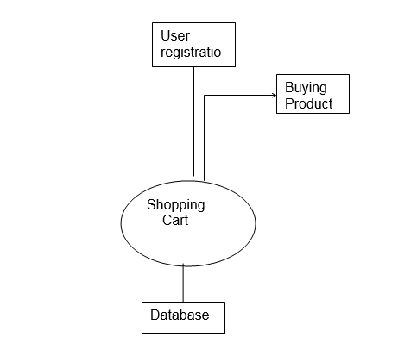
DATA FLOW DIAGRAMS:
The DFD takes an input-process-output view of a system i.e. data objects flow into the software, are transformed by processing elements, and resultant data objects flow out of the software.

Slide 9
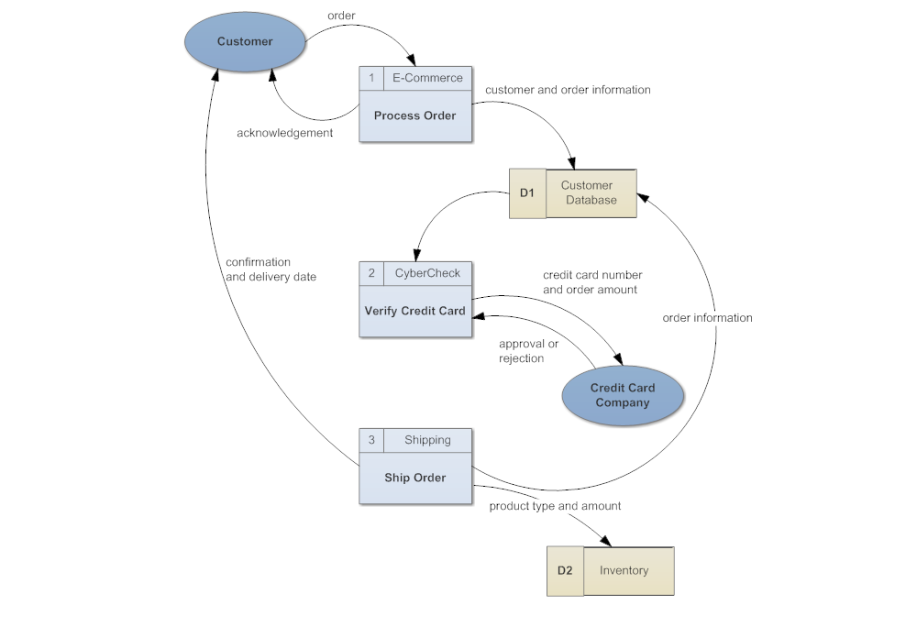

Slide 10
TABLE STRUCTURE:
TABLE NAME: ADMIN
S.NO | FIELD NAME | DATA TYPE | CONSTRAINTS
1 | uid | Varchar(50) | Not null
2 | Username | Varchar(100) | Not null
3 | password | Varchar(30) | Not null
4 | Creation date | datetime | Not null
5 | Updation date | Datetime | Not null

Slide 11
TABLE NAME: CATEGORY
S. NO | FIELD NAME | DATA TYPE | CONSTRAINT
1 | Id | Varchar(40) | Primary Key
2 | Category name | Varchar(100) | Not Null
3 | Category description | Varchar(100) | Not Null
4 | Creation date | Datetime | Not Null
5 | updationdate | Datetime | Not null
S. NO | FIELD NAME | DATA TYPE | CONSTRAINT
1 | Id | Varchar(30) | Not null
2 | Category | Varchar(40) | Not Null
3 | Subcategory | Varchar(30) | Not Null
4 | Product name | Varchar(30) | Not Null
5 | Product company | Varchar(40) | Not null
6 | Product price | Varchar(50) | Not null
14 | Posting date | Datetime | Not null
15 | Updationdate | Datetime | Not null

Slide 12
TABLE NAME: ORDER
S. NO | FIELD NAME | DATA TYPE | CONSTRAINT
1 | Order id | Varchar(20) | Primary key
2 | Userid | Varchar(30) | Not Null
3 | Productid | Varchar(30) | Not Null
4 | Quantity | Varchar (100) | Not Null
5 | Order date | Varchar(100) | Not null
6 | Payment method | Varchar(50) | Not null
7 | Order status | Varchar(100) | Not null

Slide 13
TABLE NAME: PRODUCT
S. NO | FIELD NAME | DATA TYPE | CONSTRAINT
1 | Id | Varchar(30) | Not null
2 | Category | Varchar(40) | Not Null
3 | Subcategory | Varchar(30) | Not Null
4 | Product name | Varchar(30) | Not Null
5 | Product company | Varchar(40) | Not null
6 | Product price | Varchar(50) | Not null
14 | Posting date | Datetime | Not null

Slide 14
OUTPUT DESIGN:
Outputs from computer systems are required primarily to communicate the results of processing to users. They are also used to provide a permanent copy of the results for later consultation. The various types of outputs in general are:
External Outputs, whose destination is outside the organization,.
Internal Outputs whose destination is within organization and they are the
User’s main interface with the computer.
Operational outputs whose use is purely within the computer department.
Interface outputs, which involve the user in communicating directly with User Interface.
Output Definition:
The outputs should be defined in terms of the following points:
Type of the output
Content of the output

Slide 15
Format of the output
Location of the output
Frequency of the output
Volume of the output
Sequence of the output
It is not always desirable to print or display data as it is held on a computer. It should be decided as which form of the output is the most suitable.
For Example
Will decimal points need to be inserted
Should leading zeros be suppressed.

Slide 16
.FUTURE ENHANCEMENT
Personalized Predictions: Implementing AI-driven models that factor in customer preferences, demographics, and shopping habits would allow for personalized pricing and sales forecasting tailored to individual consumers or specific market segments.
Sentiment Analysis: Analyzing online reviews, customer feedback, and social sentiment could offer valuable insights into product reception and future demand, influencing sales predictions and pricing strategies.
Supply Chain Integration: Integrating sales predictions with supply chain data (like inventory levels, shipping delays, and production capacity) could lead to more accurate demand forecasting and better inventory management, minimizing stockouts or overstocking.
Integration of Real-Time Data: By incorporating real-time data from social media, fashion trends, and influencer endorsements, predictive models can be updated instantly to capture shifts in consumer preferences and emerging trends.
Advanced Machine Learning Models: Employing more sophisticated machine learning techniques, such as deep learning or reinforcement learning, could allow for better pattern recognition and more nuanced predictions that adapt to various market conditions.

Slide 17
CONCLUSION
In conclusion, sales price prediction for clothing relies on a combination of factors such as brand reputation, material quality, design trends, seasonality, and market demand. By utilizing machine learning algorithms or statistical models, businesses can accurately forecast pricing based on historical data, consumer behavior, and other relevant variables. This predictive approach allows companies to set competitive yet profitable prices, optimize inventory management, and enhance customer satisfaction. However, it is important to continuously update the models with new data and adjust strategies based on market fluctuations and changing consumer preferences. Ultimately, a well-crafted sales price prediction model can significantly contribute to the overall success of a clothing business.

Slide 18
REFERENCES
1. Books and Research Papers on Machine Learning & Predictive Analytics:
"Hands-On Machine Learning with Scikit-Learn, Keras, and TensorFlow" by Aurélien Géron This book provides a practical approach to machine learning with examples using Python, including time-series forecasting, which is essential for sales prediction.
"Forecasting: Principles and Practice" by Rob J Hyndman and George Athanasopoulos This book focuses on time-series forecasting, covering methods like exponential smoothing and ARIMA, which are useful for predicting sales trends.
"Machine Learning Yearning" by Andrew Ng A book by Andrew Ng, offering insights on how to structure machine learning projects. While not specifically about beverage sales, it provides practical advice on deploying machine learning models, which can be applied to price prediction.
. Software and Tools:
Microsoft Azure Machine Learning: Azure provides cloud-based tools for predictive analytics, including tools for time-series forecasting, regression analysis, and demand prediction.
Google Cloud AI & BigQuery: Google offers powerful tools and APIs for building machine learning models on large datasets, useful for predicting beverage sales.

Slide 19
BIBILOGRAPHY
Books:
Géron, A. (2019). Hands-On Machine Learning with Scikit-Learn, Keras, and TensorFlow. O'Reilly Media.
This book provides practical insights into using machine learning algorithms for predictive analytics, including time-series forecasting, which can be applied to beverage sales price prediction.
Hyndman, R. J., & Athanasopoulos, G. (2021). Forecasting: Principles and Practice (3rd ed.). OTexts.
2.A comprehensive guide to time-series forecasting methods, which are essential for predicting sales and prices in industries like beverages.
Ng, A. (2018). Machine Learning Yearning. Deeplearning.ai.
2. A resource for structuring machine learning projects that can be applied to beverage sales prediction and price optimization.
Research Papers:
Choi, S. B., & Lee, H. (2018). "Price Optimization in Retail: A Literature Review." Journal of Retailing and Consumer Services, 43, 222-231.
4. Discusses methods of price optimization in the retail sector, including price elasticity and prediction models that are applicable to beverages.
S. Ghosh, & R. Prasad. (2020). “A Survey of Machine Learning Techniques for Predictive Analytics in Beverage Sales.” International Journal of Machine Learning and Computing, 10(2), 120-126.

Slide 20
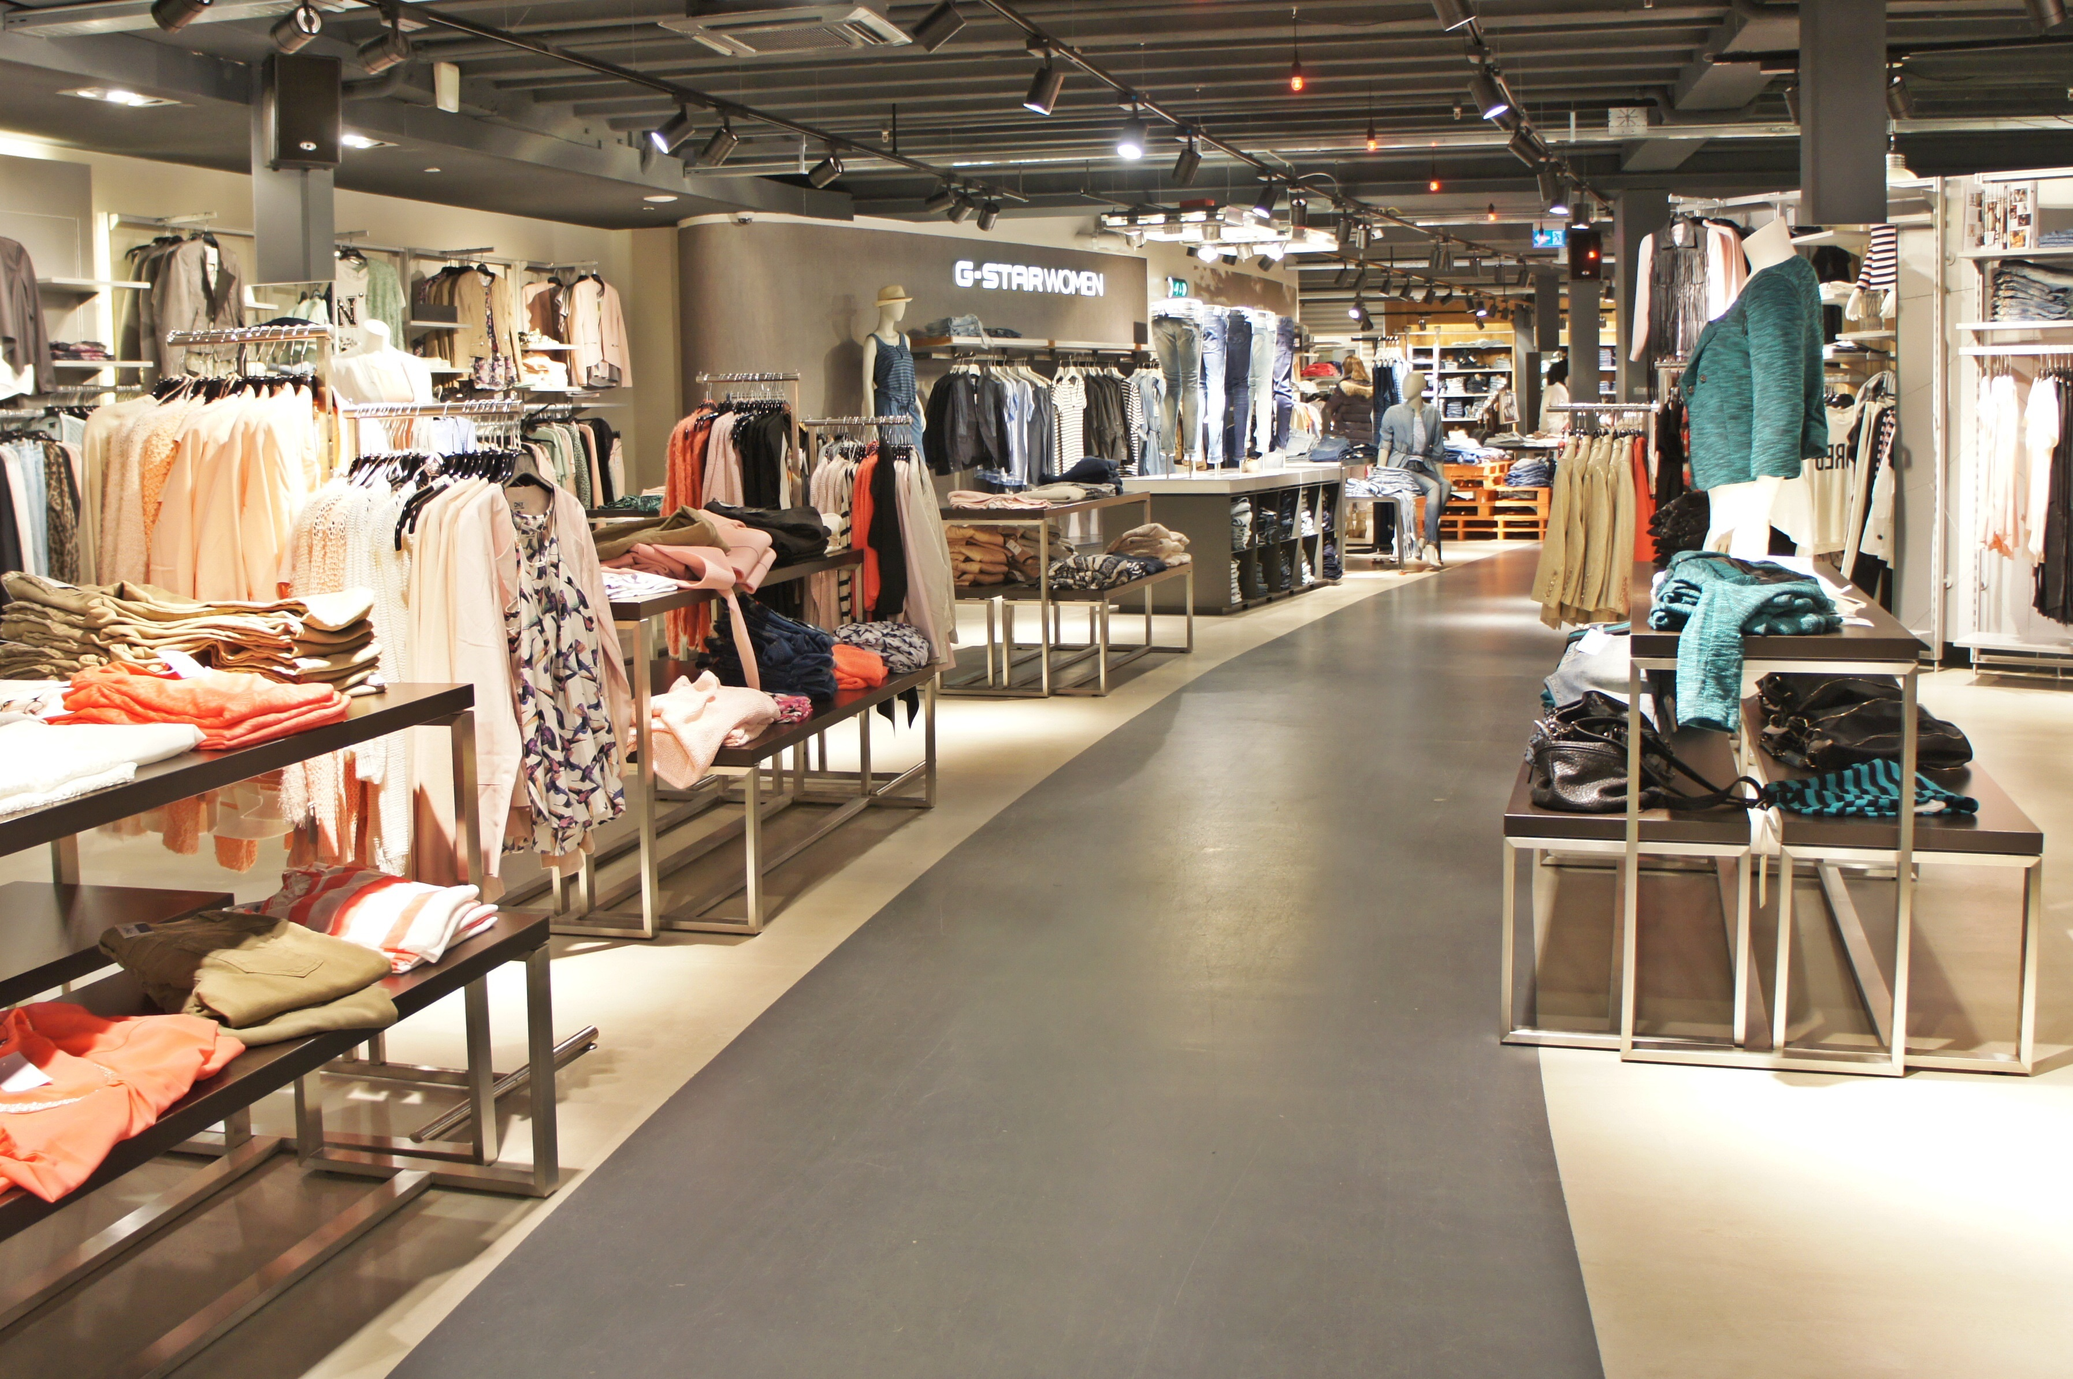
THANK YOU

