Slide 1


Social Buzz

Slide 2


Today's agenda
Project recap
Problem
Process
Insights
Summary

Slide 3

The project includes tasks such as an audit of Social Buzz big data practice, recommendations for a successful IPO, and an analysis of their content categories that highlights the top 5 categories with the largest aggregate popularity.
The tasks will be delegated to various teams, such as creating an up-to-date big data best practices presentation, on-site audit of their data-center, and preparation of a best practice document for IPO.
Project Recap

Slide 4

Problem
The problem that Social Buzz is facing is their inability to manage the scale and complexity of their platform independently.
They are still a small company and do not have the resources to manage the scale that they are currently at.
They could hire more people, but they want an experienced practice to help instead.
Therefore, they are looking for external expertise to help them manage their growth effectively and prepare for their IPO.

Slide 5



Chief Technical Architect
Andrew Fleming
The Analytics team
Senior Principle Marcus Rompton
Data Analyst
Sara Novak

Slide 6
Process
1 Data Understanding
2 Data Cleaning
3 Data Modeling
4 Data Analyzing
5 Presenting Insights

Slide 7
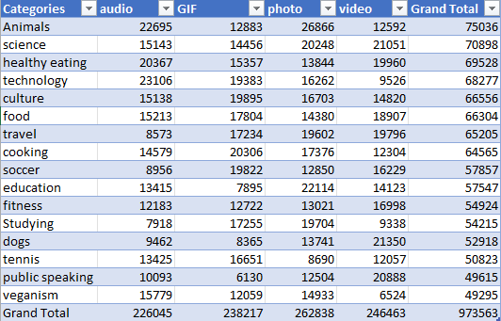

Slide 8

Insights
Based on the findings, the top 5 categories on Social Buzz are Animal, Science, Technology, Culture and Healthy Eating.
The most popular type of content on the platform is photos, followed by videos and GIFs, with audio being the least popular.
In terms of content volume, May following with January had biggest volume.
Additionally, the most significant user reaction score on the platform was "Super Love," while the least significant user reaction score was "Disgust."

Slide 11

Overall, these insights can help Social Buzz understand what types of content are most popular on their platform and which categories they should focus on.
They can also use this information to optimize their user engagement and prioritize their efforts on creating high-quality content that resonates with their users.
Summary

Slide 12
Thank you!
ANY QUESTIONS?

