Slide 1
POWER BI DASHBOARD ANALYSIS REPORT
Sales & Profit Performance Visualization
STUDENT DETAILS
📊
Name :
Saranraj
Course :
B.Com FinTech with AI
Subject :
Power BI
Topic :
Total Sales & Profit Analysis by Region, Category, Month & Employee

Slide 2
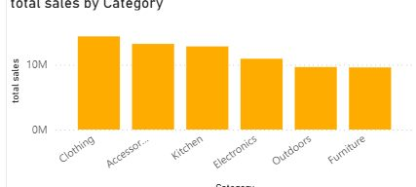
Page 2: Total Sales by Category
Saranraj | Power BI
Total Sales by Category
This column chart shows category-wise sales performance.
⭐ Top Category: Clothing
Key Observations:
1. Clothing is the top-performing category with over 14M in total sales, indicating highest demand.
2. Accessories, Kitchen, and Electronics follow closely, all contributing above 11M each.
3. Outdoors and Furniture have relatively lower sales (~9.5M), suggesting opportunity for promotion.
4. Sales distribution is fairly balanced, no category is underperforming drastically.

Slide 3
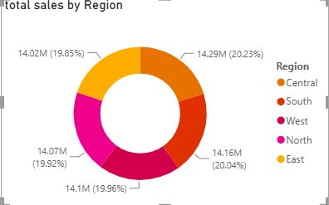
Page 3: Total Sales by Region
Saranraj | Power BI
Total Sales by Region
This donut chart represents regional contribution to total sales.
⭐ Most Balanced Distribution
Key Observations:
1. Sales are almost equally distributed across all 5 regions (19.85% to 20.23%).
2. Central region leads slightly with 14.29M (20.23%).
3. East region is lowest with 14.02M (19.85%) but difference is marginal (<0.5%).
4. Indicates strong pan-regional market presence with no regional dependency risk.

Slide 4
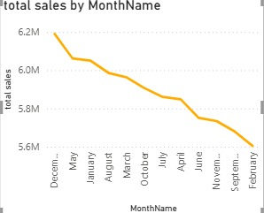
Page 4: Total Sales by Month
Saranraj | Power BI
Total Sales by MonthName
This line chart tracks monthly sales trend over time.
⭐ Peak Month: December
Key Observations:
1. Highest sales recorded in December (~6.2M), indicating year-end / holiday peak.
2. Consistent declining trend from December to February (6.2M down to 5.6M).
3. Mid-year months (April-October) remain stable around 5.8M - 6.0M.
4. Seasonality observed: Q4 is strongest, Q1 weakest - suggests need for Q1 promotional strategy.

Slide 5
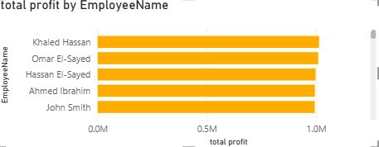
Page 5: Total Profit by Employee
Saranraj | Power BI
Total Profit by EmployeeName
This bar chart compares employee-wise total profit contribution.
⭐ Top Performer: Khaled Hassan
Key Observations:
1. All employees have generated close to 1M profit, showing high and consistent performance.
2. Khaled Hassan is the top performer with ~1.02M total profit.
3. John Smith is lowest but still near 0.9M, gap is less than 10%.
4. Team performance is uniform, indicates effective training and balanced workload distribution.

