Slide 1

Velocity Carry Trade
A Whole New Currency Trading Strategy
Team Black:
Saransh Mittal, Min Zhong,
Jun Li, Bowen Shen, Kuan Yang
WhiteSand Technologies

Slide 2
How you would profit
Your interest is the top of our concern
WhiteSand Technologies

Slide 3

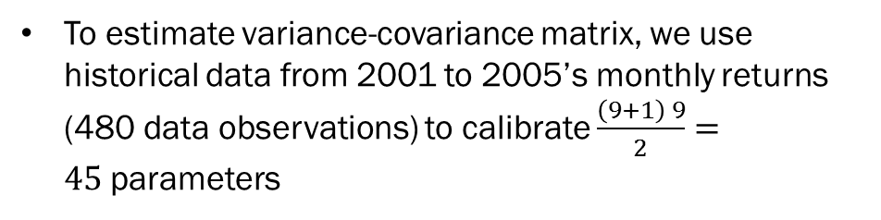
Objective
Our strategy is dollar neutral, which means we must have $e^{T}h_{t}=0$
To estimate variance-covariance matrix, we use historical data from 2001 to 2005’s monthly returns (480 data observations) to calibrate $\frac{\left(9+1\right) 9}{2}=45$parameters
WhiteSand Technologies

Slide 4
Investment table
Out-sample 2011 Jan- 2012 Sept
Risk limit | Sharp ratio | Return | Risk
10% | 0.78 | 6.55% | 8.33%
15% | 0.80 | 8.78% | 10.99%
25% | 0.79 | 14.30% | 18.07%
50% | 0.79 | 28.13% | 35.54%
100% | 0.79 | 56.10% | 70.84%
WhiteSand Technologies

Slide 5
Our strategy explained
WhiteSand Technologies

Slide 6
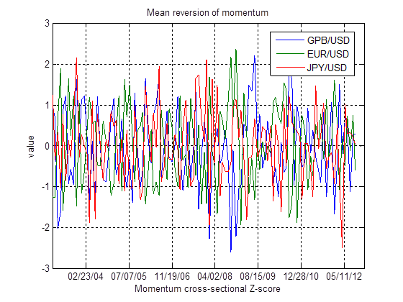
Mean reversion: momentum
The evidence for our contrarian perspective stems from the fact that all the time series z-scores of momentum, volatility and skewness demonstrate a strong mean-reverting pattern, as illustrated in the figures.
WhiteSand Technologies

Slide 7
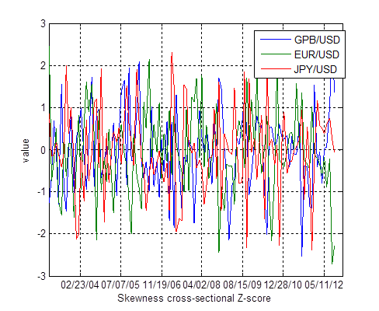
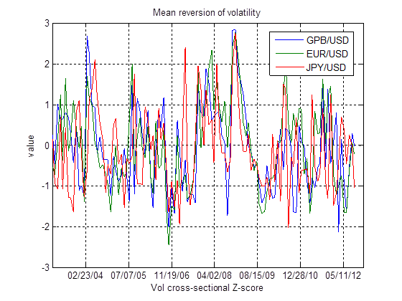
Mean reversion: skewness and volatility
Buy currencies with a high historical volatility and to sell currencies with a low historical volatility.
Skewness: bullish view on currencies with negative skewed historical returns and a bearish one for currencies of positive.
Both may be interpreted as a contrarian strategy.
WhiteSand Technologies

Slide 8
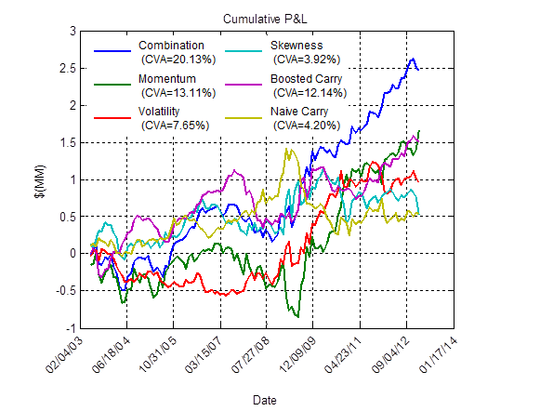
Return decomposed
Combination strategy, as the name suggests, pushes the envelope further to embrace all the time series z-scores, namely boosted FX carry trade, FX momentum, FX volatility, and FX skewness for each currency pair.
WhiteSand Technologies

Slide 9
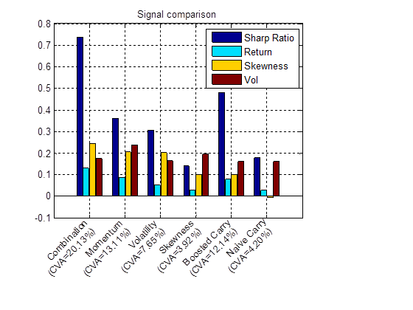
Compare signals
WhiteSand Technologies

Slide 10
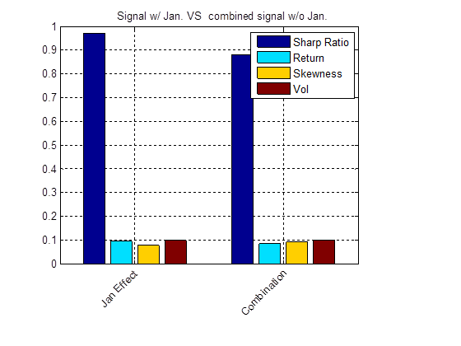
January effect
The in-sample modification of January effect, reversing the position of portfolio for rebalancing in January, turns out to increase the return while reducing the volatility of our combination strategy.
WhiteSand Technologies

Slide 11
Stop loss strategy
We further improve our trading strategy to impose neutral position on the two currency pairs with the worst performance based on the past 6 month window.
Then we keep rolling forward one month at a time and rebalancing our portfolio with the abovementioned imposed position constraints.
WhiteSand Technologies

Slide 12
Our alpha
The portfolio return is regressed against three factors: momentum, carry trade, and volatility. The alpha is 0.01518 with the corresponding t-statistics 2.7448. Hence, our strategy is generating some positive alpha of statistical significance.
The signs of factor loadings shed light on our timing skills on each explanatory variable.
The shaded areas are the scenarios and the signs of regression coefficients are populated right next to the corresponding scenarios. It is evident that agreement between signs is tantamount to good timing skill, otherwise it is subject to randomness.
WhiteSand Technologies

Slide 13
timing
With cross-comparison, one can draw the conclusion that the trading strategy tracks the carry trade and volatility with sufficient precision, yet it is lack of clairvoyance when it comes to momentum.
WhiteSand Technologies

Slide 14
In-sample and out-of-sample
WhiteSand Technologies

Slide 15
Compare different strategies
WhiteSand Technologies

Slide 16
Investor beware
What drives our strategy performance
WhiteSand Technologies

Slide 17
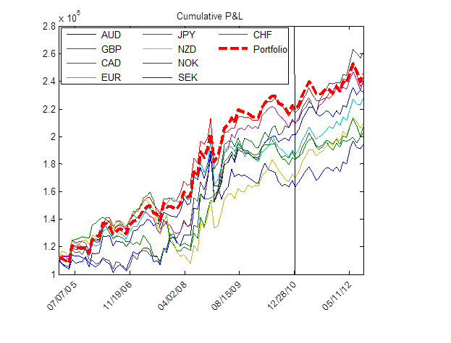
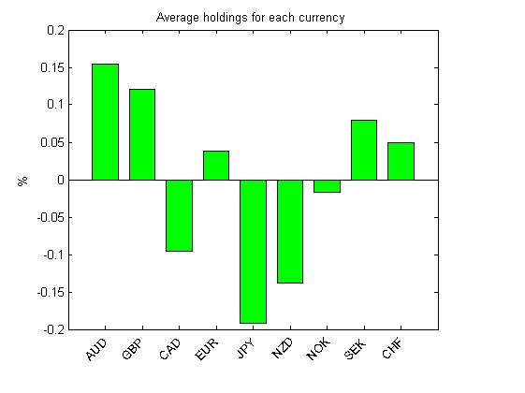
Which currency pair is important?
WhiteSand Technologies

Slide 18
Exposure to illiquid currencies
A greater portion of total cumulative profits is ascribed to the relatively illiquid currencies in the currency basket.
The liquid currencies as Euro, Japanese Yen, British Pound, and Swiss Franc.
The illiquid currencies are Canadian Dollar, Norwegian Kroner, New Zealand Dollar, and Swedish Krona.
WhiteSand Technologies

Slide 19
conclusion
“Carry trades have shown to be highly profitable (Lustig and Verdelhan, 2007), are widely used among professional currency fund managers (Pojarliev and Levich, 2008), and also show up in actual FX transactions data (Galati, Heath, and McGuire, 2007)”
However, the performance coming out of the naïve carry trade strategy is lackluster.
One immediate remedy is to combine some information existing in other signals, such as momentum, skewness and volatility. Built upon the combination, the strategy is optimized with the consideration of January effect and the establishment of stop loss constraints.
WhiteSand Technologies

Slide 20

Thank you
WhiteSand Technologies

