Slide 1
PGCP
Lectures 15 onwards

Slide 2


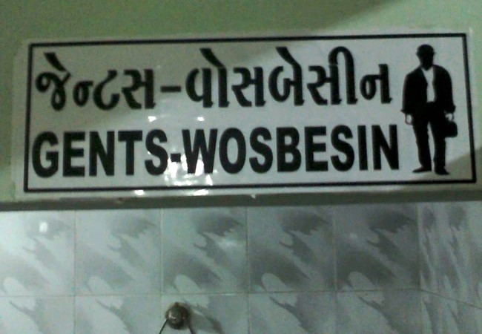

Common mispronunciations
सावन का महीना पवन करे... सोर
विश्व - बिस्व
वन - बन
बाण - बान
लक्ष्मण - लक्ष्मन
ढाबा - धाबा
अर्थ - अर्ध
जीविका - जीविगा
चिन्तितवान् - चिन्दिदवान्

Slide 3
रक्षार्थं वेदानाम्..
Development of two systems – (1) System of recitation – प्रकृति-पाठs and विकृति-पाठs
Development of 6 वेदाङ्गs
One fully dedicated to the art of pronunciation (perhaps the oldest of all the वेदाङ्गs) is शिक्षा
Perhaps the most crucial one to ensure that the correct oral transmission of the huge Vedic corpus
Sanskrit phonetics find its roots in the वेदs – ऋग्वेद 10.125 (वागाम्भृणी)
Earliest description of Sanskrit phonetics found in तैत्तिरीय उपनिषद् 1000 BCE वर्णः स्वरः । मात्रा बलम् । साम सन्तानः । इत्युक्तः शीक्षाध्यायः ॥

Slide 4
How to give the शिक्षा of correct pronunciation?
This method is not feasible when it comes to a written शिक्षा
The mother-tongue bias of a learner does not allow them to perceive the correct pronunciation … thereby articulate it
So we have to head towards ‘description’ of sounds

Slide 5
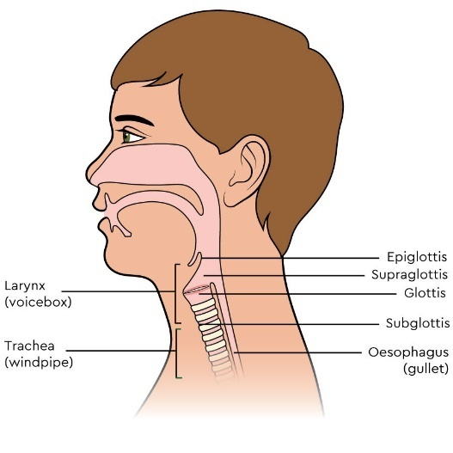
Tools for description
उच्चारण-स्थान – कण्ठः, तालु, मूर्धा, दन्ताः, ओष्ठौ
यत्नः
आस्यम् - ओष्ठात् प्रभृति प्राक् काकलकात्।
आभ्यन्तर = यत्न that happens inside the आस्य
बाह्य = यत्न that happens outside the आस्य
आभ्यन्तरः (प्रयत्नः) – स्पृष्ट, ईषत्स्पृष्ट, ईष्द-विवृत, विवृत, संवृत
बाह्यः –
संवारः, नादः, घोषः X विवारः, श्वासः, अघोषः
उदात्त, अनुदात्त, स्वरित
अल्प-प्राणः, महा-प्राणः
If you understand these categories, you understand sounds

Slide 6
The वर्णमाला
The rational order of Sanskrit alphabet – वर्णमाला was established earlier than 600 BCE
सामवेद प्रातिशाख्य organized the स्पर्श वर्ण into 5 x 5 square
क | ख | ग | घ | ङ
च | छ | ज | झ | ञ
ट | ठ | ड | ढ | ण
त | थ | द | ध | न
प | फ | ब | भ | म

Slide 7
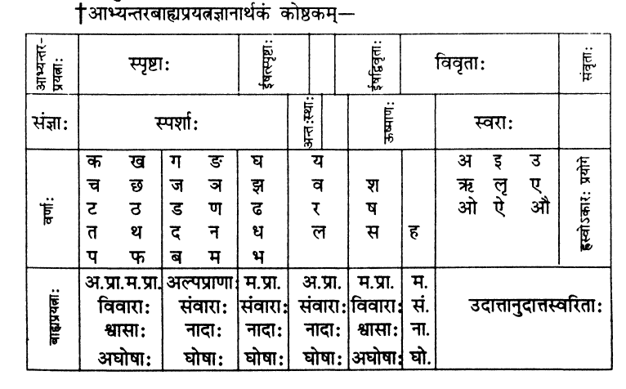
Formulation of a rational order of वर्णs

Slide 8
Helps in Two Ways
Using the vocabulary developed based on
(a) place of articulation and
(b) manner of articulation
one can provide a unique description of each sound.
Example – there is one and only one sound with (a) place of articulation - दन्त and (b) manner of articulation – स्पृष्ट, विवार, श्वास, अघोष and अल्पप्राण
that sound is ‘क’
It provides a logical reasoning for commonly observed sound shifts …

Slide 9
सोर-शोर, वन-बन, लक्ष्मण-लक्ष्मन, ढाबा-धाबा, अर्थ-अर्ध, जीविका-जीविगा, चिन्तितवान्-चिन्दिदवान्

Slide 10
Emergence of IPA
The International Phonetic Alphabet Chart – A notational standard of for phonetic representation of all languages
Maintained by International Phonetic Association
In 1886 a few language teachers in Paris formed a group - Dhi Fonètik Tîtcerz' Asóciécon (the FTA)
Objective – to help children acquire realistic pronunciations of foreign languages
Converted to IPA in 1897
The group was lead by Paul Passy
Knew English, German, Italian, SANSKRIT and Gothic Latin

Slide 11
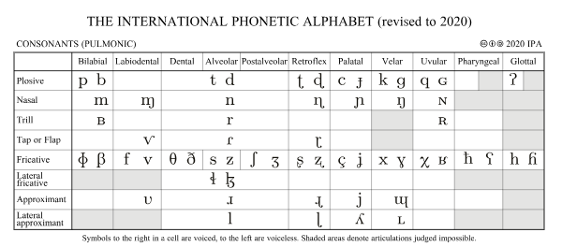
The IPA chart
Watch the video for details - https://youtu.be/6oRU7O6svO8?si=ocy_wV3qe4opVkhE

Slide 12
माहेश्वर-सूत्रs
अइउण्
कऌक्
एओङ्
ऐऔच्
हयवरट्
लण्
ञमङणनम्
झभञ्
घढधष्
जबगडदश्
खफछठथचटतव्
कपय्
शषसर्
हल्

Slide 13
..
According to a legend, Panini performed तपस् (austerity).. Lord शिव, propitiated by his तपस् played his डमरु for 14 times. These सूत्रs are created by imitating the sounds of डमरु. Since they are acquired from lord शिव (or महेश्वर), they are called as माहेश्वर सूत्रs
They are also called as शिव-सूत्रs, अक्षर-समाम्नाय and प्रत्याहार-सूत्रs
The main purpose of these सूत्रs is to create प्रत्याहारs
प्रत्याहारs are abbreviations that can denote different strings of sounds for performing different linguistic operations

Slide 14
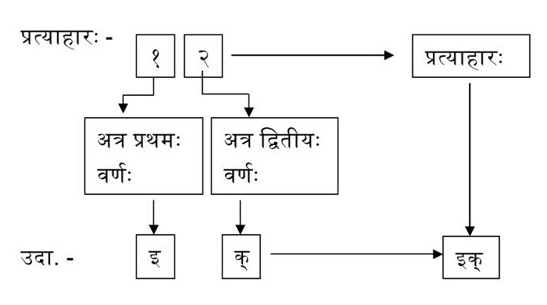
How to Prepare a प्रत्याहार
A प्रत्याहार consists of two वर्णs
The first one of them can be any वर्ण except the last sound (which is also called as इत् sound) from any माहेश्वर सूत्र.
The second one should compulsorily be the last (or इत् sound) of the same or following माहेश्वर सूत्र

Slide 15
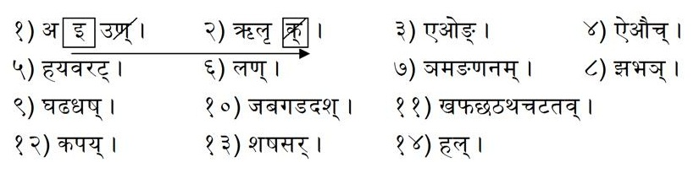
वर्णs Indicated by a प्रत्याहार
All the वर्णs beginning from the first one mentioned in the प्रत्याहार to the last one except all the इत् sounds are indicated by a प्रत्याहार
For example the प्रत्याहार ‘इक्’ includes – इ, उ, ऋ and ऌ
More about this in the video - https://youtu.be/0QnHjb3_GOE?si=rV1YwqvjhQtRAuk2
(Watch between 9 min to 22 mins of the video)

Slide 16
Few examples of प्रत्याहारs and the वर्णs indicated by them -
प्रत्याहारः | वर्णs they denote | Remarks
अक् | अ, इ, उ, ऋ, लृ
अश् | अ, इ, उ, ऋ, लृ, ए, ओ, ऐ, औ, ह्, य्, व्, र्, ल्, ञ्, म्, ङ्, ण्, न्, झ्, भ्, घ्, ढ्, ध्, ज्, ब्, ग्, ड्, द्। | अ, इ, उ et. are vowels. वर्णs beginning from ह are consonants
अच् | अ, इ, उ, ऋ, लृ, ए, ओ, ऐ, औ। | The प्रत्याहार अच् includes all vowels
हल् | ह्, य्, व्, र्, ल्, ञ्, म्, ङ्, ण्, न्, झ्, भ्, घ्, ढ्, ध्, ज्, ब्, ग्, ड्, द्, ख्, फ्, छ्, ठ्, थ्, च्, ट्, त्, क्, प्, श्, ष्, स्, ह् | The प्रत्याहार हल् includes all consonants

Slide 17
Comparison between वर्णमाला and माहेश्वर-सूत्रs
वर्ण-माला
माहेश्वर-सूत्रs
अ | आ | इ | ई | उ | ऊ | ऋ | ॠ | ऌ | ए | ऐ |  | ओ | औ
क |  | ख |  | ग |  | घ |  | ङ
च |  | छ |  | ज |  | झ |  | ञ
ट |  | ठ |  | ड |  | ढ |  | ण
त |  | थ |  | द |  | ध |  | न
प |  | फ |  | ब |  | भ |  | म
य |  | र |  | ल |  | व
श |  | ष |  | स |  | ह ह
अइउण् ऋऌक् एओङ् ऐऔच्
हयवरट् लण् ञमङणनम्
झभञ् घढधष् जबगडदश्
खफछठथचटतव् कपय् शषसर् हल्

Slide 18
How are प्रत्याहारs Used in अष्टाध्यायी
Example – इको यणचि। (6.1.77)
इकः यण् अचि
(इक्)(यण्)(अच्)
इक् - इ, उ, ऋ, ऌ
यण् - य, व, र, ल
अच् - अ, इ, उ, ऋ, ऌ, ए, ओ, ऐ, औ (all vowels)
Meaning –
इ changes to य when it is followed by any vowel
Likewise उ changes to व, ऋ changes to र and ऌ changes to ल
Read ‘Economy and the Construction of Śivasūtras’ by Paul Kiparsky (1991)

Slide 19
Ellipses : अनुवृत्तिः
In day-to-day communications an elliptical sentence is made a complete sentence by borrowing required words from the previous context
Panini has ingeniously made use of this ordinary feature of spoken language and has transferred it into a highly technical appliance called ‘अनुवृत्ति’
आकाङ्क्षा (Expectancy) plays a major role in deciding अनुवृत्ति
Panini has been able to save around 30000 words in his work with just this one technique

Slide 20
Example of अनुवृत्ति in the rules from 1.3.2 – 1.3.9
No. | सूत्रs | Meaning
1 | उपदेशे अच् अनुनासिकः इत्। | The nasalised vowels are इत् in उपदेश or original enunciation.
2 | हल् अन्त्यम् ।(उपदेशे इत्) | In उपदेश, the final consonant is इत्
3 | न विभक्तौ तु-स्-माः। (हल् अन्त्यम् उपदेशे इत्) | The final dental consonants and the final स् and म् are not इत् , in affixes called विभक्ति
4 | आदिः ञि-टु-डवः। (उपदेशे इत्) | ञि, टु and डु occurring at the beginning of an उपदेश are called 'इत्'.
5 | षः प्रत्ययस्य। (आदिः उपदेशे इत्) | The letter ष् at the beginning of a प्रत्यय is called 'इत्'
6 | चु-टू। (प्रत्ययस्य आदिः उपदेशे इत्) | The letters - च्, छ्, ज्, झ्, ञ्, ट्, ठ्, ड्, ढ्, ण् - at the beginning of a प्रत्यय are called इत्
7 | लशकु अतद्धिते। (प्रत्ययस्य आदिः उपदेशे इत्) | The initial ल् and श् and the gutturals of all affixes, except, तद्धित are called इत्
8 | तस्य लोपः। | Of this, (namely of that which has been called इत्) there is elision
In सूत्रs 1 to 7 above - no. of words used = 15 : No. of words saved = 19

Slide 21
अनुबन्धs
अनुबन्धs are an important aspect of Panini’s meta-language
The also contribute significantly to brevity/economy in Panini’s work
All the elements of उपदेशs that are labeled as इत् by the rules 1.3.2 to 1.3.9 are called as अनुबन्धs
They are removed by the rule 1.3.9, that is why they are not visible in words arrived at as a result of the derivational process
They are added to धातुs, प्रातिपदिकs, प्रत्ययs etc. (i.e., to उपदेशs) in order to trigger certain operational rules

Slide 22
Example : Compare the following derivations with a same suffix with different अनुबन्धs
पठ् + ण्यत् (Root पठ् takes the suffix ण्यत् by rule 3.1.124)
पठ् + य (अनुबन्धs – ण् and त् are removed by rules 1.3.3, 1.3.7 and 1.3.9)
पाठ् य (The second-last sound अ in a धातु is replaced by आ whenever a suffix with अनुबन्ध ण् is added to it by rule 7.2.116)
पाठ्य
शक् + क्यप् (Root शक् takes the suffix क्यप् by rule 3.1.99)
शक् + य (अनुबन्धs – क् and प् are removed by rules 1.3.3, 1.3.8 and 1.3.9)
(The second-last sound अ in शक् is not replaced by आ since the a suffix क्यप् does not have अनुबन्ध ण् in it)
शक्य
Read – ‘Anubandhas of Panini’ by G. V. Devasthali (1967)

Slide 23
Types of सूत्रs
संज्ञा – (Eg.)वृद्धिरादैच्
परिभाषा – (Eg.)
विप्रतिषेधे परं कार्यम्,
तस्मिन्निति निर्दिष्टे पूर्वस्य,
षष्ठी स्थानेयोगा,
तस्मादित्युत्तरस्य
विधि – (Eg.)इको यणचि,
नियम – (Eg.) म्रियतेः लुङ्-लिङो श्च (1.3.61)
Root मृङ् already takes the आत्मनेपद-suffixes in all its forms since the इत्-sound ङ् is attached to it by virtue of the rule – अनुदात्तङित आत्मनेपदम् (१.३.१२). म्रियतेः लुङ्-लिङोश्च (१.३.६१) again repeats that root मृङ् takes आत्मनपद-suffixes in (i) immediate past tense and (ii) potential mood forms. So, the statement in नियमसूत्र – म्रियतेः लुङ्-लिङ्गोः च is assertive, but actually it is limiting the scope of the previous सूत्र – अनुदात्तङित आत्मनेपदम्.
अतिदेश - तृज्वत् क्रोष्टुः, लोटः लङ्वत्
अधिकार - कारके, प्रत्ययः, तद्धिताः etc.

Slide 24
संज्ञा-सूत्रs
संज्ञ-सूत्रs are Naming सूत्रs
They are found mainly in the first chapter of the अष्टाध्यायी
Panini gives names to various linguistic elements through these सूत्रs
The names are of two types –
1. कृत्रिम-संज्ञा (artificial or self-created name) – for example,
by his rule 1.1.64, he names the fragment of a word starting from its last vowel as ‘टि’. Here टि is a कृत्रिम-संज्ञा
By his rule 1.1.22, he gives the names घ two suffixes तरप् and तमप्
Similarly there are many other कृत्रिम-संज्ञाs like घि (1.4.7), घु (1.1.20), भ (1.4.18), etc.
2. अकृत्रिम-संज्ञा (Natural or already existing name) – for example,
By his rule 1.1.2 he gives the name ‘नदी’ to all the feminine प्रातिपदिकs ending in ई or ऊ
Similarly there are many other अकृत्रिम-संज्ञाs like सर्वनाम (1.1.27) संख्या (1.1.23) etc.

Slide 25
परिभाषा-सूत्रs
These सूत्रs are rules regarding the other rules of the अष्टाध्यायी
That is why परिभाषा-सूत्रs are called as meta-rules
Some of them help interpreting other rules correctly
Example - the सूत्र – एचोऽयवायावः (एचः अय्-अव्-आय्-आवः) (6.1.87) says that एच् (ए,ओ,ऐ and औ) are to be replaced by अय्, अव्, आय् and आव् when they are followed by any vowel. There is a mention of 4 स्थानीs (or former occupants) and 4 आदेशs (or substitutes) in the सूत्र. However, the सूत्र does not say anything about – “which स्थानी is to be replaced by which आदेश?”. In such a situation one may arbitrarily replace any sound by any substitute. To avoid this, there is a सूत्र 1.3.10 which says. “when the number of स्थानीs and आदेशs mentioned in a सूत्र is the same, then the first is replaced by the first, second is replaced by the second, and so on.

Slide 26
…
The others are regarding their application –
Example – In the derivation of the word ‘यः’ –
At the stage – यद् + सु the rule – ‘त्यदादीनाम् अः’ (7.2.102) comes into action.
As per the rule, the words belonging to the त्यादादि-गण are to be substituted by अ in the above situation. Now if we replace the entire word यद् above by अ the resultant form will be अ + सु अः. However, the desirable form is यः. Here a परिभाषा – अलोऽन्त्यस्य (1. 1. 52) comes into play. It says that, ‘a substitution consisting of a single sound should be made on the last sound of the former occupant’. Thus only द् of यद् is replaced by अ. So the derivation proceeds as follows –
यद् + सु यअ + सु(Rules 7.2.102 and परिभाषा 1.1.52) य + सु (Rule6.1.17) यः

Slide 27
विधि-सूत्रs
These सूत्रs constitute the crux of the entire grammatical system
These सूत्रs tell us about the actual operations to be performed in the derivational process
All other types of सूत्रs are meant to aid the विधि सूत्रs to carry out the derivational process flawlessly
Examples -
एचोऽयवायावः (एचः अय्-अव्-आय्-आवः) (6.1.87) says that एच् (ए,ओ,ऐ and औ) are to be replaced by अय्, अव्, आय् and आव् when they are followed by any vowel
‘त्यदादीनाम् अः’ (7.2.102) says that the words belonging to the त्यादादि-गण are to be substituted by अ when they are followed by विभक्ति-suffixes

Slide 28
नियम-सूत्र
About नियम-सूत्रs it is said that – सिद्धे सति आरभ्यमाणः विधिः ‘नियमः’ – A new rule that is initiated to tell something that has already been told is called as a नियम-सूत्र
Literally, it is an assertive statement but in its implication, it limits the scope of some other सूत्र
Example –
The rule शेषो घि असखि (1.4.7) broadly labels all the words ending in short इ and short उ as घि
The very next rule – पतिः समासे एन (1.4.8) lables the compounds ending in पति like पशुपति, राष्ट्रपति etc. as घि. Since all the words like पशुपति, राष्ट्रपति etc. end in short इ, they get the label घि by virtue of the previous सूत्र – 1.4.7 only. The implication of सूत्र 1.4.8 is that only the compound words ending in पति like पशुपति, राष्ट्रपति etc. get the label घि, so, the word पति alone is deprived of the the label घि

Slide 29
अतिदेश-सूत्र
There are Extension rules
They enable the application of certain operations that are taught in one context to the other current context
For example, look at the लङ् लोट् forms of the root पठ् –
One rule – लोटः लङ्वत् (3.4.85) Helps applying all the processes taught for the derivation of लङ् forms to those of similar लोट् forms
लङ् forms |  |  | लोट् forms
अपठत् | अपठताम् | अपठन् | पठतु | पठताम् | पठन्तु
अपठः | अपठतम् | अपठत | पठ | पठतम् | पठत
अपठम् | अपठाव | अपठाम | पठानि | पठाव | पठाम

Slide 30
अधिकार-सूत्र
These सूत्रs are often themselves meaningless
They are carried forward to hundreds of सूत्रs following them through अनुवृत्ति and help completing the meanings of those सूत्रs
In this way they also serve as headings of various sub-topics of व्याकरण covered at different places in the अष्टाध्यायी
Some examples of अधिकार-सूत्रs are as follows –
प्रत्ययः (3.1.1) is a huge अधिकार. It is carried forward up to 5.4.160 i.e. through 1811 सूत्रs that follow it. All the suffixes taught of the अष्टाध्यायी can be found under this अधिकार only.
The अधिकार - धातोः (3.1.91) runs up to the end of the 3rd chapter. All the suffixes that can be added to the धातुs are listed under this अधिकार

Slide 31
Ordering Rules and Conflict Resolution
Rules of the अष्टाध्यायी are triggered when the conditions required by them are satisfied
In the Example – वृक्ष+भ्यस्, the conditions required by two rules, namely (i) सुपि च (7.3.102) and (ii) बहुवचने झल्येत् (7.3.103) are satisfied. Both can not be applied simultaneously or even one after the other. This is the situation of conflict.
The सूत्र – विप्रतिषेधे परं कार्यम् (1.4.2) resolves this conflict. It says that in case of such conflicts the सूत्र that occurs later in the order of the अष्टाध्यायी will win over the previous सूत्र and become applicable.
Thus in this example बहुवचने झल्येत् is applied and we have the correct form वृक्षेभ्यः

Slide 32
In the Example ते + इमे, ए of ते changes to अय् by the rule एचोऽयवायावः (6.1.78). We then arrive upto – तय् + इमे. Here य् is removed by the rule लोपः शाकल्यस्य (8.3.19). Thus we have – ’त इमे’ which is the desired form. However, here, the conditions required for the rule आत् गुणः (6.1.87) to apply are matched. If the rule is applied we will reach to an undesired form – तेमे.
This problem is solved by the rule पूर्वत्रासिद्धम् (8.2.1). It divides the entire अष्टाध्यायी into two parts – (i) from the beginning to the end of 8.1 (सपादसप्ताध्यायी) and (ii) from the beginning of 8.2 to the end of 8.4 (त्रिपादी). By virtue of the rule पूर्वत्रासिद्धम्, the changes made by the rules from त्रिपादी are not visible to those belonging to the सपादसप्ताध्यायी.
Many other principles compiled in the बाधबीज-प्रकरणम् –
पर-नित्य-अन्तरङ्ग-अपवादानाम् उत्तरोत्तरं बलीयः
पूर्वात् – परं बलवत् – (Example) वृक्षेभ्यः
परात् नित्यं बलवत् – (Example) तुदति
नित्यात् अन्तरङ्गं बलवत् - (Example) ग्रामणिने
अन्तरङ्गात् अपवादः बलवान् - (Example) श्रीशः

Slide 33
Meta-language
Meta-rules = परिभाषा सूत्रs v/s Meta-language = new language that the grammarian devices through -
प्रत्याहार
Words like कु, चु, टु, तु, पु
संज्ञा – टि, घि, लट्
As well as through परिभाषा – Use of विभक्तिs, तपरस्तत्कालस्य etc.

Slide 34
Cases to specify context
षष्ठी – स्थाने – example – इकः यण् अचि. इकः is in genitive case. That is why the substitution happens on इक्. In this सूत्र – इकः is to be read as इकः स्थाने (यण् भवति)
सप्तमी – पूर्वस्य – in the सूत्र – इकः यण् अचि, अचि is in locative case. That is why the substitution happens on that which lies immediately before अच्. That is why substitution happens on only that इक् which lies immediately before अच्.
in इति+अपि, the इक् - इ after त् is replaced by य् because it precedes अ which is अच्. The इक् – इ in इति+वदति is not replaced by य् as it precedes व् which is not अच्
पञ्चमी – परस्य – the सूत्र – अतः भिसः ऐस् – the word अतः is in ablative case. The सूत्र says that the भिस् that comes immediately after a word ending in अ is replaced by ऐस्. In वृक्ष+भिस्, we see that भिस् has come immediately after वृक्ष, a word ending in अ. It is therefore replaced by ऐस्, consequently we have the form – वृक्ष+ऐस् = वृक्षैस् = वृक्षैः. In लता+भिस्, भिस् is not similarly replaced by ऐस् it has come after आ and not अ.
……..

Slide 35
तृतीया – योगे – Example - स्तोः श्चुना श्चुः - श्चुना is in तृतीया विभक्ति or instrumental case
The सूत्र - स्तोः श्चुना श्चुः says that स्, त्, थ्, द्, ध्, न् when either followed or preceded by श्, च्, छ्, ज्, झ्, ञ् changes to श्, च्, छ्, ज्, झ्, ञ्.
Example –
रामस्+चलति [स् (स्तु)changes to श् (श्चु) as it is followed by च् (श्चु)] – रामश्चलति
यज्+न् [न् (स्तु) changes to ञ् (श्चु) as it is preceded by ज् (श्चु)] – यज् ञ = यज्ञ

