Slide 1

SMART INDIA HACKATHON 2026
Problem Statement ID : 26063
Problem Statement Title : Integrated Polar Science Outreach, Knowledge Repository and Media Dissemination Portal
Theme : Smart Education
PS Category : Software
Team ID :
Team Name : Anarch
Notes:
Polar Knowledge Index: NCPOR's existing archive, harvested, linked to expeditions, searchable and cited to the page, with reviewed lessons and announcements in English and Hindi.

Slide 2







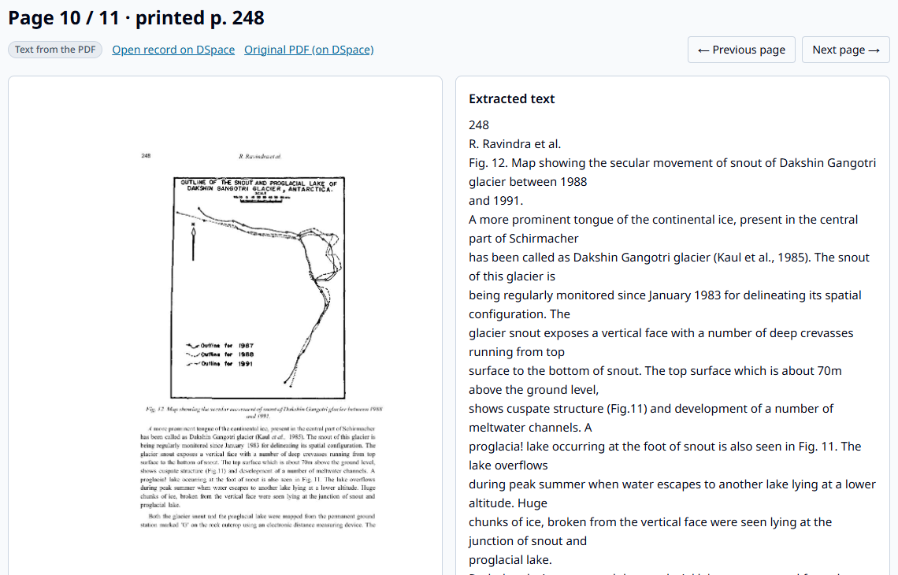







Polar Knowledge Index
TEAM
ANARCH
“Every expedition. Every page. Every claim cited.”
Proposed Solution: A knowledge index built on what NCPOR already publishes — harvested, linked to each expedition, and cited to the page.
WORKFLOW
PROTOTYPE IMAGE
DSPACE + RSS
HARVEST
01
Harvest → Read → Link → Search → Review → Teach
➤ What it does?
02
TEXT LAYER
/ OCR
Harvests, never re-enters : DSpace expedition reports (OAI-PMH) + NCPOR news feed, polite & cached — originals stay where they are
Reads the scans : PDF text layer or Tesseract OCR, page image kept for “view original page”
Links everything : item → expedition · station · topic · year; machine links stay unconfirmed until a curator confirms
LINK TO
EXPEDITION
03
04
HYBRID
SEARCH
➤ How it answers the PS?
Repository : 32 expedition reports, 765 papers and 837 news posts in one index, one page per expedition
Dissemination : cited answers, lesson units and web + social posts, in English and Hindi
CITED AI
DRAFT
05
FAITHFULNESS
CHECK
Working prototype · real DSpace scan · 9th Expedition glacier paper,
printed p. 248 — scan beside its searchable text
06
➤ What is different about it?
Scan : the page exactly as NCPOR published it
Real NCPOR archive , zero new data entry for staff
Checked, not claimed : every sentence fact-checked against its page; unsupported ones block approval
Named reviewer + append-only audit log; refuses when the archive has no source
Coverage view : shows which expeditions have no public report or story
NAMED
REVIEWER
07
Citation : every answer links back to this page
08
PUBLISH
EN / HI
Coverage : expeditions with no public report
github repo link :
demo youtube video :
Notes:
Problem: NCPOR's material is stored in six disconnected systems and nothing turns it into outreach. Solution: harvest what NCPOR already publishes, link every item to its expedition, and generate reviewed, cited content only from linked sources.

Slide 3







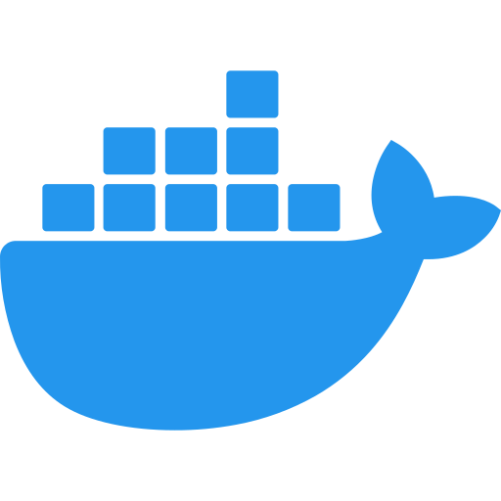








TECHNICAL APPROACH
TEAM
ANARCH
Technology stack & system architecture — built and running end-to-end on NCPOR’s real archive
Technology Stack
PIPELINE
LAYER | TOOL
Harvest | httpx · OAI-PMH · lxml · robots.txt-aware, 1 req/s, cached
Documents | PyMuPDF · Tesseract OCR 5.4 · page images
Search | PostgreSQL 16 full-text + pgvector · multilingual-e5-base
AI | Google Gemini — grounded drafting, checker, Hindi
Backend | Python 3.12 · FastAPI · SQLAlchemy 2 · Alembic
Frontend | Next.js · TypeScript · Tailwind · WCAG 2.1 AA
Security | Staff roles · JWT · bcrypt · append-only audit
Quality | 25 automated tests (pytest) · Docker Compose
1
2
3
DATA SOURCES
READ & LINK
CORE ENGINE
DSpace at NCAOR · OAI-PMH · 32 report communities
NCPOR news RSS · 837 posts since 2012
NPDC · link-only until NCPOR permits
Text layer first, Tesseract OCR if not
Printed page numbers · page images
Rules → AI fallback (always unconfirmed)
Hybrid search: keyword + meaning (RRF)
Refusal below relevance threshold
Grounded drafts: answer · lesson · post · Hindi
4
VERIFY
5
SERVE
6
DELIVER
Each sentence: supported / partial / unsupported
Unsupported sentences block approval
Named reviewer approves · audit trail
FastAPI · role-based staff API
Public endpoints read-only
Cached AI responses for offline demo
Search · Ask · scan beside text
Expedition pages · coverage view
Lessons & stories in English / Hindi
✓ Originals never re-hosted: links + OCR text + page images only
✓ Public is read-only; every staff action is audited
Evaluation: hand-verified test set, scored once → citation accuracy [__%] · refusal accuracy [__%]
Notes:
One Python backend, one PostgreSQL database, one web app. Records flow down from NCPOR's systems; originals are never copied. The AI only writes from retrieved passages and every sentence is checked.

Slide 4


FEASIBILITY AND VIABILITY
TEAM
ANARCH
✔ FEASIBILITY — already proven, not projected
➜ VIABILITY — path to operations
① Prototype ✓
Real DSpace + news;
10 reports read
797
3,266
52
25
reports & papers
harvested, zero entry
scanned pages
read & searchable
expeditions in
the coverage view
automated tests
passing
Runs on a laptop CPU: search model runs locally — no GPU; one database, one backend
Zero new work for NCPOR: harvests DSpace + news that already exist; review is the only staff task
Open standards, open source: OAI-PMH, PostgreSQL, Next.js — zero licence cost
④ Daily operations
Nightly harvest; feeds
Polar & Ocean Museum
Polar Index
engine
harvest · link
cite · review
② NCPOR pilot
Library / NPDC curators
confirm links
⚠ RISKS | 🛡 HOW WE HANDLE THEM
1980s scans read badly | Text layer first; OCR confidence shown; original page beside every quote
AI states what the source doesn’t | Per-sentence checker; unsupported blocks approval; refusal threshold
Looks like other SIH AI portals | Real archive, zero entry, coverage view, measured accuracy
NPDC not open to harvesting | Link-only until NCPOR permits; adapter slot ready
AI API outage or rate limits | Retries + cached answers; search works without AI
③ Full archive
All reports; 31–45
from digital files
Notes:
Feasibility numbers are counts from the running prototype. The main external dependency, NPDC access, is optional: the archive side works on DSpace and the news feed alone.

Slide 5

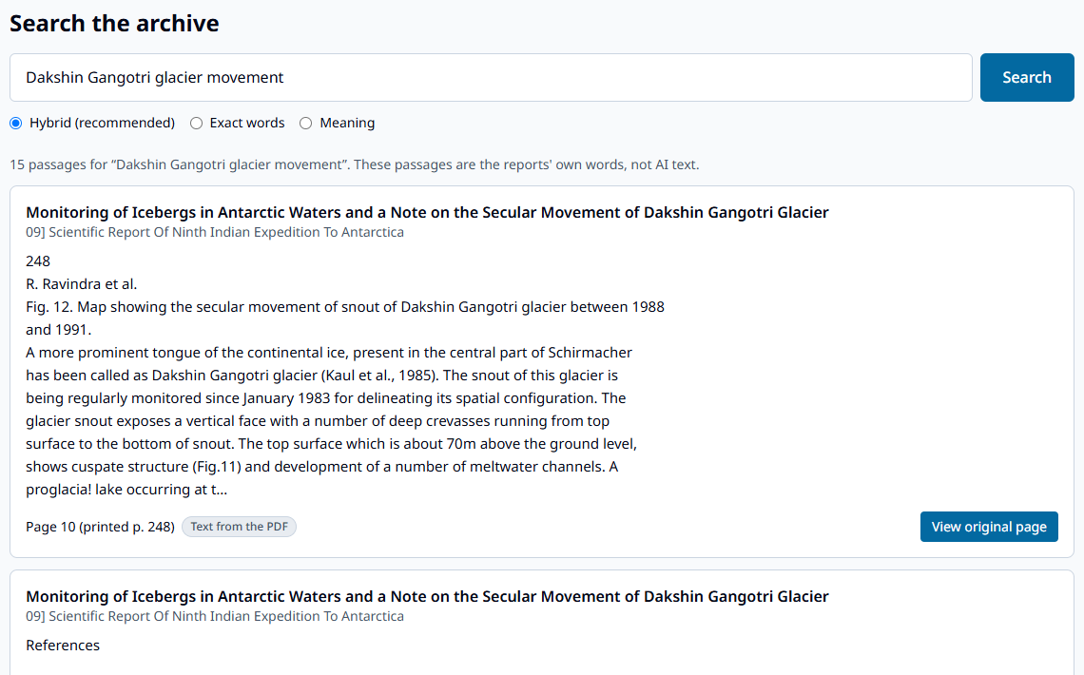
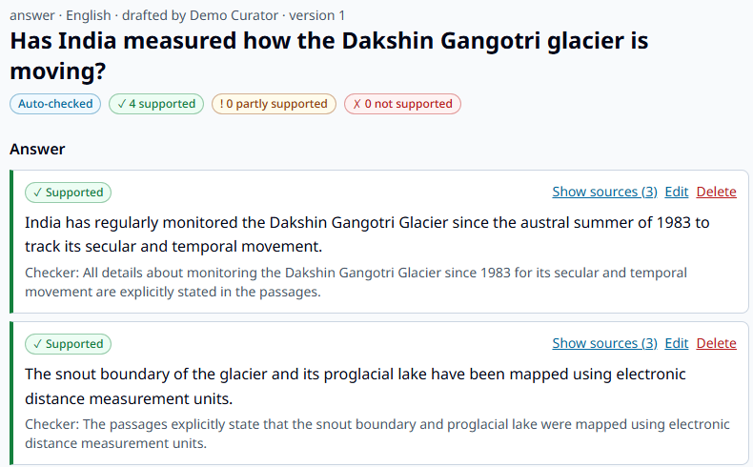
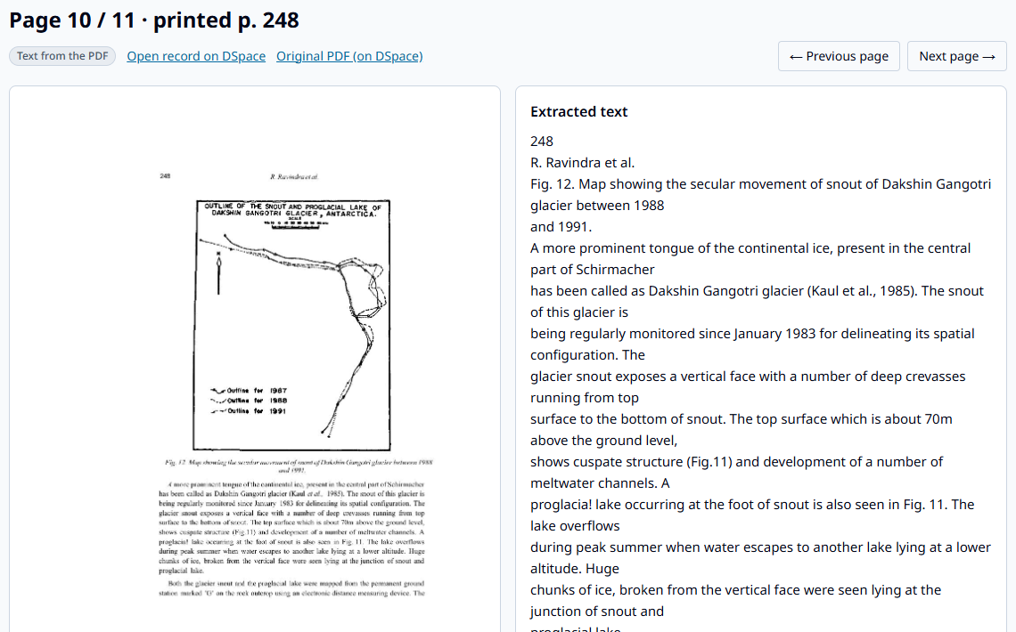










IMPACT AND BENEFITS
TEAM
ANARCH
PRACTICAL IMPACT
BENEFITS OF THE SOLUTION
Case study · a student asks: “Has India measured how the Dakshin Gangotri glacier is moving?”
SOCIAL
① Search finds the papers
② Cited draft, every sentence checked
③ Click through to the scan
Students get answers they can trust, cited to India’s own reports
ECONOMIC
No new data-entry cost; open-source stack, zero licence fees
OPERATIONAL
Outreach posts drafted in minutes from confirmed records
Answer drawn only from glaciology papers in the 9th, 11th, 26th and 30th Expedition reports — e.g. the snout receded 81 cm in 2011 — each sentence links to its page. Off-archive questions are refused.
TECHNOLOGICAL
Every public sentence traceable to a page, with an audit log
QUANTIFIED IMPACT
WHO BENEFITS ?
ENVIRONMENTAL
6 → 1
0
[__%]
Glacier, ice and climate evidence reaches classrooms
disconnected systems
become one index
new records typed
by NCPOR staff
citation accuracy,
hand-verified
NCPOR outreach
& MoES
Teachers &
students
Researchers &
PhD scholars
SCIENTIFIC
40 years of expedition science searchable; fewer duplicated baselines
NATIONAL
Journalists
& media
Polar & Ocean
Museum
India’s polar programme taught with Indian data; Hindi + GIGW 3.0
Notes:
The case study is a real run of the prototype on NCPOR's DSpace archive. The citation-accuracy tile is filled in from the hand-verified evaluation run.

Slide 6


RESEARCH AND REFERENCES
TEAM
ANARCH
Key research findings (built on NCPOR’s real archive)
Comparison with existing approaches
The archive exists — the links don’t
Capability | NCPOR today | Typical SIH prototype | Polar Index
Uses NCPOR’s real archive, no re-entry | ✖ | ✖ | ✔
Links every item to its expedition | ✖ | partly | ✔
Page-level citation for AI text | ✖ | ✔ | ✔
Sentence-level fact-check blocks approval | ✖ | ✖ | ✔
Named reviewer + append-only audit | ✖ | partly | ✔
Measured accuracy on verified set | ✖ | ✖ | ✔
Coverage view of programme gaps | ✖ | ✖ | ✔
Hindi output, reviewed | ✖ | ✔ | ✔
Six separate NCPOR systems; DSpace already speaks OAI-PMH, so 32 reports and 765 papers were harvested with no staff effort
Old scans are more readable than feared
9 of 10 reports carry a usable text layer on 68–92% of pages; the 30th was fully OCR’d at 90% mean confidence
AI must be checked sentence by sentence
In our glacier lesson test the checker flagged 4 of 27 checked sentences unsupported — incl. a general “glaciers move slowly” line absent from the sources
References :
DSpace at NCAOR — Scientific Reports of Indian Expeditions to Antarctica
NCPOR news feed (RSS)
National Polar Data Center (NPDC), NCPOR
OAI-PMH v2.0 — Open Archives Initiative protocol
Wang et al. (2024) — Multilingual E5 text embeddings, arXiv
Cormack, Clarke & Buettcher (2009) — Reciprocal Rank Fusion, SIGIR
Lewis et al. (2020) — Retrieval-Augmented Generation, NeurIPS
WCAG 2.1 — W3C accessibility guidelines (GIGW 3.0 basis)
“Typical SIH prototype” = public repositories for PS SIH26063 reviewed before building (e.g. PolarCROSS, PRISM, POLARIS, DhruvGyani). NCPOR today = main site, DSpace, NPDC, MET-Data, library and social channels as separate systems.
Coverage view finding: reports for the 7th and 8th expeditions are listed but unpublished; no DSpace report exists after the 30th — 12 later expeditions (33–37, 40–46) are known only from NCPOR news.
github repo link : demo youtube video :
Notes:
Findings are from the running prototype on 30 Sep 2026. References are linked; the comparison is based on public repositories for this problem statement reviewed before building.

