Slide 1

SMART INDIA HACKATHON 2026
RegimeCast
Problem Statement ID – 26080
Problem Statement Title – Regime-Aware AI Post-Processing of Monsoon Rainfall Forecasts
Theme – Smart Automation
PS Category – Software
Team ID-
Team Name (Registered on portal)
Regime-aware AI post-processing of monsoon rainfall forecasts
Notes:
RegimeCast: AI post-processing that corrects NWP rainfall forecasts according to the monsoon regime.

Slide 2







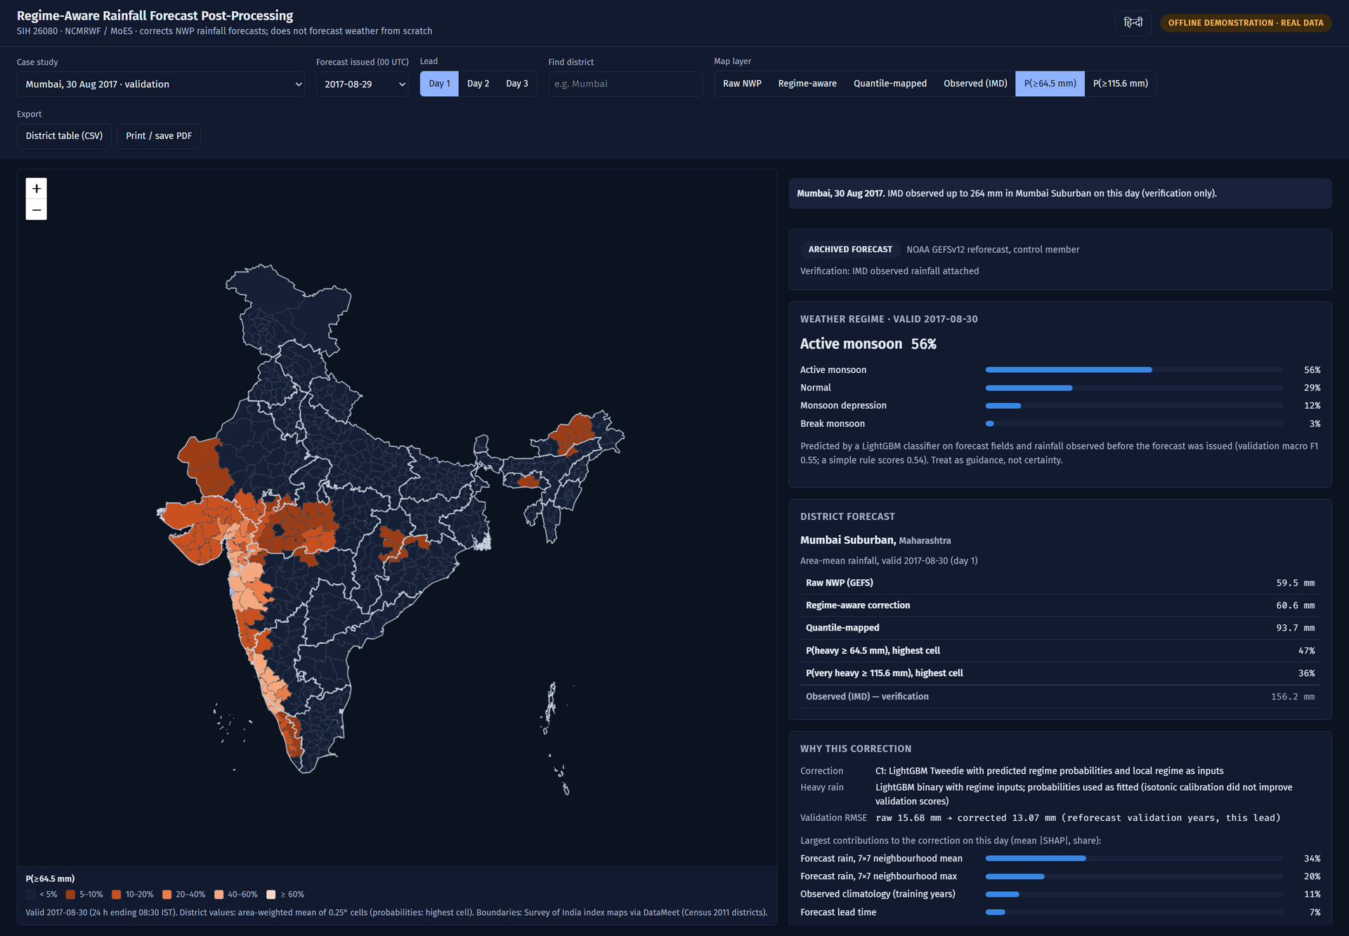



RegimeCast
Your Team Name
Regime-aware AI post-processing that corrects NWP rainfall forecasts — it never replaces the weather model
Proposed Solution
How it works
“The same forecast — corrected for the monsoon it is actually in.”
Regime Detection: reads the forecast’s own 850 hPa wind, pressure & moisture → Active / Break / Depression / Normal, plus orographic & coastal zones
Regime-Aware Correction: removes the NWP model’s bias with the regime as an input (LightGBM + quantile mapping)
Heavy-Rain Probability: calibrated chance of ≥64.5 mm and ≥115.6 mm — IMD’s own warning thresholds
District Product: area-weighted onto all 641 districts (Survey of India based boundaries)
Verified, not claimed: RMSE · ETS · CSI · POD · FAR · FSS with significance tests on every improvement
NWP forecast
(GEFS / NCUM)
Regime
classifier
Regime-aware
correction
Heavy-rain
probability
District
warnings
Why it is different
Regime as probability
Honest by design
Explainable
The corrector sees the classifier’s uncertainty, not a hard guess
Block-bootstrap tests; reports where regimes do NOT help
Every forecast ships its own SHAP feature contributions
Working prototype · real archived data · Mumbai deluge, 30-Aug-2017 (validation year)
Title
Idea
Tech
Feasibility
Impact
Research
Notes:
RegimeCast is a post-processing layer. It detects the monsoon regime from the forecast itself, corrects rainfall with the regime as input, issues calibrated heavy-rain probabilities, and maps them to 641 districts.

Slide 3





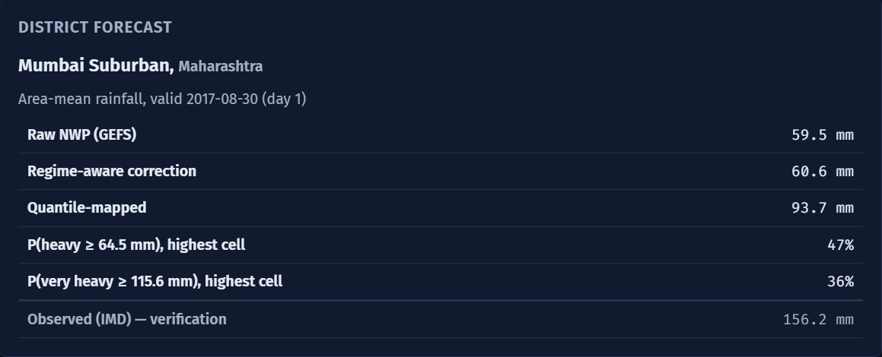













TECHNICAL APPROACH
Your Team Name
Technology stack & system architecture — built and running end-to-end on real data
Technology Stack
System Architecture Flow
Layer | Tools
Data & geo | xarray · NetCDF / GRIB (ecCodes) · GeoPandas · Shapely
ML / AI | LightGBM · PyTorch U-Net corrector · CNN classifier (tested)
Regimes | Rajeevan (2010) active/break · IMD best-track · terrain forced ascent
Verification | RMSE · ETS · CSI · POD · FAR · FSS · Brier · bootstrap CIs
Backend | Python 3.12 · FastAPI · Pydantic
Frontend | React · TypeScript · Leaflet (fully offline maps)
Quality | 179 automated tests (pytest + Vitest)
Open data | NOAA GEFSv12 (AWS) · IMD 0.25° rainfall · IMD best-track
NOAA GEFSv12 forecasts
AWS Open Data · 1–3 day leads
IMD gridded rainfall
ground truth · 0.25-degree grid
IMD best-track
monsoon depression labels
Data pipeline — align to IMD 08:30 IST rain day · crop to India · quality checks · real/synthetic provenance tags
CORE ENGINE
Regime classifier
850 hPa wind · MSLP · PWAT · vorticity
Bias correction
quantile mapping · LightGBM C1 / C2
Heavy-rain probability
calibrated ≥64.5 / ≥115.6 mm
District aggregation
641 districts, area-weighted
Verification engine
FastAPI
RMSE · ETS · CSI · POD · FAR · FSS · Brier · block-bootstrap confidence intervals
REST API · validated inputs · no file paths from clients
✓ Observations never used as model inputs ✓ Held-out years scored once
✓ Real vs synthetic data tagged and never mixed
Dashboard — prototype screenshot
Title
Idea
Tech
Feasibility
Impact
Research
Notes:
Real data in, verified products out. The engine never sees observations at inference time; held-out years were scored once with the model files hashed.

Slide 4





FEASIBILITY AND VIABILITY
Your Team Name
FEASIBILITY — already proven, not projected
VIABILITY — path to operations
18
29.1 M
641
179
① Prototype ✓
② Live mode ✓
monsoon seasons of real data trained & validated (2000–17)
training rows (forecast ↔ observation)
districts covered
automated tests passing
Validated 2016–17 + one-time held-out test (real data)
Tested on 610 real NOAA daily forecasts (2021–25): AUC 0.88
Runs on a laptop CPU: forecast product in ~10 s, full retrain ~1.5 hours — no GPU
Open data, open source: NOAA GEFS (AWS) + IMD data — zero licence cost
Live mode ✓: today’s NOAA GEFS run → district forecast in < 1 min
RegimeCast
engine
regime AI · correction
probability · districts
RISKS → HOW WE HANDLE THEM
continuous
re-verification
NCMRWF’s NCUM forecast archive is not public
Validated on NOAA GEFS as proxy; adapter retrains on NCUM once shared
Rare regimes (depressions) have few training days
Trained on 16 seasons (2000–15); pooled models with regime inputs + fallback
④ Daily operations
③ Plug in NCMRWF data
Regime classification is imperfect (macro-F1 0.55)
Regime passed as probabilities; transparent rule baseline; evidence tags on every rule
Products every forecast cycle → IMD / NCMRWF dashboards
Retrain on NCUM / NEPS via the ready adapter; re-verify
Title
Idea
Tech
Feasibility
Impact
Research
Notes:
Everything on this slide already runs on a laptop. The main external dependency is NCMRWF's NCUM archive, which plugs into the existing adapter.

Slide 5





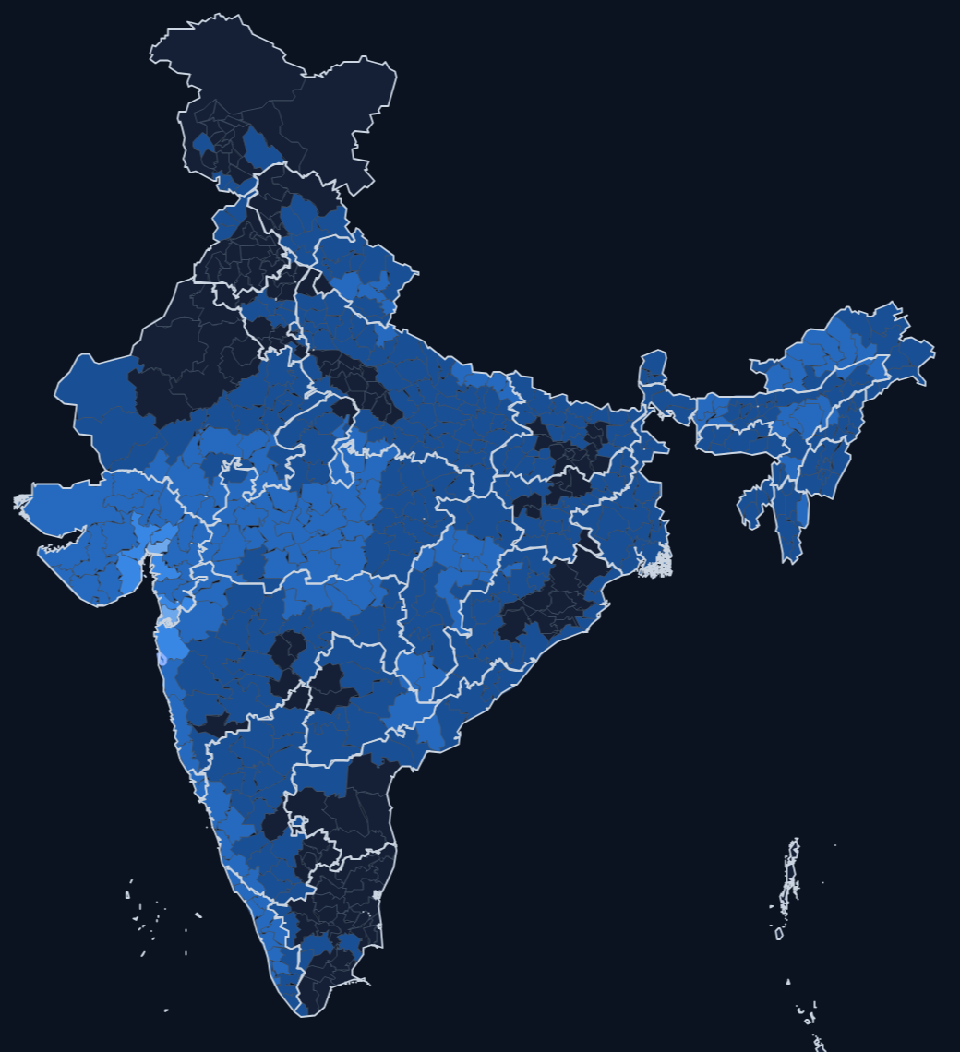
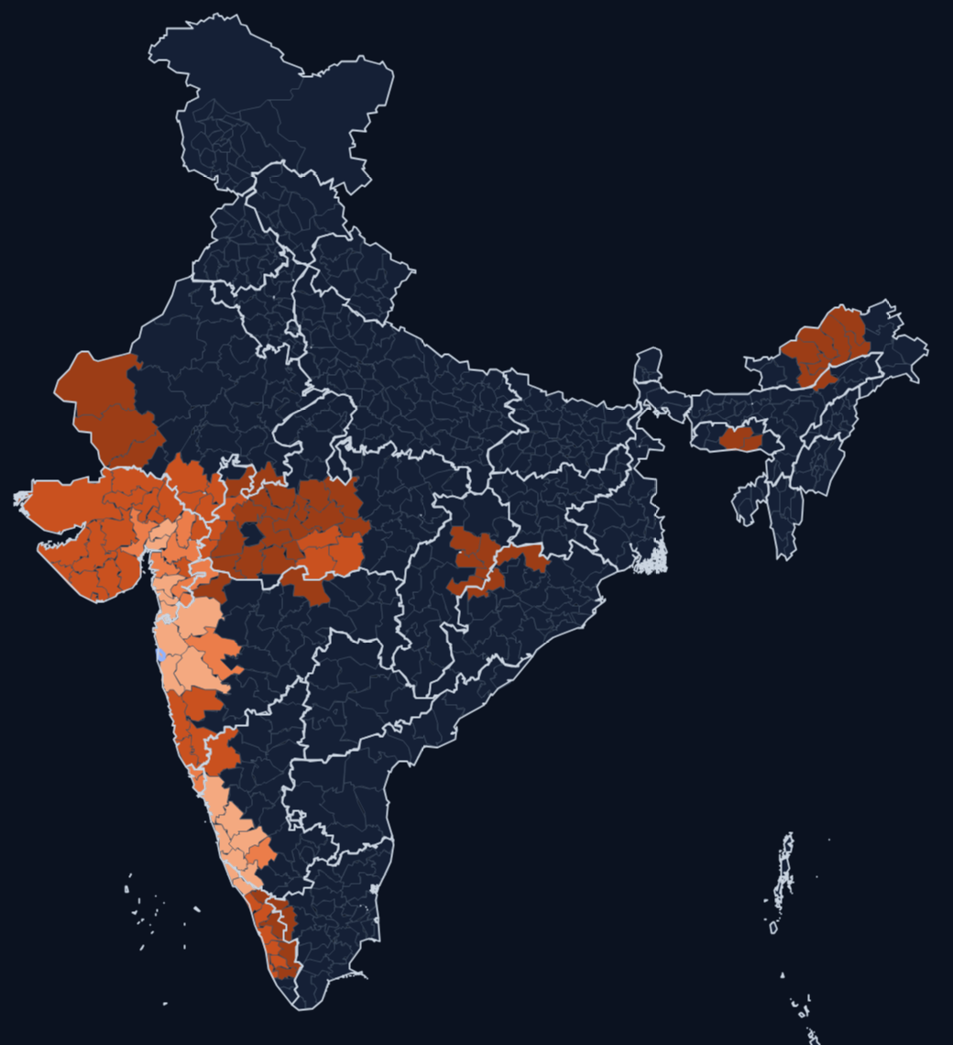
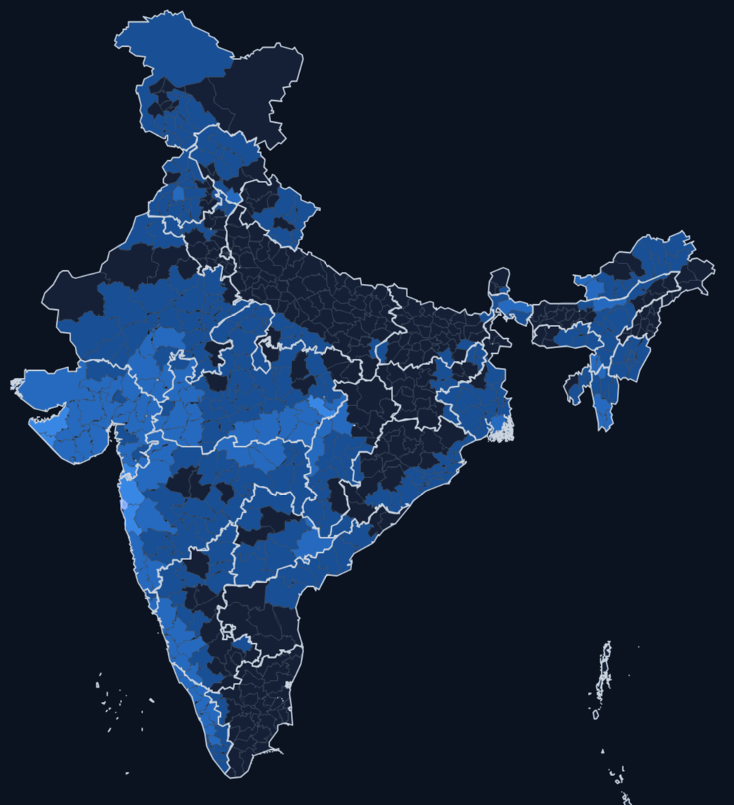






IMPACT AND BENEFITS
Your Team Name
Measured impact — unseen real data, scored once
Benefits of the solution
0.56 → 0.90
−20%
47%
SOCIAL
ECONOMIC
Earlier district-level heavy-rain warnings for flood preparedness
Better sowing, irrigation and reservoir decisions from calibrated odds
heavy-rain detection (ROC AUC), test years 2018–19: raw forecast vs our model
day-1 forecast error (RMSE), test years 2018–19; −12% on 610 live NOAA forecasts
heavy-rain chance flagged for Mumbai Suburban vs 1.4% base rate
Case study · Mumbai deluge — rain day ending 08:30 IST, 30-Aug-2017, forecast issued 29-Aug (day 1)
ENVIRONMENTAL
OPERATIONAL
Raw GEFS forecast (mm)
Our P(heavy rain ≥64.5 mm)
IMD observed (mm)
Smarter water-resource management through monsoon variability
Plugs onto NCMRWF’s existing NWP output — no new weather model
SCIENTIFIC
TECHNOLOGICAL
Regime-wise error diagnostics, e.g. raw GEFS beats ML correctors in depressions
Offline, explainable, auditable — every number traces to data + code
Who benefits
Mumbai Suburban: raw 60 mm · regime-aware 61 mm · U-Net 67 mm · quantile-mapped 94 mm · observed 156 mm — amounts under-forecast the extreme, the probability layer flags it
Validation-year case (2017). Dark-mode maps: brighter = more rain (blue) or higher probability (orange)
IMD / NCMRWF
forecasters
NDMA / SDMA
disaster mgmt
Farmers &
agri planners
Reservoir &
water managers
Citizens in
flood-prone areas
Title
Idea
Tech
Feasibility
Impact
Research
Notes:
Headline numbers are from data never used for training or model choice: test years 2018-2019 and 610 real NOAA operational forecasts (JJAS 2021-2025) run through live mode, scored once. The Mumbai maps are a validation-year case.

Slide 6

RESEARCH AND REFERENCES
Your Team Name
Key research findings (validated, then held-out)
Comparison with existing approaches — day 1, unseen 2018–19
Regime-awareness helps — modestly and provably
Metric | Raw NWP | Quantile mapping | Global ML | Regime- aware C1 | Regime- split C2 | U-Net (DL)
RMSE (mm) ↓ | 16.73 | 17.99 | 13.49 | 13.39 | 13.47 | 13.51
Correlation ↑ | 0.487 | 0.496 | 0.599 | 0.607 | 0.601 | 0.613
ETS ≥64.5 mm ↑ | 0.108 | 0.151 | 0.099 | 0.098 | 0.100 | 0.155
FSS ≥64.5 mm ↑ | 0.520 | 0.593 | 0.357 | 0.353 | 0.365 | 0.551
Beats the regime-blind model on RMSE in validation and on both held-out sets (test: 0.08 mm, 95% CI 0.03–0.14); strongest over the Western Ghats
Deep learning wins on heavy rain
U-Net heavy-rain ETS 0.155 vs 0.098 (test) and 0.096 vs 0.070 (live forecasts), both significant; wetter on average, so it is an extra layer
Heavy rain needs probabilities; splitting data hurts
Test years 2018–19: never used for training or tuning, scored once. Green = best. ML models cut average error; the U-Net and quantile mapping keep heavy-rain skill — heavy rain is also issued as a probability.
Yes/no exceedance scores below climatology; our probability model AUC 0.90 on test years; per-regime quantile mapping stays worse even with 16 seasons
What sets RegimeCast apart
References (click to open)
Capability | Raw NWP | Single bias correction | RegimeCast
Corrects systematic NWP bias | ✖ | ✔ | ✔
Adapts correction to weather regime | ✖ | ✖ | ✔
Calibrated heavy-rain probability | ✖ | ✖ | ✔
Explanation shipped with each forecast | ✖ | ✖ | ✔
Rajeevan, Gadgil & Bhate (2010) — Active and break spells of the Indian summer monsoon, J. Earth Syst. Sci.
Pai et al. (2014) — IMD 0.25-degree gridded daily rainfall, MAUSAM
NOAA GEFSv12 Reforecast — AWS Open Data Registry
Roberts & Lean (2008) — Fractions Skill Score, Monthly Weather Review
IMD RSMC New Delhi — cyclone and monsoon-depression best track
Hunt — ERA5 South Asian low-pressure-system catalogue (Zenodo, CC BY 4.0)
District boundaries — DataMeet / Survey of India index maps
Title
Idea
Tech
Feasibility
Impact
Research
Notes:
Findings are reported with confidence intervals, including where regime-awareness did not help.

