Slide 1
TaskFolio
Crafting your To-Dos into Dones with Style
Presented By:
Prerna Sharma
Rudra Pratap Singh
Saransh Singh

Slide 2
Table of Contents
Abstract
Introduction
System Architecture
Dockerization
Service Management
Conclusion
Future Scope

Slide 3
Abstract
TaskFolio is an advanced task management application designed to enhance productivity through a seamless integration of functionality and aesthetic appeal. The application features a user-friendly interface, real-time synchronization, advanced task categorization, reminders, notifications, and analytics to optimize task management. The backend is powered by Flask, with data stored in a MySQL database, all containerized using Docker for consistent development and deployment. HELM and Kubernetes streamline application management, while AWS provides a scalable and reliable cloud hosting environment. TaskFolio addresses the need for a comprehensive and visually appealing task management solution, transforming the task management process into an engaging and efficient experience.
Keywords: Task Management, Productivity, Docker, Kubernetes, AWS.

Slide 4
Introduction
In today’s fast-paced world, effective task management is crucial for both personal and professional success. TaskFolio is an innovative task management application designed to meet this need by combining robust functionality with an elegant user experience. It aims to transform the way users handle their tasks, providing a seamless and intuitive platform that enhances productivity and organization.
The application is built on a two-tier architecture, leveraging modern technologies to ensure reliability and scalability. The backend is powered by Flask, a lightweight web framework that handles the core logic and API endpoints. Data is securely stored in a MySQL database, ensuring efficient data management and retrieval. Both Flask and MySQL are containerized using Docker, which facilitates consistent development environments and streamlined deployment processes.
To manage and deploy the application, HELM and Kubernetes are utilized, simplifying the orchestration of containerized applications. The final deployment is hosted on AWS (Amazon Web Services), providing a scalable and reliable cloud infrastructure capable of handling a growing user base.

Slide 5
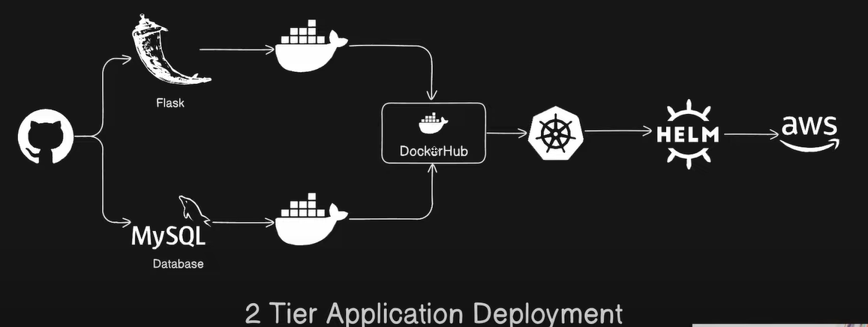
System Architecture

Slide 6
System Architecture
Frontend (User Interface):
TaskFolio Interface: This is the web application interface where users interact with the system. It includes features like adding tasks, viewing tasks, and managing them. The interface is built using HTML, CSS, and JavaScript for a responsive and interactive user experience.
Backend (Application Logic):
Flask Application: The backend is developed using Flask, a Python web framework. Flask handles the application logic, processes user requests, and interacts with the database. It serves the web pages and APIs required for the frontend to function.
Database:
MySQL Database: The application uses MySQL to store task data. This includes task titles, descriptions, completion status, and other relevant information. The database ensures data persistence and supports CRUD (Create, Read, Update, Delete) operations.

Slide 7
System Architecture
4. Containerization:
Docker: Both the Flask application and MySQL database are containerized using Docker. Docker ensures that the application runs consistently across different environments by packaging the application and its dependencies into containers.
5. Container Registry:
DockerHub: The Docker images of the Flask application and MySQL database are stored in DockerHub. This allows for easy distribution and deployment of the application containers.
6. Orchestration:
Kubernetes: Kubernetes is used to manage and orchestrate the deployment of the Docker containers. It handles the scaling, load balancing, and management of the containerized applications. Kubernetes ensures high availability and reliability of the application.

Slide 8
System Architecture
7. Package Management:
HELM: HELM is used as a package manager for Kubernetes. It simplifies the deployment and management of Kubernetes applications by using Helm charts. These charts define, install, and upgrade the Kubernetes applications.
8. Cloud Infrastructure:
AWS (Amazon Web Services): The entire application is deployed on AWS, which provides the cloud infrastructure. AWS services like EC2 (Elastic Compute Cloud) are used to host the Kubernetes cluster. AWS ensures scalability, security, and reliability of the infrastructure.

Slide 9

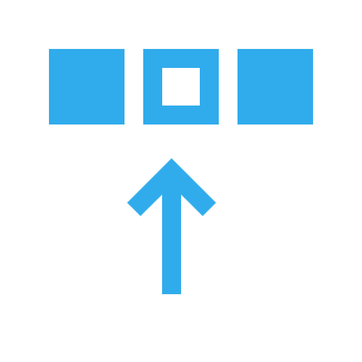
Deployment Flow
Development
Containerization
Pushing to DockerHub
Kubernetes Setup
HELM Packaging
Deployment

Slide 10
User Interaction Flow
User Interface
Backend Processing
Data Storage
Container Management
Cloud Hosting

Slide 11
Dockerization
Dockerization involves packaging the application and its dependencies into Docker containers to ensure consistent operation across different environments.
Flask Application:
Dockerfile: Defines the environment and dependencies for the Flask application.
Build and Run: Use Docker CLI to build the image and run the container.
MySQL Database:
Dockerfile: Defines the environment and dependencies for the MySQL database (or use the official MySQL image).
Build and Run: Use Docker CLI to build the image (if custom) and run the container.
Docker Compose:
Multi-Container Management: Use Docker Compose to define and run both the Flask and MySQL containers together.
Configuration: docker-compose.yml file specifies the services and their configurations.

Slide 12
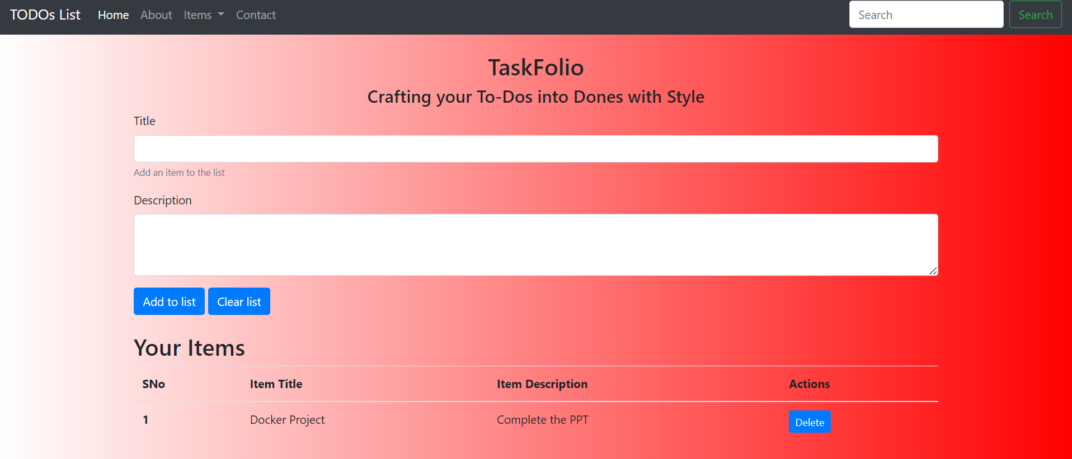
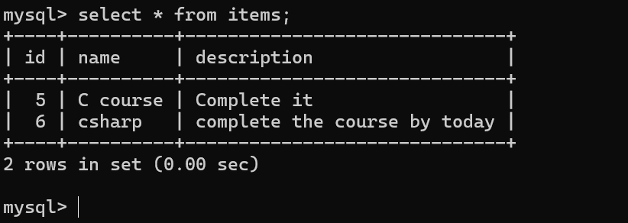
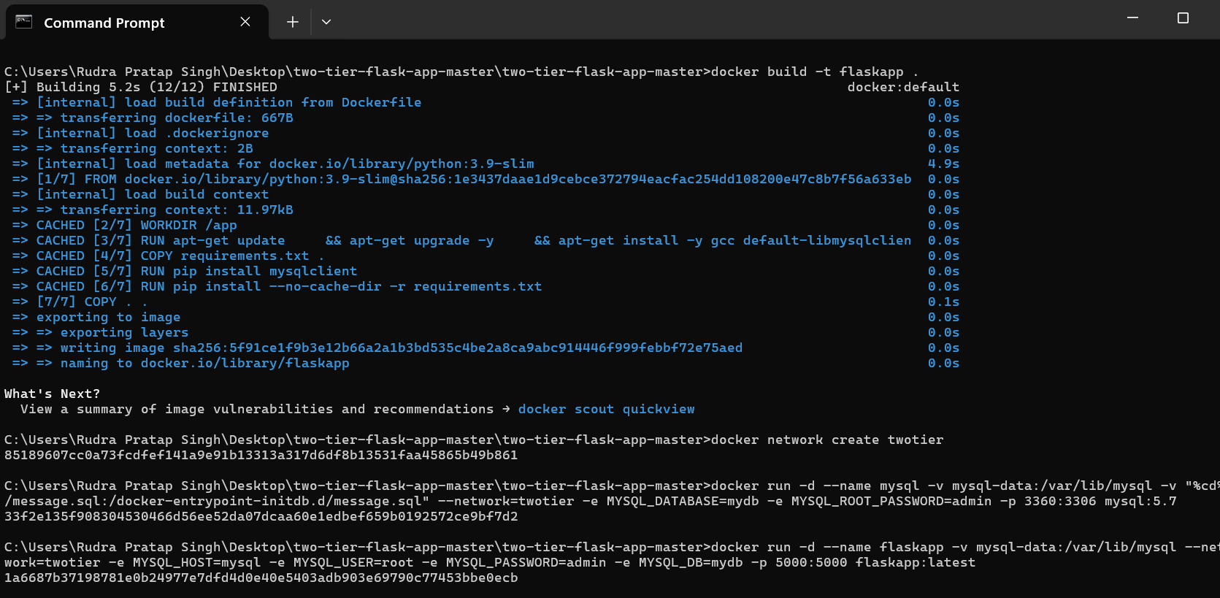
Service Management

Slide 13
Service Management
Kubernetes Overview:
Master Node: Manages the cluster and schedules workloads.
Worker Nodes: Run the containerized applications.
Service Management:
Service Types: ClusterIP, NodePort, LoadBalancer.
Service Configuration: Defines how services are exposed and accessed.
Orchestration with Kubernetes:
Deployments: Define the desired state and manage updates.
Scaling: Automatically scale applications based on resource usage.
Load Balancing: Distribute traffic across multiple pods.
Rolling Updates and Rollbacks: Ensure zero downtime and quick recovery.
HELM for Kubernetes:
HELM Charts: Package and deploy applications.
Using HELM: Install, upgrade, and rollback applications easily.

Slide 14
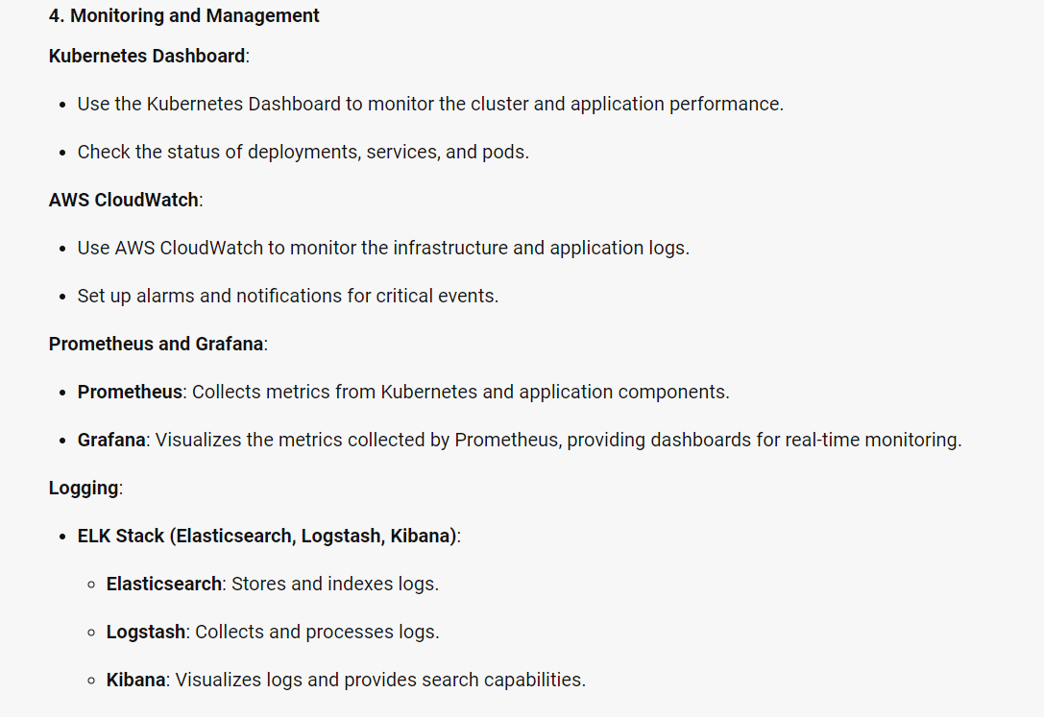

Slide 15
Conclusion
The deployment of TaskFolio using Docker, Kubernetes, HELM, and AWS represents a modern, scalable, and efficient approach to application management. By containerizing the Flask application and MySQL database, you ensure consistency across different environments. Kubernetes provides robust orchestration, managing the deployment, scaling, and maintenance of your containers. HELM simplifies the packaging and deployment process, making it easier to manage complex Kubernetes applications. AWS offers a reliable and scalable cloud infrastructure, ensuring high availability and performance.
This architecture not only enhances the application’s scalability and reliability but also simplifies the deployment and management processes. The use of monitoring and logging tools like Kubernetes Dashboard, AWS CloudWatch, Prometheus, Grafana, and the ELK Stack ensures that you can maintain visibility into the application’s performance and quickly address any issues that arise.
Overall, this project demonstrates a comprehensive and modern approach to deploying and managing a 2-Tier application, leveraging the best practices and tools available in the industry. It sets a strong foundation for future enhancements and scalability, ensuring that the application can grow and adapt to changing requirements.

Slide 16
Future Scope
Enhanced Scalability and Performance:
Implement advanced auto-scaling policies.
Conduct comprehensive load testing.
Advanced Monitoring and Logging:
Integrate distributed tracing tools like Jaeger or Zipkin.
Enhance logging with the ELK Stack (Elasticsearch, Logstash, Kibana).
Security Enhancements:
Apply security best practices for containerized applications.
Define and enforce network policies in Kubernetes.
CI/CD Pipelines:
Set up CI/CD pipelines using Jenkins, GitLab CI, or GitHub Actions.
Integrate automated testing frameworks.

Slide 17
Future Scope
5. Multi-Cloud and Hybrid Deployments:
Explore multi-cloud strategies to enhance redundancy.
Implement hybrid cloud solutions for better flexibility.
6. Microservices Architecture:
Decompose the monolithic application into microservices.
Implement a service mesh like Istio for better management.
7. User Experience Improvements:
Continuously improve the UI/UX based on user feedback.
Develop a mobile version of the TaskFolio application.
8. Data Analytics and Insights:
Integrate analytics tools for user behavior insights.
Implement data warehousing solutions for business intelligence.

Slide 18
Thank You

