Slide 1
Pathfinder
Resume Matcher & Skill Recommender
Mentor:
Sangeetha Mahalingam
Team-D
Rithvik Goud Mushkam
Saransh Thakran
Subhasree Yenigalla
B Sahithya

Slide 2
What This App Does
Analyses resume vs job description
Extracts skills using keyword matching
Calculates match percentage
Identifies missing skills
Suggests Coursera & Udemy courses
Generates a PDF report
Saves and displays user history
Includes login & registration system

Slide 3
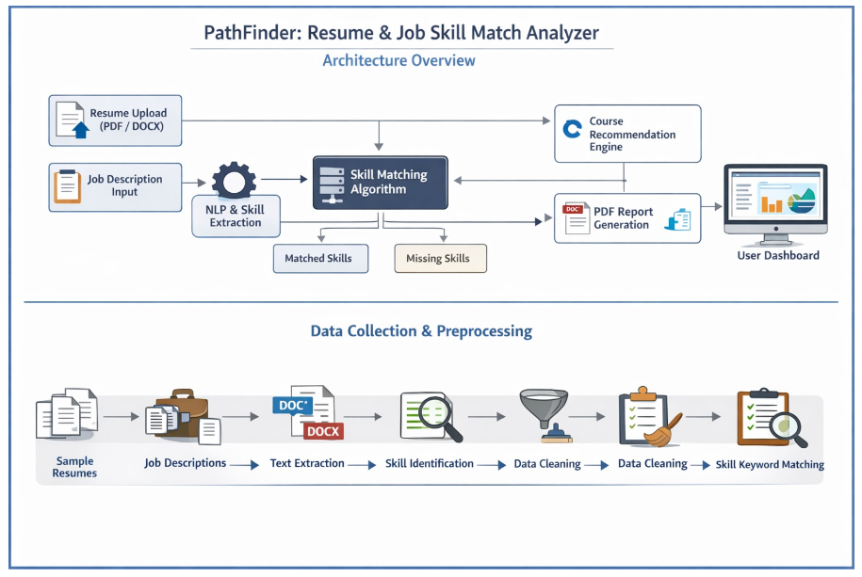

Slide 4
Authentication System
Login & Registration via Streamlit UI
Credentials stored in users.json
Each user has profile image, history, and data stored
Logout & Clear History options in sidebar

Slide 5
Skill Extraction Logic
Predefined list of skill keywords
Extracts text from PDF or DOCX
Searches for keyword patterns using regex
Produces Resume Skills & Job Skills

Slide 6
Matching Mechanism
Intersects Resume & Job skills
Identifies matched and missing skills
Calculates match % = matched / job skills
Displays bar graphs & pie charts using Plotly

Slide 7
Course Recommendations
Dataset lookup from Coursera & Udemy CSV files
Finds first matching course for each missing skill
Generates links for user convenience

Slide 8
PDF Report Generation
Uses ReportLab
Includes match %, skills, missing skills
Lists recommended courses with URLs
Automatically downloadable

Slide 9
User History Tracking
Saves each session’s match result
Shows past timestamps & matches in sidebar
Stores file name of generated PDF
Can clear entire history

Slide 10
Overall Workflow
1. User logs in
2. Uploads resume + pastes job description
3. System extracts skills
4. Calculates match statistics
5. Suggests courses
6. Generates PDF report
7. Saves result to history

Slide 11
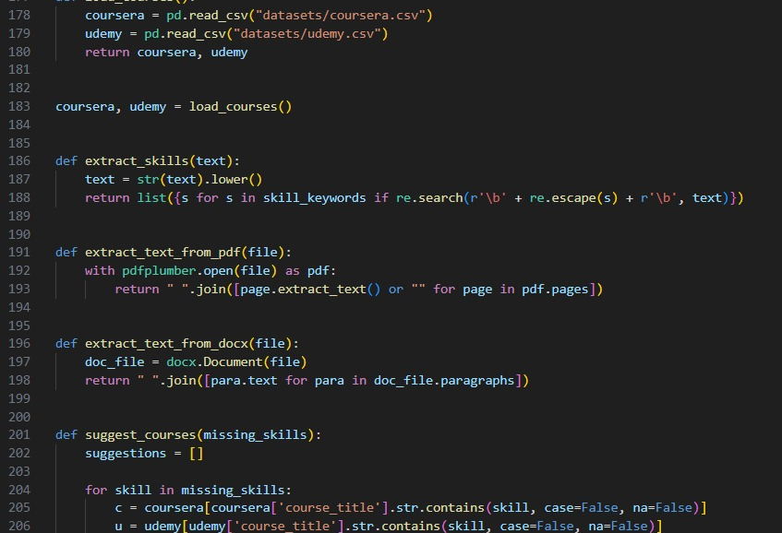
Code snippets:

Slide 12
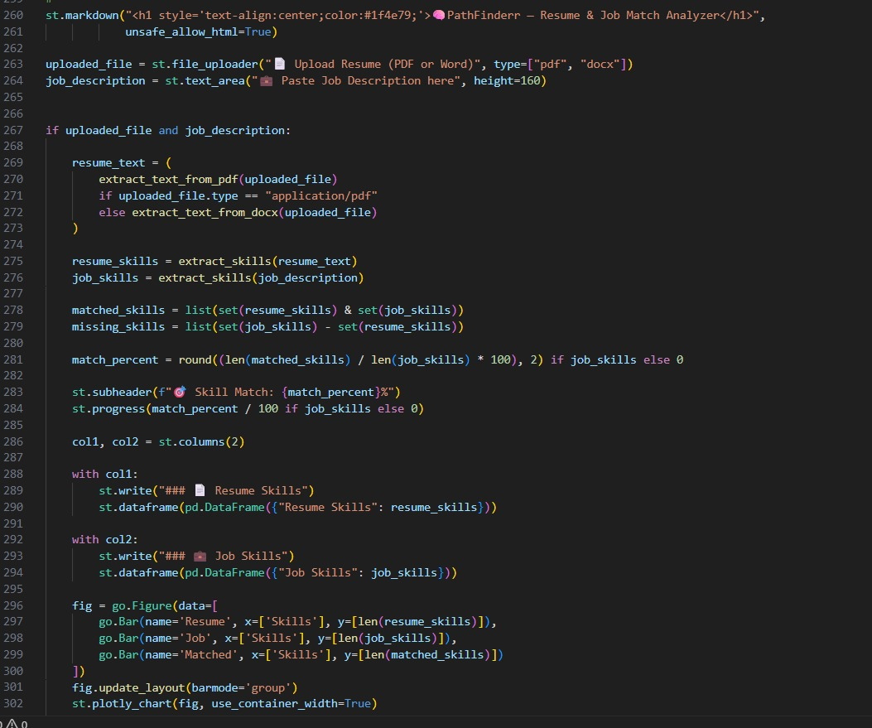

Slide 13

THANK YOU

