Slide 1
color detection model

Slide 2
Team Details
Faculty Mentor
Dr Anu Bajaj
Members
Aditya Pratap (102103064)
Aradhak Kandhari (102103078)
Gaurav Arya (102103081)
Saransh Mahajan (102103077)
Shivang Aggarwal (102103094)

Slide 3
Problem Statement
Nowadays most of the people can be seen as a victim of Color Blindness which is an incurable disease because of genetic disorder. It can be cured by some genetic therapy but it is very much costly. The problem they face is that these people are unable to differentiate between shades of color or when two colors are mixed together so it will be very difficult for them to see item’s color clearly. So, the problem is how it can be analyzed without curing the disease.

Slide 4
Description
Now in order to implement the setup and develop the model which would help as an aid for the color blind people, some techniques and methods needs to be put in use which include libraries like NumPy, OpenCV and a technique called Image Processing.
OpenCV(Open Source Computer Vision) library aims at real time Computer Vision. It is mainly used to do all the operations related to images.
Pandas is a software library written for the Python programming language for data manipulation and analysis. In particular, it offers data structures and operations for manipulating numerical tables and time series.
Image Processing technique is used to perform some certain operations on an image, in order to get an enhanced image as an output or to extract some useful information from the image. It acts as a type signal processing in which input is an image and output may be an image or characteristics/features associated with that image.

Slide 5
Objectives
To identify the color of the given picture
To represent the color found on the object and generating its respective RGB color code.

Slide 6
Methodology
Theory:
Color detection model is used to find the respective color, and its’ shade. Color detection model will be useful for people having disorder of color blindness, agricultural fields and in medical fields as well.
For the implementation of this technique, we need to have some python libraries:
OpenCV
To use picture and to identify object’s color from that picture in our code.
Panda
Pandas is a software library written for the Python programming language for data manipulation and analysis

Slide 7
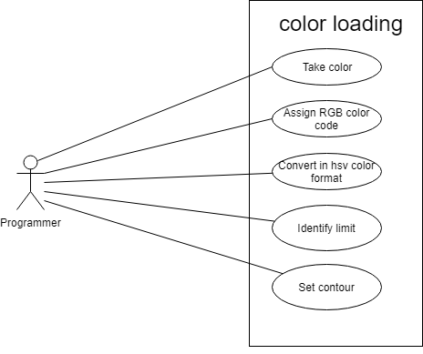
Use Case
Color Loading

Slide 8
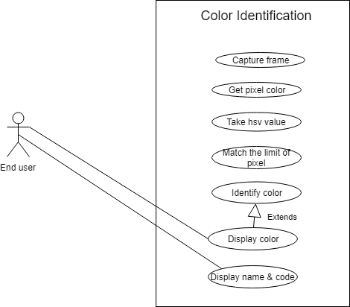
Color Identification

Slide 9
Algorithm:
Importing Libraries
Converting image frame from BGR(Blue-Green-Red) to HSV(Hue-Saturation-Value)
Defining the range of each color in the image.
Find range of the colors in the frame

Slide 10
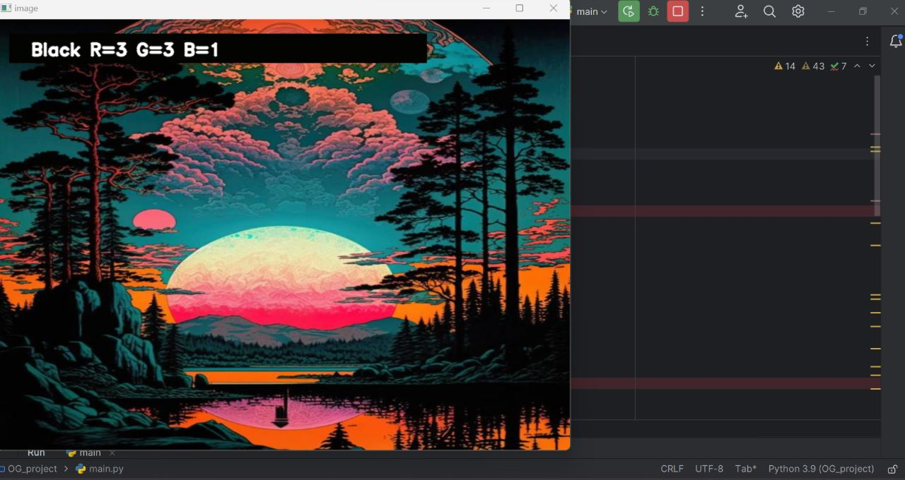
RESULTS

Slide 11
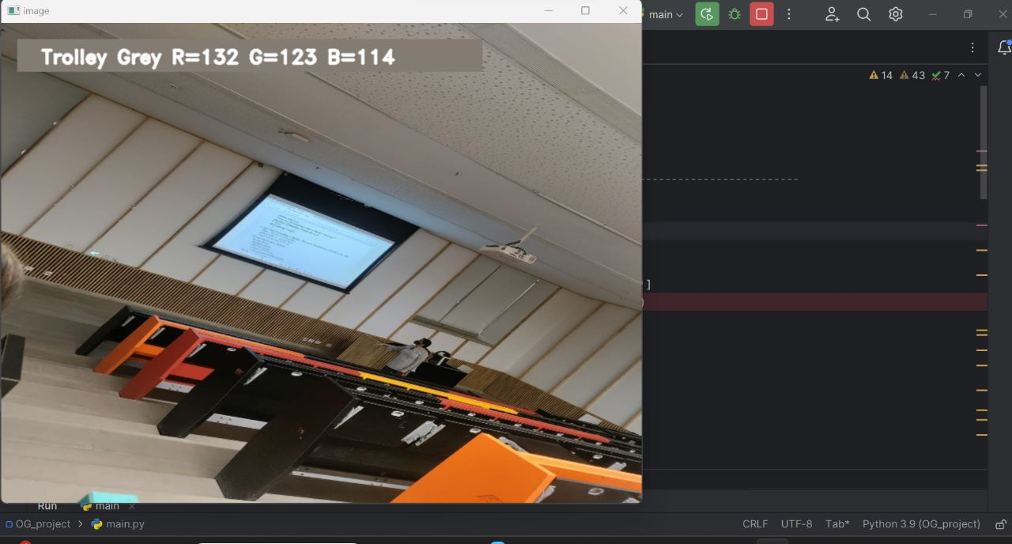

Slide 12
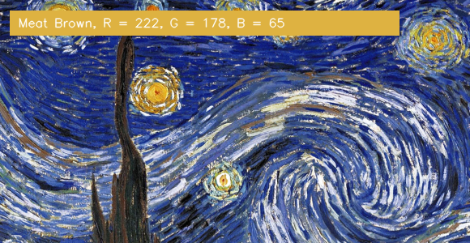

Slide 13
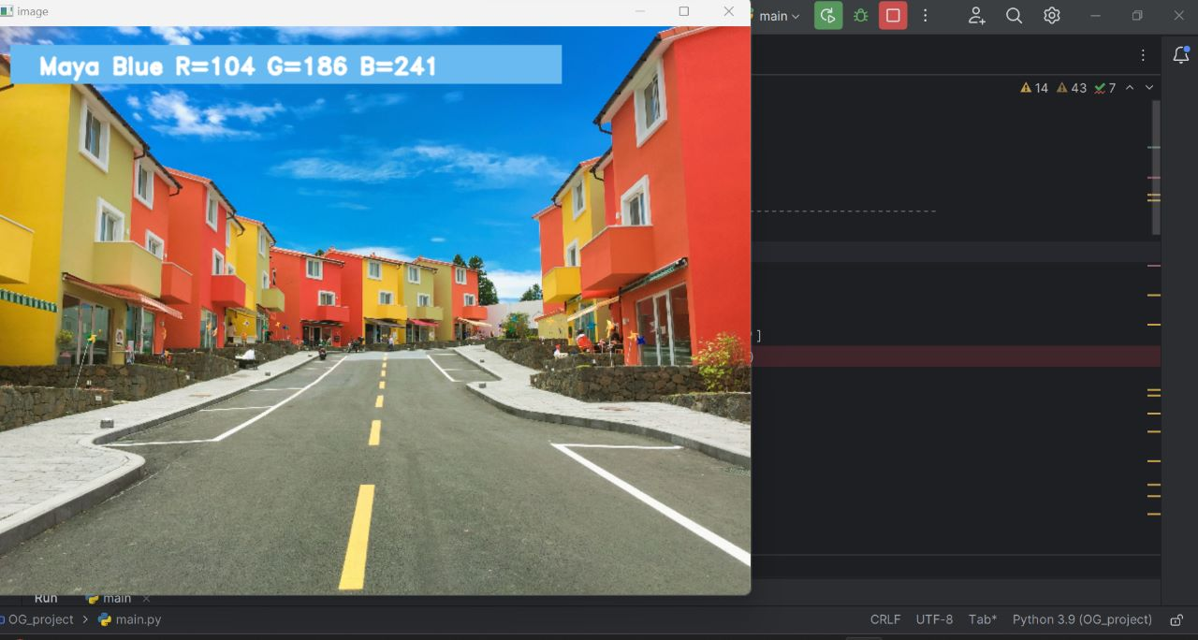

Slide 14
THANK YOU!

