Slide 1
TEAM 3

Slide 2
Introduction
Notes:
Change Color

Slide 3





Congestion
Data traffic exceeds
the capacity
New users Blocked
Excess Mobile Users
Burden on Towers
Deteriorate network
service quality

Slide 4




Objective
PREDICT
OBJECTIVE
RELATION
INTERPRET

Slide 5
Overview
Dataset
Provided
Data
Pre-processing
Further
Data
Analysis
Feature
Engineering
Fine
Tuning
Exploratory
Data
Analysis
Basic
Algorithms
Ensemble
Models
Maximum
Vote
Classifier
Notes:
9th largest, 16B$ Market Size, Passenger Traffic: 85M

Slide 6
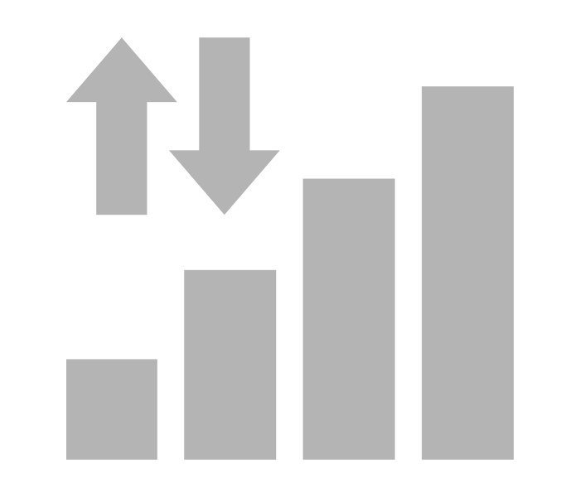







Dataset Description
4G SUPPORT
BYTE DATA
BINARY
VARIABLE
26 VARIABLES FOR
DIFFERENT TYPES OF
DATA CONSUMPTION
TARGET VARIABLE
CONGESTION TYPE
CELL TOWER NUMBER
SUBSCRIBER COUNT
NUMBER OF CONNECTED SUBSCRIBERS
INDEX
VARIABLE
TOWER ATTRIBUTES
DATE MONTH YEAR HOUR 5 MINUTE BUCKET
TIME OF THE DAY
TILT
CELL RANGE
BEAM DIRECTION

Slide 7
Methodology
Notes:
Change Color

Slide 8
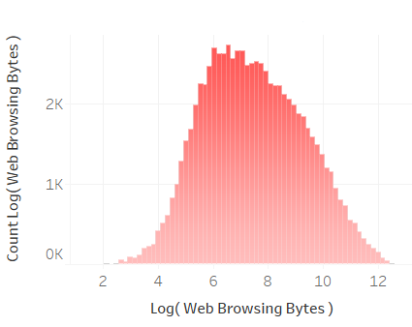
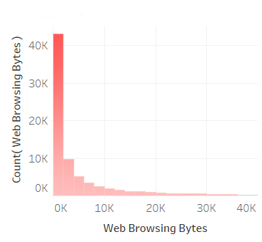
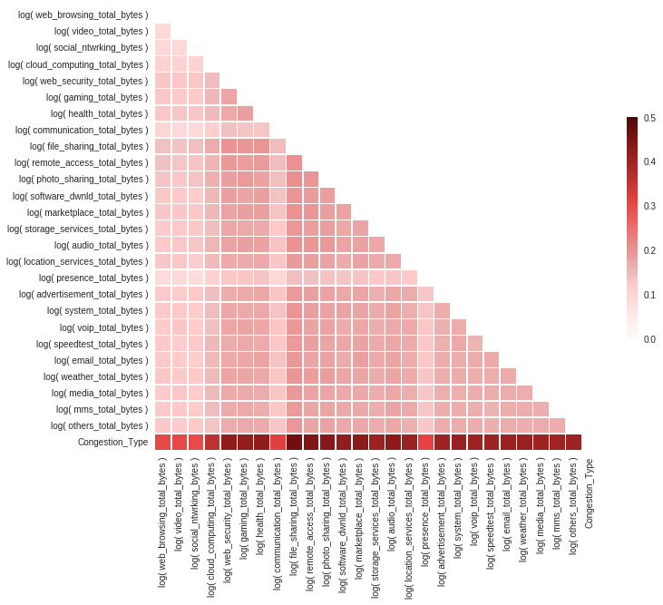
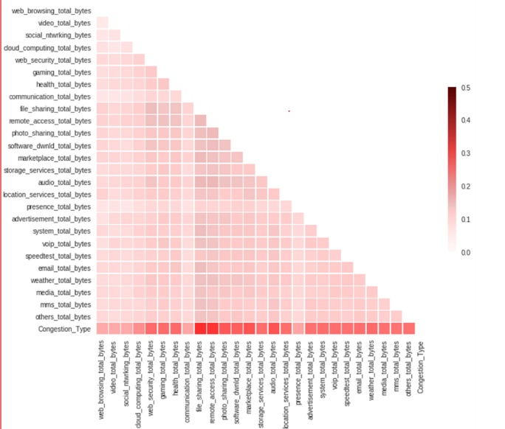
Pre-Processing
MCC
.744
MCC
TEST
ACC.
74.1%
MCC
Logarithmic
Transformation
TRAIN
ACC.
TRAIN
ACC.
MCC
.746
TEST
ACC.
TEST
ACC.
82.3%
TRAIN
ACC.
80.2%
TRAIN
ACC.
82.3%
MCC
.736
TRAIN
ACC.
TEST
ACC.
MCC
TEST
ACC.
80.2%
82.6%
81.3%
TRAIN
ACC.
82.3%
TRAIN
ACC.

Slide 9



Basic Models
Logistic
Regression
Statistical analysis used to predict the outcome of a dependent variable based on prior observations using sigmoid function
CART
MCC
0.688
Validation Accuracy
76.10
Train Accuracy
76.50
SVM

Slide 10

Basic Models
Logistic
Regression
Splitting data at a node based on the value of one variable and predict for the target variable at each terminal node
CART
MCC
0.453
Validation Accuracy
59.00
Train Accuracy
83.50
SVM

Slide 11

Basic Models
Performs classification by finding the hyperplane that maximizes the margin between the two classes and the vectors that define the hyperplane are the support vectors
Logistic
Regression
CART
MCC
0.768
Validation Accuracy
76.40
Train Accuracy
76.60
SVM

Slide 12


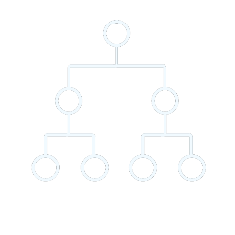

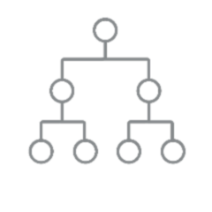



Advanced Models
It is a supervised learning method that is based on function
approximation by optimizing specific loss functions as well as applying several regularization techniques.
Neural
Network
It is an algorithm which is very useful in inferring unseen relationships between the variables and doesn’t impose any restrictions on the input data type
Random
Forest
It is an algorithm used when the data is not linearly separable. The algorithm works on the idea of generating non-linear decision boundaries to classify the data.
It is a supervised machine learning algorithm that develops large number of random decision trees. It adds additional randomness to the model while growing the trees.
XG Boost
MCC
0.695
Validation Accuracy
77.0
Train Accuracy
78.50
Validation Accuracy
78.30
Train Accuracy
86.60
MCC
0.711
Validation Accuracy
80.60
Train Accuracy
82.50
MCC
0.742
Validation Accuracy
80.0
Train Accuracy
80.60
MCC
0.733
SVM

Slide 13




Maximum Voting Classifier
Validation Accuracy
MCC
Score
XGBOOST
80.6%
.742
Random Forest
78.3%
.711
.806
ADVANCED
MODELS
Neural Network
77%
.695
SVM
(Radial Basis Kernel)
80%
.733

Slide 14

Maximum Voting Classifier
XGBOOST
.806
ENSEMBLE
MODELS
Maximum Vote
Classifier
80%
.745
SVM
(Radial Basis Kernel)
Validation
Accuracy
MCC
Score

Slide 15
Further Data Analysis For Improving Accuracy
Notes:
Change Color

Slide 16
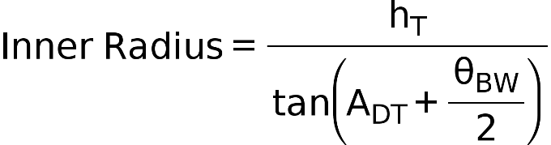
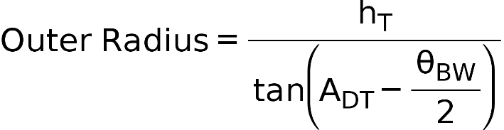

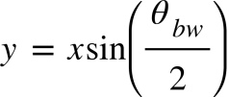

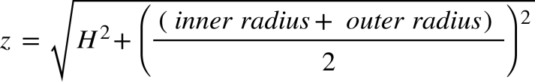
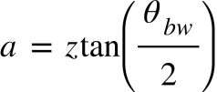
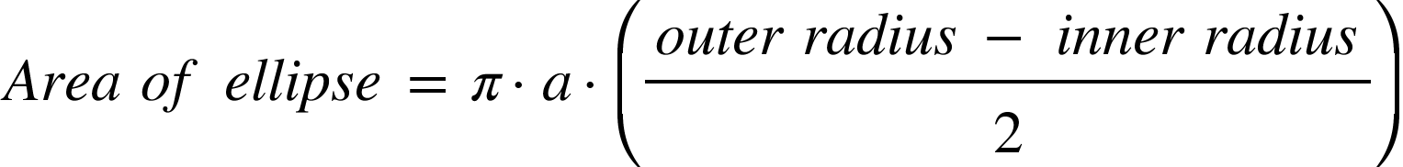
Advanced Models
A_{DT}(Tilt Angle)
ƟBW
x
H
z
y
a
Inner Radius
Outer Radius

Slide 17











Byte Consumption
Major Bytes consumption
Web
Video
Social
Cloud
Call
Presence
Minor Bytes consumption
………..
Software
Storage
Advertisement
Weather

Slide 18





Subscriber Density
Range
Total no. of subscriber
Subscriber density
------------------------
=
(Range)²

Slide 19
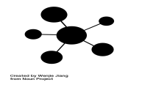



Data Features
Log of all provided byte features
Final Features
Engineered Features
Sum of major bytes usage
Sum of minor bytes usage
Weekend Features
Density Features
Subscriber density
Mechanical Features
Elliptical area covered by the users

Slide 20
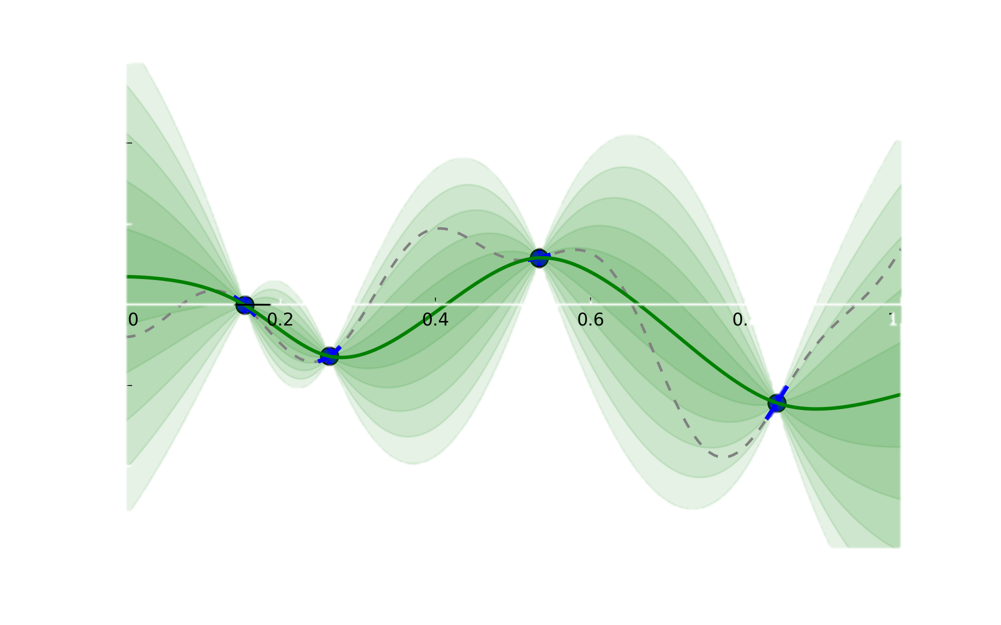
Fine Tuning
GRID SEARCH
BAYESIAN OPTIMISATION
0.78
0.76
Accuracy
0.74
0.72
Depth
500
Estimators
20
550
15
600
10
650
5

Slide 21
Robustness
Notes:
Change Color

Slide 22
Robustness
Estimating Uncertainty
3
AVG
MCC
.744
MCC
.741
2
TEST
ACC.
TEST
ACC.
74.1%
74.4%
MCC
TRAIN
ACC.
TRAIN
ACC.
4
.736
MCC
.746
TEST
ACC.
82.3%
80.2%
82.4%
TEST
ACC.
TRAIN
ACC.
80.2%
82.6%
TRAIN
ACC.
82.3%
5
1
K-Fold
Cross
Validation
.746
MCC
.736
TRAIN
ACC.
TEST
ACC.
MCC
TEST
ACC.
80.2%
TRAIN
ACC.
81.3%
82.6%
82.3%
TRAIN
ACC.

Slide 23
Results
Notes:
Change Color

Slide 24
MODEL
Train Accuracy
Test Accuracy
MCC
LR 76.50 76.10 0.688
CART 83.50 59.00 0.453
SVM(Linear) 76.60 76.40 0.768
RF 86.60 78.30 0.711
ANN 78.50 77.00 0.695
XGBoost 82.50 80.60 0.742
SVM(RBF) 80.60 80.00 0.733
ENSEMBLE 81.80 80.70
0.745

Slide 25
Insights: Outcome Analysis
Notes:
Change Color

Slide 26
1
Total bytes:332200
NC
3G_BACKHAUL CONGESTION
Probability
Total bytes:50200
4G_BACKHAUL CONGESTION
Total bytes:92200
4G_RAN CONGESTION
Total bytes:330200
Total Bytes

Slide 27
285.9
173.9
Average subscriber Density
96.8
52.6
3G_BACKHAUL CONGESTION
4G_BACKHAUL CONGESTION
4G_RAN CONGESTION
NC

Slide 28
Generated Rules
YES
Minor>=966
.25 .25 .25 .25
100%
NO
YES
Minor<1830
.08 .43 .50 .00
49%
NO
Minor>=555
.42 .09 .01 .49
51%
YES
Minor<1243
.13 .60 . 27 .00
30%
NO
YES
NO
Major<104000
.03 .60 . 37 .00
19%
YES
NO
4G_BACK
.29 .59 . 11 .00
11%
4G_BACK
.03 .62 . 35 .00
17%
4G_RAN
.00 .30 .70 .00
2%
4G_RAN
.00 .16 .84 .00
19%
3G_BACK
.69 .18 . 01 .11
24%
NC
.17 .00 .00 .82
27%
Notes:
Change Color

Slide 29
Congestion Relationship
 | NO CONGESTION | 3G BACKHAUL CONGESTION | 4G BACKHAUL CONGESTION | 4G RAN CONGESTION
4G RAN CONGESTION
NO CONGESTION
3G BACKHAUL CONGESTION
4G BACKHAUL CONGESTION
4G RAN CONGESTION
2313
212
0
0
4G BACKHAUL CONGESTION
284
1994
239
1
Average bytes used
0
355
1788
365
3G BACKHAUL CONGESTION
NO CONGESTION
0
9
483
1957
Date

Slide 30
Regression Back Testing
4G RAN CONGESTION
TEST ACCURACY
4G BACKHAUL CONGESTION
77.25%
Congestion Type
3G BACKHAUL CONGESTION
NO CONGESTION
Average bytes used

Slide 31
6500
NC
3G_BACKHAUL CONGESTION
4G_BACKHAUL CONGESTION
Number of Records
4G_RAN CONGESTION
ERICSSON
HUAWEI
NOKIA
Ran Vendor / Congestion Type

Slide 32
Relationship between average byte used per subscriber and congestion:
Avg. Data/ Subs. Count
Avg. Data/ Subs. Count
Days

Slide 33
Variation of average total bytes over the month:
Avg. Total Data
0
6
15
19
25
Days

Slide 34
THANK YOU

