Slide 1
BigData and Hadoop
Do IT yourself -> The Practical way

Slide 2
Giving some thought
Has your flight ever been cancelled due to bad weather conditions?
Can aeroplane catastrophic engine failures be prevented?
Have you ever missed out on buying something during a sale and wished the store or the department would have kept more quantity?
Have you ever wished political campaigns can be better targeted using social media data?
Do you wish your banking services to be more secure and fraud tolerant?
Today data is everything, each appliance we use in whatever sector produce huge volumes of data. Now this data is like an open oil field waiting to be tapped.

Slide 3
The BigData era…
Social media has brought about a revolution and dictated a paradigm shift in the operational strategies of firms globally.
It has resulted in collection of massive data from a variety of social media channels, necessitating use of this data for business intelligence purposes.
Despite its importance, little research exists on the implications of the use of Big Data analytics for business intelligence purposes.

Slide 4
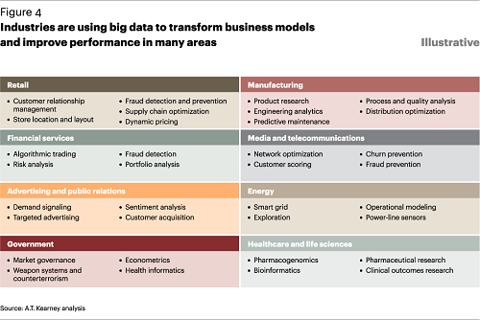
Major industrial impact

Slide 5
Distributed computing
Distributed computing is a computing concept that, in its most general sense, refers to multiple computer systems working on a single problem.
In distributed computing, a single problem is divided into many parts, and each part is solved by different computers.
As long as the computers are networked, they can communicate with each other to solve the problem. If done properly, the computers perform like a single entity.
The ultimate goal of distributed computing is to maximize performance by connecting users and IT resources in a cost-effective, transparent and reliable manner.
It also ensures fault tolerance and enables resource accessibility in the event that one of the components fails.

Slide 6
The breakthrough - Hadoop
Apache Hadoop is a collection of open-source software utilities that facilitate using a network of many computers to solve problems involving massive amounts of data and computation.
It provides a software framework for distributed storage and processing of big data using the MapReduce programming model.
Originally designed for computer clusters built from commodity hardware—still the common use—it has also found use on clusters of higher-end hardware.
All the modules in Hadoop are designed with a fundamental assumption that hardware failures are common occurrences and should be automatically handled by the framework.

Slide 7
Hadoop Architecture
Hadoop Common – contains libraries and utilities needed by other Hadoop modules
Hadoop Distributed File System (HDFS) – a distributed file-system that stores data on commodity machines, providing very high aggregate bandwidth across the cluster
Hadoop YARN – introduced in 2012 is a platform responsible for managing computing resources in clusters and using them for scheduling users' applications
Hadoop MapReduce – an implementation of the MapReduce programming model for large-scale data processing
Hadoop splits files into large blocks and distributes them across nodes in a cluster. It then transfers packaged code into nodes to process the data in parallel.
This approach takes advantage of data locality,where nodes manipulate the data they have access to. This allows the dataset to be processed faster and more efficiently.

Slide 8
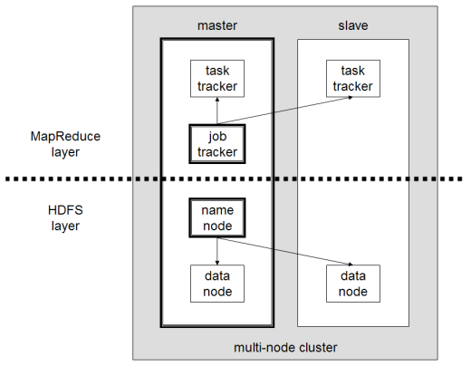
The architecture cont...

Slide 9
File System : HDFS
The Hadoop distributed file system is a distributed, scalable, and portable file system written in Java for the Hadoop framework.
A Hadoop cluster has nominally a single namenode plus a cluster of datanodes, although redundancy options are available for the namenode due to its criticality.
Each datanode serves up blocks of data over the network using a block protocol specific to HDFS. The file system uses TCP/IP sockets for communication. Clients use remote procedure calls (RPC) to communicate with each other.
It achieves reliability by replicating the data across multiple hosts, and hence theoretically does not require redundant array of independent disks (RAID) storage on hosts (but to increase input-output (I/O) performance some RAID configurations are still useful).
With the default replication value, 3, data is stored on three nodes: two on the same rack, and one on a different rack. Data nodes can talk to each other to rebalance data, to move copies around, and to keep the replication of data high.

Slide 10
Job Tracker & Task Tracker- The map-reduce engine
Atop the file systems comes the MapReduce Engine, which consists of one JobTracker, to which client applications submit MapReduce jobs.
The JobTracker pushes work to available TaskTracker nodes in the cluster, striving to keep the work as close to the data as possible. With a rack-aware file system, the JobTracker knows which node contains the data, and which other machines are nearby.
If the work cannot be hosted on the actual node where the data resides, priority is given to nodes in the same rack. This reduces network traffic on the main backbone network. If a TaskTracker fails or times out, that part of the job is rescheduled

Slide 11
The map-reduce engine cont...
The TaskTracker on each node spawns a separate Java virtual machine (JVM) process to prevent the TaskTracker itself from failing if the running job crashes its JVM. A heartbeat is sent from the TaskTracker to the JobTracker every few minutes to check its status. The Job Tracker and TaskTracker status and information is exposed by Jetty and can be viewed from a web browser.
The allocation of work to TaskTrackers is very simple. Every TaskTracker has a number of available slots (such as "4 slots"). Every active map or reduce task takes up one slot. The Job Tracker allocates work to the tracker nearest to the data with an available slot. There is no consideration of the current system load of the allocated machine, and hence its actual availability.
If one TaskTracker is very slow, it can delay the entire MapReduce job – especially towards the end, when everything can end up waiting for the slowest task. With speculative execution enabled, however, a single task can be executed on multiple slave nodes.

Slide 12
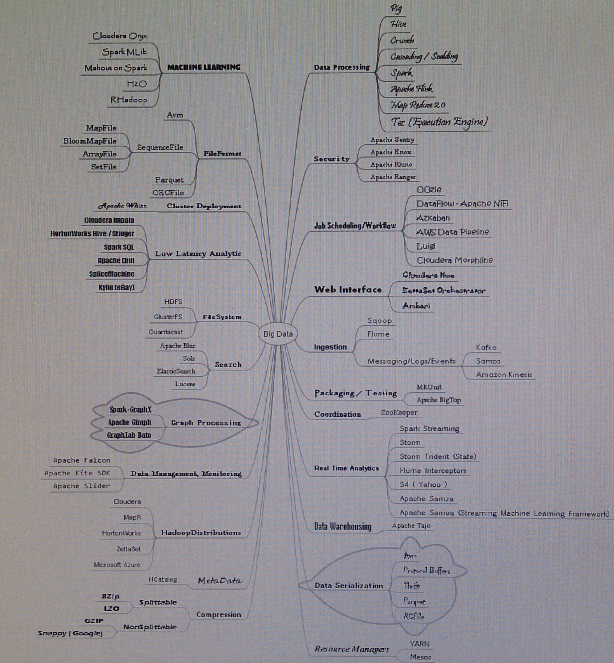
The ecosystem

Slide 13
What we would learn
Framework | Hadoop
File system | HDFS
Database | HBase, Cassandra, MongoDB
Data Processing | Pig, Hive, Spark
Ingestion and streaming | Kafka, Flume, Sqoop
Low latency analysis | Impala, SparkSQL
Job scheduling | Oozie
Real time analytics | Storm, Spark Streaming
Machine learning | Mahout, Spark MLib
Security | Sentry, Ranger
File formats | Avro, Parquet
Resource manager | Yarn
Co-ordinator | Zookeeper
Search | SOLR
Metadata | HCatalog
Web Interface | Hue, Ambari
Data Warehouse | Tajo
Compression | Snappy

Slide 14
Database

Slide 15
Hbase
HBase is an open-source, non-relational, distributed database modeled after Google's Bigtable and is written in Java. It runs on top of HDFS, providing Bigtable-like capabilities for Hadoop.
It provides a fault-tolerant way of storing large quantities of sparse data (small amounts of information caught within a large collection of empty or unimportant data, such as finding the 50 largest items in a group of 2 billion records, or finding the non-zero items representing less than 0.1% of a huge collection).
HBase features compression, in-memory operation, and Bloom filters on a per-column basis as outlined in the original Bigtable paper.
In the parlance of Eric Brewer’s CAP Theorem, HBase is a CP type system

Slide 16
Hbase cont...
Tables in HBase can serve as the input and output for MapReduce jobs run in Hadoop. HBase is a column-oriented key-value data store and has been idolized widely because of its lineage with Hadoop and HDFS.
HBase runs on top of HDFS and is well-suited for faster read and write operations on large datasets with high throughput and low input/output latency.
HBase is not a direct replacement for a classic SQL database, however Apache Phoenix project provides a SQL layer for HBase as well as JDBC driver that can be integrated with various analytics and business intelligence applications.
The Apache Trafodion project provides a SQL query engine with ODBC and JDBC drivers and distributed ACID transaction protection across multiple statements, tables and rows that uses HBase as a storage engine.

Slide 17
Cassandra
Apache Cassandra is a free and open-source distributed NoSQL database management system designed to handle large amounts of data across many commodity servers, providing high availability with no single point of failure.
Cassandra offers robust support for clusters spanning multiple datacenters,with asynchronous masterless replication allowing low latency operations for all clients.
Main features
Decentralized
Supports replication and multi data center replication
Scalability
Fault-tolerant
Tunable consistency
MapReduce support
Query language

Slide 18
MongoDB
MongoDB is a free and open-source cross-platform document-oriented database program. Classified as a NoSQL database program, MongoDB uses JSON-like documents with schemas.
Main features
Ad hoc queries
Indexing
Replication
Load balancing
File storage
Aggregation
Server-side JavaScript execution
Capped collections
Transactions

Slide 19
Data Processing

Slide 20
Hive
Apache Hive is a data warehouse software project built on top of Apache Hadoop for providing data summarisation, query and analysis.
Hive gives an SQL-like interface to query data stored in various databases and file systems that integrate with Hadoop.
Hive provides the necessary SQL abstraction to integrate SQL-like queries (HiveQL) into the underlying Java without the need to implement queries in the low-level Java API.
Since most data warehousing applications work with SQL-based querying languages, Hive aids portability of SQL-based applications to Hadoop.
While initially developed by Facebook, Apache Hive is used and developed by other companies such as Netflix and the Financial Industry Regulatory Authority (FINRA).Amazon maintains a software fork of Apache Hive included in Amazon Elastic MapReduce on Amazon Web Services.

Slide 21
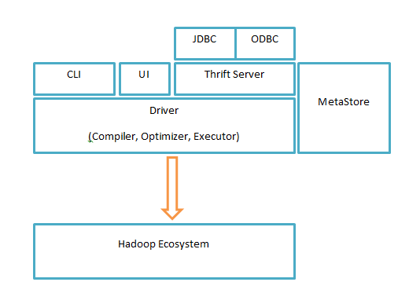
Hive cont...

Slide 22
PIG

Slide 23
Spark

Slide 24
Ingestion and Streaming

Slide 25
KAFKA

Slide 26
FLUME

Slide 27
Sqoop

Slide 28
Low Latency Analytics

Slide 29
Impala
Massively parallel processing (MPP) SQL query engine for data stored in Apache Hadoop
Enables users to issue low-latency SQL queries to data stored in HDFS and Apache HBase without requiring data movement or transformation
Impala is integrated with Hadoop to use the same file and data formats, metadata, security and resource management frameworks used by MapReduce, Apache Hive, Apache Pig
Features include:
Supports HDFS and Apache HBase storage,
Reads Hadoop file formats, including text, LZO, SequenceFile, Avro, RCFile, and Parquet,
Supports Hadoop security (Kerberos authentication),
Fine-grained, role-based authorization with Apache Sentry,
Uses metadata, ODBC driver, and SQL syntax from Apache Hive.

Slide 30
Spark SQL

Slide 31
Job Scheduling : Oozie
Oozie is a workflow scheduler system to manage Apache Hadoop jobs.
Oozie Workflow jobs are Directed Acyclical Graphs (DAGs) of actions.
Oozie Coordinator jobs are recurrent Oozie Workflow jobs triggered by time (frequency) and data availability.
Oozie is integrated with the rest of the Hadoop stack supporting several types of Hadoop jobs out of the box (such as Java map-reduce, Streaming map-reduce, Pig, Hive, Sqoop and Distcp) as well as system specific jobs (such as Java programs and shell scripts).
Oozie is a scalable, reliable and extensible system.

Slide 32
Real Time Analytics

Slide 33
Storm

Slide 34
Spark Streaming

Slide 35
Machine Learning

Slide 36
Mahout

Slide 37
Spark MLib

Slide 38
Security : Sentry & Rhino

Slide 39
File Formats : Avro & Parquet

Slide 40
Resource Manager : Yarn

Slide 41
Co-ordination : Zookeeper

Slide 42
Search : SOLR

Slide 43
Metadata : HCatalog

Slide 44
Web Interface : Hue & Ambari

Slide 45
Data Warehousing : Tajo

Slide 46
Compression : Snappy and BZip

