Slide 1
Install it yourself – Bigdata & Hadoop
Learn it the practical way
https://github.com/saranshsk/bigdata
Hostname available at - https://github.com/saranshsk/bigdata/blob/master/ipaddress.txt
1st level login:
Username - gatewayuser
Password - 12345
2nd level login: type ssh hadoop@edgenode
Username - hadoop
Password - hadoop

Slide 2
Installing virtual box
Double click the installer (.exe) file either x86 or x64 version as per the system configuration
Select the directory to install the application or you can leave it as default for windows to decide
Post successful installation open the application for next steps

Slide 3
Creating a new virtual machine

Slide 4
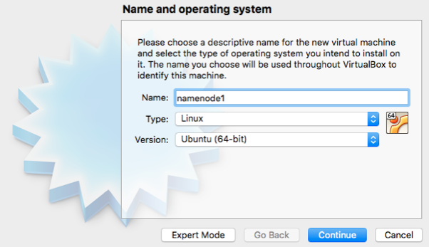
Choose a name and type of OS

Slide 5
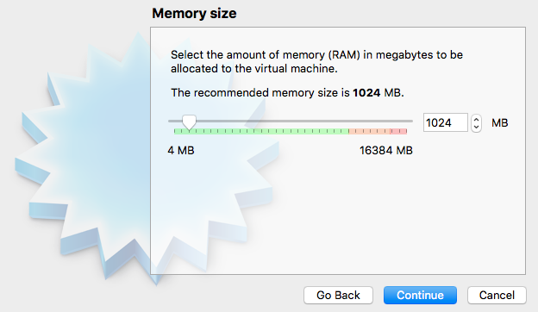
Assign memory

Slide 6
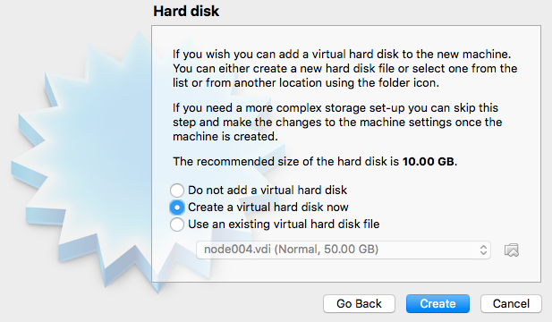
Choose hard disk for installation

Slide 7
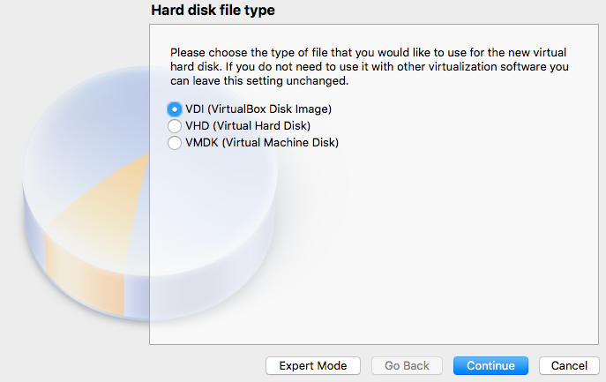
Select type of virtual disk

Slide 8
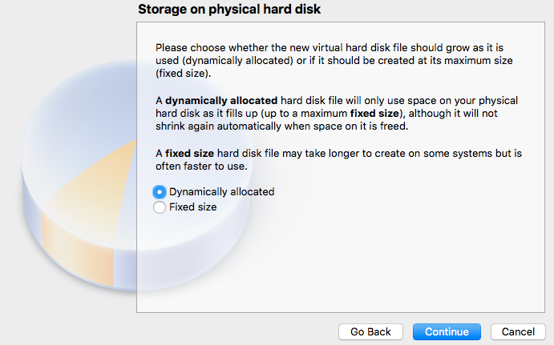
Select between space allocation

Slide 9
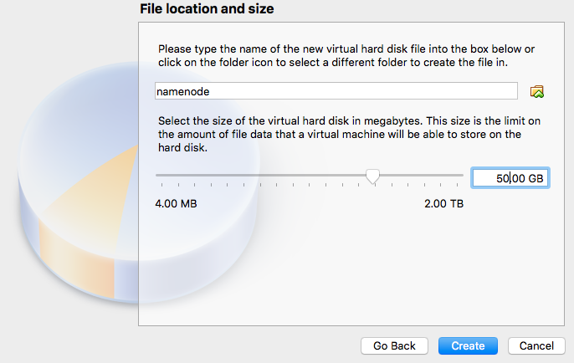
Allote the disk size

Slide 10
Installing Ubuntu on top of the VM

Slide 11
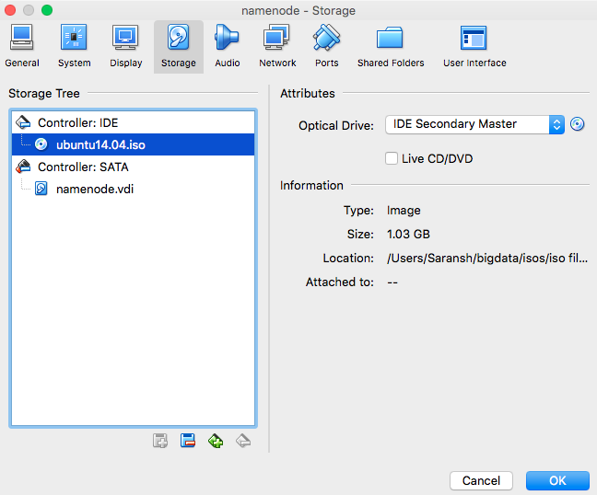
Choose ISO file to install from

Slide 12
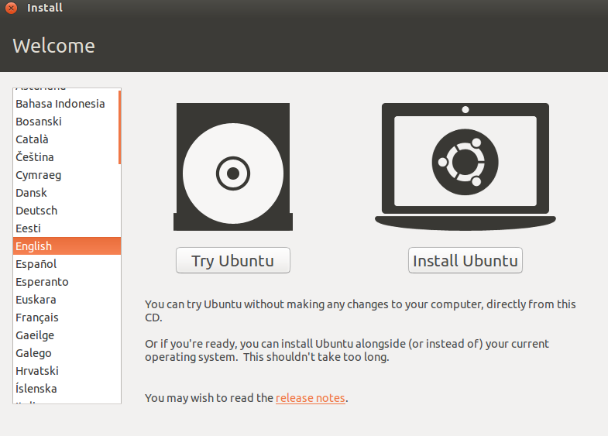
Click on Install Ubuntu

Slide 13
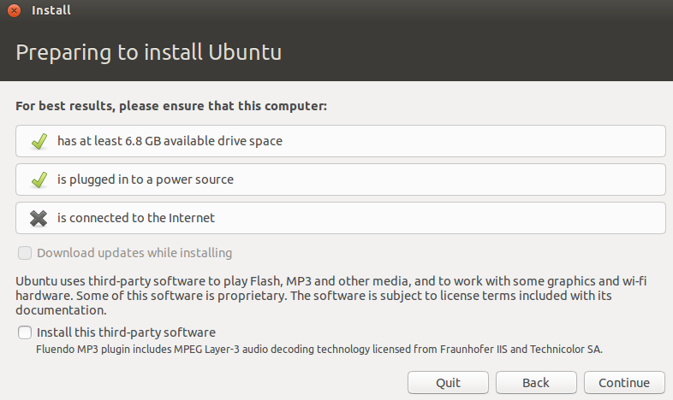
Disconnect the internet and click continue

Slide 14
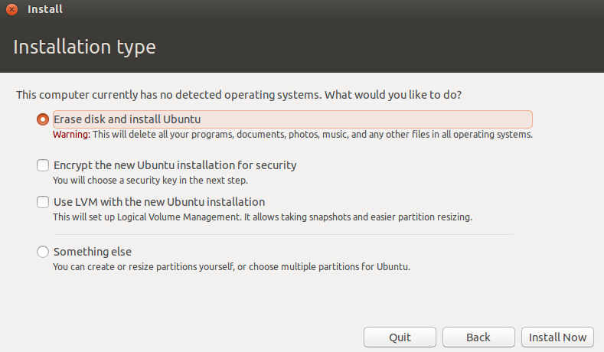
Choose disk activity

Slide 15
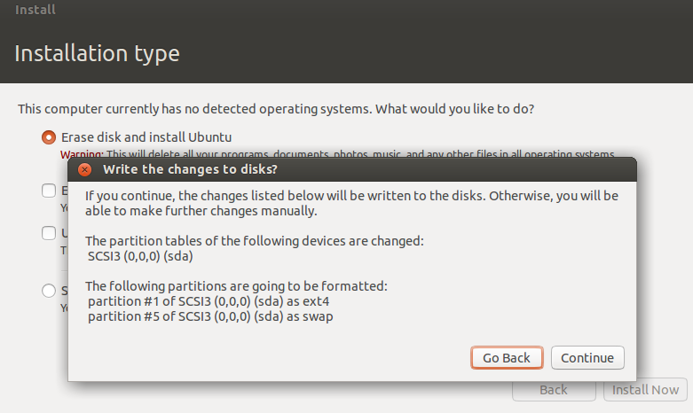
Confirm action to format the disk

Slide 16
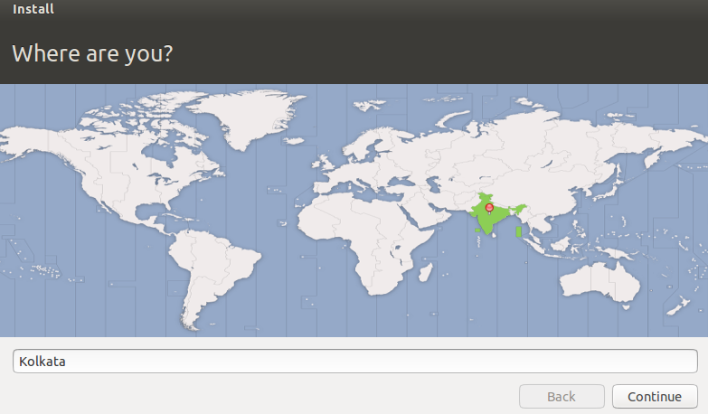
Choose your region

Slide 17
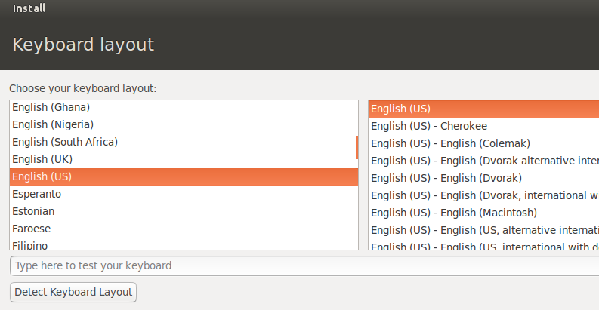
Select from keyboard layout

Slide 18
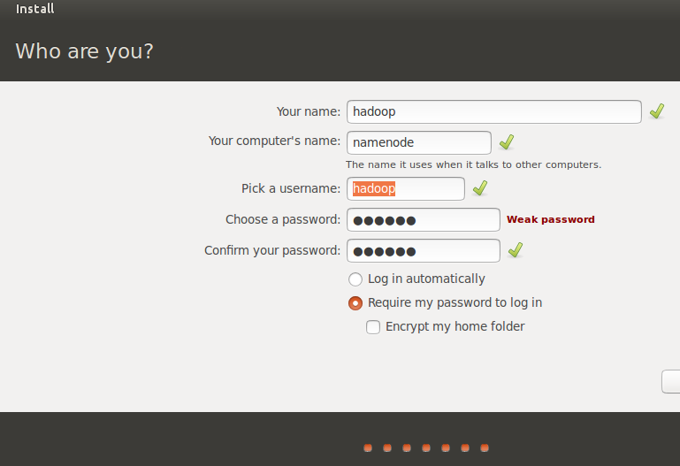
Enter the hostname and username

Slide 19
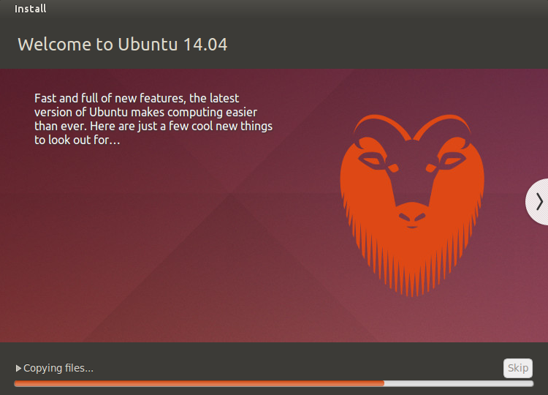
Installation continues till completion

Slide 20
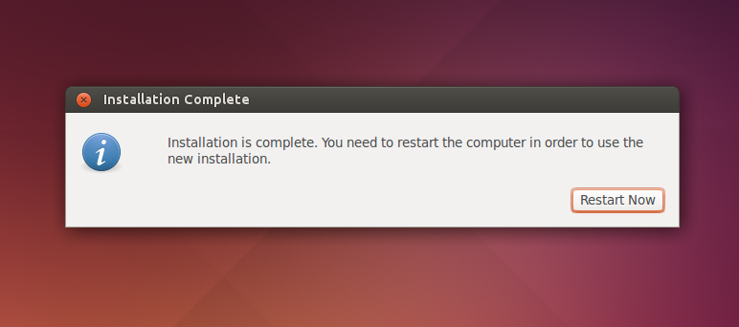
On completion

Slide 21
Online installation of Java & openssh server
Openssh-server is required for interaction between the machines
Type in the below commands in sequence:
sudo apt-get update
sudo apt-get install openssh-server
Type 'Y' when prompted
Jave is required on all machines in order for Hadoop and other frameworks to run.
Type the below commands in sequence:
sudo add-apt-repository ppa:openjdk-r/ppa
sudo apt-get update
sudo apt-get install openjdk-8-jdk
java -version
For ease of use the copy of virtual machine already has these 2 installed up and running

Slide 22
Offline installation of java
Create a directory where your Java will live:
sudo mkdir -p /usr/lib/jvm
Move the downloaded Java:
sudo mv jdk-7u51-linux-x64.tar.gz /usr/lib/jvm
Extract Java:
sudo tar zxvf jdk-7u51-linux-x64.tar.gz
Tell Ubuntu that Java exists:
sudo update-alternatives --install /usr/bin/javac javac /usr/lib/jvm/jdk1.7.0_51/bin/javac 1
sudo update-alternatives --install /usr/bin/java java /usr/lib/jvm/jdk1.7.0_51/bin/java 1
sudo update-alternatives --set javac /usr/lib/jvm/jdk1.7.0_51/bin/javac
sudo update-alternatives --set java /usr/lib/jvm/jdk1.7.0_51/bin/java

Slide 23
Offline installation of java cont…
Add java path to your system profile, so that the machine knows where the Java binaries are:
sudo vi /etc/profile
JAVA_HOME=/usr/lib/jvm/jdk1.7.0_51
PATH=$PATH:$JAVA_HOME/bin
export JAVA_HOME
export PATH
Test your Java installation:
update-alternatives --display java
and
update-alternatives --display javac

Slide 24
Offline installation of ssh server
sudo apt-get download openssh-server
sudo apt-get build-dep --download-only -o dir::cache=<path_to_save> openssh-server
sudo apt-get download openssh-sftp-server openssh-client
Ensure all the .deb files are under the same location and then execute the below:
sudo dpkg -i *.deb

Slide 25
Assigning static IP address
Each machine going to be a part of the cluster would require communication through ssh
Hence static IP addresses need to be provided to each and every machine on the network
To assign an IP address, make following changes to the /etc/networks/interfaces file using sudo accesses
auto eth0
iface eth0 inet static
address 192.168.1.2
netmask 255.255.255.0
gateway 192.168.1.1
Once changes are done restart the network services using
systemctl restart ifup@eth0
sudo service network-manager restart
sudo ifconfig eth0 up
Or restart the machine using “sudo init 6”

Slide 26
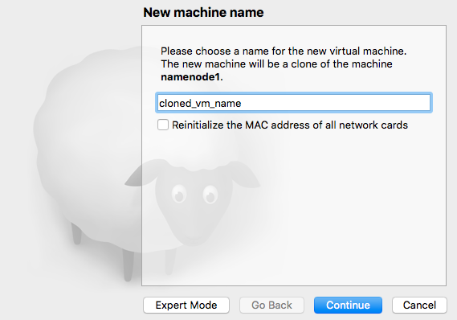
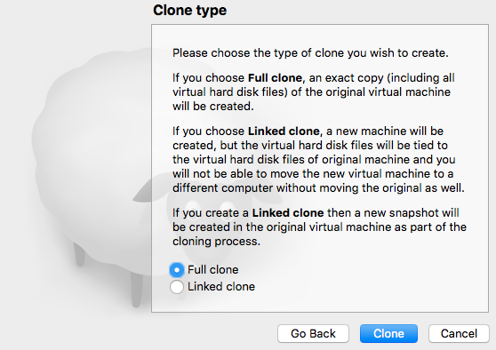
Cloning a machine
Once a base machine is created and java, sshserver and static IP addresses are configured, it is time to start cloning the machine
Cloning would create an exact replica of the source machine and the cloned machine would be ready to be part of your cluster
The name you provide here is only at virtual box application level and has nothing to do with the actual hostname of your machines on the cluster

Slide 27
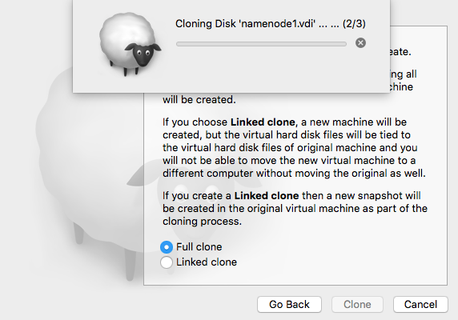
Cloning a machine cont…

Slide 28
Post clone changes
Changing the hostname since 2 machines in a cluster need a different name to communicate with each other
vi /etc/hostname
Delete the existing entry and put in the name of the machine that you wish
Changing the IP address as 2 machines in a same cluster need to have different communication addresses.
Make following changes to the /etc/networks/interfaces file using sudo accesses.
auto eth0
iface eth0 inet static
address 192.168.1.3
netmask 255.255.255.0
gateway 192.168.1.1
Once changes are done restart the network services using
systemctl restart ifup@eth0
sudo service network-manager restart
sudo ifconfig eth0 up
Or restart the machine using “sudo init 6”

Slide 29
Resolve hostnames from IP address
Append entries in the /etc/hosts file to automatically resolve hostnames with the attached IP addresses
vi /etc/hosts
192.168.1.2 namenode1
192.168.1.3 datanode1
192.168.1.4 datanode2
192.168.1.5 edgenode
Now all ssh/pings would be possible without mentioning the ip address of the target machines

Slide 30
Communicating between machines
Network communication is an integral part of any distributed system
Most of the instances of a cluster failure are due to bad networking
To establish a secured communication channel password-less ssh is used using public key sharing
Follow the below steps in order to set up:
On the namenode machine, type “ssh-keygen” command. There would be multiple prompts which would ask for details. Just keep on hitting enter till public and private keys are generated
Repeat the same process for all the machines that are going to be part of the cluster
Now on the namenode machine run the below command to copy over the public key onto the other nodes
ssh-copy-id hadoop@datanode1
ssh-copy-id hadoop@datanode2

Slide 31
Communication cont…
These would prompt you to enter the passwords for source and target machines. In our case it would be the namenode and the varios datanode machines
Once namenode’s key is shared with all the datanodes in the cluster, repeat the same process from each of the datanode machines
For example datanode1 to other machines on the cluster would be something like this:
ssh-copy-id hadoop@namenode1
ssh-copy-id hadoop@datanode2
Once keys are shared, test out the connectivity using below commands:
From namenode terminal:
ssh datanode1
ssh datanode2
In both the instances of the above commands, you would not be prompted for any password. In case anything goes wrong, delete the keys and repeat the whole process

Slide 32
With this session we have completed installing virtual machines and created a distributed setup
Learn It The Practical Way:
https://github.com/saranshsk/bigdata
Up Next In The Series:
Installing Hadoop binaries on the cluster and make it all up and running

