Slide 1
Install it yourself – Hadoop
Learn it the practical way
https://github.com/saranshsk/bigdata
Hostname available at - https://github.com/saranshsk/bigdata/blob/master/ipaddress.txt
1st level login:
Username - gatewayuser
Password - 12345
2nd level login: type ssh hadoop@edgenode
Username - hadoop
Password - hadoop

Slide 2
Installing hadoop
Start with logging onto the namenode machine and getting hold of the latest hadoop version available
For your ease the hadoop tar package is already available under directory “/home/hadoop/softwares”
Open a terminal and type in the below commands in sequence:
tar –xvzf /home/hadoop/softwares/hadoop-2.9.0.tar.gz
sudo mv /home/hadoop/hadoop<press tab to autocomplete> /usr/local/hadoop
sudo chmod –R 775 /usr/local/hadoop
sudo chown –r hadoop /usr/local/hadoop
Now its time to start configuring the files one by one.

Slide 3
Changing the hadoop-env.sh
Now to tell hadoop which Java to use make the below entry into the hadoop environment file:
sudo vi /usr/local/hadoop/etc/hadoop/hadoop-env.sh
Make the below entries into the file
﻿export JAVA_HOME=/usr/lib/jvm/java-1.8.0-openjdk-amd64export HADOOP_OPTS="$HADOOP_OPTS -Djava.net.preferIPv4Stack=true”

Slide 4
Changing the core-site.xml
sudo vi /usr/local/hadoop/etc/hadoop/core-site.xml
Here we are trying to define the location of hdfs filesystem on the namenode
﻿
<property>
<name>fs.default.name</name>
<value>hdfs://namenode1:10001</value>
</property>
The above configuration entries go in-between the <configuration> blocks

Slide 5
Changing the hdfs-site.xml
sudo vi /usr/local/hadoop/etc/hadoop/hdfs-site.xml
Here we are trying to define the replication factor for the file blocks
﻿<property>
<name>dfs.replication</name>
<value>2</value>
</property>
Here we are defining the location for namenode to save intermediate files
﻿<property>
<name>dfs.namenode.name.dir</name>
<value>file:/usr/local/hadoop/tmp/namenode</value>
</property>
Here we are defining the location for datanodes to save intermediate files
<property>
<name>dfs.datanode.name.dir</name>
<value>file:/usr/local/hadoop/tmp/datanode</value>
</property>

Slide 6
Changing the hdfs-site.xml cont…
<property>
<name>dfs.permissions</name>
<value>false</value>
</property>
<property>
<name>dfs.datanode.use.datanode.hostname</name>
<value>false</value>
</property>
<property>
<name>dfs.namenode.datanode.registration.ip-hostname-check</name>
<value>false</value>
</property>
<property>
<name>dfs.namenode.http-address</name>
<value>namenode1:50070</value>
<description>Your NameNode hostname for http access.</description>
</property>

Slide 7
Changing the mapred-site.xml
cp /usr/local/hadoop/etc/hadoop/﻿mapred-site.xml.template /usr/local/hadoop/etc/hadoop/mapred-site.xml
sudo vi /usr/local/hadoop/etc/hadoop/mapred-site.xml
Here we are telling hadoop to use yarn as the mapreduce framework
﻿﻿<configuration>
<property><name>mapreduce.framework.name</name>
<value>yarn</value>
</property>

Slide 8
Changing the yarn-site.xml
sudo vi /usr/local/hadoop/etc/hadoop/yarn-site.xml
Long running service which executes on Node Manager(s) and provides MapReduce Sort and Shuffle functionality
<property>
<name>yarn.nodemanager.aux-services</name>
<value>mapreduce_shuffle</value>
</property>
Enable log aggregation so application logs are moved onto hdfs
<property>
<name>yarn.log-aggregation-enable</name>
<value>true</value>
</property>
url for yarn
<property>
<name>yarn.resourcemanager.scheduler.address</name>
<value>namenode1:8030</value>
</property>

Slide 9
Changing the yarn-site.xml cont…
sudo vi /usr/local/hadoop/etc/hadoop/yarn-site.xml
Few port numbers with the services they hold
﻿<property>
<name>yarn.resourcemanager.resource-tracker.address</name>
<value>namenode1:8025</value>
</property>
<property>
<name>yarn.resourcemanager.address</name>
<value>namenode1:8050</value>
</property>
<property>
<name>yarn.resourcemanager.admin.address</name>
<value>namenode1:8033</value>
</property>
<property>
<name>yarn.resourcemanager.webapp.address</name>
<value>namenode1:8088</value>
</property>

Slide 10
Updating the slaves file
sudo vi /usr/local/hadoop/etc/hadoop/slaves
Enter all the hostnames of the machines that would act as a datanode in side the cluser
For example in out case of 1 namenode and 2 datanodes we would make entries into this file as:
datanode1
datanode2
Note - These names should match the entries of the /etc/hosts file

Slide 11
Updating the ~/.bashrc file
Update the bashrc file for updating the PATH variable across the user session for hadoop user by updating the ~/.bashrc file
sudo vi ~/.bashrc
﻿export HADOOP_PREFIX=/usr/local/hadoop
export PATH=$PATH:$HADOOP_PREFIX/bin
export JAVA_HOME=/usr/lib/jvm/java-1.8.0-openjdk-amd64
export PATH=$PATH:$JAVA_HOME/bin

Slide 12
Configuring the datanodes
The datanodes also need to be configured with configured hadoop binaries, hence copy over the /usr/local/hadoop directory with all it’s content.
The command to copy over the directory from namenode machine onto the datanodes is:
cd /usr/local
scp –r hadoop datanode1:/usr/local
scp –r hadoop datanode1:/usr/local
The above commands would not require any password since we already have the keys shared.
Once copy is done ssh onto the datanodes one by one and run the below commands:
sudo chmod –r 775 /usr/local/hadoop
sudo chown –r hadoop /usr/local/hadoop
Make entries to the .bashrc file on the datanodes also as was done for namenode

Slide 13
Configuring the datanodes cont…
Create a file named “masters” at location /usr/local/hadoop/etc/hadoop and put the name of the namenode inside it
Change the entry in /usr/local/hadoop/etc/hadoop/core-site.xml file so that it points back to the hdfs parent directory
﻿<property>
<name>fs.default.name</name>
<value>hdfs://namenode1:10001</value>
</property>

Slide 14
Starting and stoping the services
Before starting the services for the first time only execute the below command
hdfs namenode -format
The server can be started by triggering the wrapper script using /usr/local/hadoop/sbin/start-all.sh and stopped using /usr/local/hadoop/sbin/stop-all.sh.
But latest hadoop versions point out that this is a depreciated method
Hence first start the dfs services by using:
/usr/local/hadoop/sbin/start-dfs.sh
Then start the yarn manager services using:
/usr/local/hadoop/sbin/start-yarn.sh
Similarly the services should be stopped in the opposite sequence
/usr/local/hadoop/sbin/stop-yarn.sh
/usr/local/hadoop/sbin/stop-dfs.sh
The above commands need to be triggered from the namenode machine

Slide 15
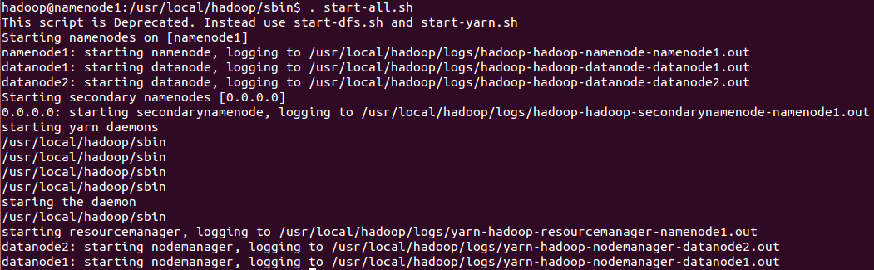
If all goes well

Slide 16



Checking if all is up and running
Run the jps command on namenode and observe for the below output:
Run the jps command on namenode and observe for the below output:

Slide 17
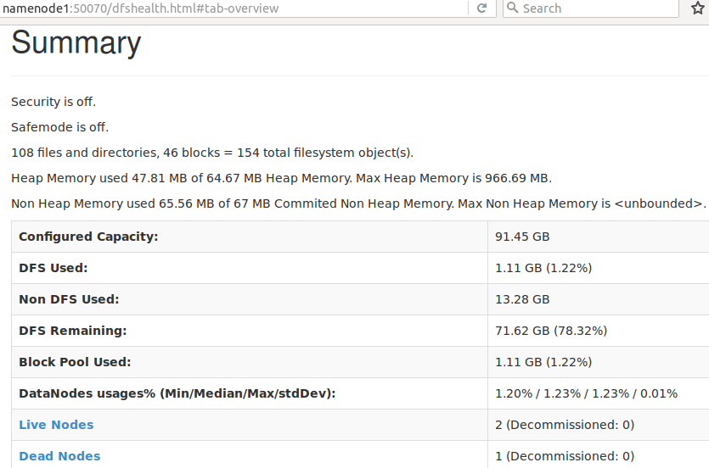
Using web ui to check the status

Slide 18
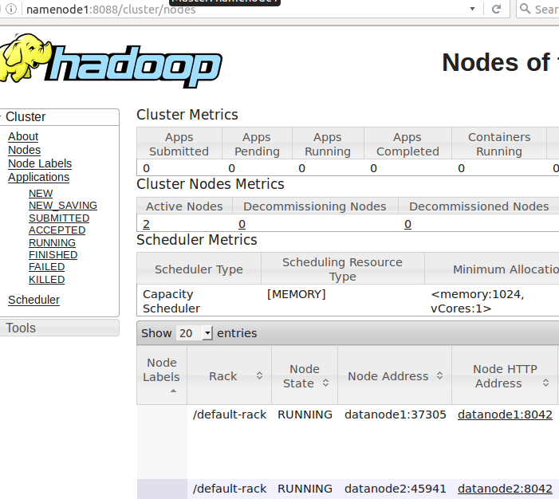
Mapreduce job status screen

Slide 19
With this session we have completed installing hadoop on our cluster.
Learn It The Practical Way:
https://github.com/saranshsk/bigdata
Up Next In The Series:
Working on hdfs file system using commands (basic to advanced)

