Slide 1

Velammal Bodhi Campus, Trichy
Everest Ascender
A classic platformer game

Slide 2
Our Team
BUUSHIT BALAJI M
VEDANT MOHAN R
GANAPATHY SANJEEV S
SARANSH DAS
MURALI ANAND M.R

Slide 3
DOWNLOAD FROM WEBSITE saranshvbct.github.io/everestweb

Slide 4
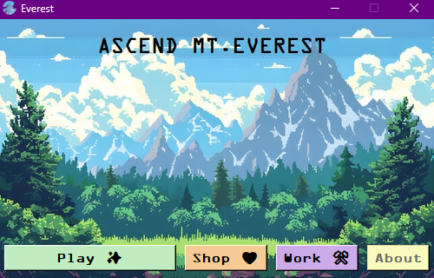
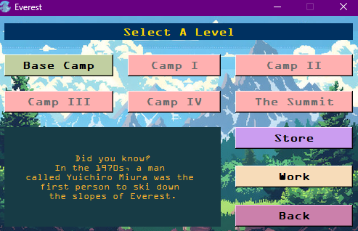
MAIN SCREEN contains play menu, shop menu, work menu. About Section (COMING SOON.)
PLAY MENU
Contains all the playable levels, to get into one level, rope and climbers are necessary.
E.g. For Base camp, 2 climbers and one rope Is required.
After Camp I The game is yet under development

Slide 5
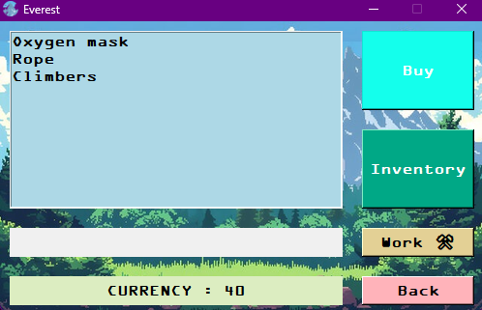
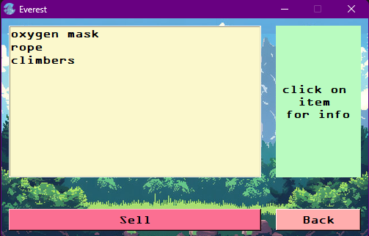
Inventory
Information about bag
and
unnecessary items can be sold and get return of coins, while returning an amount of 1 to 5 coins is deducted.
SHOP necessary items can be buyed from the shop using coins, Ropes and climbers are necessary to get into a mission while Oxygen or O2 is necessary during a mission.

Slide 6
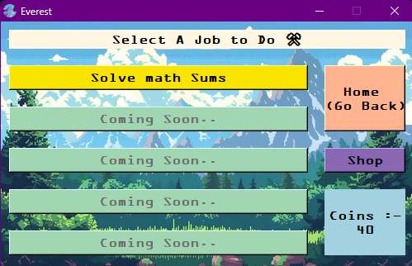
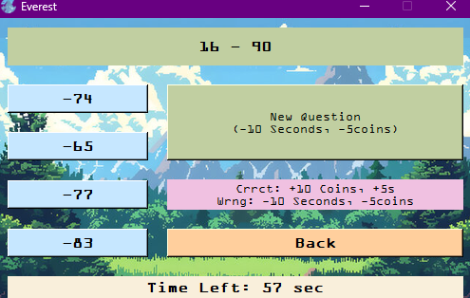
Solving Math
Math sums can be solved and earn money from, solving correctly gives 10 coins and adds 5 secs to timer and wrong deducts 5 coins and removes 10 seconds. Asking for new question deducts 10 seconds and 5 coins.
WORK to earn money working is necessary, our work form currently is to solve math sums, more are to come in future.

Slide 7
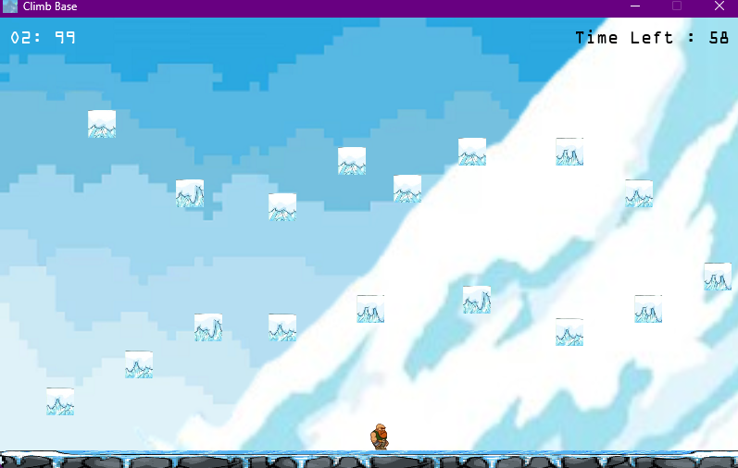
GAME SCREEN
The Everest Climbing platformer game, use left arrow to go left and right arrow to go right and space bar to jump, each jump eats up some amount of Oxygen, to pass one level 50 to 100 Oxygens is recommended. Once Oxygen is over the game has to be restarted from first or if time is over the game has to be restarted from first.
Enjoy ☺

Slide 8
THANK YOU
VBCT

