Slide 1
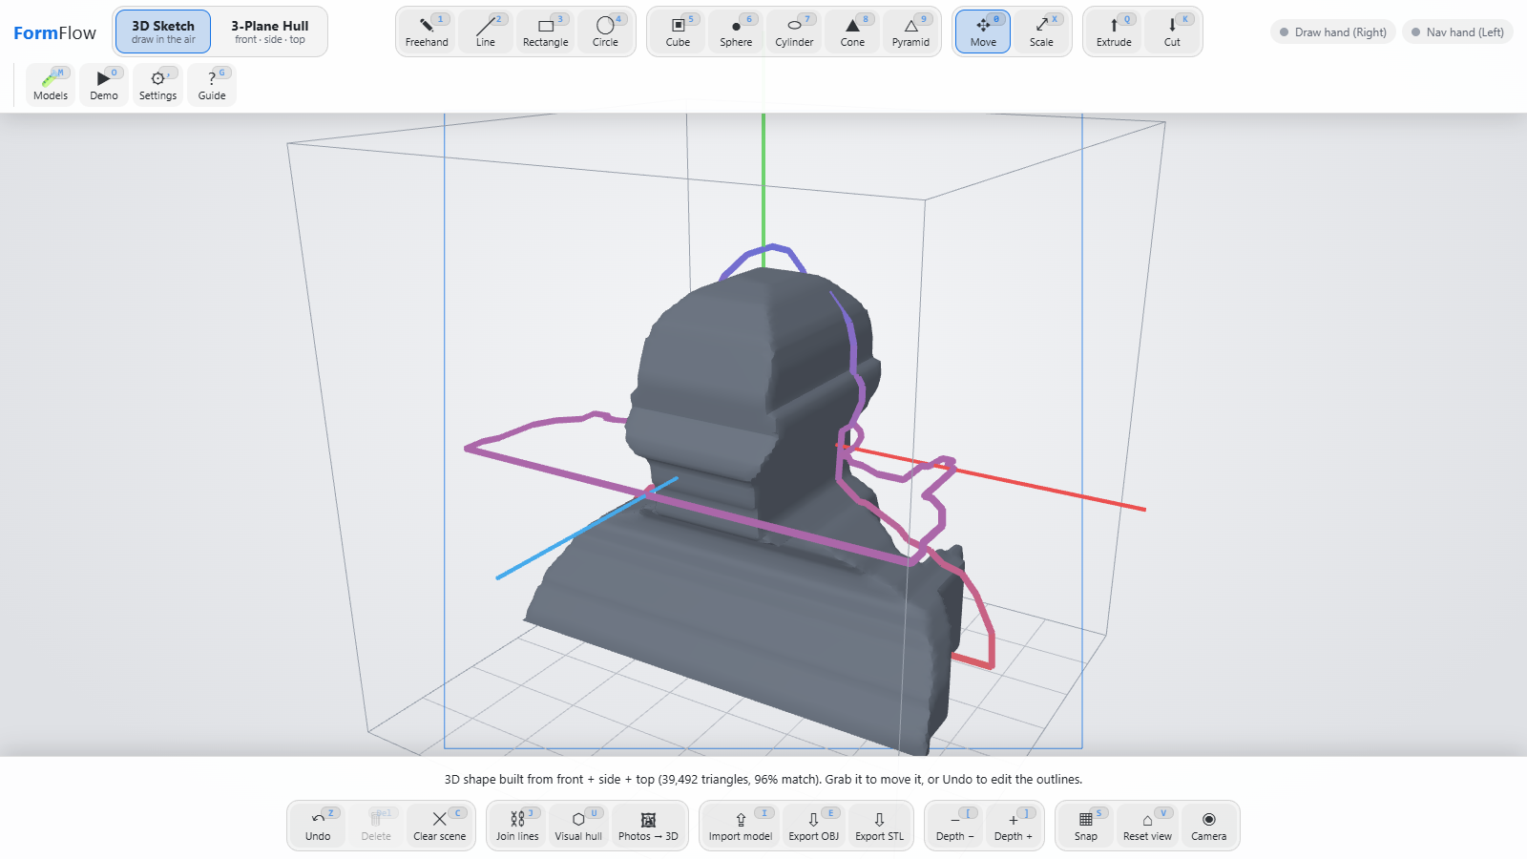
INTRODUCTION TO COMPUTER VISION · PBCMT504 · S5
FormFlow
Sketch in the air. Build it in 3D.
An easy, fun way for beginners to learn 3D: move your hands, or add a few pictures, and watch a 3D shape appear. One ordinary webcam, in the browser.
Three pencil drawings in, one 3D bust out (96% match)
Presented by Saran S Kumar · 453
Project presentation (PBL)
Notes:
FormFlow turns hand gestures and simple pictures into 3D models using one webcam. The image shows the end result: three pencil drawings of a head, converted into a 3D bust.

Slide 2
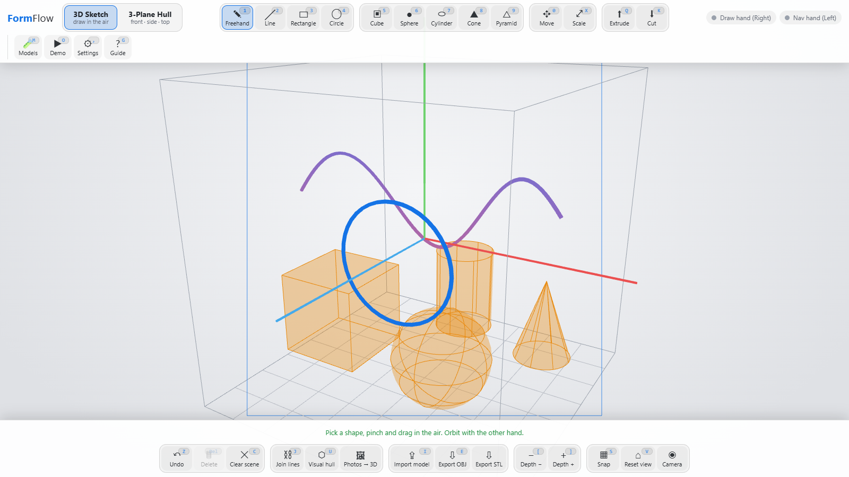
Learning 3D should be easy and fun
WHY FORMFLOW
PROBLEM
CAD tools need training and mouse-and-menu input, so beginners give up before they ever see their idea in 3D.
CONSTRAINTS
One ordinary webcam. No markers, gloves or depth sensor. No model training. Real time, in a browser.
GOAL
The 3D sketch workspace: solids and strokes drawn with hand gestures
Make 3D easy and fun to learn: move your hands, or add simple outlines or photos, and get a 3D model you can export (OBJ, STL). No CAD skills needed.
Notes:
State the problem, then the constraints that make it a computer-vision problem: one RGB camera, no markers, no depth sensor, no custom model training.

Slide 3
From your hands to a 3D shape, in three steps
HOW IT WORKS
1
2
3
The camera sees your hands
Your moves become commands
Pictures become a 3D shape
A webcam picture goes into an AI that finds 21 points on each hand: fingertips, knuckles and wrist.
Pinch to draw. Make a fist to turn the view. A filter smooths out hand shake, so lines come out clean.
Outlines from the front, side and top views, drawn by hand or found in photos, are crossed to make a solid you can save.
Pretrained hand and arm models
Gesture rules and a smoothing filter
Silhouettes, visual hull, export
No special equipment: an ordinary webcam and a browser. No depth camera, no gloves and no training data.
Notes:
Keep it simple: the camera sees, the computer understands, the app builds. The small grey line under each step names the technique, for anyone who wants the detail.

Slide 4
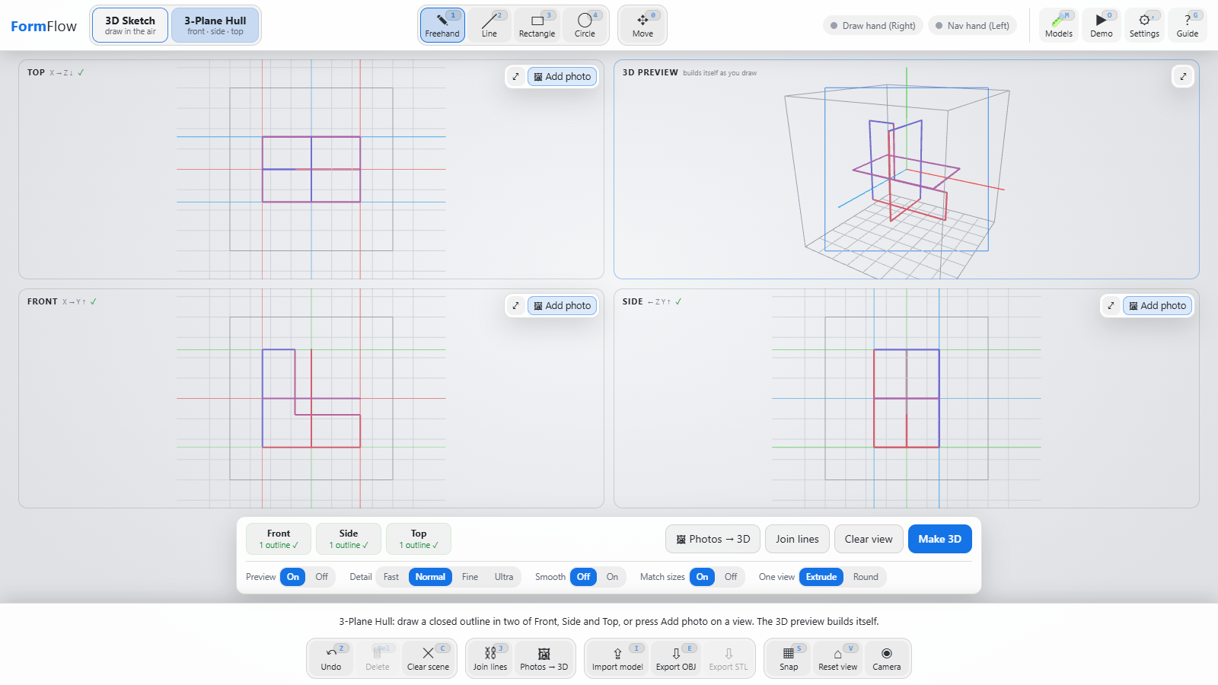
Three views tell us how big a thing is
SEEING DEPTH WITH ONE CAMERA
Front view
shows width and height
Side view
shows depth and height
Top view
shows width and depth
Every size is seen by two views, so the views can check each other.
If they disagree a lot, the app warns you.
One camera cannot see depth, so three outlines do the job.
Front, Side and Top, with a live 3D preview
Notes:
One camera cannot measure depth. But three outlines of the same object, from the front, the side and the top, do. Each size is seen by two views, so the views must agree.

Slide 5
Smoothing a shaky cursor
CLEANING UP NOISE
Think of it as a shock absorber for your cursor.
The problem: hands shake and the camera adds noise, so the cursor wobbles.
The filter: smooths slow moves a lot and fast moves a little, so it feels smooth but never laggy.
Wrist trick: the wrist shakes less than the fingertips, so the cursor follows the wrist.
Same idea for photos: a small blur removes camera noise before we look for the object.
Test with a simulated shaky hand.
Notes:
Hands shake a little and cameras add noise. A filter averages that out. The One-Euro filter smooths slow movement a lot and fast movement a little, so it never feels laggy.

Slide 6
The AI that finds your hand
MACHINE LEARNING
1 Find the palm
2 Find 21 points
3 Give a pointer
a quick scan of the picture
fingertips, knuckles, wrist
where the hand is and what it is doing
Already trained: Google trained these networks. We only use them (no training from us).
Two helpers: a hand model, and an arm model that keeps a hand found when the fingers are hard to see.
Runs in your browser, on your own computer, with no internet needed.
3D points too: the hand model also gives 3D positions, so a pinch looks the same when you turn your hand.
Notes:
We do not train a network. The pretrained MediaPipe models turn pixels into landmarks; everything after that is our own code.

Slide 7
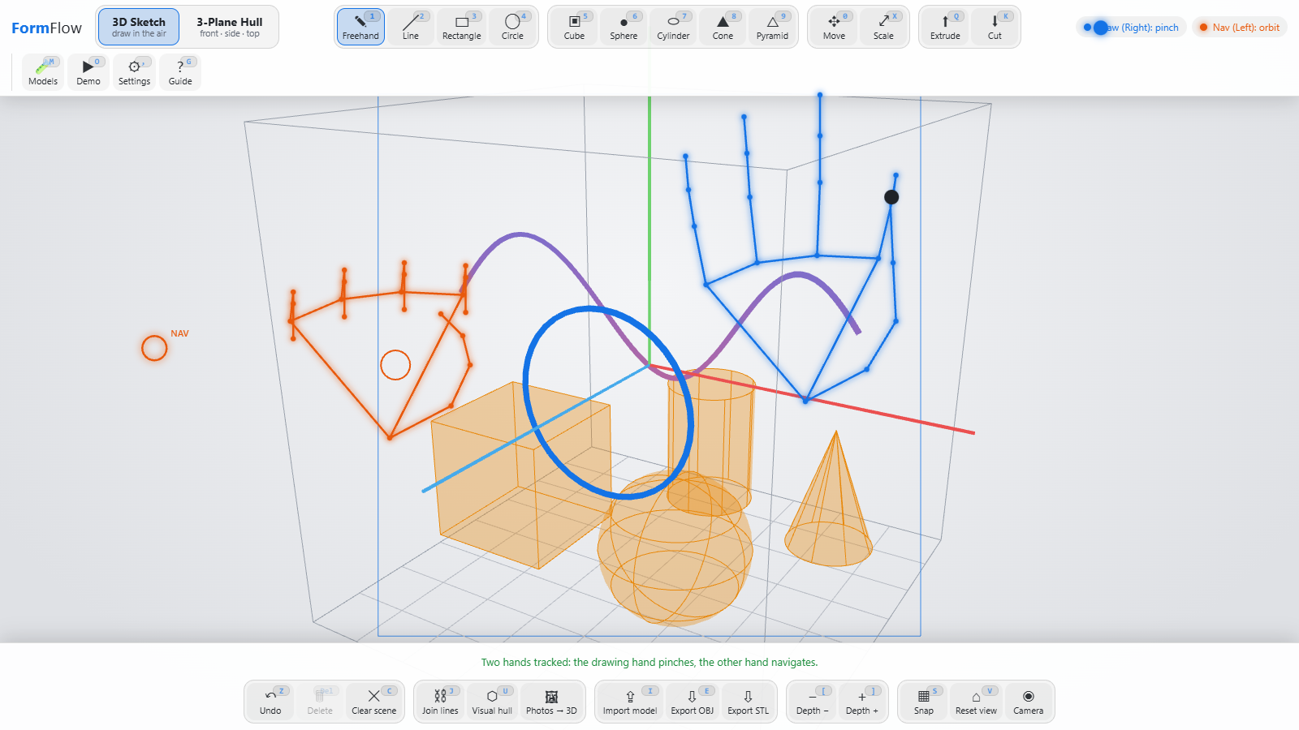
Turning finger positions into gestures
CLASSIFICATION
Gesture | How to make it | What it does
Pinch | touch thumb to index finger | draw, place, press
Grab | touch thumb to middle finger | move an object
Fist | close all fingers | turn the view
Peace | two fingers up | slide the view
Blue hand: pinching to draw. Orange hand: fist to turn the view. Simulated hands, real tracker.
Works near or far: distances are compared with the size of your palm.
No flicker: a gesture must hold for a moment, and it is easier to keep than to start.
Fits your hand: practice mode measures your hand and sets your own limits.
Notes:
The gestures are simple rules over distances between fingertips, divided by palm size so they work near or far.

Slide 8
Fixing the mistakes the detector makes
MAKING THE AI DEPENDABLE
What goes wrong | What we do
Left and right get mixed up | follow the hand by where it is
One hand is seen twice | merge the copies
A hand appears for one frame | wait a few frames to be sure
The hand is lost for a moment | keep the last pose briefly
Real-camera testing is still to do.
Notes:
The raw model output glitches. The tracker layer fixes four failure modes. Numbers are from a simulated 300-frame stream with injected glitches.

Slide 9
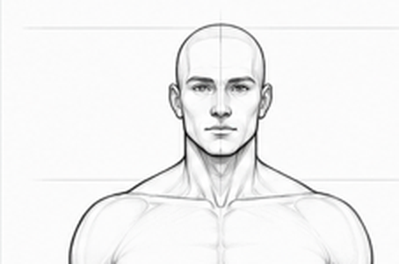

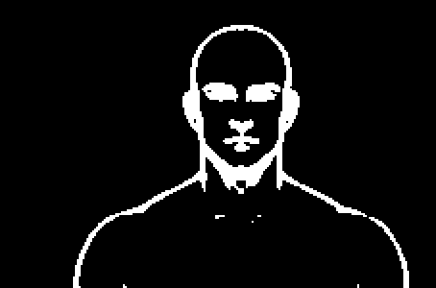

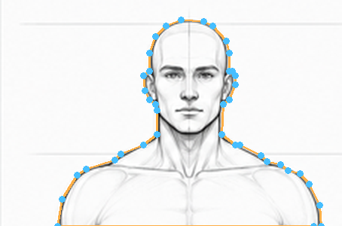
Finding the object in a picture
SEGMENTATION
1 The picture
2 The background
3 What differs
4 Fill it in
5 Trace the edge
Compare with the background: guess what the empty background looks like, then mark every pixel that is different.
Keep the biggest piece: throw away specks and fill any holes, so the object is solid.
Trace the edge: walk around the shape and keep only the corner points.
Notes:
Walk left to right through the five stages on a real pencil drawing.

Slide 10
How do we know it works?
MEASURING QUALITY
Finding hands: one quick scan finds where the hands are, then a second look reads the details.
Small or far hands: zoom in on them first, then look again.
A score for the answer: IoU is how much our answer overlaps the true shape. 1.0 is perfect.
Our outlines score about 0.98, even with a lot of noise in the picture.
Notes:
IoU is the model-quality metric: overlap divided by union. It measures the tracer against known shapes and the hull against its own drawings.

Slide 11
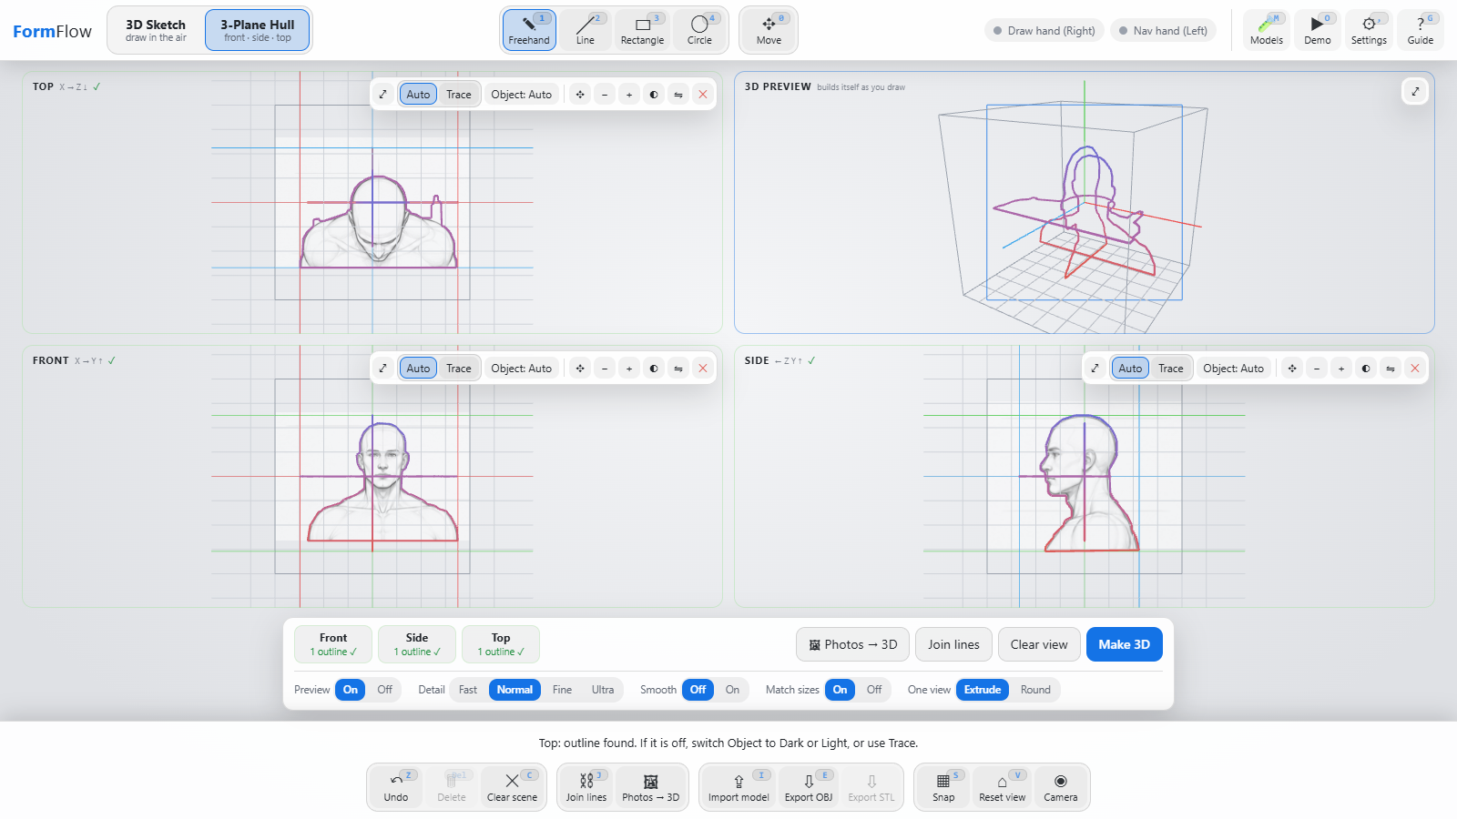
Visual hull: carving a shape from outlines
MAKING THE 3D SHAPE
1
Get an outline for each view
2
Make the views agree on sizes
3
Stretch each outline into a tall block
4
Keep only where every block overlaps
5
Smooth the surface into a mesh
Three drawings and their traced outlines; Make 3D builds the hull.
Like carving: keep a piece only if all three views say "solid here".
Notes:
Each silhouette extruded along its viewing direction contains the object. Their intersection is the tightest bound from those views.

Slide 12
How many views do we need?
CASE STUDY
More views, better shape: a sphere is 27% too big with 2 views and 12% too big with 3, exactly as the maths predicts.
One view: depth is a guess.
Simple shapes: a flat-sided bracket is already exact with 2 views.
The limit: a hull can fill in dents, but never carve them out.
Detail | Build time | Triangles | Size error
Draft | 13 ms | 6,800 | -0.6%
Normal | 30 ms | 14,940 | -0.2%
Fine | 48 ms | 25,004 | -0.4%
Very fine | 157 ms | 57,884 | -0.1%
Measured on an L-shaped bracket.
Notes:
A sphere is the worst case for a visual hull: two crossed cylinders overestimate by 27%, three by 12%. Our numbers match the theory, which validates the implementation.

Slide 13
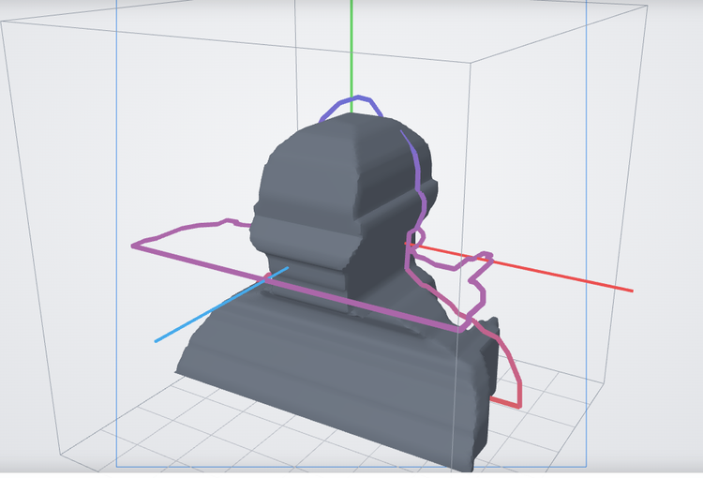
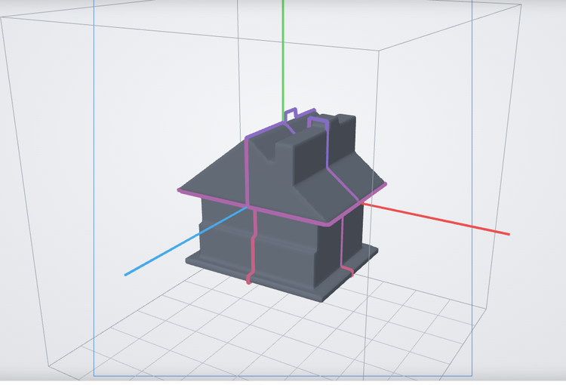
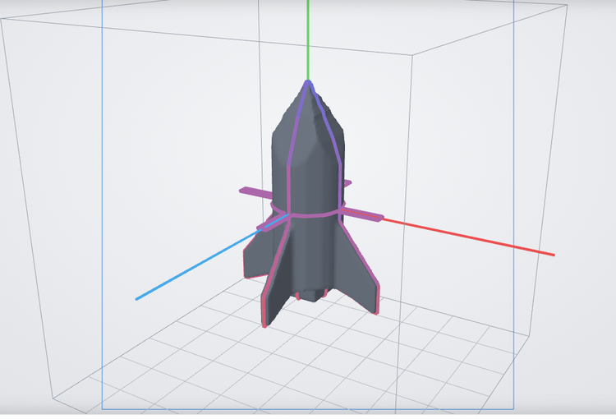
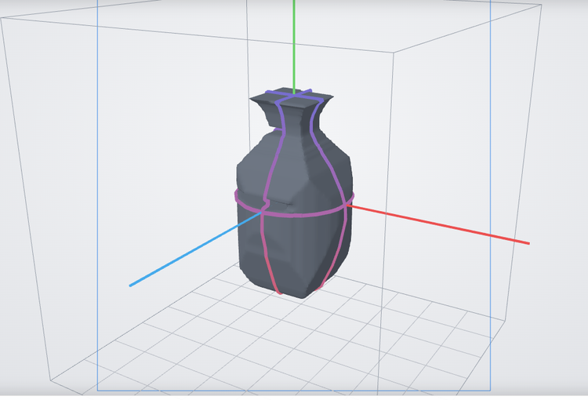
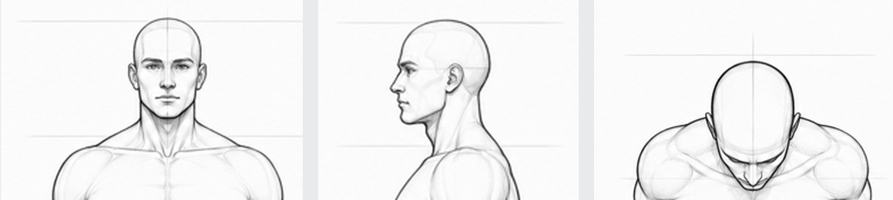
Real pictures in, 3D objects out
RESULTS
Head and shoulders
House with chimney
Rocket
Vase
3 pencil drawings, 96% match
3 pictures
3 pictures; fins show only in the top view
1 picture, spun into a round solid
The inputs are ordinary pictures. The app finds each outline, aligns the views and builds the mesh in the browser, with no 3D software and no training.
The three input drawings: front, side, top
Notes:
These are the four built-in samples. The head uses real pencil drawings that run off the picture.

Slide 14
What was used, and where it comes from
ENGINEERING
288
6.7k
0
2
automated tests
lines of JavaScript
models trained
pretrained models used
Component | Source | Role in FormFlow
MediaPipe (hand and arm models) | Google, already trained | finds the hands and arms
Three.js | open source | draws the 3D scene
FastAPI (Python) | open source | runs the app and saves files
Web Speech | built into Chrome and Edge | voice commands
Node test and pytest | standard tools | 288 automated tests
Own code (core logic) | written for this project | tracking, gestures, filters, sketching, outlines, 3D hull, the screen
Notes:
Only the two landmark networks are off-the-shelf models. The rest of the vision pipeline is our own code.

Slide 15
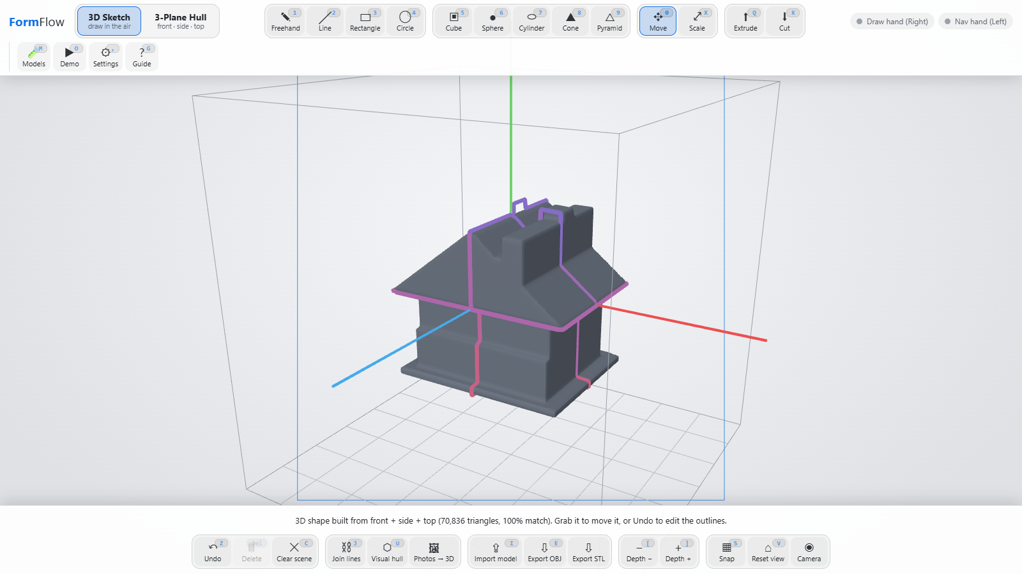
CONCLUSION
Learning 3D by playing: easy and fun for beginners
Made for beginners: a guided tour with practice, hints after every action, built-in demo pictures, and no CAD skills or special hardware.
Under the hood: classical computer vision plus one pretrained hand sensor; filters and tracking turn flickering landmarks into a smooth pointer.
Multi-view geometry gives 3D without a depth sensor, and its error matches the theory.
Limits: a visual hull cannot recover concavities, one camera gives no metric depth, and gesture thresholds still need real-camera tuning.
Thank you. Questions?
Saran S Kumar · 453

